Slide 1
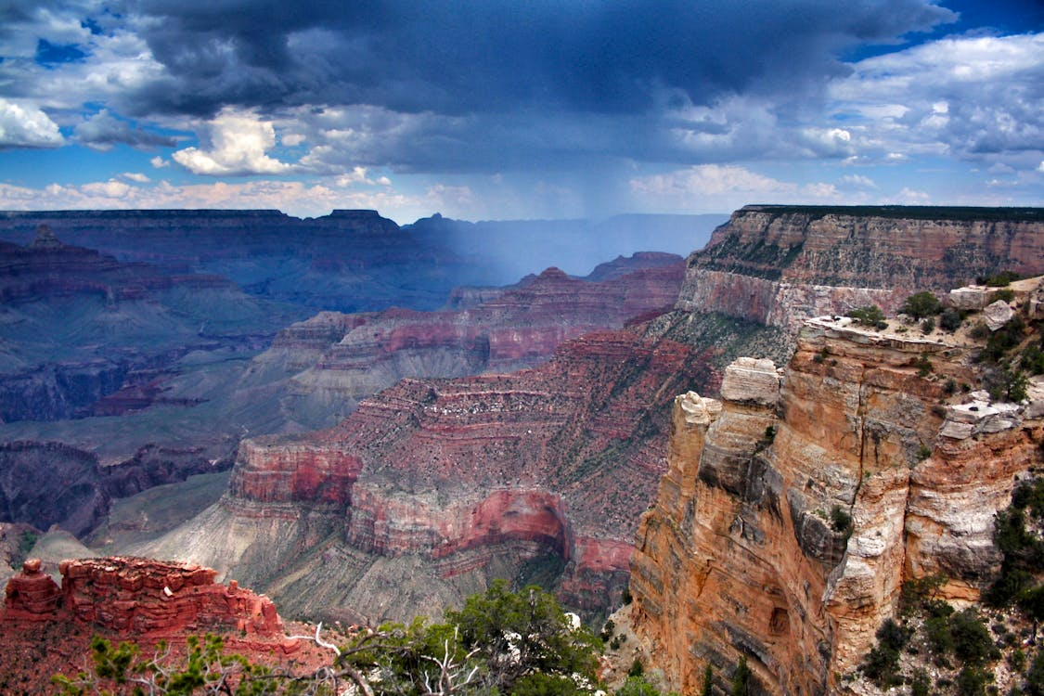
Welcome!

Slide 2
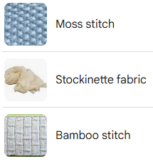

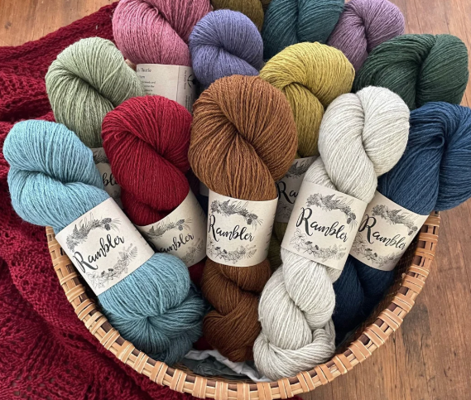
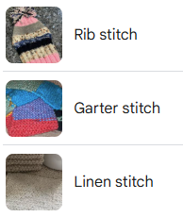
2025 Knitting Conference
Notes:
Good morning. Welcome to the 2025 Annual Knitting and Cross-stitch conference. Hopefully, you’re all in the right location.

Slide 3

Welcome!
Western Regional Gas Conference 2025
Tempe Mission Palms Conference Center
Tempe, Arizona
Notes:
Just kidding!
It is my pleasure to welcome you to the 2025 Western Regional Gas Conference. My name is Alex Hughes from SoCalGas.
This conference has been taking place for over 20 years now. It serves to promote an atmosphere of fellowship, information exchange and networking between delegates, vendors, speakers, PHMSA, State Regulators, and subject matter experts, all to advance pipeline safety.
Our completely non-profit organization puts these conferences together on a strictly volunteer basis. It’s especially encouraging to see the new generation of pipeline safety engineers, compliance personnel, field construction and tech services folks, managers and others.

Slide 4

Notes:
You should have all got a WRGC Program brochure. It contains the agenda, Session Summaries, Bios, and Vendor information. All to help you plan your schedule to attend sessions that interest you. I’d like to thank Paradigm who helped with the production of our brochures. Check out their ad within the brochure.

Slide 5
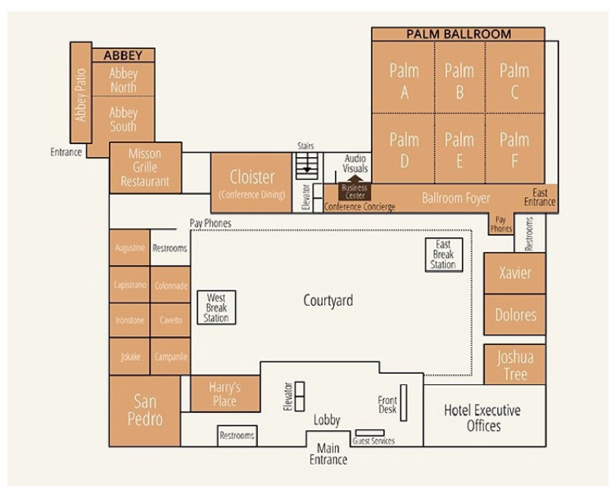
Notes:
There’s also a map in the brochure.

Slide 6

Agenda
Western Regional Gas Conference 2025
Tempe Mission Palms Conference Center
Tempe, Arizona
Notes:
As in past conferences we have a packed agenda with very diverse topics including: PHMSA rulemaking updates, AGA updates, Research and Development activity, Methane Emissions reduction, Incident investigations, Emergency Response and a full Measurement & Regulation track.

Slide 7
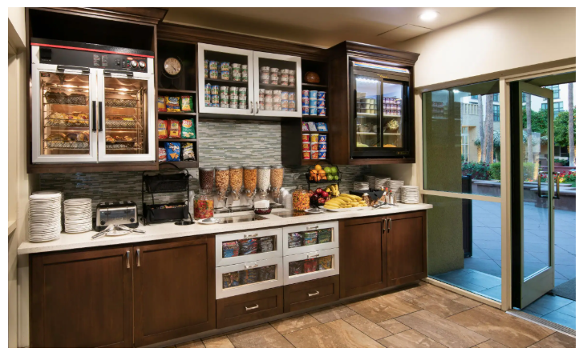
Snack Shack®
Western Regional Gas Conference 2025
Tempe Mission Palms Conference Center
Tempe, Arizona
Notes:
Make sure you find the famous snack shacks, which have great snacks for everyone, during our conference. There are two, one at the east end, and one over at the west end by the courtyard. They are open most of the day; please help yourself. This closer one usually sees more traffic, so don’t be afraid to venture over to the other one at the far end.

Slide 8

Platinum Sponsor
Notes:
Now I’d like to first give Special recognition to our Platinum Sponsor, IPEX – Thank you - IPEX has a diverse selection of products and services for our industry. Make sure to visit them in the vendor hall. They have a large display on the West wall…we appreciate them very much. WE COULDN’T DO it Without them!

Slide 9
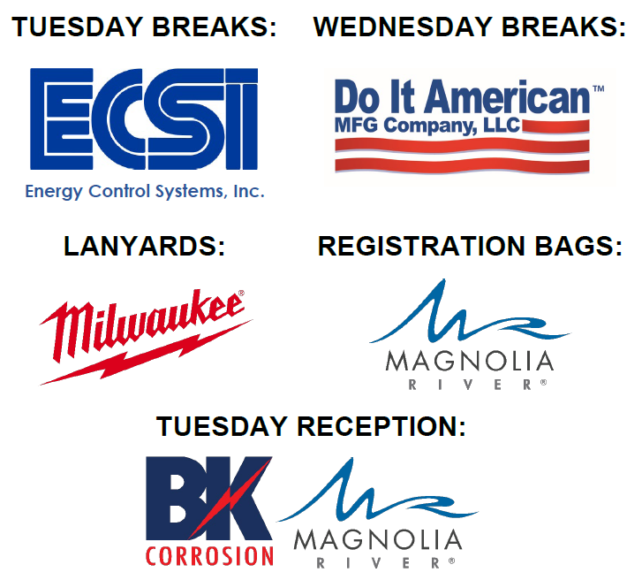
Key Sponsors
Notes:
Next, we’d like to recognize some of our other key sponsors
Milwaukee Tool for the conference lanyards
Energy Control Systems for our Tuesday breaks
Do It American for our Wednesday breaks
Magnolia River for our Registration Bags
And BK Corrosion and Magnolia River for this evening’s reception
Thank You!

Slide 10
Housekeeping
www.westernregionalgas.org
Western Regional Gas Conference 2025
Tempe Mission Palms Conference Center
Tempe, Arizona
Notes:
Housekeeping Items:
Breakfast and Lunch – The Mission Grille is just down the walkway to the west of the Ballroom area. There will be a Buffet Line inside at the Mission Grille for lunch and also outside. There’s seating inside and outside. No tickets required, just have your badge
Snack Shacks – As I previously mentioned, there are two, one at the east end, and one at the west end by the courtyard.
Registration – Is in the Xavier Room, most of you have already found it by now; any questions, someone from our team will be in there at most times
Restrooms – Next to Xavier Room right outside the ballroom on the east end of the courtyard. Also, another restroom on the west end of the hotel, across from the Mission Grille. And a set of restrooms in the lobby area.
Valet Parking – There is no charge, just make sure to give a tip. All parking in surrounding parking lots is on a pay per hour basis.
Break and lunch raffles - There will be several raffles held throughout the conference. Your names have already been entered into the raffles to be conducted during break and lunch sessions. So, no action is required on your part there. This will give everyone time to visit vendors and accumulate bonus tickets for tonight’s main raffle. Winners must be present!
Reception and Raffle -The main raffle this evening will be based on tickets you obtain from the vendors. So please spend some time with the vendors. The more vendors you visit, the more tickets you get and the better your odds of winning. We will start drawing that raffle around 5:30; don’t miss it, we have a LOT of great prizes.
There will be appetizers floating around, along with a bar. Please note the appetizers are not meant to be dinner! So, please make sure to save some for everyone.
Last year we piloted a day 2 attendance raffle and we’re gonna do it again this year. We know you like to have a good time on the Tuesday evening, and there have been occasions where folks wake up feeling under the weather on the second day for some reason! We’re not sure why! Hence this extra incentive! Basically, as long as you show up to the first two sessions tomorrow, you will be added into our day 2 bonus drawing. I have 2 Go Pro Hero 12 Essential Starter Bundles to give away right before the Grand Prize drawing.
BK Corrosion and Magnolia River will be sponsoring some free bar drinks at the Reception.
????
??Milwaukee is doing a raffle of XXX tools. ??? See these guys not us 😊 Milwaukee raffle drawing will be just ahead of our Grand Prize drawing on Wednesday after the last session.
Grand Prize Raffle – ??? Two Apple Macbook Airs and a couple other items. here in the Palm Ballroom tomorrow afternoon at the close of the conference (ABOUT 3:30) . And you must be present to win! Hold on to your name badges as these will be collected at the door.
Harry’s – Restaurant in hotel in Lobby area to the west. Good food and drinks.
Mill Ave – Restaurants and bars all along Mill Ave and a few new ones across the street near the newer hotels.
Presentations – Presentations will be posted to the www.westernregionalgas.org site within a few weeks after the event.
WIFI - Wireless wifi - SSID: xxx Password: xxxxx

Slide 11
Thank You!
Western Regional Gas Conference 2025
Tempe Mission Palms Conference Center
Tempe, Arizona
Notes:
Before I close, I would like to take a moment to thank all of you.
Delegates – for your attendance and support. Speakers - for sharing their experience, insight, and opinions on topics that affect each of us as operators.
Vendors - One of the reasons this conference has had such great success is that we are able to keep costs down for our attendees. The incredible support we receive from our vendors is how we can do this. This year we have ?? vendors. In addition, our vendors have always stepped up to donate some great items to our raffle.
I’d like to give a big shot out to Lyndon Boltz and Erich Trombley, who volunteered so much of their time and efforts to this Western Regional Gas Association board until the end of last year. Erich served for over 10 years and Lyndon for over 15 years. Thank you so much to both of them. We miss them already.
I would like to thank our event organizer Sheila Deringis
And lastly my fellow WRGA Board of Directors – Bill Parry, Duncan Jakes, and our executive director Robert Clarillos.
Without further ado, I would like to bring up our keynote speaker to discuss NATURAL GAS INNOVATION: PAST, PRESENT, AND FUTURE… Senior Director of Gas Strategy and System planning at Pacific Gas & Electric, Mike Kerans.

