Slide 1
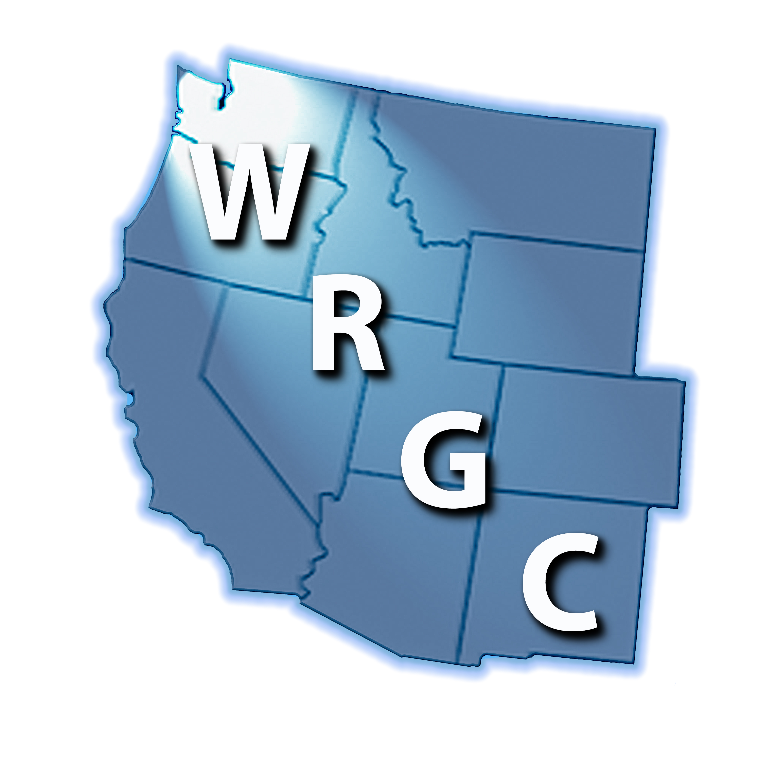
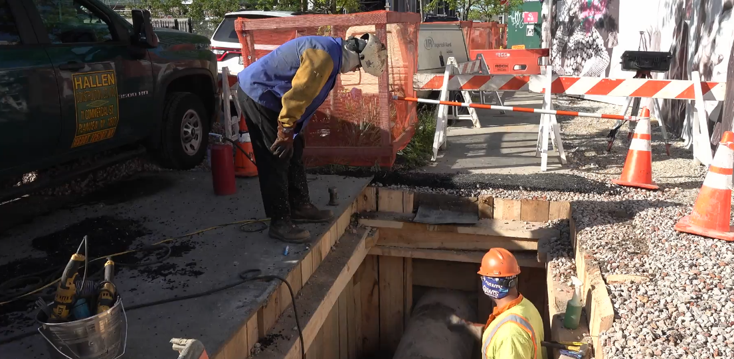
2025 Training Innovations:
Emergency Response
Construction Oversight
Welding Fundamentals
August 19, 2025

Slide 2

Presenter Introduction
Ray Deatherage – Director, Education and Training with GTI Energy
33 years experience in the natural gas industry
25+ years experience with a gas distribution company
Operations, Standards, Materials, Failure Analysis, Quality Assurance, Compliance, Training, and Operator Qualification
20+ years experience developing, delivering, and maintaining training and qualification programs
9+ years after hours emergency on-call for management
Participated in legal depositions related to training and procedures

Slide 3
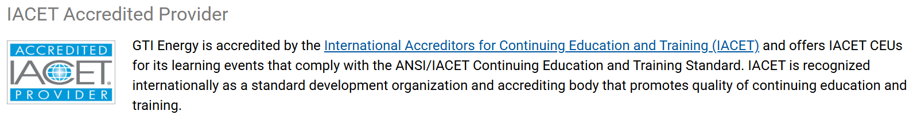
GTI Energy Overview
Non-profit training and research organization (Des Plaines, IL)
Training Offerings: (30+ instructor led course offerings)
Instructor-led Training:
Open enrollments
Hosted
Digital & Immersive: eLearning, micro-videos, gamification, 360-degree experiences, 3D models, virtual reality, and soon to come an AI assistant.
Training development (Team of 10+ technology partners under contract and over 100+ team members working on our current projects.)

Slide 4
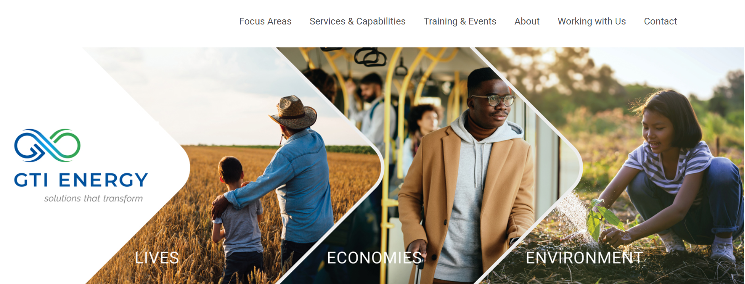
GTI Energy Website

Slide 5

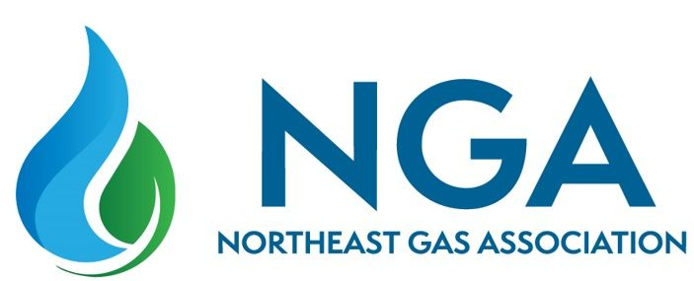
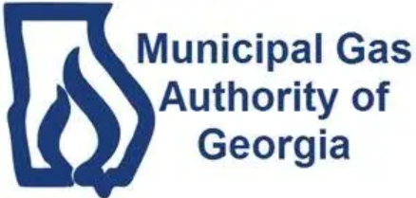
Genesis of New 2025 Training Programs
Leader Surveys (Host site sponsors)
Student Surveys
Associations
Operations Technology Development (OTD) Sponsors
Requested focused training on these topics versus overview as part of multi-day sessions.

Slide 6

New 2025 Training Courses
Emergency Response: Make Safe Operations
Duration: 10:30am to 3:00pm (two-days)
0.8 CEU’s/ 8.0 PDH’s
Construction Contractor Oversight Fundamentals
Duration: 10:30am to 3:00pm (two-days)
0.8 CEU’s/ 8.0 PDH’s
Welding Oversight Fundamentals
Duration: 10:30am to 3:00pm (one-day)
0.4 CEU’s/ 4.0 PDH’s

Slide 7
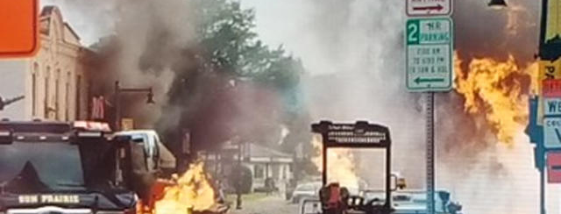
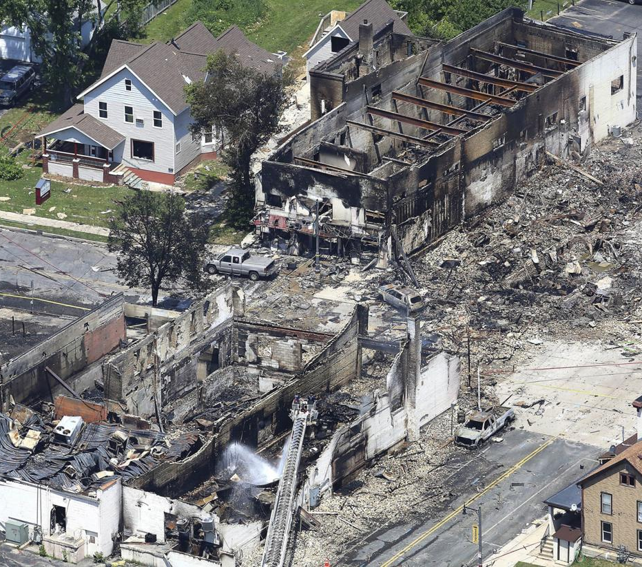
Natural Gas Emergency Response: Make Safe Operations

Slide 8
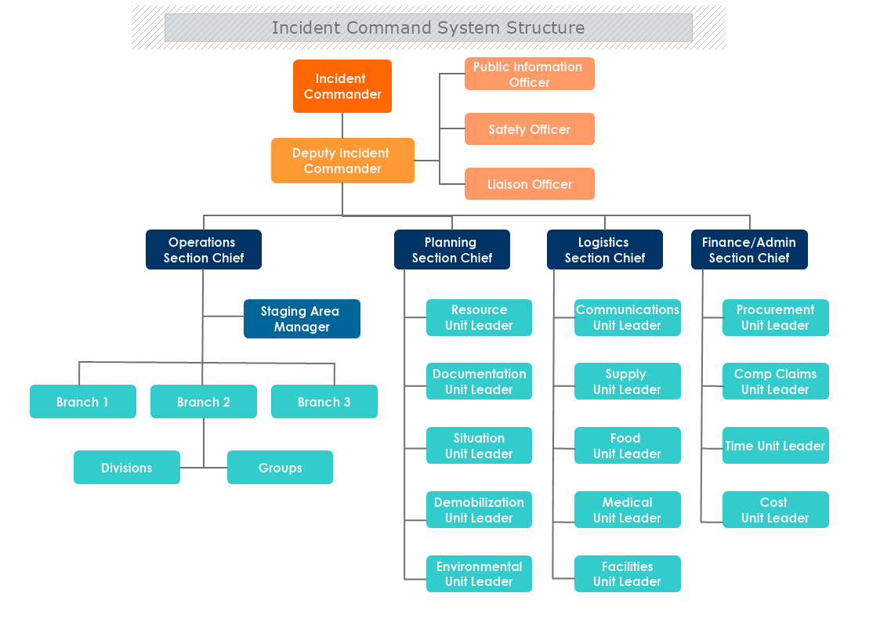
Learning Objectives
By the end of this course, participants will be able to:
Recognize Regulatory and Organizational Emergency Response Requirements
Apply Safe Practices During Natural Gas Emergencies
Integrate Effectively into the Incident Command System (ICS)
Analyze Lessons Learned from Real-World Incidents

Slide 9
Lesson Topics
PHMSA Emergency Response Requirements
Reportable Incidents
Emergency Response Plans
Incident Command System (ICS)
Recent Natural Gas Incidents
Properties of Natural Gas
Tools and Equipment for Emergency Response
Evacuation and Ventilation Techniques
Leak Investigation Techniques
Failure Investigation
Make Safe Operations: Case Studies
Industry Resources – Emergency Response

Slide 10
Key Takeaways
Protect Life then Property!
Do not treat emergency calls as “Routine” calls.
Be prepared for the most severe gas emergency.
Most gas incidents occur within the first 30-60 minutes of being reported.
Always assume there may be more than one leak.
Share emergency response lessons learned with co-workers, this better prepares the team for responding to the next gas emergency.

Slide 11
Examples of Emergencies
Fire/Explosions
Damage to Company Facilities
Third-Party Damage
Leak/Odor Complaints
Natural Gas/CO
Pressure/Odorization Problems
Major interruptions of service
Relieving overpressure protection device
Malfunctioning odorizer/spills
Notes:
Class participation – give examples of what may cause these types of emergencies.
Fire/Explosions
Damage to Company Facilities
Third-Party Damage
Leak/Odor Complaints
Natural Gas/CO
Pressure/Odorization Problems
Major interruptions of service
Relieving overpressure protection device
Malfunctioning odorizer/spills

Slide 12
Questions to Consider
How many leaks go unreported?
How many excavators do not initiate a one-call ticket?
How many times do excavators come in contact with piping but do not report it?
How many homeowners attempt to perform their own gas installations?
How many gas leaks are the result of foul play?

Slide 13
Discussion Points For This Training*
The average amount of time before reportable incidents occur.
When should additional company support be requested?
When should evacuation of structures be initiated?
When should fire department presence be requested?
When is it safe to assume the gas emergency has been identified and no additional investigation is required?

Slide 14
Response Considerations Prior to Arrival*
Establish a mindset to Protect Life then Property upon arrival
Reported odor location and other details (e.g., inside, outside, near the street, etc.)
Time of day (e.g., business hours, after hours, etc.)
Service territory age (pipeline material type, age of appliances, etc.)
System design and pressure (e.g., back-fed, low/medium/high, etc.)
Odor complaint history in area reporting to
Who do I call if I need assistance? (e.g., supervisor, dispatch, peer, fire department)
Who do I call to report my initial findings? (e.g., supervisor, dispatch, peer)
What tools and equipment do I need to grab upon arrival
Consider all reported customer odor calls as leading to an incident

Slide 15
Response Arrival Upon Arrival
Protect Life then Property
Take a look at the big picture (e.g., people present, excavator present, etc.,)
Do you smell gas in the air?
What direction is the wind blowing, this may play into the leak investigation?
Determine the magnitude of a potential underground gas leak by taking gas readings in centerline sewers, storm drains, or other substructures on the way to make contact
Grab the necessary tools and equipment to take immediate action if a hazardous situation is identified.

Slide 16
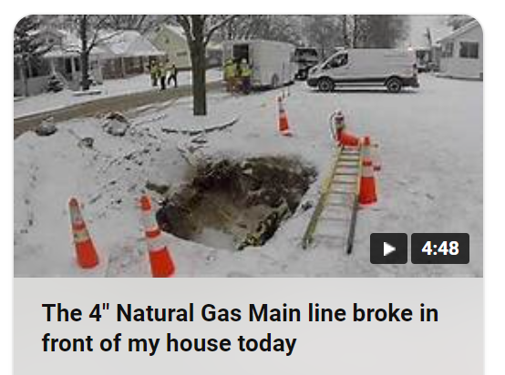

Reminder – Every Action is Being Recorded
Ring Doorbells
Smartphones
Facebook
You Tube
Tik Tok
Instagram
Others
Any recordings of the event and your response will become part of any potential litigation. Perception becomes reality in the court room.
Notes:
Review video link and discuss correct and incorrect actions.
The 4" Natural Gas Main line broke in front of my house today

Slide 17
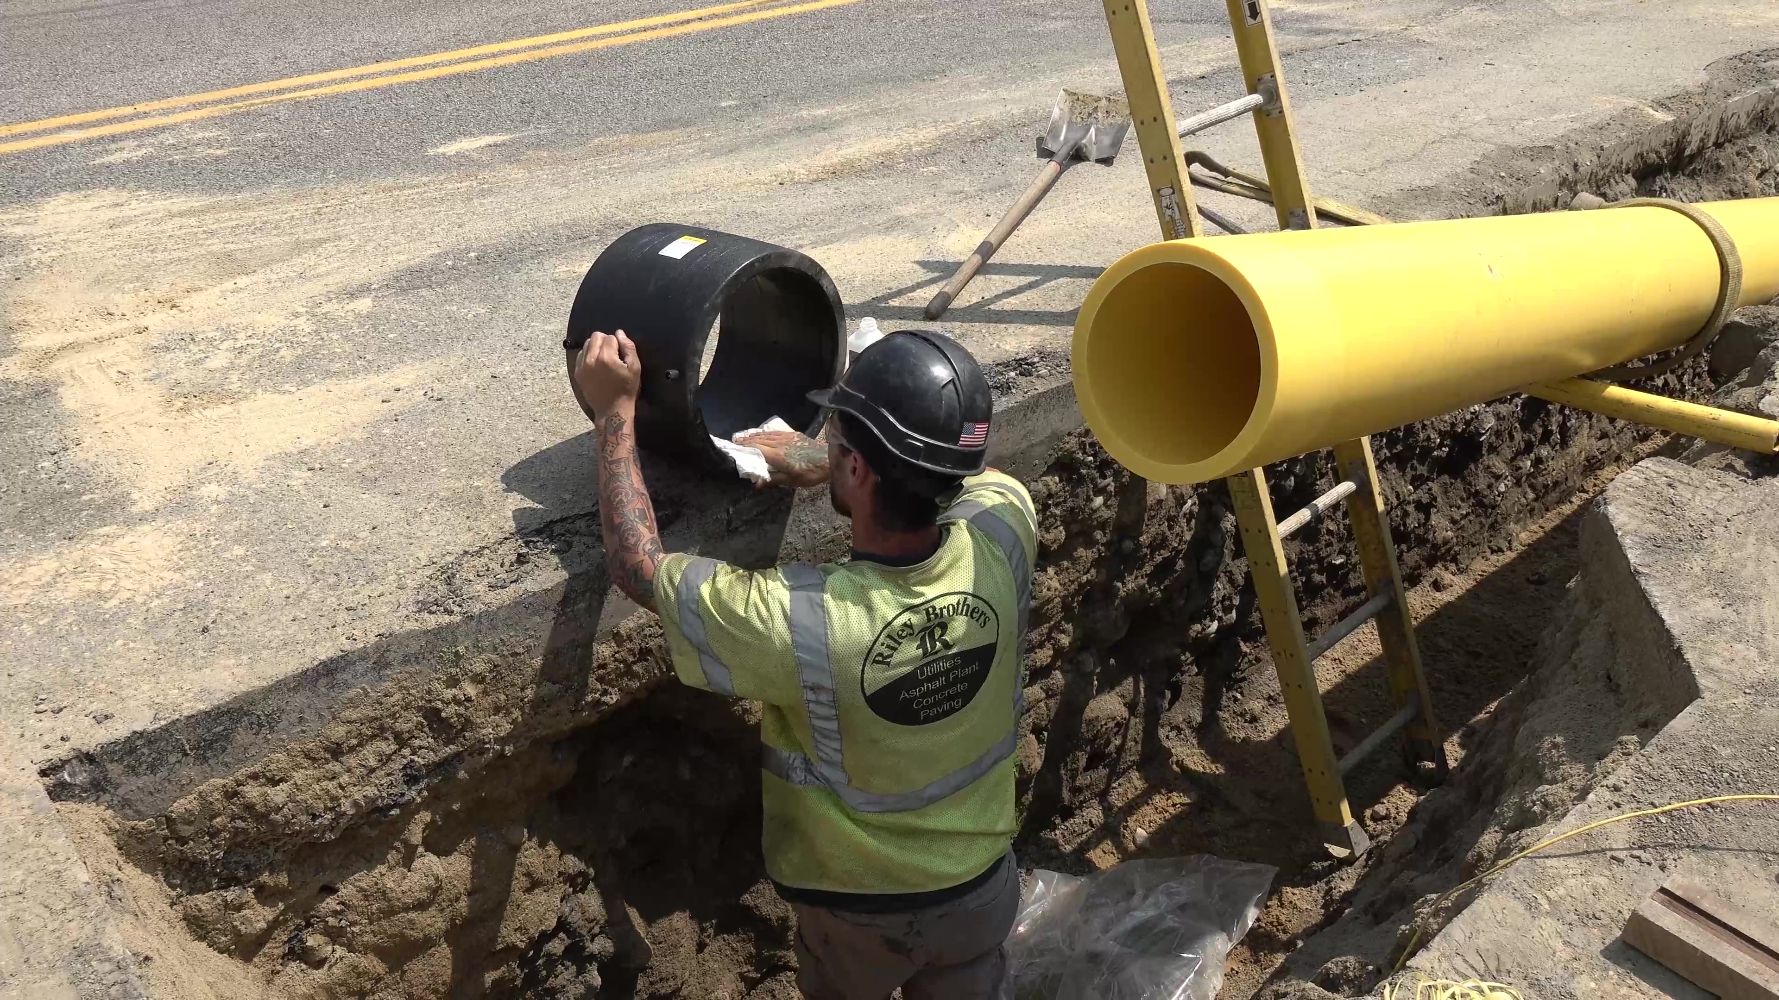
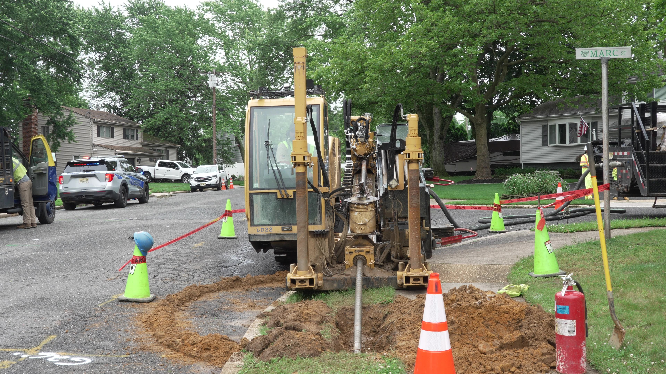
Construction Contractor Oversight Fundamentals

Slide 18
Learning Objectives
By the end of this course, participants will be able to:
Understand Expectations for Construction Oversight Activities
Increase Consistency Among Construction Inspectors
Identify Opportunities for Process Improvement
Identify Additional Training Opportunities
Increase Awareness of Lessons Learned for Construction Oversight Activities
These objectives ensure a consistent, effective, and proactive approach to contractor oversight, driving improved safety, quality, and performance in pipeline and construction projects.
Notes:
Learning Objectives for Contractor Oversight Fundamentals Training Course
By the end of this course, participants will be able to:
Understand Company Expectations for Contractor Oversight Activities
Define the roles and responsibilities of inspectors and oversight personnel.
Align oversight activities with company policies, procedures, and regulatory requirements.
Recognize the importance of contractor compliance in maintaining safety, quality, and operational efficiency.
Increase Consistency Among Inspectors for Oversight Activities
Standardize inspection and documentation practices to ensure uniform application across projects.
Apply company-approved checklists, reporting tools, and quality control measures.
Ensure all inspectors adhere to regulatory and industry best practices for contractor oversight.
Identify Opportunities for Process Improvement
Evaluate current oversight processes for efficiency and effectiveness.
Recognize and address gaps in contractor performance and compliance.
Provide feedback and recommendations to enhance oversight procedures and contractor accountability.
Identify Additional Training Opportunities
Assess inspector and contractor knowledge gaps through field observations and performance reviews.
Recommend targeted training programs to improve contractor competency and compliance.
Promote ongoing professional development and knowledge sharing among oversight personnel.
Increase Awareness of Lessons Learned for Contractor Oversight Activities
Review past incidents, near misses, and best practices to enhance contractor oversight strategies.
Apply case studies and real-world scenarios to reinforce learning and decision-making.
Foster a culture of continuous improvement by sharing lessons learned across teams and projects.
Learn the Resources Available to Help Guide Oversight Activities
Identify company policies, procedures, and manuals that outline oversight expectations.
Understand how to utilize inspection checklists, audit tools, and reporting systems.
Leverage regulatory resources (PHMSA, API, ASME, OSHA) and industry best practices for guidance.
Access subject matter experts (SMEs), safety personnel, and training materials for additional support.
These objectives ensure a consistent, effective, and proactive approach to contractor oversight, driving improved safety, quality, and performance in pipeline and construction projects.

Slide 19
Lesson Topics
Safety Considerations
Work Preparation
Safe Excavation Practices
Welding Fundamentals
State Commission Audit Prep
Contractor Qualifications (OQ)
Pressure Testing
PE Pipe Joining & Installation
Steel Pipe Installation
Pipe Coatings
Horizontal Directional Drilling
Thrust Restraints
Tie-In and Pressure Control

Slide 20
Gaps with Construction Contractor Oversight
Contractors are an extension of the company’s workforce, set them up for success.
Qualifications to perform the work
How to verify, what qualifications are needed for each activity
Company inspector actually performing the work for the contractor – not good
Ability to track and verify calibration of equipment (e.g., pressure gauges, torque wrenches, etc.)
Knowledge of procedures and location (e.g., welding)
Who has authority over who? The pipeline operator that writes the checks has authority.

Slide 21
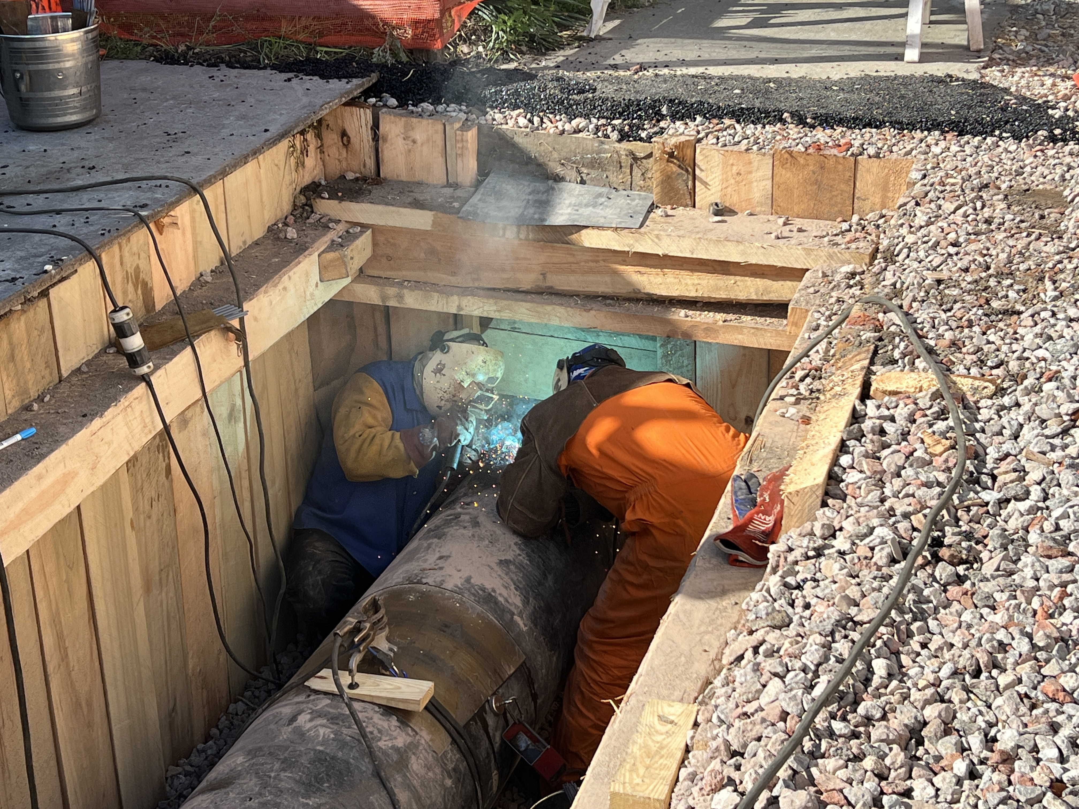
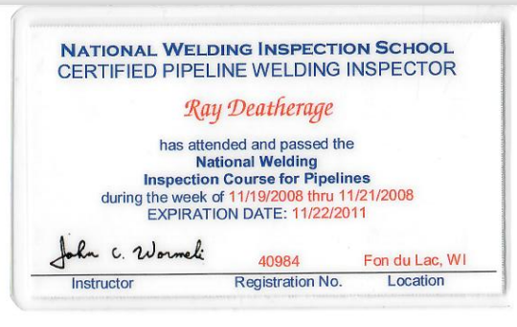
Welding Oversight Fundamentals

Slide 22
Learning Objectives
Learn the associated codes and standards for pipeline welding activities.
Comprehend welder qualification requirements.
Differentiate between welding processes.
Identify equipment and materials used in welding.
Recognize different types of welding defects.
Learn non-destructive testing (NDT) techniques.
Notes:
Understand the Associated Codes and Standards for Welding Activities:
Identify key codes and standards related to welding procedures, such as ASME, API, and AWS.
Explain how these standards guide welding practices in the industry.
Recognize the importance of compliance with welding-related codes and standards for safety and quality assurance.
Comprehend Welder Qualification Requirements:
Understand the essential criteria for welder qualification, including the role of welder performance qualifications.
Explain the difference between welder certification and qualification.
Identify the documentation required to verify a welder’s qualifications.
Differentiate Between Welding Processes:
Explain the key differences between common welding processes such as Stick Welding (SMAW), MIG Welding (GMAW), TIG Welding (GTAW), and Flux-Cored Arc Welding (FCAW).
Discuss the advantages and limitations of each welding process and their suitability for different applications.
Identify Equipment and Materials Used in Welding:
List common welding equipment, including welding machines, electrodes, torches, and safety gear.
Understand the role of various materials used in welding, including welding rods, filler materials, and base metals.
Recognize the importance of selecting appropriate materials and equipment for specific welding applications.
Recognize Different Types of Welding Defects:
Identify common welding defects such as porosity, slag inclusion, cracks, and undercut.
Understand the causes of these defects and their potential impact on the integrity of welded joints.
Discuss methods for detecting and preventing welding defects during the welding process.
Understand Non-Destructive Testing (NDT) Techniques:
Define non-destructive testing and its importance in welding inspection.
Recognize the most common NDT techniques used in welding, such as ultrasonic testing (UT), radiographic testing (RT), and visual inspection (VT).
Understand how NDT techniques are applied to ensure the quality and safety of welded structures.
Understand General Welding Inspection Requirements:
Identify the key responsibilities of a welding inspector, including pre-welding, in-process, and post-welding inspections.
Understand the necessary documentation and records required for welding inspection activities.
Discuss the importance of adhering to inspection procedures and maintaining quality control throughout the welding process.

Slide 23
Lesson Topics
Codes and Standards
Safety
Welder Qualifications
Welding Joint Types
Welding Processes
Pipe Grades and Materials
Difference between Distribution and Transmission Welding
Welding Procedure Overview
Welding Defects
Non-Destructive Testing (NDT)
Performing Welding Inspection
Weld Records
Lessons Learned
Q&A

Slide 24

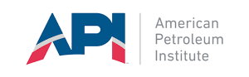
Codes and Standards
Here are the key codes and standards commonly applied to welding gas distribution and transmission pipelines:
49 CFR Part 192: Transportation of Natural and Other Gas by Pipeline
API 1104: 21st Edition
ASME B31.8
API 5L: Specification for Line Pipe

Slide 25
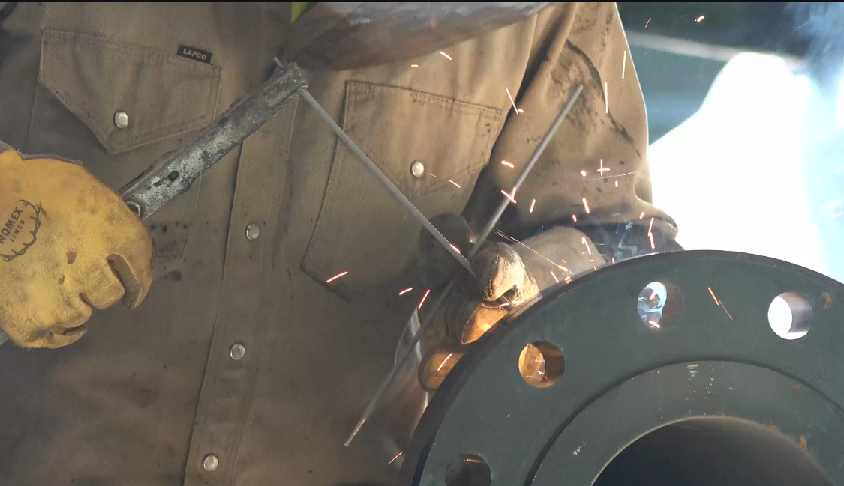
Welding Processes: Shielded Metal Arc Welding (SMAW)
Also Known As: Stick welding
Application: Commonly used for field welding of steel pipes in all positions.
Advantages:
Versatile and portable.
Suitable for welding in outdoor environments.
Notes:
Overview of Shielded Metal Arc Welding (SMAW)
Shielded Metal Arc Welding (SMAW), commonly known as stick welding, is one of the oldest and most widely used welding processes. It involves using a consumable electrode coated with a flux material that protects the weld area from atmospheric contamination, such as oxygen and moisture. SMAW is versatile, portable, and suitable for a wide range of applications, making it a go-to process for many welding tasks in the natural gas, construction, and industrial sectors.
Key Features of Shielded Metal Arc Welding:
Process Description:
Electrode: A consumable electrode (a coated metal rod) is used to create an arc between the electrode and the base metal, causing the electrode to melt and deposit filler material into the weld joint.
Flux Coating: The coating on the electrode serves two purposes:
It creates a shielding gas when heated, protecting the weld pool from contaminants.
It forms a slag layer on top of the weld, which helps to protect the cooling weld bead from oxidation and contamination.
Applications:
Pipeline Welding: SMAW is commonly used in field welding for natural gas pipelines, especially for root passes and repairs in pipeline construction.
Heavy Equipment Repair: Ideal for welding thicker materials and providing strong, durable welds for heavy machinery and equipment.
Structural Welding: Used in construction and bridge welding due to its ability to handle a wide variety of positions and joint configurations.
Outdoor Welding: SMAW is highly favored for outdoor welding applications, as it doesn't require shielding gas, making it effective in windy or harsh environments.
Advantages:
Versatility: SMAW can be used to weld a variety of materials, including carbon steel, stainless steel, and other alloy steels.
Portability: The equipment is relatively simple and portable, making it ideal for fieldwork, maintenance, and repair jobs.
Adaptability to Various Positions: It can be used in all positions (flat, horizontal, vertical, and overhead) with proper technique.
Minimal Equipment: Unlike other processes, SMAW requires minimal equipment, which makes it cost-effective and easy to use for both small and large-scale projects.
Limitations:
Slag Removal: After welding, the slag created by the flux must be removed, which can add extra steps to the process and increase labor time.
Limited to thinner electrodes: While SMAW can handle a variety of materials and thicknesses, it is generally less efficient for welding very thin materials compared to other methods, like GMAW.
Welding Speed: SMAW can be slower compared to other processes, especially for larger or more complex welds.
Types of Electrodes:
Exposed Electrodes: SMAW uses electrodes with coatings that provide specific properties (e.g., better weld appearance, penetration, or resistance to cracking). Common types of electrodes include E6010, E7018, and E6013, each of which is suited for different welding conditions and materials.
E6010: Known for deep penetration and is commonly used for root passes in pipeline welding.
E7018: Low hydrogen electrode used for high-strength applications, providing high-quality, crack-resistant welds.
Summary:
Shielded Metal Arc Welding (SMAW) is a versatile, portable, and highly effective welding process used for a variety of applications, especially in fieldwork, pipeline construction, and heavy equipment repairs. While it may require more post-weld clean-up than other processes, it offers flexibility, strong welds, and the ability to perform welding in challenging environments without the need for shielding gas. This makes SMAW a go-to choice for industries where durability and versatility are key.

Slide 26
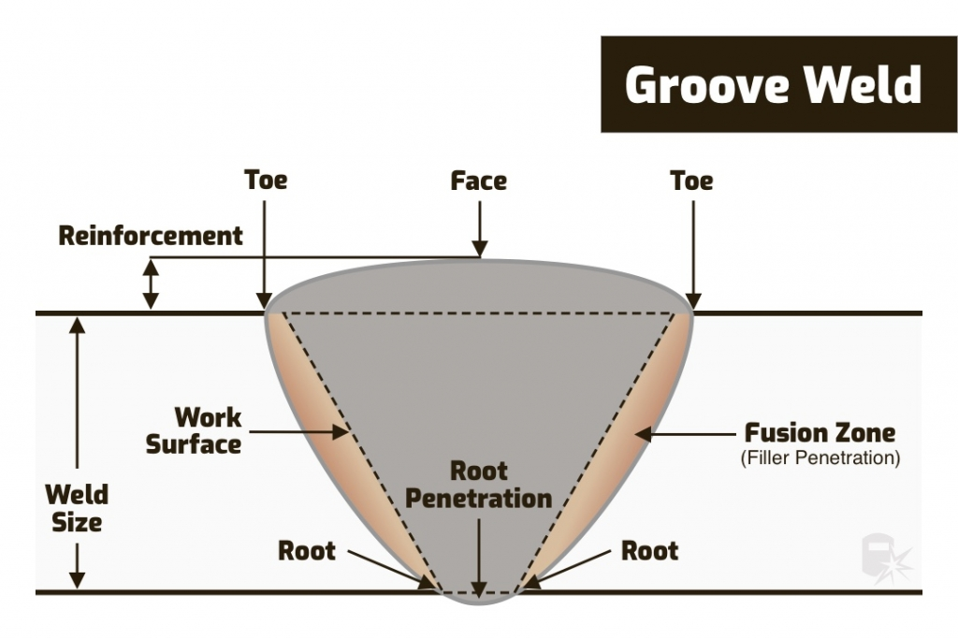
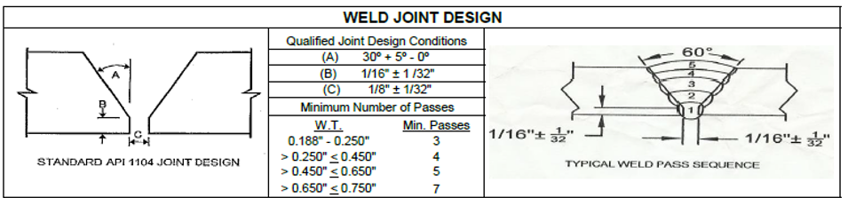
Weld Joint Profile
Root Bead: The first pass made during the welding process that forms the initial fusion between the two pieces of material.
Hot Pass: A pass made immediately after the root bead, typically using higher heat to fill and reinforce the root pass.
Filler Pass: Filler passes are used to build up the weld metal to the required height and fill the gap between the joint edges, there is no maximum number required.
Cap Pass: The final pass applied to the top of the weld, giving the weld its finished appearance and smoothness.

Slide 27
Pipe Grades and Tensile Strength
Grade A (API 5L-A)
Tensile Strength: 48,600 psi
Grade B (API 5L-B)
Tensile Strength: 60,200 psi
Grade X42 (API 5L X42)
Tensile Strength: 60,200
Grade X52 (API 5L X52)
Tensile Strength: 66,700
Grade X60 (API 5L X60)
Tensile Strength: 75,400
Grade X70 (API 5L X70)
Tensile Strength: 82,700
The Specified Minimum Yield Strength (SMYS) is used to determine the appropriate pipe grade by selecting a material with a yield strength that meets or exceeds the required pressure and operational conditions for the pipeline.

Slide 28
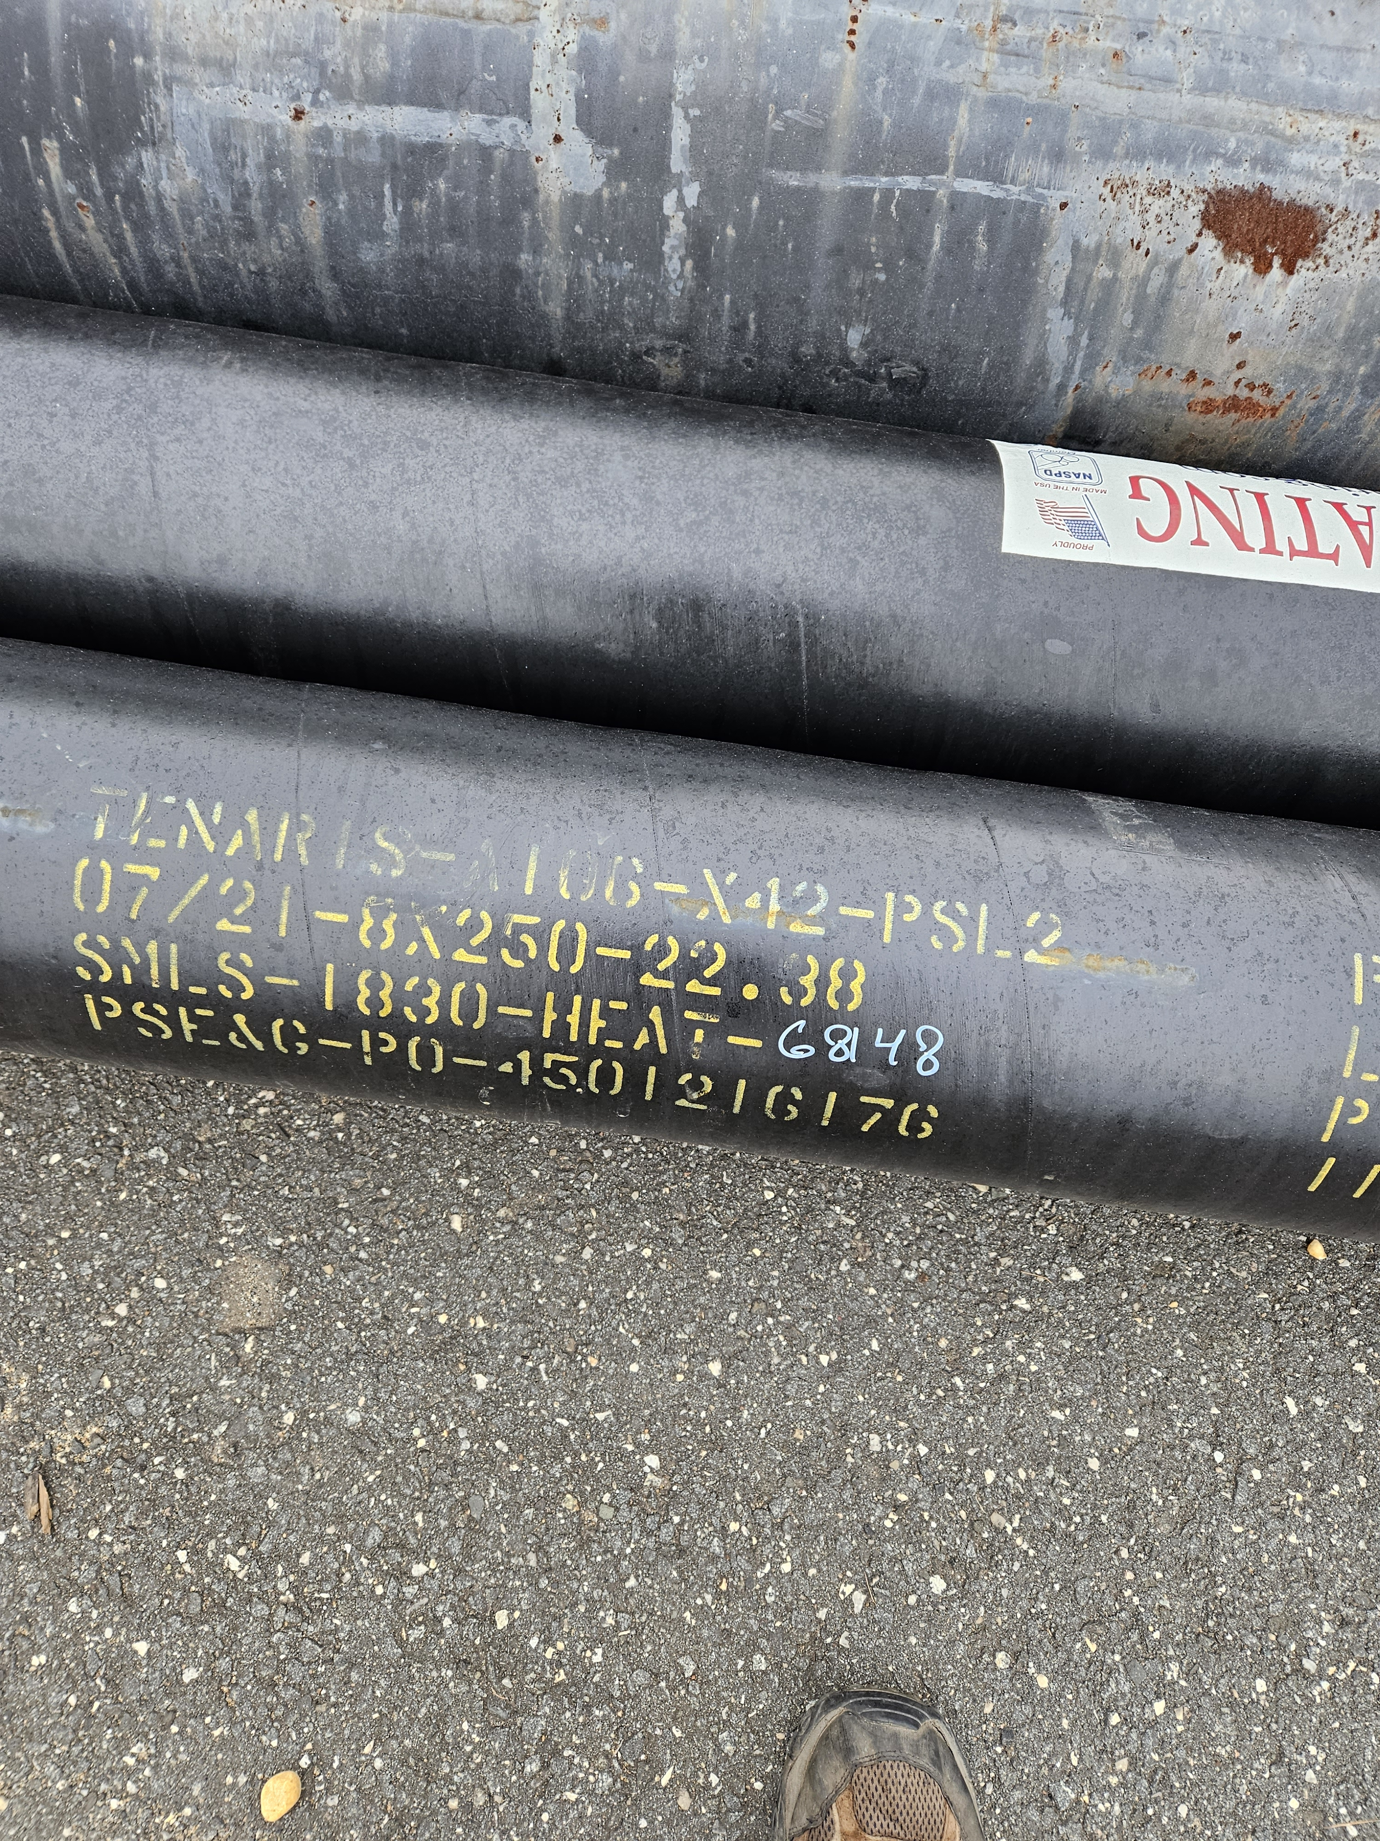
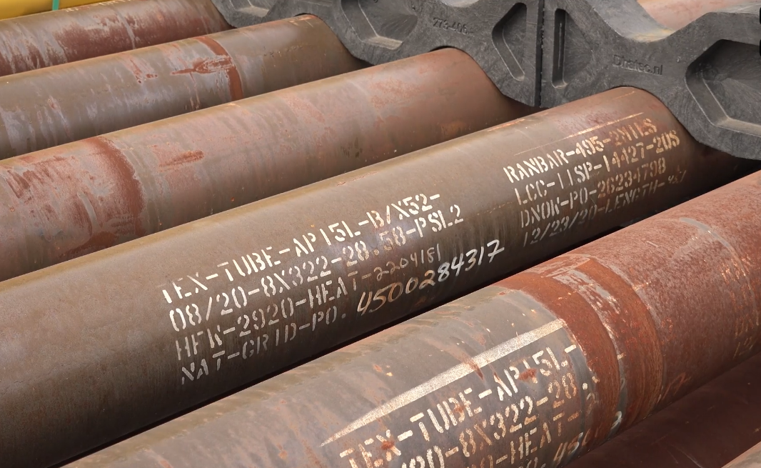
Welding Dissimilar Pipe Grades
When welding two dissimilar steel pipe grades, always use the welding procedure for the higher-grade pipe.
For example, if welding X42 pipe to X52 pipe, the welding procedure for X52 should be used to ensure the weld can handle the higher strength and performance requirements of the stronger pipe grade.

Slide 29
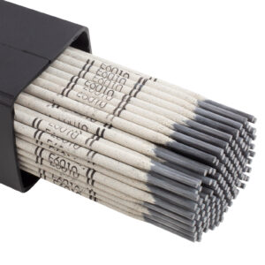
Electrode Coating Type
Cellulosic Rod (e.g., E6010, E7010, E8010):
The coating contains cellulose, which helps produce a very deep penetration and fast arc.
It generates a high amount of gas and slag, which helps protect the weld pool from contamination.
Low Hydrogen Rod (e.g., E7018):
The coating contains low hydrogen salts, designed to minimize the amount of hydrogen introduced into the weld metal.
It produces a cleaner weld with fewer defects, such as cracking, and is ideal for high-strength materials.

Slide 30
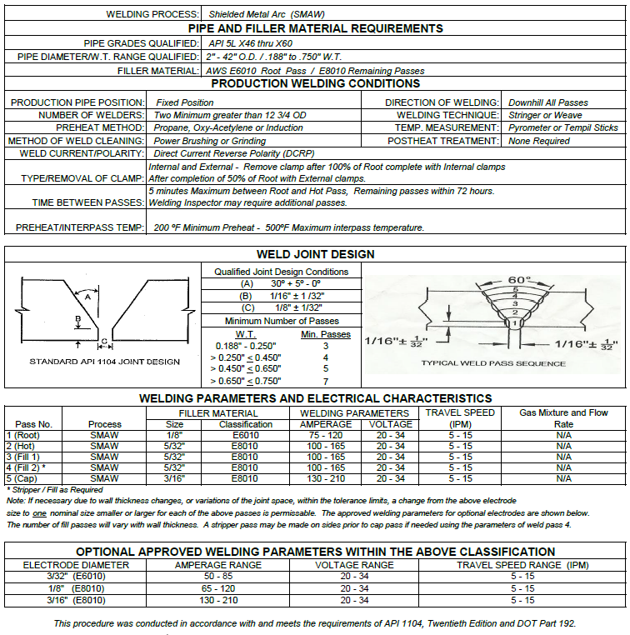
Welding Procedure Overview

Slide 31
Example of Weld Procedure Variables
Process
Material/Pipe Grade (SMYS)
Diameter and Wall Thickness
Joint Design
Filler Metal and Number of Beads
Shielding Flux
Electric Characteristics
Position
Direction of Welding
Number of Welders
Type of Line-Up Clamps
Time Lapse Between Passes
Preheating
Post heating
Speed of Travel
Time Lapse Between Passes
Removal of Line-Up Clamps
Cleaning
Test Method
Notes:
Process: SMAW. 2. Material: API Standard 5L Grade B (SMYS of 42,000 psi or less). 3. Diameter and Wall Thickness: 12.750 in. outside diameter, 0.250 in. wall thickness. 4. Joint Design: Root face or land, 1/16 in. + or - 1/32 in., bevel angle 35 degrees + 2-1/2 degrees - 5 degrees. 5. Filler Metal and Number of Beads: 1st Pass E-6010 (Fleetweld 5P Plus or equivalent), Remaining Passes E-7010-P1 (Shield Arc-HYP or equivalent). 6. Electric Characteristics: Direct current, reverse polarity (electrode positive). 7. Position: Fixed on a 6G position (45 degrees upward angle). 8. Direction of Welding: Vertical down. 9. Number of Welders: One welder only. 10. Time Lapse Between Passes: 5 minutes maximum between root and hot pass. 11. Type of Line-Up Clamps: Internal or external clamps are permitted. 12. Removal of Line-Up Clamps: When internal clamps are used, do not remove them until the first bead is 100% complete. Do not move the pipe while welding the first bead. When using external clamps, hold them in place for 50% of the first bead. 13. Cleaning: Use power grinder. Grind all starts, stops, and windows before restringing. Ensure hot pass and fillers are dirt and slag free by brushing before next pass. Brush cap before leaving the weld. 14. Test Method: Determine the quality of the weld by destructive testing in accordance with API Standard 1104

Slide 32
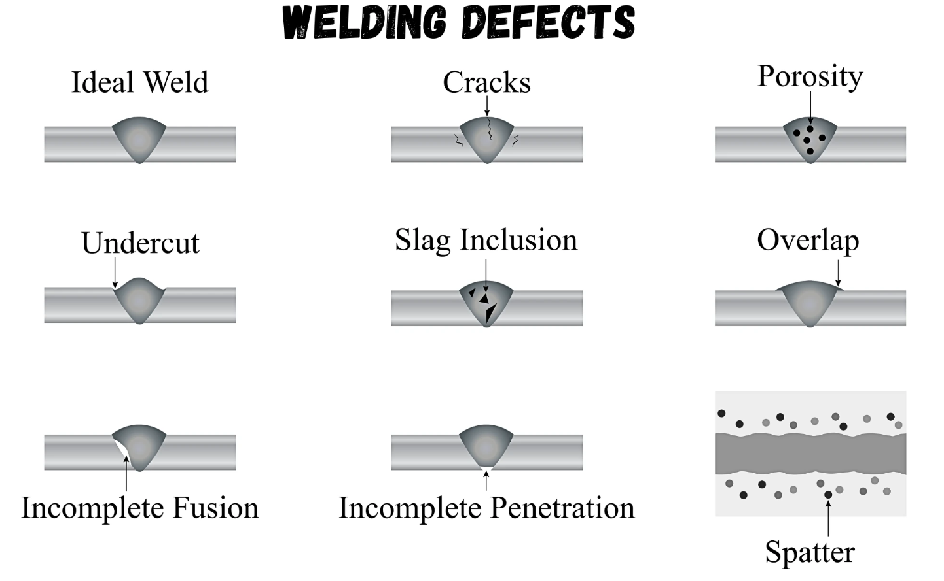
Welding Defects
Cracking
Porosity
Undercut
Slag Inclusion
Overlapping
Incomplete Fusion
Inadequate Penetration
Excessive Splatter

Slide 33
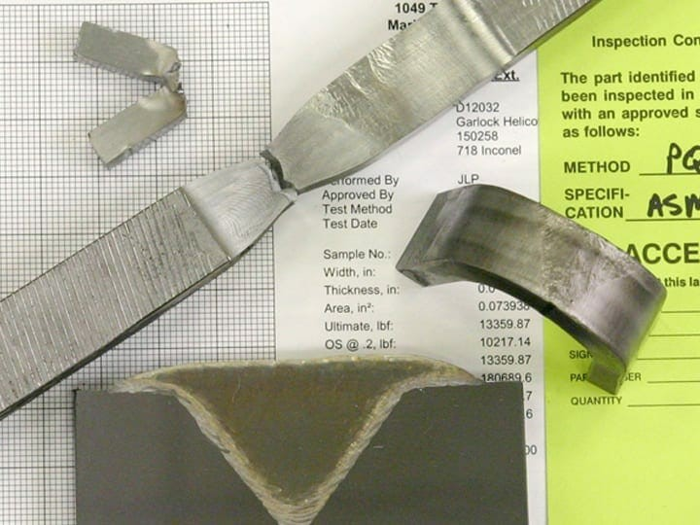
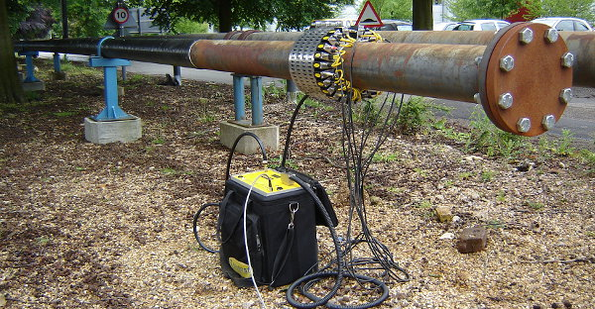
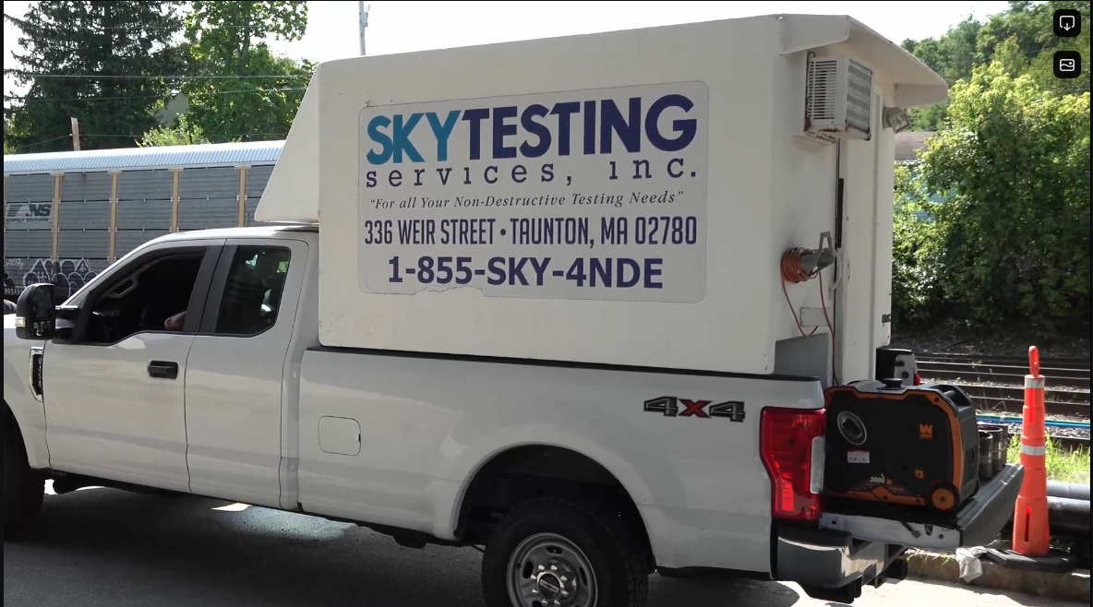
Introduction to Test Methods for Pipeline Welds
Testing is critical to ensure the integrity, strength, and safety of pipeline welds. There are two primary categories of testing:
Destructive Testing (DT) – Primarily used for initial qualification. Sometimes used for requalification and disqualification.
Non-Destructive Testing (NDT)
Each method has its specific applications, advantages, and limitations in verifying weld quality

Slide 34
Questions?
Ray Deatherage
rdeatherage@gti.energy
((847) 489-6261

