Slide 1
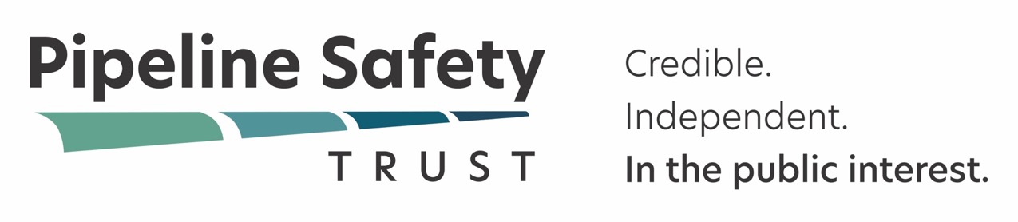
Western Regional Gas Conference
August 19, 2025
Bill Caram
Executive Director

Slide 2
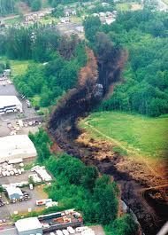
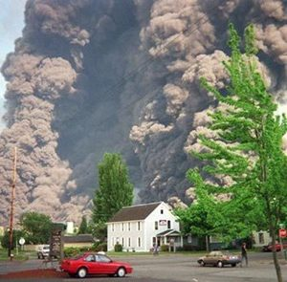

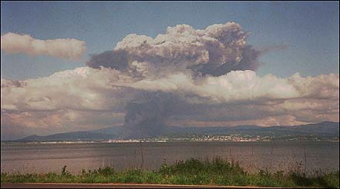
Pipeline Safety Trust History

Slide 3

Pipeline Safety Trust History
“… there’s going to be a Trust that’s going to be funded as part of today’s sentencing. With $4,000,000 … they’ve nowhere near the lobbying potential of the oil industry. It’s not even David and Goliath. It’s more like Bambi and Godzilla. No industry polices itself very well… you need outside people, and these are going to be the people so pay attention to them.”
The Honorable Barbara Rothstein
United States District Judge
at Olympic Pipe Line Co Sentencing

Slide 4
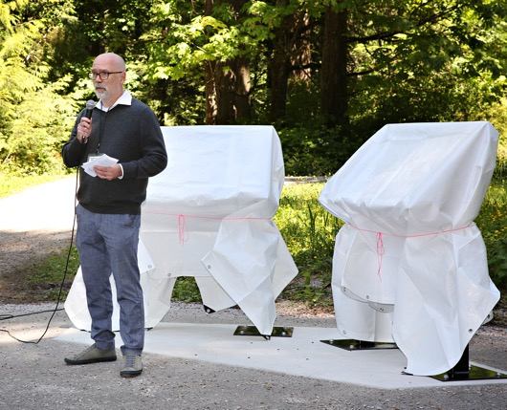
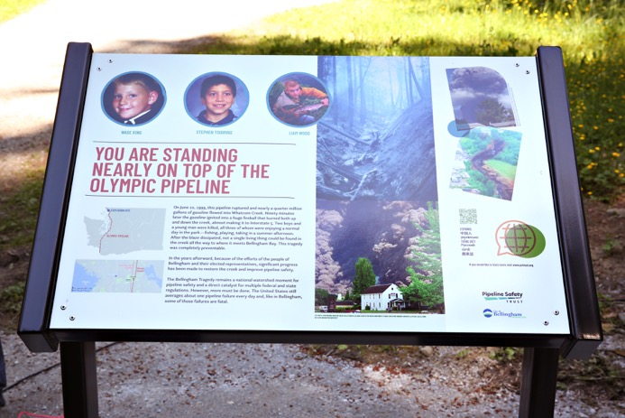
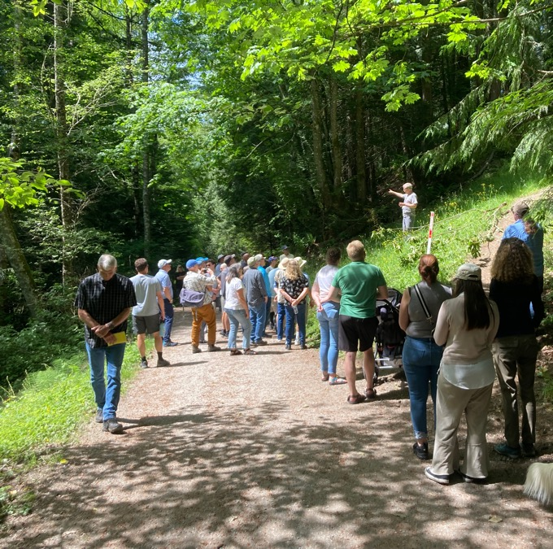
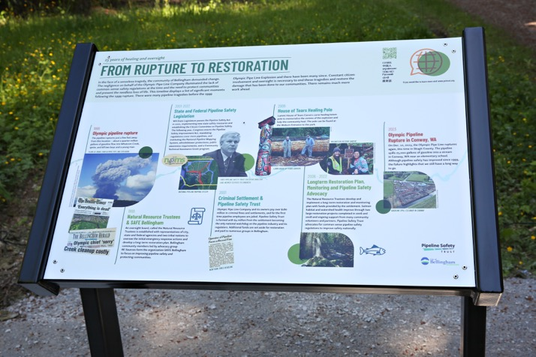
Pipeline Safety Trust History – 25 Years

Slide 5
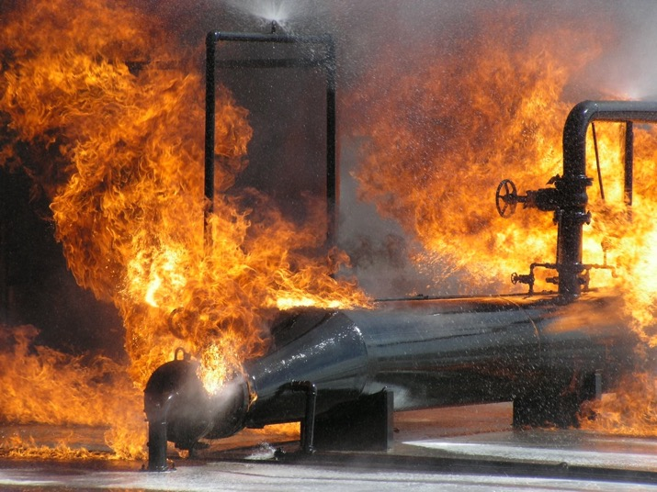
Pipeline Safety Trust Mission
The Pipeline Safety Trust promotes pipeline safety through education and advocacy, increased access to information, and partnerships with residents, safety advocates, government, and industry, resulting in safer communities and a healthier environment.

Slide 6
Shared Goals
PHMSA
Public
Industry
Local Gov’t
Tribes
States
Safer pipelines!
Zero incidents!

Slide 7

PST Priorities
Methane detectors
Fire shutoff valves (thermally activated)
Leak detection performance standards
CO₂ pipeline safety
H₂ and H₂ blend pipeline safety
Rupture mitigation valves
Public engagement

Slide 8
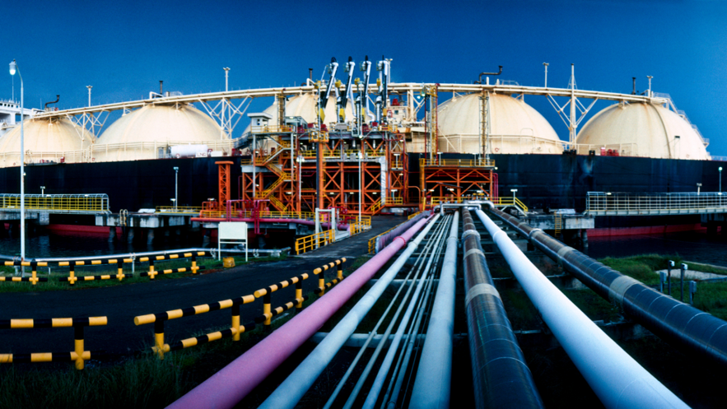
PHMSA Rulemaking – LNG ANPRM
Primary concerns:
Outdated regulations
Congressional delays
Backwards progress
Safety vs. deregulation

Slide 9
PHMSA Rulemaking – LNG ANPRM
Main recommendations:
Public access to standards: Make all industry standards incorporated by reference available to the public for free
Enhanced reporting: Require additional data on LNG exports/imports, leaks, and operational status during incidents
Safety-first approach: Focus on improving safety rather than cost savings for industry
Risk-based requirements: Support Congressional mandate for risk-based approach for large-scale facilities
Implementation plans: Require operators to submit detailed safety implementation plans for PHMSA approval

Slide 10
PHMSA Rulemaking – Repair Criteria
Primary concerns:
Terminology confusion
Backwards movement
Missing safety focus

Slide 11
PHMSA Rulemaking – Repair Criteria
Main recommendations:
Clarify language: Change "repair conditions/criteria" to "response conditions/criteria" throughout regulations
Codify timeframes: Establish clear 5-day timeframe for examining immediate repair conditions
Type A sleeve prohibition: Ban problematic Type A sleeves on hazardous liquid pipelines due to leak risks
Enhanced tank inspections: Allow risk-based inspection intervals for certain breakout tank designs
Maintain gas standards: Don't reduce recently improved safety standards for gas transmission lines
Address reporting gaps: Need better data collection on remediation activities and emerging safety trends

Slide 12
PHMSA Rulemaking – Mandatory Reg. Reviews
Primary concerns:
Mission alignment
Overwhelming workload
CO₂ pipeline safety

Slide 13
PHMSA Rulemaking – Mandatory Reg. Reviews
Main recommendations:
Finalize CO2 rules: Reissue CO2 pipeline safety regulations without substantial revisions
Improve state support: Provide states with full 80% reimbursement for pipeline safety programs
Study special permits: Comprehensively analyze performance of pipelines operating under special permits
Maintain methane rules: Don't rescind guidance on minimizing methane emissions (Section 114 of PIPES Act)

Slide 14
PHMSA Rulemaking – Common Themes
Safety First:
Prioritize public and environmental safety over industry cost savings
Don't pursue deregulation when Congress mandated safety improvements
Maintain or strengthen safety standards, don't weaken them

Slide 15
PHMSA Rulemaking – Common Themes
Transparency & Public Participation:
Make industry standards publicly accessible
Hold accessible public meetings with proper notice
Allow meaningful public comment periods
Post relevant documents and summaries online

Slide 16
PHMSA Rulemaking – Common Themes
Congressional Compliance:
Follow Congressional mandates from PIPES Acts of 2016 and 2020
Complete overdue rulemakings before starting new deregulatory efforts
Maintain required reporting and tracking systems

Slide 17
PHMSA Rulemaking – Common Themes
Regulatory Clarity:
Use clear, consistent terminology across regulations
Provide specific timeframes and requirements
Eliminate ambiguous language that allows problematic interpretations

Slide 18
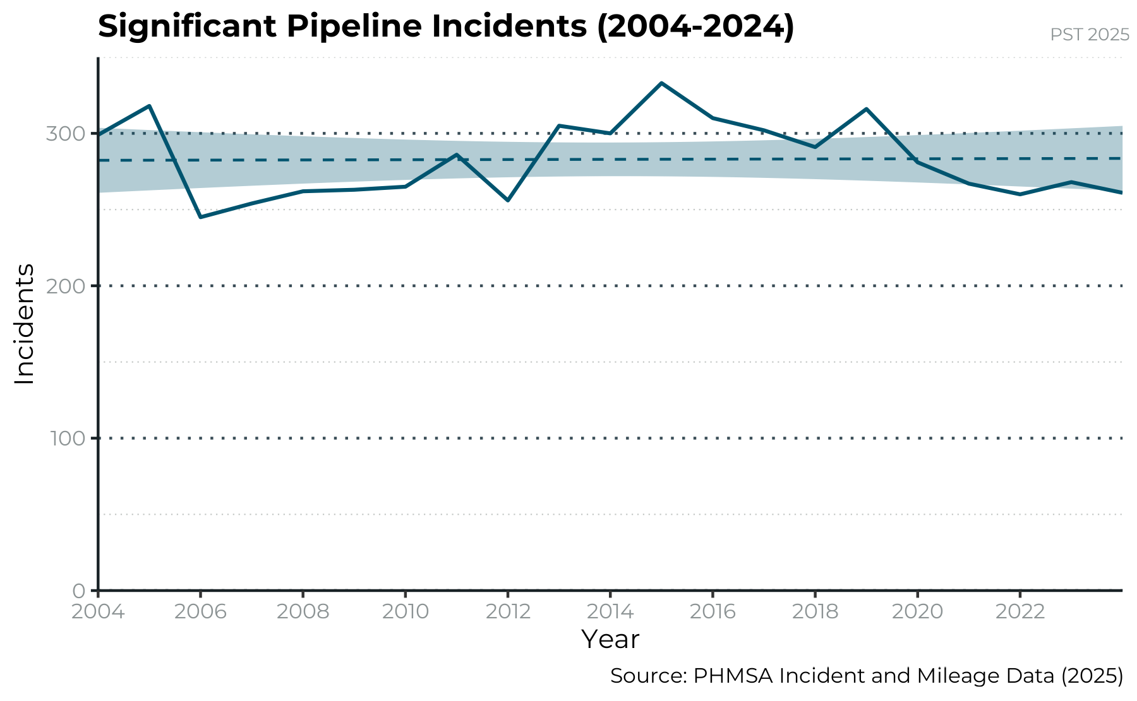
Zero Incidents?

Slide 19
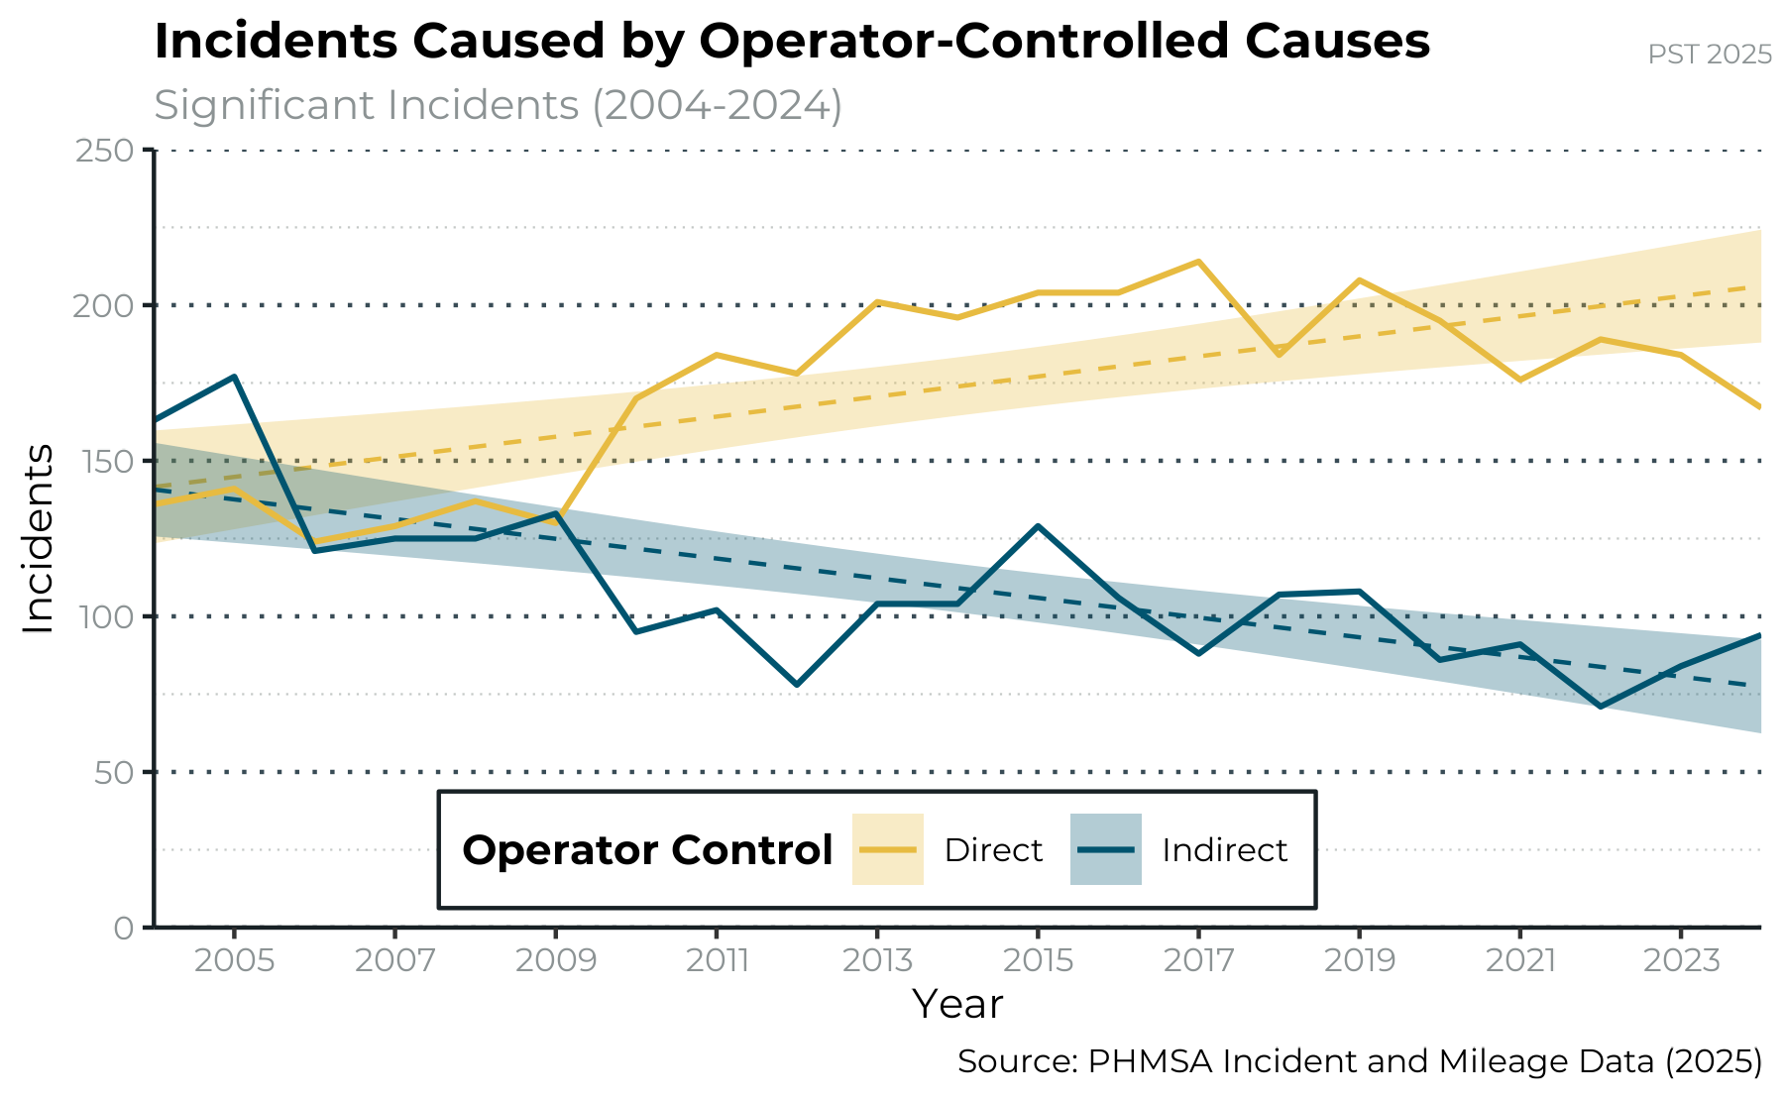
Zero Incidents?

Slide 20
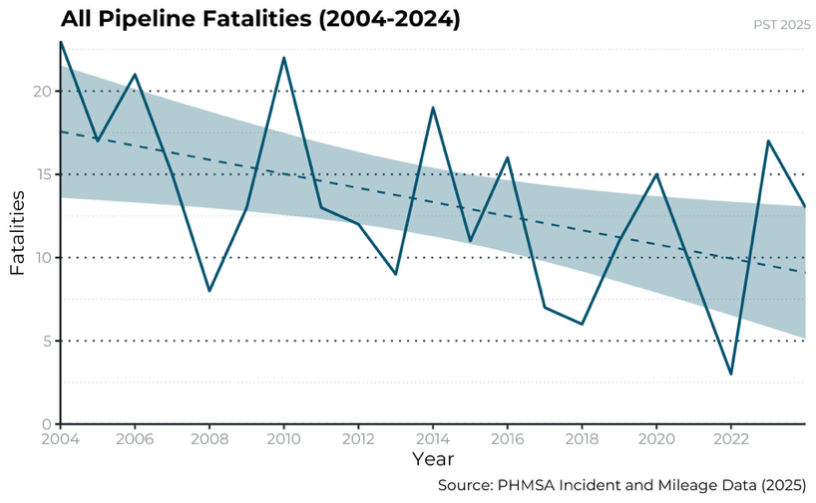
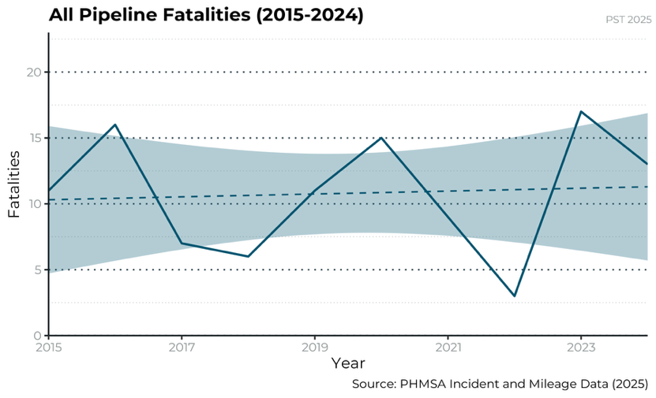
Zero Incidents?

Slide 21

PST Annual Pipeline Safety Conference
Save the Date!
November 13-14, 2025
New Orleans, LA
Registration live at pstrust.org

Slide 22
Thank you!
Bill Caram
Executive Director
Pipeline Safety Trust
bill@pstrust.org
360-543-5686 Ext. 103
www.pstrust.org

