Slide 1
Implementing Quantitative Risk Analysis (QRA)
For Transmission Pipeline Operations and Facilities

Slide 2
Risk Analysis
Risk Theory

Slide 3

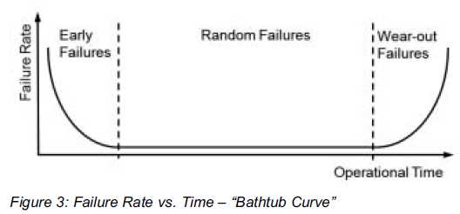
RISK ANALYSIS -
Risk Theory
What are some common root causes of pipeline failures?
Pipeline failure mechanisms are grouped into ‘Threats’
Threats have different mechanisms on how they affect a pipeline
Time dependent threats (corrosion or EAC)
Time independent threats (Outside forces – 3rd party or Weather)
Stable* threats (material defects after initial hydrotest)

Slide 4
RISK ANALYSIS -
Risk Theory
Interactive Threats?
Threats can interact to create a higher risk situation than each individual threat poses by itself.
Third Party <> External Corrosion
Third party damage to external coatings
Construction Practices <> Weather & Outside Forces
Girth joint weakness in the presence of ground movement
Inappropriate Operations <> Manufacturing
Inadvertent valve closure causing a pressure surge with LF ERW seam

Slide 5
RISK ANALYSIS -
Risk Theory - Algorithms
Tabletop
SME opinion, subjective and broad.
Qualitative
Relative (comparative); PoF and CoF are derived from informal assessment (e.g. High/Med/Low).
Semi-Quantitative
Combination of quantitative and qualitative.
Quantitative
Absolute (predictive); Probability of Failure (PoF) and Consequence of Failure (CoF) are derived from measured data and mathematical reasoning.
Probabilistic (stochastic)
Statistics-based; scenarios are represented by probability theory.
Deterministic (mechanistic)
Physics-based; a unique set of inputs yields a unique outcome.

Slide 6
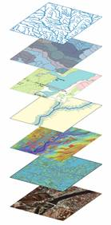
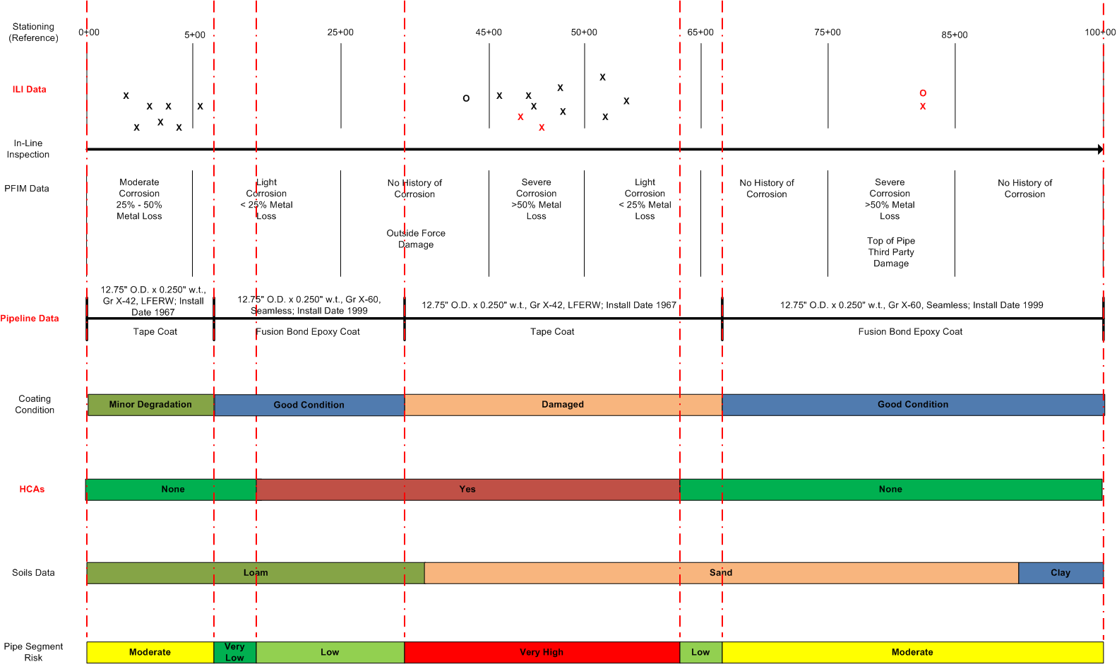
RISK ANALYSIS -
Risk Theory – Data Integration
Data Types & Integration
High Consequence Areas
Other Risk Model Results
Soil Corrosivity
Close Interval Survey
Elevation Profile
Pipe Design Data
Aerial Imagery
Assessment Results

Slide 7
Risk Analysis
Quantitative Risk

Slide 8
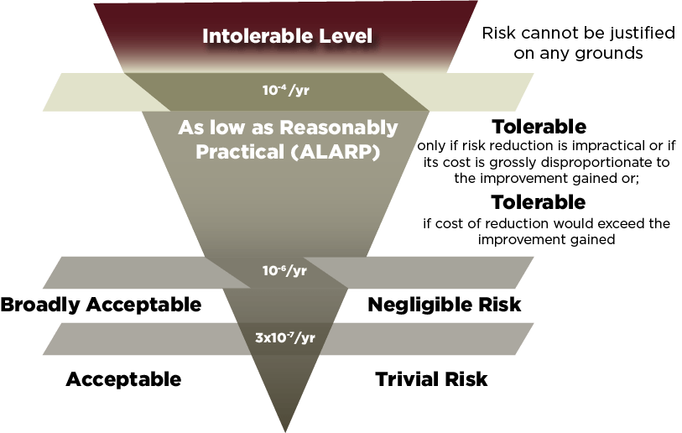
RISK ANALYSIS -
QUANTITATIVE RISK – PHMSA TECHNICAL INFORMATION DOCUMENT (Feb 2020)
Pipeline Risk Modeling
Overview of Methods and Tools for Improved Implementation
Pipeline and Hazardous Materials Safety Administration
February 1, 2020
The Pipeline and Hazardous Materials Safety Administration (PHMSA) is issuing this report to highlight the strengths and limitations for pipeline risk models, and to support improvements in Gas Transmission and Hazardous Liquid pipeline risk models. Based on the results of pipeline inspections and failure investigation findings, both the Department of Transportation’s PHMSA and the National Transportation Safety Board (NTSB) have identified general weaknesses in the risk models used by pipeline operators in performing risk assessments for their IM programs…

Slide 9
RISK ANALYSIS -
RISK & PROBABILITY
Probability of Failure
Transportation industry failure statistics
Absolute risk
Comparable to other pipelines
Can use Tier approach
Tier 1 = Unacceptable risk
> 1.0 x 10⁻⁴ (e.g. 1 in 10,000 mi/yr)
Tier 2 = High but tolerable risk
< 1x10⁻⁴ to > 1.0 x10⁻⁵
Tier 3 = Moderate but tolerable risk
< 1.0 x10⁻⁵ to >1.0 x 10⁻⁶
Tier 4 = Low and acceptable risk
<1.0 x 10⁻⁶

Slide 10
RISK ANALYSIS -
RISK & PROBABILITY
Mitigation Effectiveness (1-Probability)
Industry failure statistics
Performance measures of programs
Operator experience

Slide 11
Risk Analysis
Quantitative Risk Algorithms

Slide 12
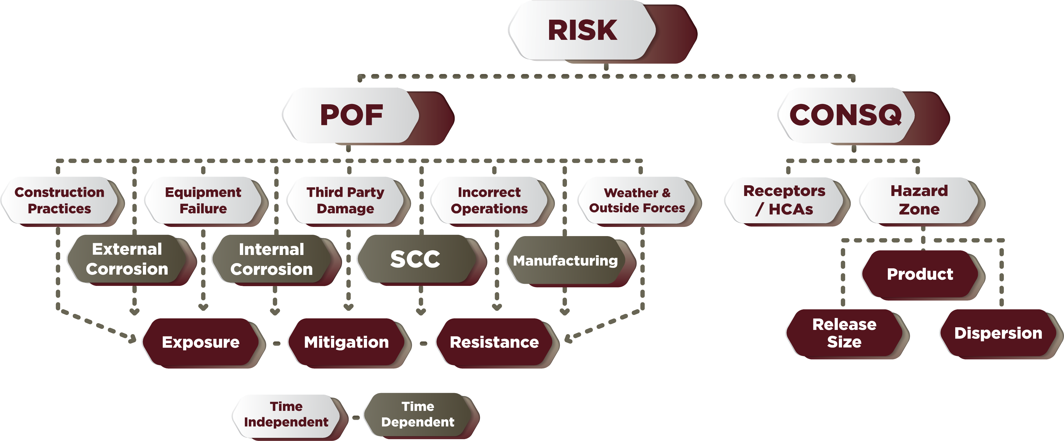
RISK ANALYSIS -
RISK DIAGRAM

Slide 13
RISK ANALYSIS -
THREAT IDENTIFICATION
Recategorize some threats (Time Dependent, Stable, Time Independent)

Slide 14
RISK ANALYSIS -
PFIM™ QUANTITATIVE RISK ALGORITHM (QRA)
Expected Loss → Product of Probability and Consequence
Expected Loss
Probability of Failure
Consequence of Failure
ALGORITHM COMPONENTS
Probability of Failure Threats (9) Consequence
Threat Exposure
(mpy or #/mi-yr))
1
Threat Resistance
(w.t. or %)
2
Threat Mitigation
(% mitigated)
3
Consequence of Failure
($/event)
4

Slide 15
PROBABILITY
OF FAILURE
Definitions:
THREAT EXPOSURE
THREAT MITIGATION
THREAT RESISTANCE
“Attack Rate” of force or failure mechanism reaching the asset when no mitigation is applied.
Actions that keep the force or failure mechanism off the asset.
The systems ability to resist a force or failure mechanism applied to the asset.

Slide 16
RISK ANALYSIS
QUANTITATIVE RISK ALGORITHM
(QRA)
EL = EXPECTED LOSS [$ / Year]
EL = POF x CONSQ
POF = PROBABILITY OF FAILURE [Failure Event / Mile * Year]
POF_{time_ind} = (Exposure)*(1 – Mitigation)*(1- Resistance)
Exposure = [Failure Events / Year] (unmitigated attack rate)
Mitigation = [% Effectiveness] (exposures prevented by mitigation measures)
Resistance = [% Effective] (exposures prevented by resistance)
POF_{time_dep} = 1 / TTF
TTF = Resistance / (Exposure x (1 – Mitigation))
TTF = Time-to-Failure [Years] (number of years to a failure of the pipe)
Exposure = [Mils / Year] (unmitigated attack rate)
Mitigation = [% Effectiveness] (exposures prevented by mitigation measures)
Resistance [mils] (applicable pipe wall thickness)
CONSQ = CONSEQUENCE OF FAILURE [$ / Failure Event]
CONSQ = (1-(1-Var₁)*(1-Var₂)*(1-Var₃)*…(1-Var_{N}))

Slide 17
PROBABILITY
OF FAILURE
The Math
POF = 1 – [(1 - EC) * (1 - IC) * (1 - SCC) * (1 - MFG) * (1 - CONS) * (1 - EQ) * (1 - TP) * (1 - IO) * (1 - WOF)]
What It “Means”
Uses Muhlbauer’s “OR Gate”
POF is the inverse time to failure from the “EC Threat” OR the “IC Threat” OR “SCC Threat” OR the “MFG Threat”….

Slide 18
Individual Threat Scores
INDIVIDUAL THREAT SCORES
The Math
TP = (Exposure) * (1 – Mitigation) * (1- Resistance)
What It “Means”
The EC threat score used in the POF calculation is the remaining threat after mitigation and resistance, OR the non-mitigated and non-resistant portion of the exposure from a threat.
-or-
EC = 1/TTF
TTF = Resistance / (Exposure x (1 – Mitigation))

Slide 19
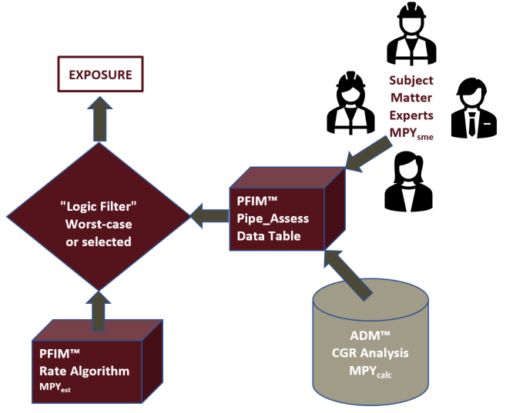
Pipeline & Facility Integrity Manager (PFIM™) Algorithm Development Approach – Exposure Determination
RISK ANALYSIS -
QRA Algorithm Basis –
Exposure “Rates”
Threat Exposure based on “Attack Rate(s)”:
Corrosion MPY (EC, IC)
Cracking MPY (SCC, MFG)
Events per Mile-Year (IO, EQ, CONS*, WOF*, TP*)
PFIM™ Algorithm will allow user to set “Logic Filters” to choose
Calculated (ADM™, SafeSeam™)
Estimated by “Rate” algorithm
SME Determined (Outside source or expert opinion)

Slide 20
Pipeline & Facility Integrity Manager (PFIM™) Algorithm Development Approach – CORROSION Exposure
RISK ANALYSIS -
QRA Algorithm Basis –
Exposure “Rates”
ADM™ Calculated corrosion growth rate(s):
Global
Joint to joint
Girth Joint to Girth Joint
Anomaly to anomaly
ILI Run on 16” x 0.250” wt. crude pipeline
2018 MFL
20% metal loss anomaly (0.200” remaining wt.)
2023 MFL
50% metal loss anomaly (0.125” remaining wt.)
75 mill loss over 5 years
75/5 = 15 MPY

Slide 21
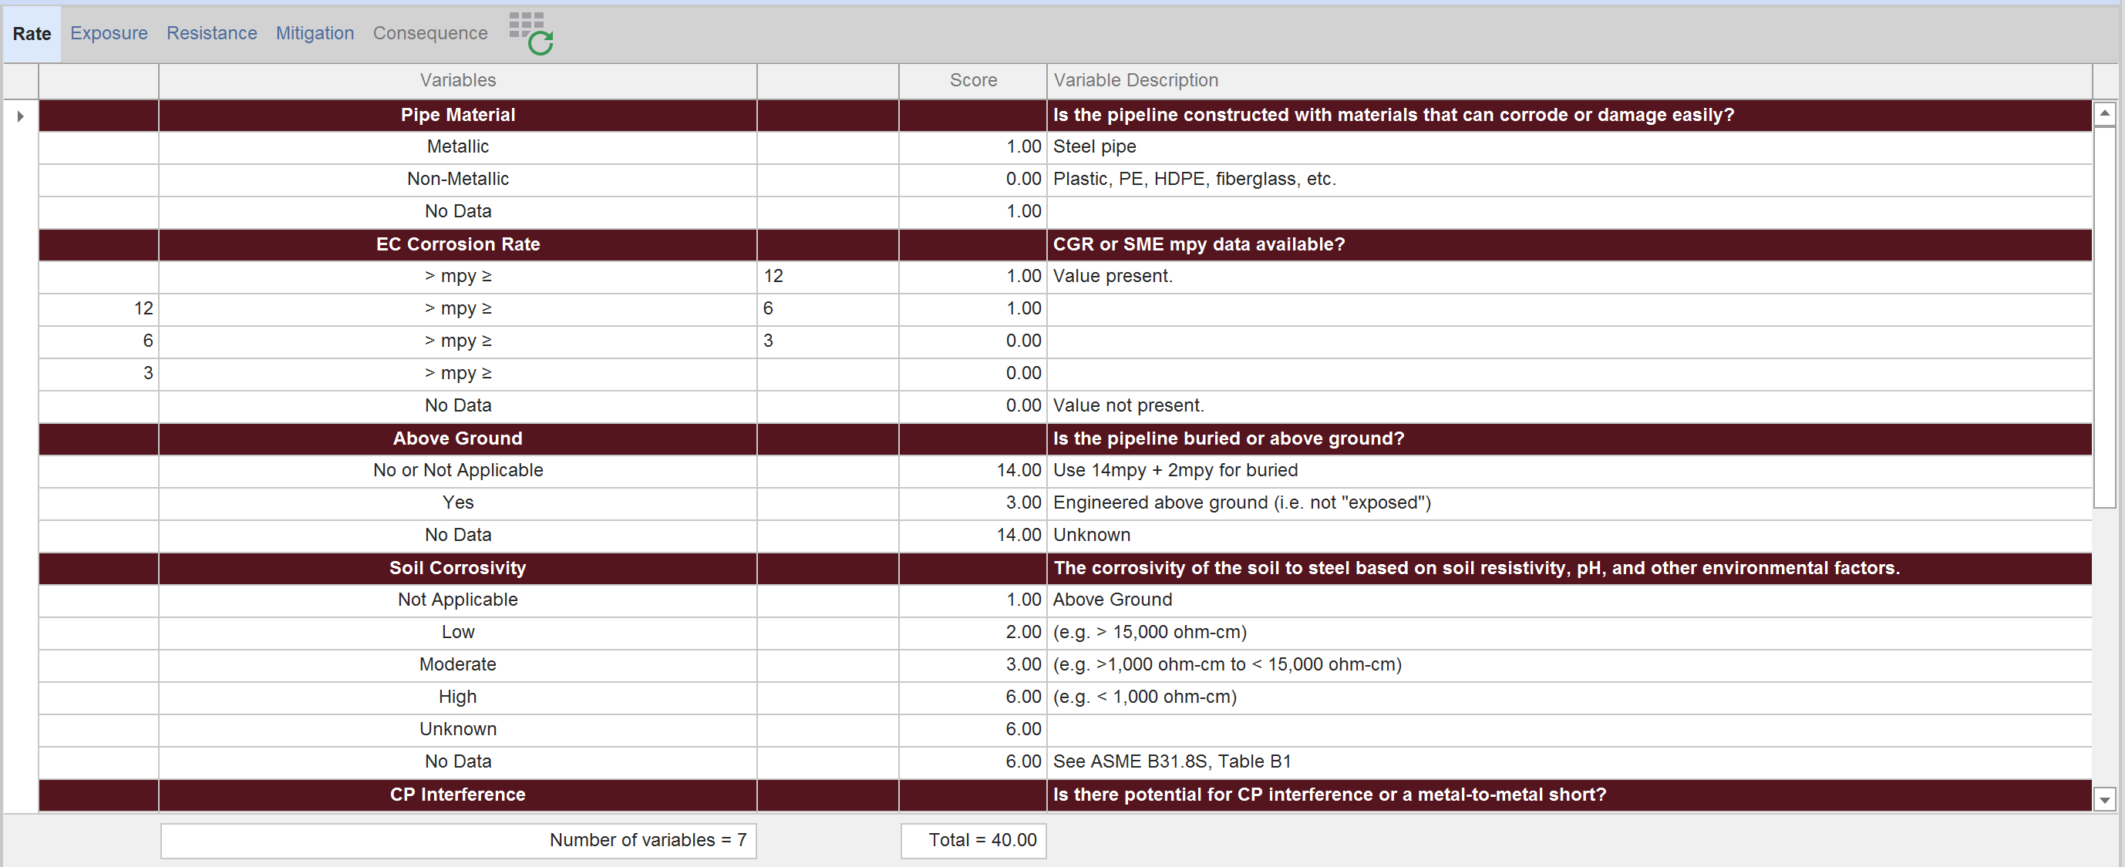
Pipeline & Facility Integrity Manager (PFIM™) Algorithm Development Approach – CORROSION Exposure
RISK ANALYSIS -
QRA Algorithm Basis –
Exposure “Rates”
PFIM™ Estimated corrosion growth rate(s):
Above / Below Ground (3mpy / 14mpy)
Soil Corrosivity (+1mpy to +6mpy)
CP Interference (+0mpy to +12mpy)
Stray Current (+0mpy to +4mpy)
Casing Shorted (+0mpy to +4mpy)

Slide 22
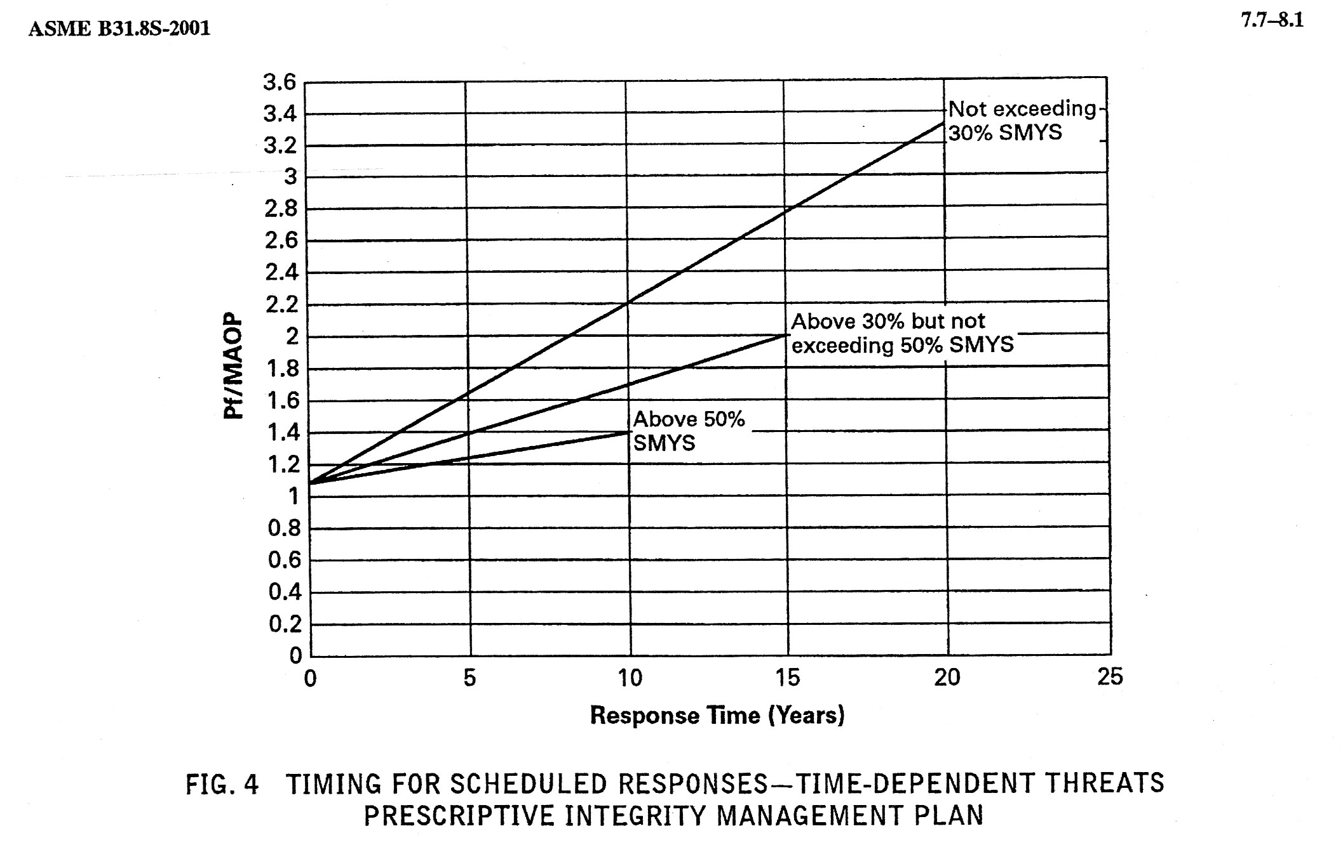




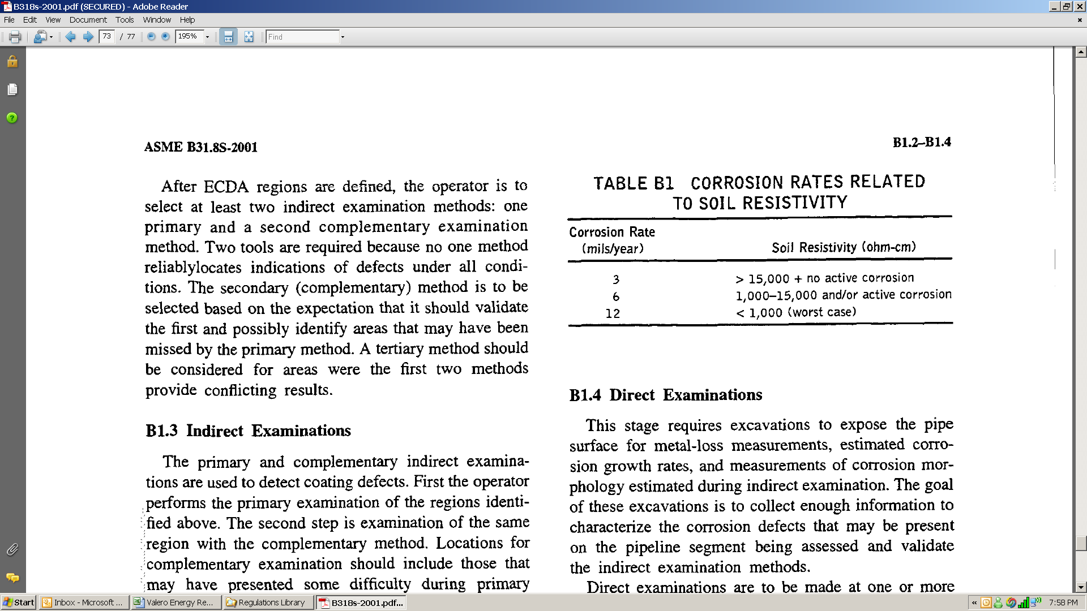
Pipeline & Facility Integrity Manager (PFIM™) Algorithm Development Approach – CORROSION Exposure
RISK ANALYSIS -
QRA Algorithm Basis –
Exposure “Rates”
PFIM™ Subject Matter Expert determined corrosion growth rate(s):
Industry Source Material (B31.8S, PRCI)
Soil Corrosivity (3mpy to 12mpy)
Other factors (+0mpy to +40mpy)
Subject Matter Experts
MPY_{sme}

Slide 23
Pipeline & Facility Integrity Manager (PFIM™) Algorithm Development Approach – CORROSION Exposure
RISK ANALYSIS -
QRA Algorithm Basis –
Exposure “Rates”
PFIM™ determined corrosion growth rate(s):
SME or Industry Source Material corrosion growth rate (B31.8S, PRCI)
Corrosion Growth Rate (CGR) calculation from ILI run to run matching
Estimated corrosion growth rate [(+0mpy to +40mpy)*(Exp%)]
ILI CGR = 5 mpy
SME (Hydro) = 12 mpy
Estimated (PFIM) = 8.5 mpy

Slide 24
Individual Threat Scores
RISK ANALYSIS - RESISTANCE
The Math
Resistance = 1 – [(1 – Variable R₁) * (1 – Variable R₂) *……..* (1 – Variable R_{n})]
What It “Means”
Uses Muhlbauer’s “or gate”
“Resistance” represents the amount of the exposure that is “resisted” based on the presence of resistance variable R₁ OR resistance variable R₂ OR resistance variable R_{n}

Slide 25
Pipeline & Facility Integrity Manager (PFIM™) Algorithm Development Approach – CORROSION Resistance
RISK ANALYSIS -
QRA Algorithm Basis –
Resistance “Values”
PFIM™ determined “effective” wall thickness:
SME or Industry Source Material value (B31.8S, PRCI)
Estimated Remaining Effective Wall Thickness calculation from ILI
Estimated value [Nominal pipe design = 0.250” wt)*(Res%)]
ILI CGR = 0.205” wt
SME (Hydro) = 0.175” wt
Estimated (PFIM) = 0.190” wt

Slide 26
Individual Threat Scores
RISK ANALYSIS - MITIGATION
The Math
Mitigation = 1 – [(1 - VariableM₁) * (1 – Variable M₂) *…….*(1 – Variable M_{n})]
What It “Means”
Uses Muhlbauer’s “or gate”
“Mitigation” represents the amount of the exposure that is mitigated from applying mitigation variableM1 OR mitigation variable M₂ OR mitigation variable M_{n}
Note: If multiple mitigations are applied, the mitigation increases, but asymptotically approaches 100% (so it is possible to have three 90% mitigations working together)

Slide 27
PFIM Risk Algorithm – Algorithm Definitions
Diminished cost-benefit
RISK ANALYSIS -
Mitigation – Diminishing Return (QRA)

Slide 28
Pipeline & Facility Integrity Manager (PFIM™) Algorithm Development Approach – CORROSION Exposure Example
RISK ANALYSIS -
QRA Algorithm Basis –
Time to Failure
EC (& IC) Threat = 1 / TTF
TTF = Res / (Exp*(1-Mit))
Where:
Res (WT) = 0.250” wt.
Exp (mpy) = 10 mpy
Mit (%) = 0%
TTF = 0.250 / (10*(1-0)) = 25 years to failure
Apply a 90% effective mitigation (e.g., Cathodic Protection)
TTF = 0.250 / (10*(1-0.9)) = 250 years to failure
Apply a second 90% effective mitigation (Combined 99%)
TTF = 0.250 / (10*(1-0.99)) = 2,500 years to failure
Apply a third 90% effective mitigation (Combined 99.9%)
TTF = 0.250 / (10*(1-0.999)) = 25,000 years to failure

Slide 29
Risk Analysis
Consequence

Slide 30
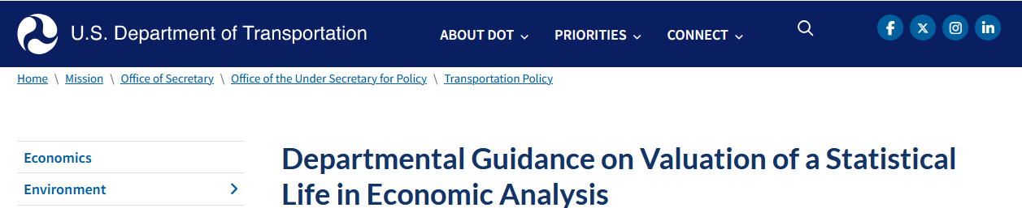
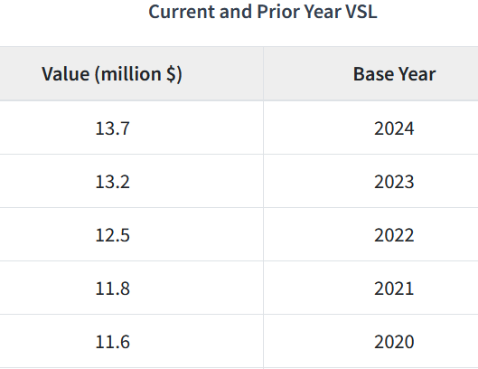
CONSEQUENCE
OF FAILURE
Definitions:
THREAT MITIGATION
IMPACT ON POPULATION
IMPACT ON ENVIRONMENT
IMPACT ON BUSINESS
The potential cost of a personal injury, impairment or loss of life (*VSL).
The potential cost of ecological or environmental damage.
The potential cost of public or business property damage, loss of operation or tarnished public opinion.
https://www.transportation.gov/office-policy/transportation-policy/revised-departmental-guidance-on-valuation-of-a-statistical-life-in-economic-analysis

Slide 31
Individual Threat Scores
CONSEQUENCE
OF FAILURE
CONSQ ($) = (IOP + IOE + IOB)*CONSQ Exp
CONSQ “Exposure”
Scores
IOP = Product Type * IOP Rate (i.e., VSL)
The Math
CONSQ Exp = (1-(1-Var₁)*(1-Var₂)*(1-Var₃)*…(1-Var_{N}))
IOE = Product Type * IOE Rate
IOB = Product Type * IOB Rate

Slide 32
Individual Threat Scores
EXPECTED LOSS
EXPECTED LOSS = POF * CONSQ
What it “Means”
The Math
Results in Dollars per mile per year ($/Mi-Yr)
Typical values ~$500/mi-yr
Values > $1,000/mi-yr may require risk reduction

Slide 33
Risk Prevention & Mitigation
“What If” Scenarios

Slide 34
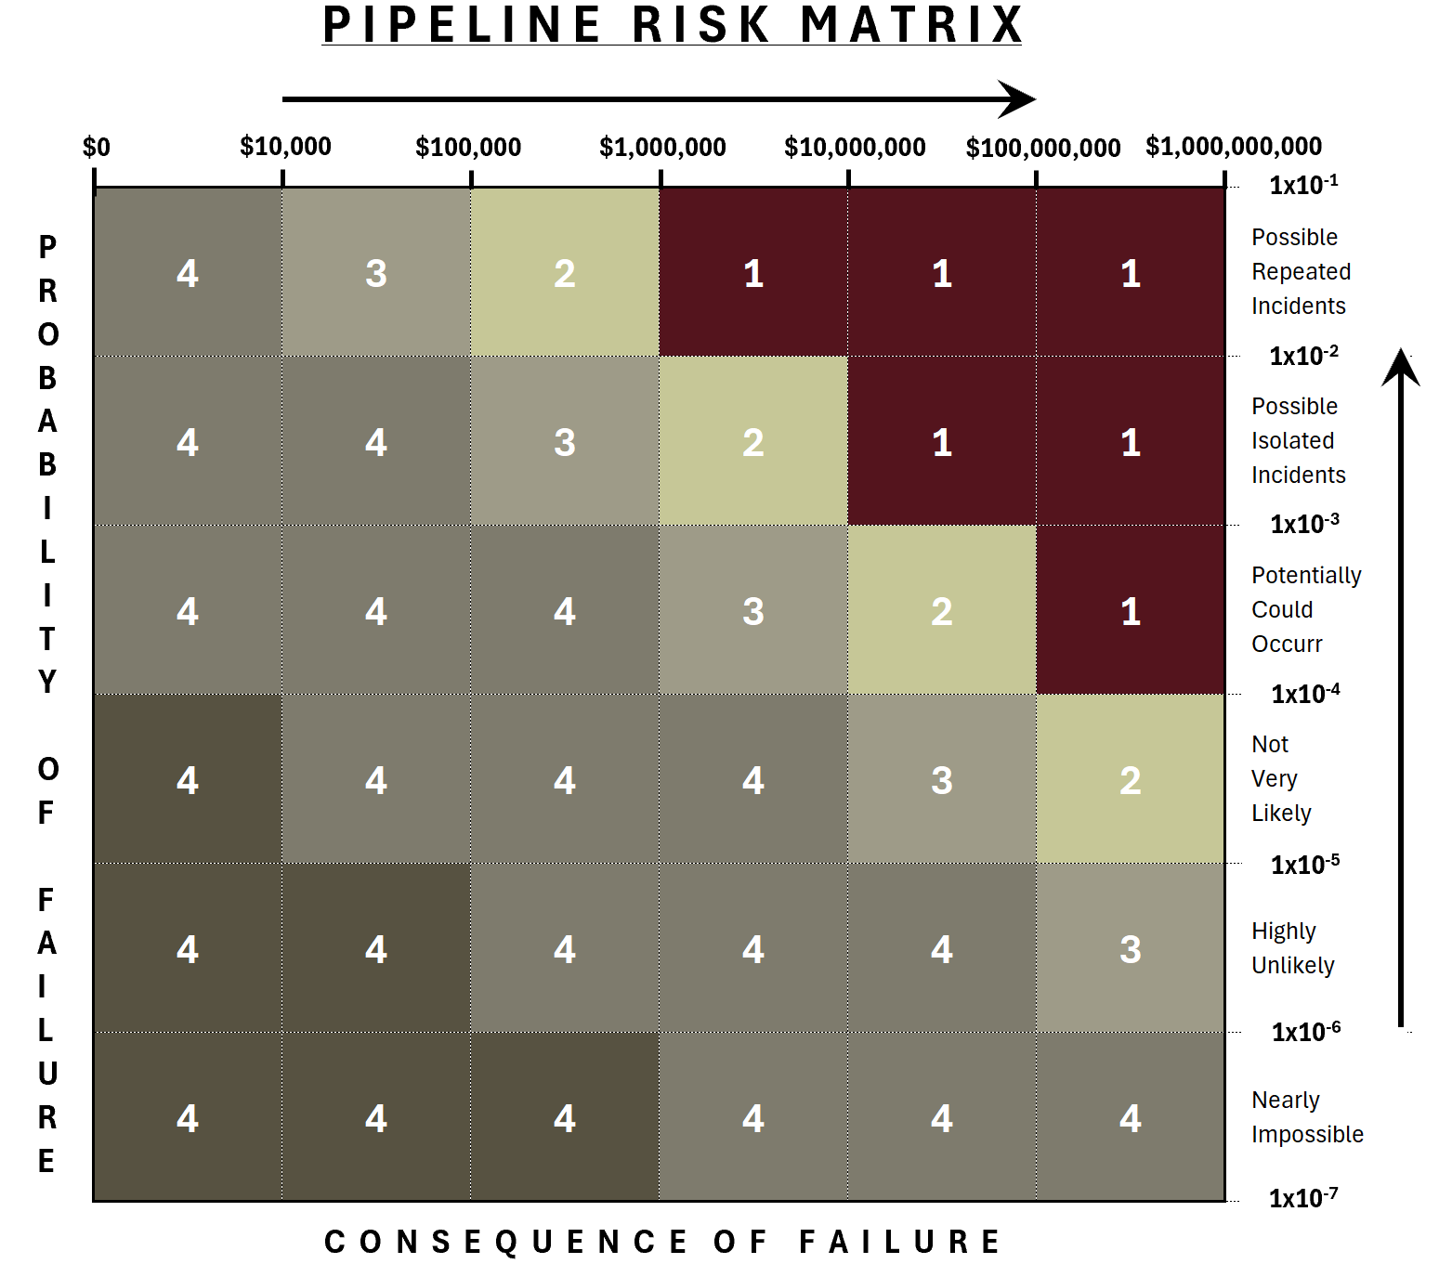
Probability vs Consequence – Ranking Matrix (Absolute Risk)
P&MMs-
POF vs CONSQ RISK MATRIX

Slide 35
Risk Reduction Scenarios
P&MMs-
What if scenarios

Slide 36
QRA Algorithm Enhancements
Data Mining & Machine Learning

Slide 37
Individual Threat Scores
QRA ENHANCEMENTS
Creating the Quantitative Algorithm:
The specific steps are:
Inline Inspection data is dynamically segmented with physical & external pipeline attributes, called variables, to create a “training” dataset.
The “training” dataset is submitted to the Data Mining Engine. A “prediction” variable is selected along with multiple “input” variables to be considered in the analysis.
The Data Mining Engine produces a “quantitative” algorithm using Bayes Theorem. The algorithm is in the form of a Decision Tree which consists of many Rule based relationships, called “affinity nodes”, along with the corresponding probability of the prediction variable.

Slide 38
Generate Probabilities
QRA ENHANCEMENTS

Slide 39
Generate Probabilities
QRA ENHANCEMENTS

Slide 40
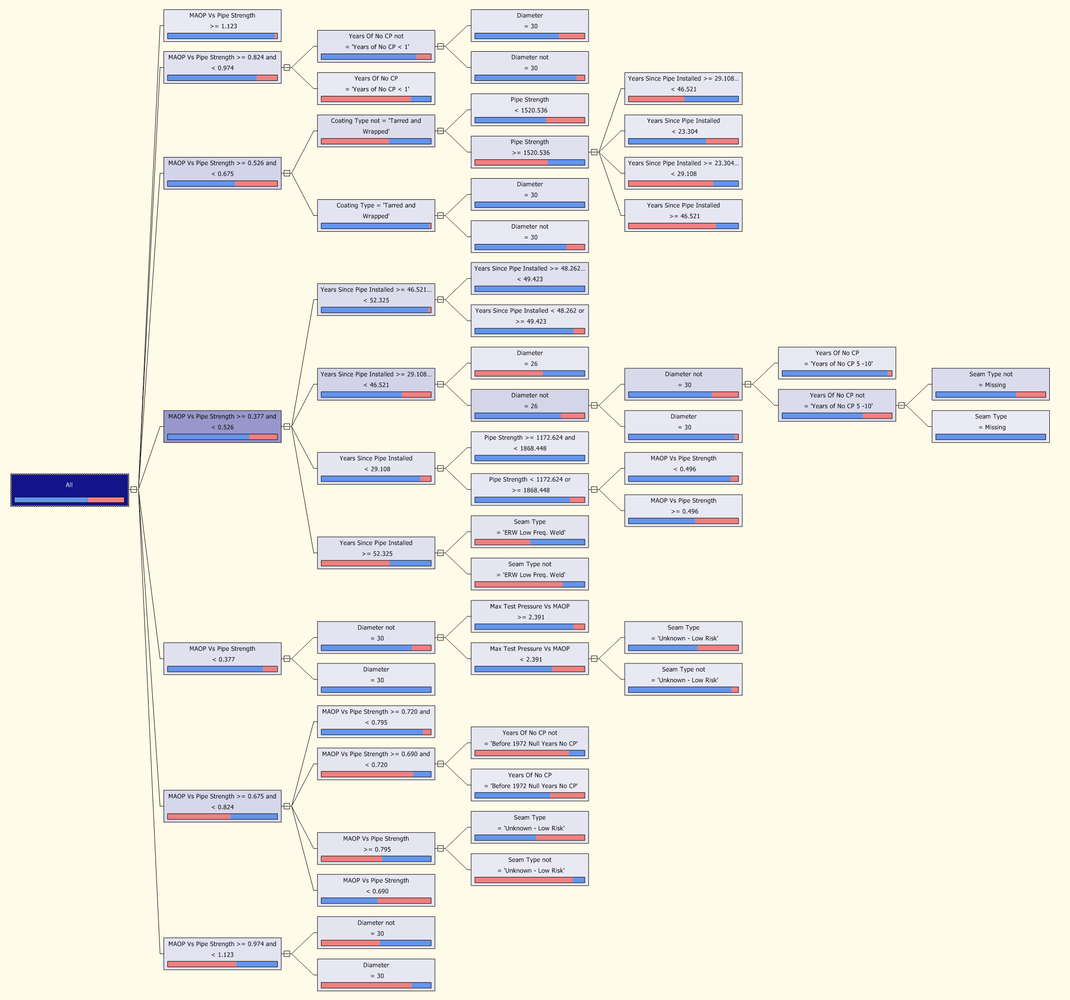
Generate Probabilities
QRA ENHANCEMENTS

Slide 41
QUESTIONS?

