Slide 1




Gas Meter Operation: Diaphragm and Ultrasonic for Design and Applications
Scott Henrich, Meter Valve & Control
August 2025
Notes:
Bring Candy, decks of cards, anybody know where the first US Gas Utility was
One of the things you might not have known and, and I love trivia that the very first gas utility in the United States was the Gaslight Company of Baltimore, founded in 1816. Back then they used a flat rate billing system, so that meant that everybody paid the same price no matter what, and you can imagine that the people who were more responsible if their usage didn't want to keep paying for people who are irresponsible for their usage.
And that picture actually represents what used to happen in the day.
Somebody would walk around and and wrap on the sidewalk to let people know when they should be turning out their lights to try to keep those costs down.
So again, you know, utilities had no way of accounting for who was using what and they had no way to account for theft or leakage.
Gas light trivia: Why are they called 20 lt, 30 lt, etc?
That is the number of lights the gas pipe could light.
Size of piping that can hold the quantity of the gas used based on the number and possibly the size of the light burners in the home
Thus the first gas meters developed were rated as “5 light”, “10 light”
Gas burner based on 6 cubic feet per hour

Slide 2
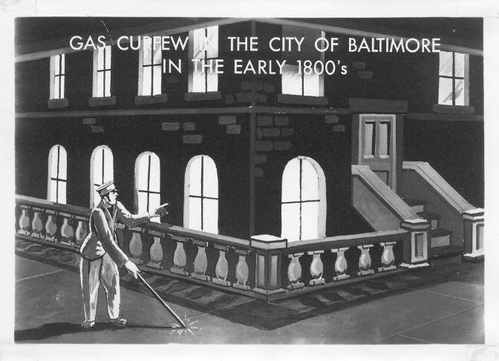
Beginnings of utility measurement
Founded in 1816, the Gas Light Company of Baltimore was first U.S. utility.
Used a “flat rate” billing scheme
Charged equally regardless of actual usage
Costs were high and users did not want to pay for other irresponsible end users
Utility had no way of accounting for theft or leakage
Notes:
Bring Candy, decks of cards, anybody know where the first US Gas Utility was
One of the things you might not have known and, and I love trivia that the very first gas utility in the United States was the Gaslight Company of Baltimore, founded in 1816. Back then they used a flat rate billing system, so that meant that everybody paid the same price no matter what, and you can imagine that the people who were more responsible if their usage didn't want to keep paying for people who are irresponsible for their usage.
And that picture actually represents what used to happen in the day.
Somebody would walk around and and wrap on the sidewalk to let people know when they should be turning out their lights to try to keep those costs down.
So again, you know, utilities had no way of accounting for who was using what and they had no way to account for theft or leakage.
Gas light trivia: Why are they called 20 lt, 30 lt, etc?
That is the number of lights the gas pipe could light.
Size of piping that can hold the quantity of the gas used based on the number and possibly the size of the light burners in the home
Thus the first gas meters developed were rated as “5 light”, “10 light”
Gas burner based on 6 cubic feet per hour

Slide 3
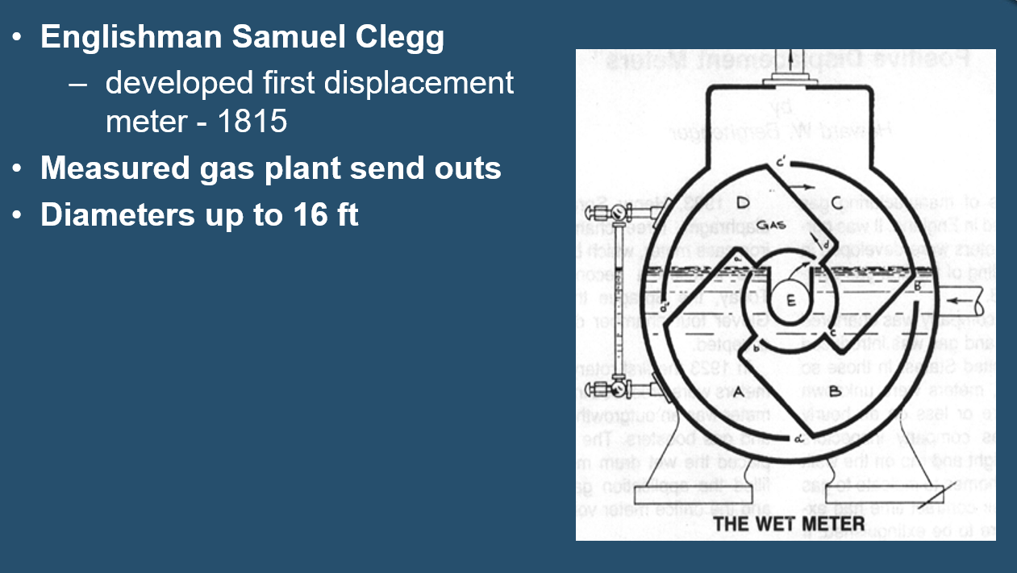
Beginnings of utility measurement

Slide 4
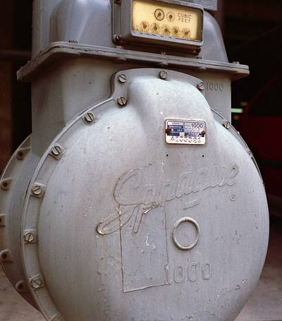
Gas measurement
1843 – First dry positive displacement meter by William Richards (later improved by Thomas Glover)
2 diaphragm, slide valve, 4-chamber
(1881 – Thomas Edison’s electric meter patented)
1903 – Sprague Meter Company patented
2 diaphragm, oscillating valve, 3-chamber
Changes in materials, construction, assembly and testing have improved the life expectancy and durability of the diaphragm meter.
Cast Iron Aluminum Alloy
Leather Diaphragms Synthetic Diaphragms
1973 – first industry standards established and published by ANSI
Notes:
Now that actually went on for about 30 years before the 1st dry positive displacement meter was invented by William Richards and later improved by Thomas Glover.
Both the 4-chamber and the 3-chamber designs are widely accepted.The principle operation of the Glover type meter has basically been mechanically unchanged since 1844, however many changes in materials, construction, assembly and testing have improved the life expectancy and durability of the diaphragm meter.
The diaphragms used today are fabric reinforced synthetic rubber and not leather made from sheep or goat skins That is when Henry Sprague got his two diaphragm oscillating Valve 3 chamber gas meter patented and he formed the Sprague Meter Company which first started operating out of Connecticut.Changes in materials constructions, assembly testing have, of course, improved life expectancy and durability, but really, you know, it went from
cast iron to aluminum alloys, went from leather diaphragms. I mean sheepskin and goatskin that used to create these membranes within these chambers to synthetic rubber reinforced rubber fabric, reinforced rubber, synthetic diaphragms.
Over 120 years ago is really this the basis and still being used today?
1973 that our industry had the first set of standards established, and there was published by ANSI, And until that time, you had all kinds of manufacturers providing you whatever they want to provide you.

Slide 5
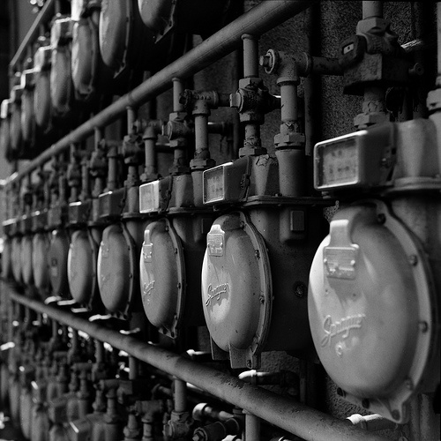
Diaphragm Technology
Oldest metering technology
Most widely used (still)
Design is:
Simple
Efficient
Relatively mechanically unchanged since the 1800’s.
Major improvements in materials, construction, assembly, and testing
Large Turndown
Long Useful Life
Physically large for capacity
Mechanical Reading
Notes:
Diaphragm meter technology is the oldest metering technology and “still” the most widely used.
I added the “still” to this slide because we know with the one millionth Intelis gas meter shipped this month (May 2023), that certainly the ultrasonic technology is becoming more prevalent in the residential market.
But as far as the installed base, diaphragm meters are still the most widely used technology.
The design is simple, it's efficient and as I said, relatively unchanged since the 1800s.

Slide 6
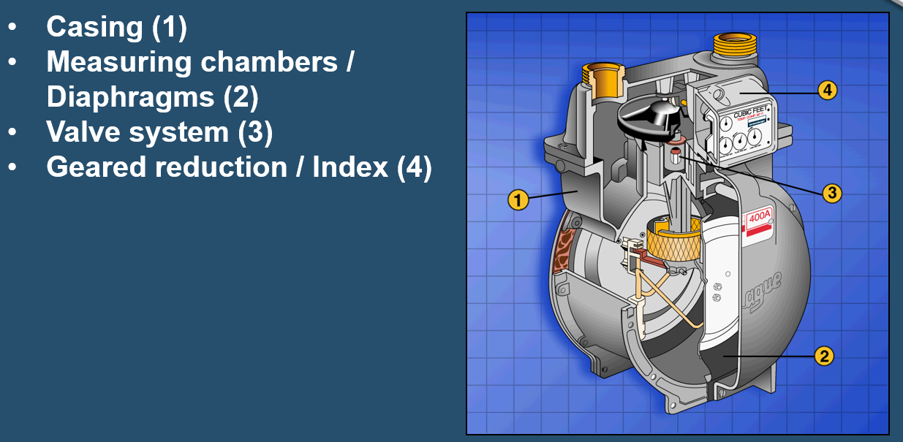
Diaphragm Construction/Operation

Slide 7
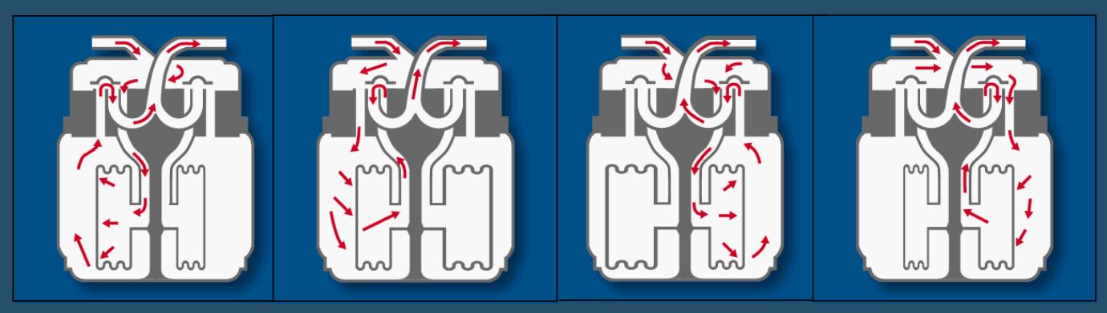
Diaphragm Construction/Operation
Notes:
Unlike inferential meters pd meters measure volume directly
Physical capture of discrete volume
Mech simulation to find total volume
Movement of meter is cyclical and repetitive
1 rev equals defined volume
Valves change direction of flow between measurement chambers
Meter revolutions counted by mechanical register
First chamber 1 is emptying, 2 fill, 3 is empty, 4 has just fille
1 is now empty, 2 is full, 3 is filling and 4 is emptying
1 filling/2 emptying/3 filled/4 empty
1 is full/2 empty/3 emptying/4 filling

Slide 8
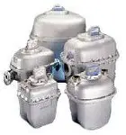
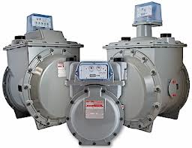
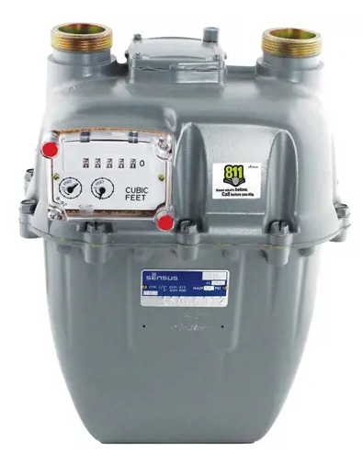
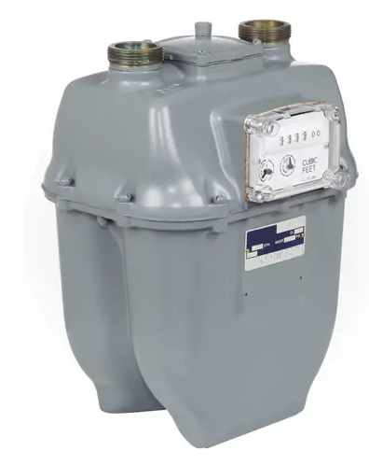
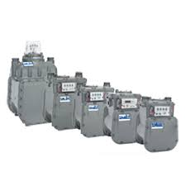
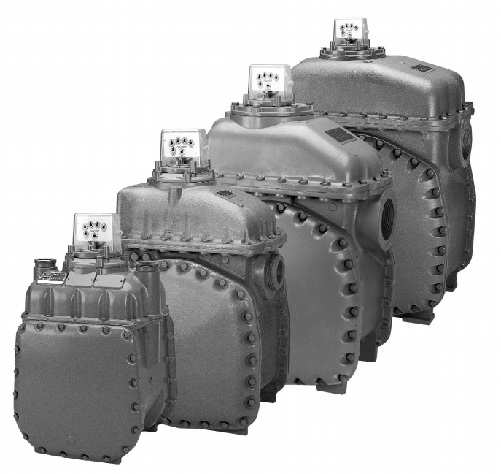
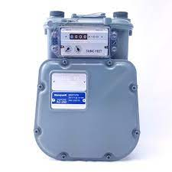
Size and Availability
Sensus
R-275
Sensus
R-415
Sensus
750/1000/1600/3000/5000/10000
Itron 250-400A-675A-800A-1000A
Honeywell
AC/AM/AT/AL-250
Honeywell 425/630/800/1000
Honeywell AL-1400/2300/5000

Slide 9
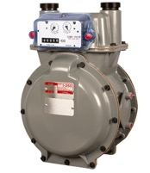
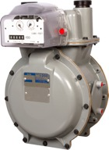
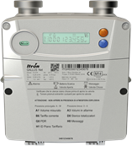
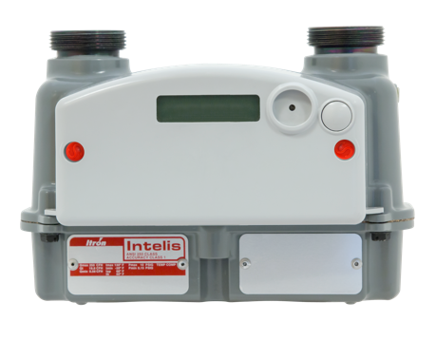
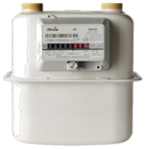
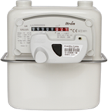



A NATURAL PROGRESSION TO THE ACTIVE GRID
Mechanical Gas Meter
with mechanical index
Mechanical Gas Meter
mechanical index with
clip on modules
Hybrid Gas Meter
gas meter with electronic index and integrated communication
Solid State Gas Meter
fully electronic sensor with integrated communication
Long ago!
1990’s
2010’s
2010’s
Notes:
Diaphragm-oldest metering technology, design is simple, efficient, unchanged for 70+ years, millions in service
Recap of Diaphragm to USM
Flat rate billing, 1843 fist gas meter,
late 80s first communication module, remote reading, datalogging, alerts and alarms, communication,
2010 first meter with LCD index, asset tracking,
2019-Intelis introduced,

Slide 10
Ultrasonic gas meters have been around for decades
- used in Japan since the 1970’s
Their use in residential applications has more recently seen exponential growth in North America
- more than 3 million shipments since introduced in April 2019
- more than 1 million shipped in the last year alone
Lack of industry standards prevented some utilities from implementing
- ANSI B109.6 Single Path Ultrasonic Gas Meters (Under 1400 Cubic Feet Per Hour Capacity) was released January 2024 by AGA
Ultrasonic meters now, or soon to be available, from
Itron Honeywell/American Meter
Sensus Landis+Gyr
Pietro Fiorentini
Notes:
Numbers above are just for Itron, higher if add additional vendors (although not much)
Enhancements in technology, battery life, ANSI std
Exponential increase in sales,
Our industry follows electric industry in many aspects, has been solid state for quite some time, water and gas are finally making the transition.

Slide 11

Principle of Operation
Transducer B
Δt = t_{BA} - t_{AB}
Transducer A
Ultrasonic wave pulse (frequency>20kH) is generated in a transducer (A). The pulse goes trough the pipe, and then received and measured by another transducer (B).
The time of travel of the acoustic wave from point A to point B (t_{BA}) is not the same that from the point B to the point A (t_{AB}), which generate a delay (Δt). This difference is due to the flow stream inside the pipe: the higher is the flow velocity, the greater is the difference. Knowing the distance between the two transducers and the travel time difference, the volume flow rate is calculated.

Slide 12

Benefits of Ultrasonic Meters Over Diaphragm Meters
Notes:
Who knows a benefit of USM?

Slide 13
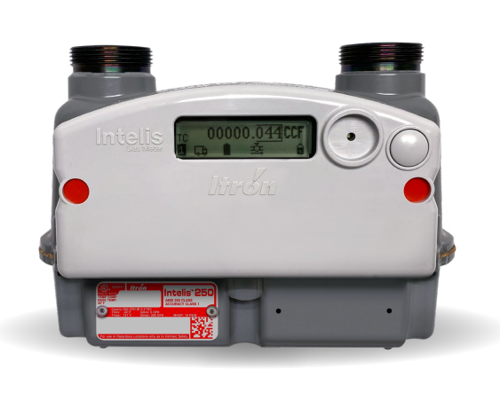
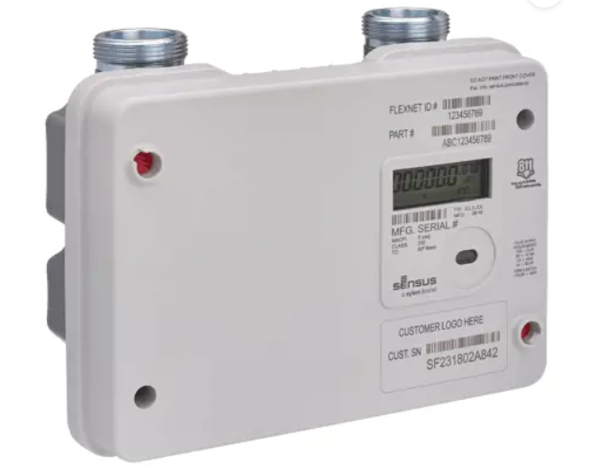
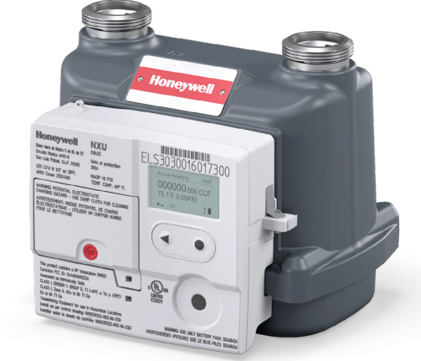
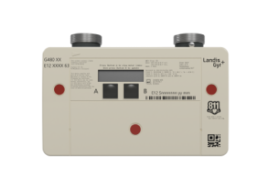
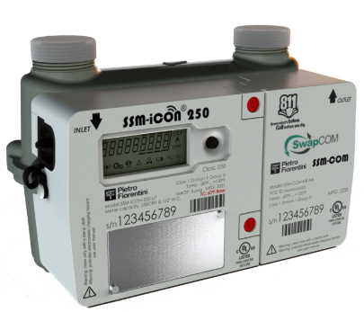
Benefits of Ultrasonic Meters over Diaphragm Meters
Accuracy
Size
Streamline Asset Tracking
Integrated Radio
AMR or AMI Programmable
Integrated Additional Functionality
Notes:
Accuracy over time, no moving parts, wear and tear, sturdy
Built in AMR/AMI
Additional Features we will get into
Max Flowrate, identify undersized meters
Excess Flow
Fire Detection
Seismic
Regulator Performance Monitoring
Theft

Slide 14
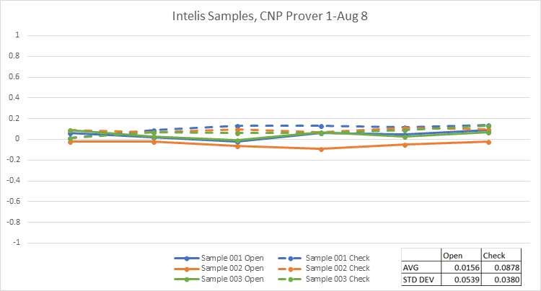
Accuracy
Ultrasonic meters have no moving parts compared to diaphragm meters
This results in a flatter, more accurate accuracy curve over flow rates
They also have a tighter standard deviation than diaphragm meters
Some manufacturers meet Class 1 Accuracy of +/- 1% over operating temperature and +/-0.5% at room temperature
Notes:
Data from CenterPoint prover Aug 8, 2018.
Itron meets this accuracy spec
Travel with it, gets banged up at TSA, every time I prove it within 0.3%
TC for diaphragm versus USM, metal band expands and contracts,
Leaving factory at 0.0 not slow or fast.
Electronic temp sensor instantaneously ready to roll, no leaving meters in proving room for a day or more?

Slide 15
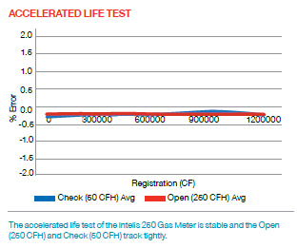
Accuracy - Accelerated Life Test
ANSI B109.6 requires ALT of +/- 2% after “2,000 times the capacity flow rate per hour” of the meter
Note that diaphragm meter spec ANSI B109.1 requires 4,000 times or 1M CF
Data shown at right shows this to 1.2M CF
Do not see long term drift in accuracy which is common with diaphragm meters
Benefit is long term accuracy to meet sampling plans
Notes:
Data from CenterPoint prover Aug 8, 2018.
Itron meets this accuracy spec
Accuracy does not fall off over time
Ansi b109.1 is 4000 x
Itron measures to 4000x or 1mill cf and there is no dropoff.

Slide 16
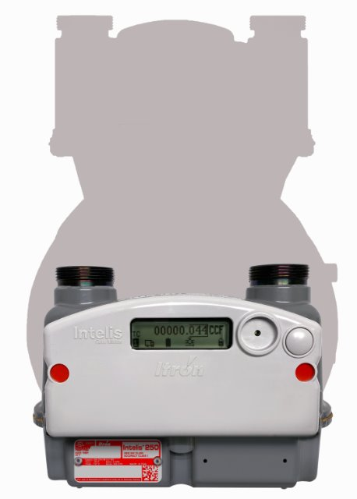
Size
Move from mechanical to solid state allows for 70% size reduction of residential meter
Weight now 4.35 lbs
Improved ergonomics for meter installers
Less soft tissue injuries
Can get 180 meters per pallet vs 46 for diaphragm meter
Reduces warehouse space
Reduces transportation costs
Notes:
1/3 of the size for 250 class
Durability

Slide 17
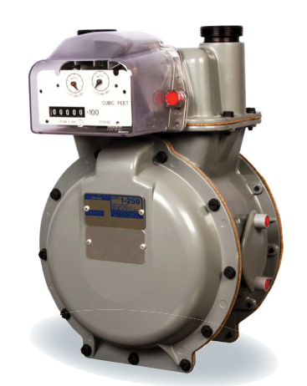
Streamline Asset Tracking
When diaphragm meters are field retrofitted with an AMR/AMI gas module, you end up with 2 assets with a different life span
You may have a new gas module on an older meter and need to replace the meter before the 20 year life of the gas module expires
Or you may have to replace the gas module before the life of the diaphragm meter has expired
This increases complexity of managing changeouts
Ultrasonic meters come with built in AMR/AMI gas modules that offer a full 20 year life for all components, including batteries and require no servicing
Replace meter within 20 year life
Notes:
Diaphragm meter with ert is 2 assets, difficult to track, 1 20 year life for meter and ert,
Battery alarm lets them know within 2 years of EOL

Slide 18
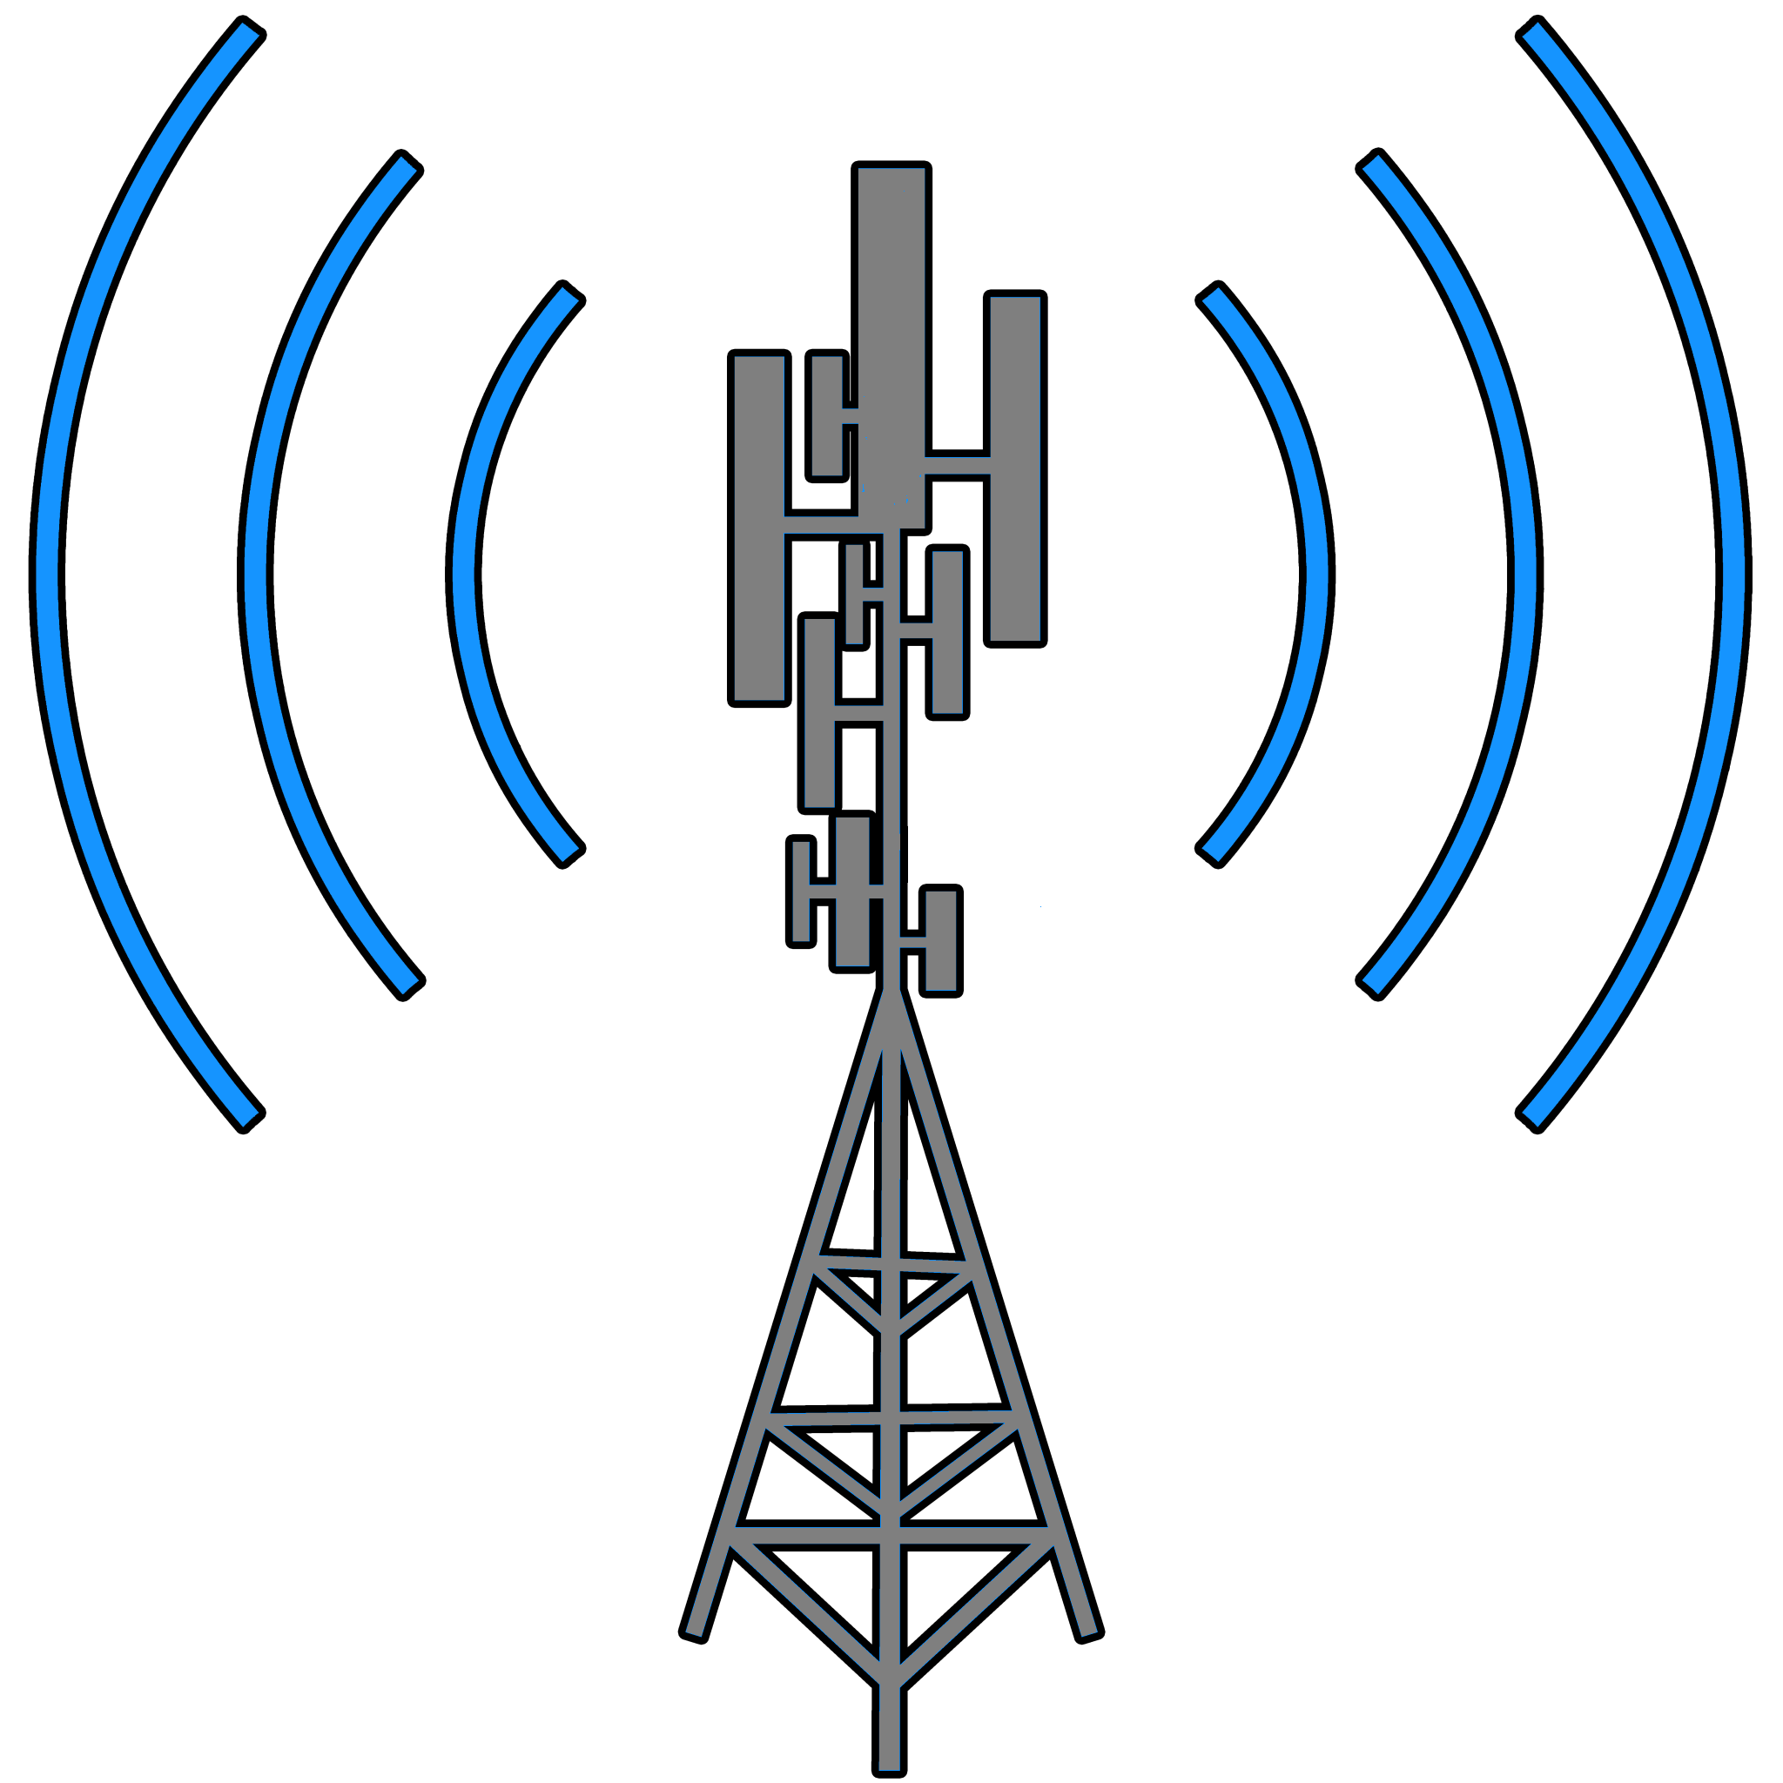

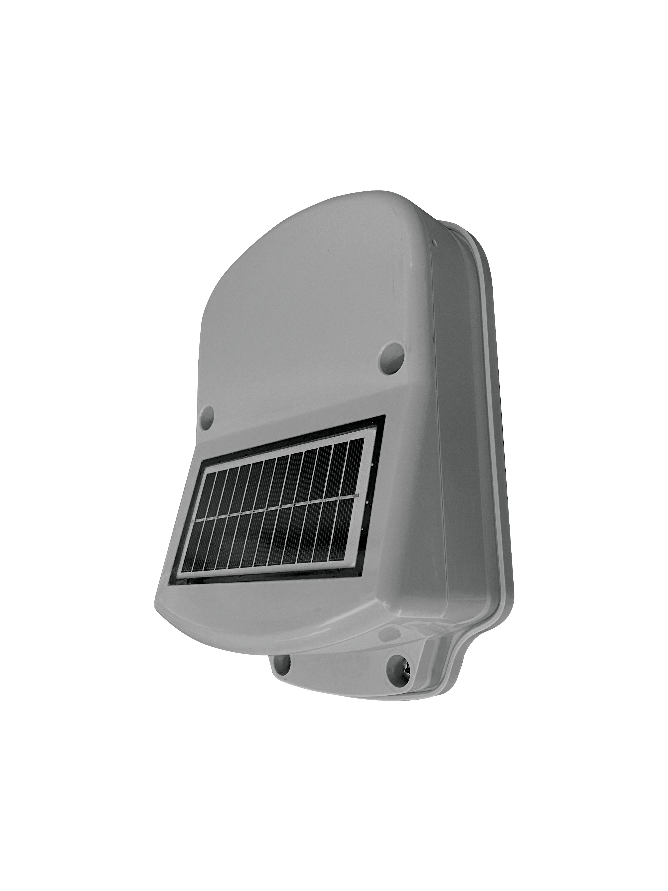

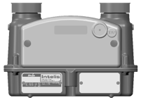




Integrated Radio - AMR or AMI Programmable
Other Utility Applications
CIS/MDMS
WAN
UIQ Itron Headend
LTE Wireless Network
Solar
Battery AP
Gas/Water Only Areas
Combo / Existing Mesh Areas
Intelis
500G
500G
Cellular
Intelis
Cellular
500G
500G
500G
Intelis
Intelis
Intelis
500G
Mobile Collection Applications
Intelis
500G
500G
Mobile Collector
Notes:
Network – all this functionality can be ready reads 3 different ways,
Electric or street light canopy, RF mesh, dense areas
Cellular for remote
Gas Mesh,
Perfect combo is a mesh/cell
Can be programmed to AMR mode for mobile or handheld meter reading
Can be programmed to AMI mode with various options for reading
- Gas can be read through electric meters or street light canopy
- Gas can be read directly by the network
Gas can be read through other battery powered devices (gas or water) and reads brought back through Solar Battery Access Point (SBAP)
Or gas mesh

Slide 19
Solar Battery AP Overview
Innovating a Battery Powered Mesh Network
Solar Powered Access Point enabling a battery powered mesh for network connectivity
Battery Powered Access Point that mounts on utility owned assets…no joint use agreements
Battery mesh technology that delivers connectivity resiliency while maintaining 20-year life
Field Area Network
Average of ~25-35 devices/Battery AP, initial support for up to 50 (meter room use case)
Communicates with GenX battery devices (500G/W/Intelis/500M)
Life designed for 20 years
Minimizes the overall Total Cost of Ownership
Utilizing standard 500G/W and Intelis Gas modules, lowering project capital cost
One cellular takeout point for up to 50 devices minimizes cellular O&M costs
Enables Itron’s partner ecosystem of technology solution providers (i.e. Methane, RTUs, EVCs)
Provides utilities the full flexibility to deploy in AMR and graduate to AMI at the speed of value
Solar Battery AP
In development:
Available on Gen5 / UIQ (Verizon, coming in Q1, 2025)
Notes:
Battery mesh, gas only mesh, install on gas piping
25-30 meters to one solar AP

Slide 20
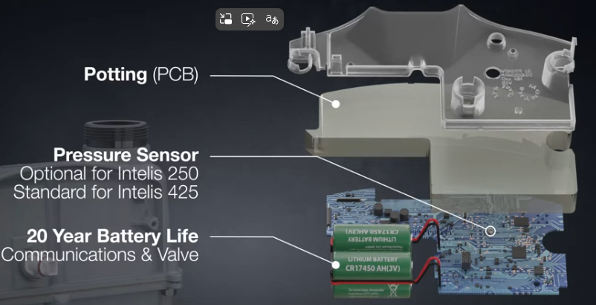
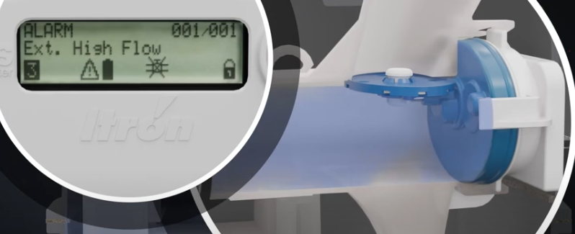
Integrated Sensors
Pressure Sensor
Real time pressure
Alert on high and low pressure
Temperature Sensors (External and Internal)
Real time temperature
Alert if temperature exceeds a certain value
Flow Sensor
Real time flow rate
Alert if exceeds threshold
Detect in air in pipe
Detect reverse flow
Notes:
Low set at 3.5”wc
16-18” wc high set point
Lock up 3” above set
Relief at 7”
above set
Temp sensors, 1 for gas, 1 for ambient (fire)
Speed of sound detected

Slide 21
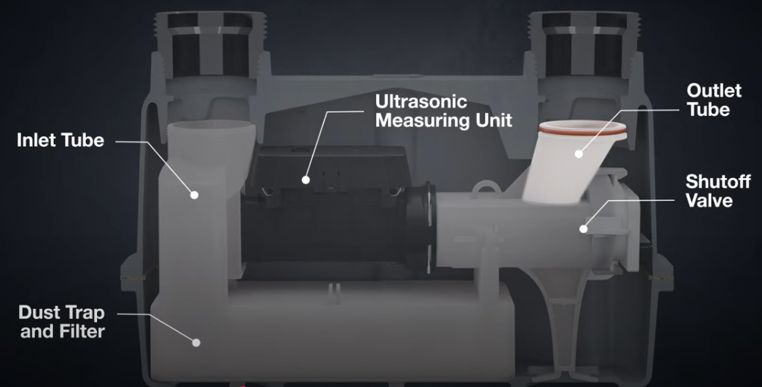
Integrated Shutoff Valve
Shutoff Scenarios
High Flow Alarm
High Temperature Alarm
High Pressure
Customer Smelling Gas
Non-Payment
External Sensors(examples include methane and flood)
Notes:
6 ways to shutoff, high flow at double capacity
Double the rate
180 deg F for fire
Below 2 psig, so set at 1 psig
Customer smelling gas

Slide 22
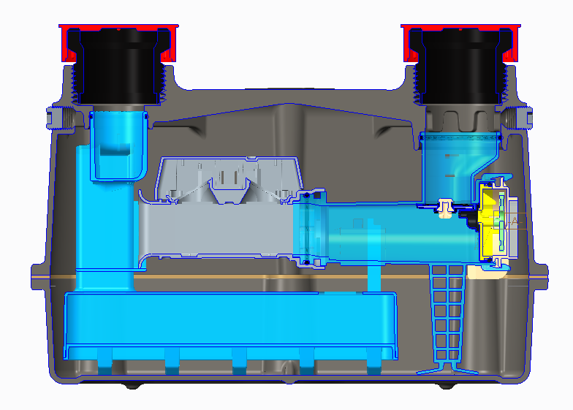
Autonomous Disconnect
The valve can be programmed to close automatically, without utility intervention, regardless of whether reading in AMR or AMI mode
Here the valve is on the outlet of the meter and is shown in the closed position
Safety feature for
High flow due to open fuel line downstream of the meter
High temperature due to fire
High pressure due to regulator issue or system being subjected to high pressure
Notes:
You don’t need a network to use these features, high flow, high pressure

Slide 23
New safety benefits
DISTRIBUTED INTELLIGENCE
High Flow Alarm
Triggers auto safety shutoff in meter without utility intervention
Benefits Mobile & Network users for open fuel line downstream of the meter (EFV)
High Temperature Alarm
Triggers auto safety shutoff in meter without utility intervention
Benefits Mobile & Network users due to high temp such as fire
Homeowner calls utility due to smelling gas
Network users can send command to close the valve benefiting homeowner, employee and community at large
Mobile users can close the valve from a distance before investigating benefiting employee safety
Non-Payment – Utility Worker Safety!
- Mobile and Network users can temporarily shut off gas
Notes:
Identify over/undersized meters

Slide 24
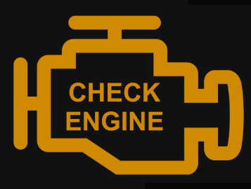
Diagnostics
Notes:
Built in diagnostics
Instant notification
Eliminate statistical sampling

Slide 25
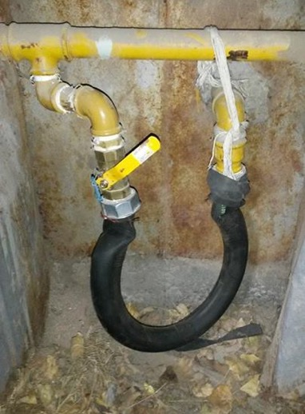
Additional benefits
Theft/Safety
- Air detection alarm for meter removal
- Reverse flow alarm (network only)
Lightweight & Compact 4.5# Meter
- Improve your customer satisfaction with aesthetics
- Reduce worker injuries such as soft tissue
- Reduced footprint for warehousing & shipping
Primary & Secondary Index
- Allows for comparison between TC and NTC volume
- Secondary Index available via FDM and network
Flowing Gas Temperature
- Available via LCD, FDM and network
Quiet Class 1 Meter
- Improved accuracy and customer satisfaction due to no moving parts
Notes:
Anybody ever seen something like this? Red neck Mcgyver
Built in air sensor
Ferris Buellers day off alarm, reverse flow, did not work out for Cameron, won’t work for customer
Two indexes whether you order TC or not
Live pressure and temp available
Anybody ever heard a loud diaphragm
Better Data for System Modeling
Seismic
Regulator Performance

Slide 26
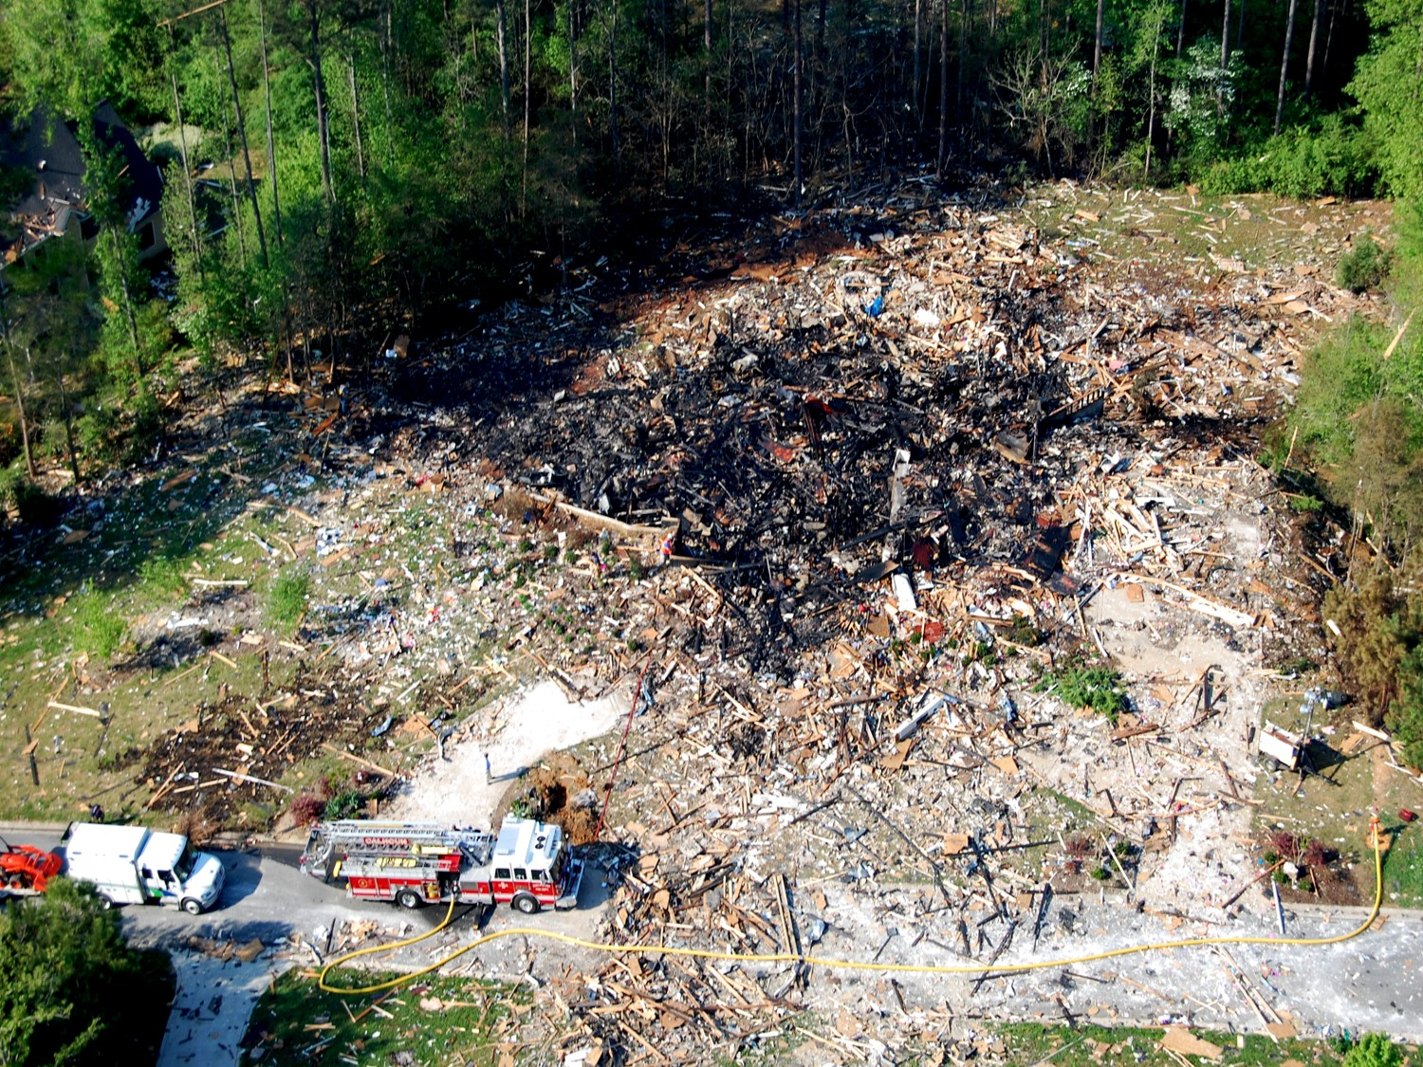
Smart Meters can prevent this!
April 15, 2010
Calhoun, GA
Nearly 60 homes damaged
7 hours of high flow peaking at 2,422 CFH
A smart meter would have shut off after ~15 seconds of seeing 500 CFH and explosion would not have occurred
Notes:
High flow incident, 10 times rated capacity
Guy tried to blow up his house,
Itron ert installed, saw the consumption, no payout required

Slide 27
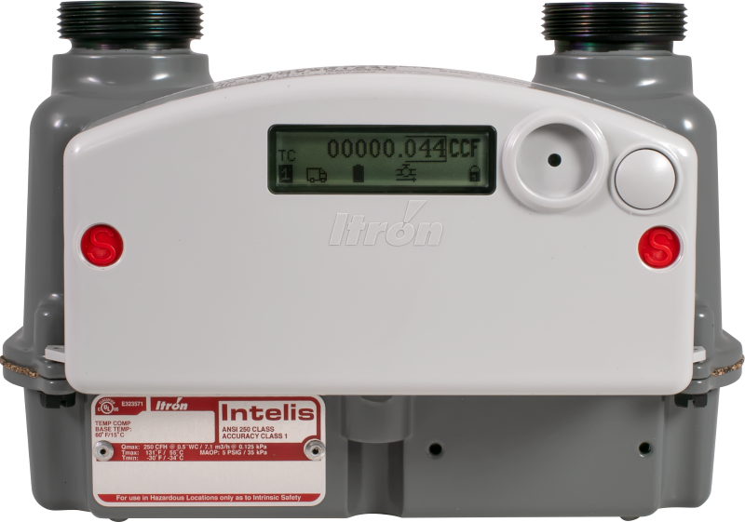
A METER IS NO LONGER JUST A METER
Consider what Connected Metrology Delivers
Consumer Safety
Workforce Protection
Distribution Integrity
Operational Savings
Revenue Assurance
Customer Satisfaction
Notes:
No longer just a meter
Shutoff valve gives consumer safety, distribution safety,
Revenue assurance with theft detection and accuracy,
Workforce is lightweight,
Operational savings, 1 truckroll every 20 years, remote shutoff
Customers like the LCD, smaller footprint, safety

Slide 28
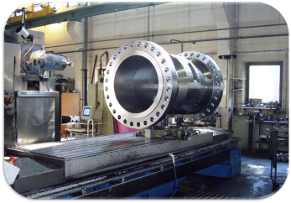
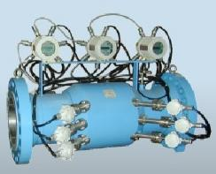
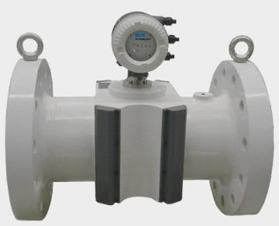
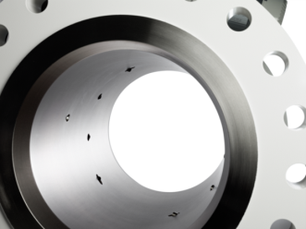
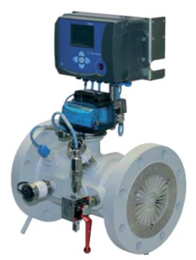
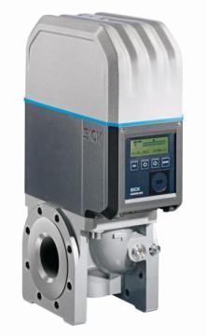
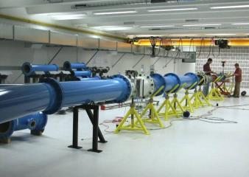
Innovative German Engineering
Accepted competitor product
SICK innovation
2004
2013

Slide 29

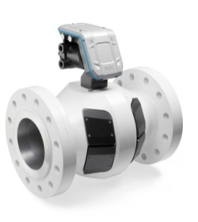
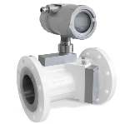


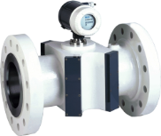


Product Protfolio Ultrasonic
SICk flow solutions for Oil and gas market
Upstream
Midstream
Downstream
Production
Gas gathering
Transmission
Distribution
Residential
FLOWSIC30
FLOWSIC100 Flare FLOWSIC600 DRU
FLOWSIC600(XT)
FLOWSIC300
FLOWSIC500
Gas production
Flare gas
Natural gas & Process industry
Natural gas distribution

Slide 30
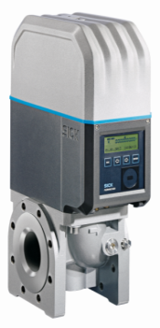

DIV04 Product portfolio
FL500 - Application
Natural gas distribution
Transfer and measuring stations for municipal and regional gas suppliers
Measuring stations of industrial and commercial applications
Applications where continuous gas supply must be ensured

Slide 31




FLOWSIC500
Device variants
Meter sizes:
2” 5.5M285
3” 14M285
4” 23M285
6” 35M285
6.75”
6.75” | 9.5”
9.5” | 11.81”
17.75”
35… 5,650 ft³/h
88… 14,150 ft³/h
141… 23,000 ft³/h
141… 35,300 ft³/h
ANSI CL150 | flat face - smooth finished | aluminum

Slide 32



DIV04 Product portfolio
FLowsic500 - Design
U-turn
Flow
conditioning
Metering
section

Slide 33
Thank You
Notes:
I would recommend that you start testing and getting them approved as diaphragm meters are phased out.
Tantalus

Slide 34


Slide 35
See How Ultrasonic Meters Operate
https://youtu.be/YYUr50_T-rs

Slide 36


Gas Distribution Safety
A solution for rapid identification and response to gas safety incidents
Integrates data and alarms from Intelis meters, sensors, and third-party sources into a centralized monitoring hub with management tools for rapidly responding to safety events from the back office
Use Cases:
Rapid awareness of gas disconnect to improve customer service
Identify systematic events associated with a given facility or distribution line
Shut-off downstream service in response to upstream problems
Proactively respond to severe weather, wildfires, natural disasters
Alarm Monitoring Dashboard:
High-Flow
High-Temperature Alarm
High-Pressure Alarm
Low-Pressure Alarm
Air-In-Pipe Alarm
Response Management Tools:
Remote disconnect
Valve status
Notes:
Now that you have all these features what do you do with it, how do you manage it?
Give you the ability to look at distribution system as a whole and react accordingly
One more thought, leak testing, USM reads down to 0.01 cf

Slide 37








Alarm Management Workspace
Icon Library
Intelis Alarm Icons (Single event per meter)
High Temperature
High Pressure
Low Pressure
High Flow
Air-In Pipe
Intelis Event Icons (Numerous alarms on same premise/pipeline)
High Temperature
High Pressure
Low Pressure
High Flow
Air-In Pipe
External Events (Can be entered into GDS via UI or External System)
Gas Explosion
Gas Leak
Notes:
These are how the alarms look on the mapping software

Slide 38
Integrated Additional Functionality

Slide 39
Distribution Saftey

