Slide 1

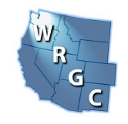

“What Will Happen Next?”
Pipeline Safety Reauthorization
and PHMSA Priorities
Chris McLaren
Executive Consultant, RCP Inc.
PROFESSIONAL ENGINEERS | REGULATORY EXPERTS | TRUSTED PARTNERS

Slide 2


Agenda
Changes at PHMSA
PHMSA Advisory Bulletins
Rulemakings and Priorities
NTSB Investigations and Reports
PROFESSIONAL ENGINEERS | REGULATORY EXPERTS | TRUSTED PARTNERS

Slide 3

Changes at PHMSA
PROFESSIONAL ENGINEERS | REGULATORY EXPERTS | TRUSTED PARTNERS

Slide 4
A New Administration with New Priorities
Trump 47: Focus on Deregulatory Activities
“Ensuring Lawful Governance and Implementation of the President’s ‘DOGE’ Deregulatory Agenda” (Executive Order 14219, February 19, 2025).
“Unleashing Prosperity through Deregulation” (Executive Order 14192, January 31, 2025) – “10-to-1”.
DOT RFI: “Ensuring Lawful Regulation; Reducing Regulation and Controlling Regulatory Costs” – published April 3, 2025.
Proposed Name Change: Gulf of Mexico to Gulf of America – published May 20, 2025.

Slide 5
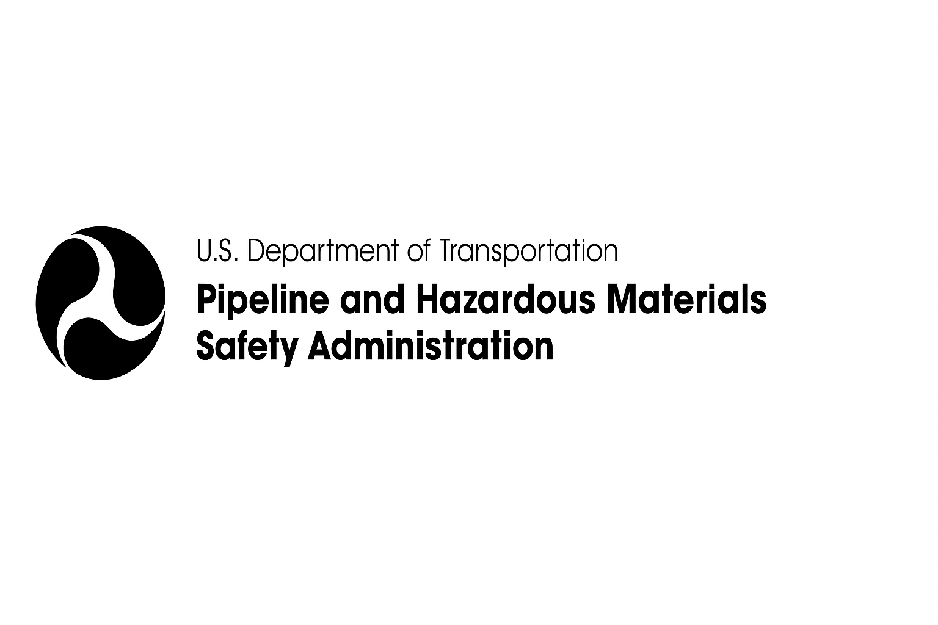
Personnel Changes at PHMSA
Secretary of Transportation - Sean Duffy, Confirmed
PHMSA Administrator - Paul Roberti, Nomination Process
PHMSA Deputy Administrator - Ben Kochman, Confirmed
PHMSA Chief Counsel - Keith Coyle, Confirmed
PHMSA Director of Governmental, International, and Public Affairs - Emily Wong, Confirmed

Slide 6
PHMSA Actions
Launched new website for interpretation comments.
  More stakeholder input & transparency.
Streamlining the special permit process.
Shifting enforcement focus away from minor/non-safety issues.
Accelerating the GPAC process.
Issuing more early-stage rulemaking notices (ANPRMs).
  To better define risk & scope.
Goal: Act faster, reduce waste, and complete agency priorities.
Notes:
Stood up new website for commenting on PHMSA Interpretation requests
Seeking more input from affected stakeholders
Creating transparency
Working to streamline special permit process
Amending enforcement process to curtail enforcement on peripheral issues with no bearing on pipeline safety (e.g., small documentation errors)
Improving GPAC process to be sped up and streamlined
Issue more Advanced Notices of Proposed Rulemakings:
Seek to better understand risks and parameters of proposed rule early in process
Overall, PHMSA wants to move more quickly, cut waste, and ensure that all agency priority items are completed

Slide 7
Administration is Focused on Deregulation
Unconstitutional
Unlawful Delegation
Poor Reading of Underlying Statute
Unauthorized Social / Political / Economic Impact
Significant Costs
Impedes Technology
Impedes Private Enterprise
Cost Reduction
Ineffective
Outdated
Poor Performing
Siting / Permitting Barriers
Unnecessary Info Collection
Simplify
Outdated Technology
Poor Methodology in Rulemaking

Slide 8

Rulemakings and Priorities
PROFESSIONAL ENGINEERS | REGULATORY EXPERTS | TRUSTED PARTNERS

Slide 9
July 1st - Federal Register Notices
To further the Administration’s deregulatory policies, PHMSA has published in the Federal Register twenty-eight (28) separate rulemaking actions affecting the pipeline safety regulations (PSR; Parts 190-199).
You may access the documents from the following link:
https://www.federalregister.gov/documents/current#pipeline-and-hazardous-materials-safety-administration.

Slide 10
July 1st - Federal Register Notices
Notice of Proposed Rulemaking
Rationalize Special Permit Conditions
Exception for In-Plant Piping Systems
Codify Enforcement Discretion on Incidental GG Lines
Eliminating Duplicative Deadlines for Gas Pipeline Coating Damage Assessments and Remedial Actions
Atmospheric Corrosion Reassessment for Pipeline Replacements
Harmonize Class Change Pressure Test Requirements with Subpart J Pressure Test Requirements
Direct Final Rules
Rationalize Calculation of Regulatory Filing and Compliance Deadlines
Adjust Annual Report Filing Timelines
Property Damage Definition for Incident Reporting
Clarifying Recordkeeping Requirements for Testing in MAOP Reconfirmation Regulation
Integration of Innovative Remote Sensing Technologies for Right-of-Way Patrols on Gas and Hazardous Liquid Pipelines
Periodic Updates of Regulatory References to Technical Standards; Additional Technical Amendments; Response to Petition for Reconsideration
Update of Standards Incorporated by Reference (16)
Notes:
The following standards are addressed in this effort:
API 6D
API 1170 and 1171 UNGS
API 620
API 2026
ASTM A53/A53M etc. (gas and liquid)
ASTM A381 (gas and liquid)
ASTM F2145
ASTM F2600
ASTM F2767
ASTM A578/A578M
ASTM F2817
ASTM F2945
ASTM F1973

Slide 11
PHMSA Regulatory Agenda
Advanced Notice of Proposed Rule Making - ANPRM
Repair Criteria for Hazardous Liquid and Gas Transmission Pipelines | 2137-AF44
Amendments to Liquefied Natural Gas Facilities | 2137-AF45
Mandatory Regulatory Reviews to Unleash American Energy and Improve Government Efficiency | 2137-AF73
Notes:
PHMSA is publishing this advance notice of proposed rulemaking to solicit stakeholder feedback on potential opportunities to improve the cost-effectiveness of its repair requirements for gas transmission and hazardous liquid or carbon dioxide pipelines. PHMSA also seeks stakeholder feedback on authorizing a risk-based approach for determining the inspection interval for in-service breakout tanks. Comments on this ANPRM must be submitted by July 21, 2025.

Slide 12
PHMSA Regulatory Agenda
Proposed Rules - NPRM
Oil Spill Response Plans, Accident Notifications, Inspections and Investigations and other Miscellaneous Pipeline Safety Changes (issued April 16, 2020) | 2137-AF37
Pipeline Operational Status (not yet issued – on hold) | 2137-AF52
Safety of Gas Distribution Pipelines and Other Pipeline Safety Initiatives (not yet issued – on hold) | 2137-AF53
Safety of Carbon Dioxide and Hazardous Liquid Pipelines (not yet issued – on hold) | 2137-AF60
Cost Recovery for Siting Reviews for LNG Facilities (not yet issued – on hold) | 2137-AF61
Administrative Rulemaking Regulatory Procedures (not yet issued – on hold) | 2137-AF63

Slide 13
PHMSA Regulatory Agenda
Final Rule Stage – Next Step is issuance of Final Rule
Class Location Requirements | 2137-AF29
Coastal Ecological Unusually Sensitive Areas | 2137-AF31
Periodic Standards Update II | 2137-AF48
Gas Pipeline Leak Detection and Repair | 2137-AF51

Slide 14
Regulatory Watch: Key Dates & Deadlines
Topic | Deadline Type | Date
Onshore Gas Transmission: Develop and follow a Management of Change process from ASME/ANSI B31.8S, Section 11 for “significant changes that pose a threat to safety or the environment” | Implementation Deadline | February 26, 2024
Breakout tank reporting to NPMS | Implementation Deadline | June 15, 2024
Gas Transmission: Assessments Outside HCAs § 192.710 | Implementation Deadline | July-1,-2034
All Liquid HCA segments are capable of ILI § 195.452(n) | Implementation Deadline | July 2, 2040

Slide 15

PHMSA Advisory Bulletins
PROFESSIONAL ENGINEERS | REGULATORY EXPERTS | TRUSTED PARTNERS

Slide 16
Recission of ADB–2021–01 (Section 114)
PHMSA rescinded the ADB on methane emissions from Section 114 of the Pipeline Safety Improvement Act of 2020.
The agency determined that the bulletin overstepped the statutory language of Section 114, particularly by:
Applying to facilities not transporting natural gas.
Introducing new, undefined terms not found in law or regulation (ie. Fugitive and vented emissions)
Notes:
As a result, PHMSA and state regulators no longer have ABD-2021 as a reference point when reviewing O&M procedures. That said, many operators may find that the practices adopted since 2021, such as enhanced leak detection and changes to venting and blowdown procedures, have become routine. Operators are not required to rollback those changes, but operators may choose to adjust procedures now that the ABD has been formally withdrawn.

Slide 17
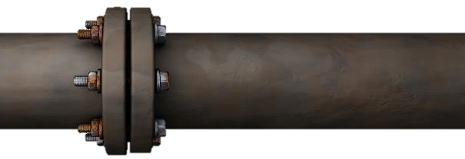
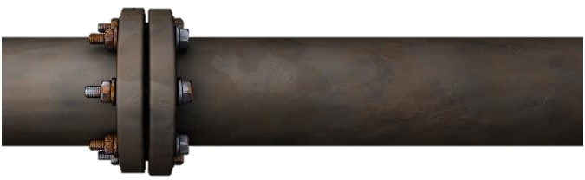
Recent PHMSA Safety Advisory Bulletins
ADB 2025-01 – Pipeline Safety: Pipeline Safety Management System, Published March 25, 2025.
  Fulfills a Congressional mandate from Section 205 of the PIPES Act of 2020.
  Addresses a Safety Recommendation from the NTSB.

Slide 18
ADB 2025-01 – PSMS
PHMSA encourages regulated pipeline owners and operators to:
Implement a PSMS program and ensure that the program covers all essential elements of an effective PSMS, such as those in API RP 1173.
Ensure the PSMS program continually evolves and improves.
Maintain a positive safety culture that continually promotes diligence throughout the operator’s organization and addresses issues that can erode the safety culture.
Encourages of adoption of PSMS as a voluntary exercise.
Notes:
Per PHMSA’s August 2024 Report to Congress, weakest PSMS elements for process maturity were: Safety Assurance, Management Review & Continuous Improvement

Slide 19
ADB 2025-01 – PSMS
Reflected findings in PHMSA’s August 2024 Report to Congress:
  289 operators whose leadership have committed to implementing a PSMS operate 86% of all gas distribution pipeline mileage.
  Most larger operators reported their PSMS efforts to be “on track” for completion.
Per PHMSA’s August 2024 Report to Congress, the weakest PSMS elements for process maturity were:
  Safety Assurance (Element 6)
  Management Review & Continuous Improvement (Element 7)
Continued..
Notes:
Per PHMSA’s August 2024 Report to Congress, weakest PSMS elements for process maturity were: Safety Assurance, Management Review & Continuous Improvement

Slide 20
Recent PHMSA Safety Advisory Bulletins
ADB 2024-01 Pipeline Safety: Identification and Evaluation of Potential Hard Spots— In-line Inspection (ILI) Tools and Analysis
Published October 18, 2024
Hard spots could affect multiple pipelines manufactured prior to 1970.
PHMSA recommends the use of magnetic flux leakage (MFL) ILI tools and following best practices for ILI data analysis.
Unaddressed hard spots may contribute to Coating degradation, Soil chemistry interaction and Hydrogen-induced cracking.
Pipeline owners and operators should expand hard spot threat evaluations to all pre-1970 pipelines, regardless of manufacturer.
Notes:
Susceptibility comes from the plate and pipe manufacturing and is broader than previously understood. Recent data and incident investigations indicate that hard spots could affect multiple pipelines manufactured prior to 1970. Operators need to identify what pipelines have the threat of hard spots. Most categorize this under “manufacturing.”
PHMSA encourages regulated pipeline owners and operators to collect and analyze data associated with hard spot magnetic flux leakage in-line inspection tools and follow industry best practices when conducting in-line inspection data analysis.
Hard spots, if not identified and mitigated, pose a threat to the integrity of the pipeline from interacting threats such as coating degradation, soil chemistry, and/or increased hydrogen exposure, which can result in hydrogen induced cracking.
Pipeline owners and operators should consider expanding their hard spot threat evaluation to all pipe manufactured prior to 1970, regardless of manufacturer.
Run a residual field MFL – however, they are only currently available for 16”-48 single diameter lines and a few select dual diameter lines.

Slide 21

NTSB Investigations and Reports
PROFESSIONAL ENGINEERS | REGULATORY EXPERTS | TRUSTED PARTNERS

Slide 22
NTSB Investigations and Reports
The National Transportation Safety Board is active
Currently 9 open investigations
NTSB Findings and Recommendations affect Pipeline Safety Regulations
Investigations
  https://www.ntsb.gov/investigations/Pages/Investigations.aspx
Reports
  https://www.ntsb.gov/investigations/AccidentReports/Pages/Reports.aspx

Slide 23
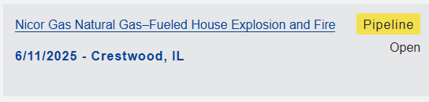
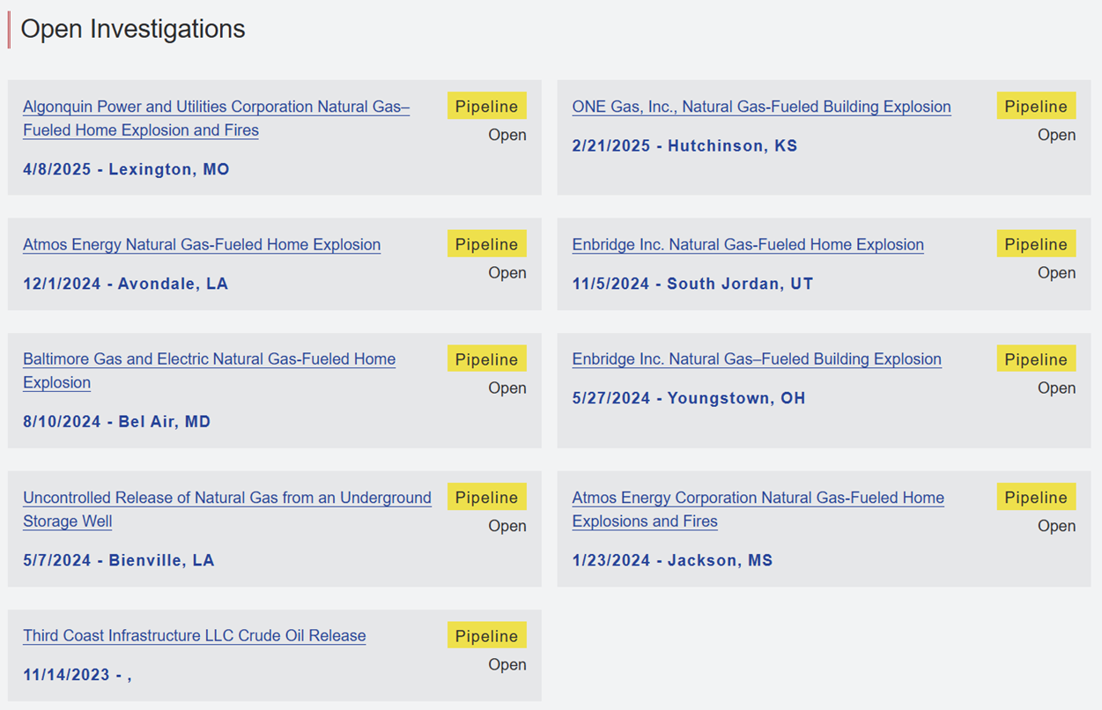
NTSB Open Pipeline Safety Investigations

Slide 24
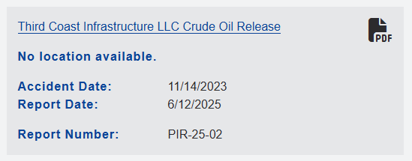
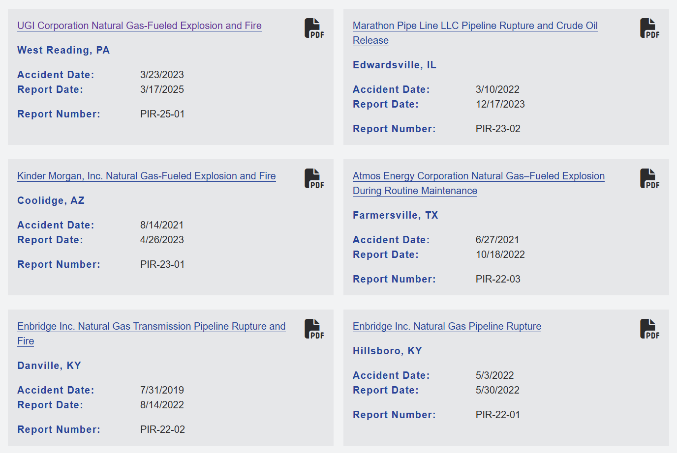
NTSB Investigation Final Reports (Recent)

Slide 25
NTSB Investigation in Reading, Pennsylvania
Incident Date: March 24, 2023 Location: R.M. Palmer Company, Building 2
Event: Natural gas–fueled explosion and fire City: West Reading, Pennsylvania
Key Safety Issues Identified
Degradation of a retired service tee
Inadequate threat evaluation to pipeline integrity
Unmarked private pipelines crossing public rights-of-way (e.g., streets)
Delayed evacuation despite detection of natural gas
Ineffective safety messaging that may not reach all public members
Lack of guidance on gas leak emergency procedures
No natural gas detection alarms in commercial buildings
Limited accessibility of gas distribution line valves
Notes:
March 24, 2023, natural gas–fueled explosion and fire at Building 2 of the R.M. Palmer Company, a candy manufacturer located in West Reading, Pennsylvania.
Safety issues identified in this report include degradation of a retired service tee, insufficient consideration of threats to pipeline integrity, the risk associated with unmarked private pipeline assets crossing public rights-of-way (for example, a public street), delayed evacuation of Building 2 despite detection of natural gas, natural gas safety messaging that may not reach certain members of the public, insufficient guidance on gas leak emergency procedures, absence of natural gas detection alarms in commercial buildings, and insufficient accessibility of gas distribution line valves.

Slide 26
NTSB Recommendations to PHMSA
Advisory Bulletin on Plastic Assets (P-25-1), encourage operators to:
  Conduct a one-time inventory of plastic assets exposed to or at risk of elevated temperatures.
  Identify such assets during maintenance and new construction.
  Evaluate and mitigate risks of degradation.
Advisory Bulletin on Aldyl A Service Tees (P-25-2), following the March 24, 2023, incident in West Reading, Pennsylvania:
  Advise operators to address risks tied to Aldyl A service tees with Delrin inserts.
  Recommend replacement or remediation actions.
Notes:
Issue an advisory bulletin to all regulated natural gas distribution pipeline operators referencing distribution integrity management program regulations and encouraging operators to:
Complete a one-time inventory of all plastic assets that are located in environments that experience or are at risk of elevated temperatures;
Continue, during maintenance and new construction projects, to identify plastic assets that are in elevated temperature environments; and
Evaluate and mitigate risks to deter the degradation of these assets. (P-25-1)
Issue an advisory bulletin that reviews the details of the March 24, 2023, natural gas–fueled explosion and fire in West Reading, Pennsylvania, and advises all regulated natural gas distribution pipeline operators to address the risk associated with Aldyl A service tees with Delrin inserts, including replacing or remediating them. (P-25-2)

Slide 27

NTSB Recommendations to PHMSA
Improve Public Awareness (P-25-3)
  Identify effective ways for operators to communicate with the public in areas covered by the gas distribution system.
  Develop and implement plans to increase awareness of natural gas safety.
Continued…..
Notes:
Identify effective means for natural gas distribution pipeline operators to communicate with people who live, work, or congregate within the coverage area of a natural gas distribution pipeline system and implement a plan to help operators drive continuous improvement in public awareness of natural gas safety. (P-25-3)

Slide 28
NTSB Recommendations to AGA
NTSB recommended that the American Gas Association share the details of this accident with its members, encouraging them to evaluate the effectiveness of their public awareness programs and to promote the installation of natural gas alarms.
NTSB recommended that the Gas Piping Technology Committee develop guidance to ensure natural gas pipeline operators’ DIMPs appropriately assess and address threats to plastic pipelines from nearby temperature-elevating assets (25-9).

Slide 29


Pipeline Safety Reauthorization 2025
PROFESSIONAL ENGINEERS | REGULATORY EXPERTS | TRUSTED PARTNERS

Slide 30
Reauthorization for PHMSA in 2025?
Primary Congressional Sub-Committees
US House of Representatives
  House Transportation & Infrastructure - Railroads, Pipelines and HazMat
    Chair – Nehls (R-TX), Ranking – Wilson (D-FL)
  House Energy & Commerce – Energy, Climate and Grid Security
    Chair – Duncan (R-SC), Ranking – Degette (D-CO)
US Senate
  Commerce, Science, & Transportation – Surface Trans., Maritime, Freight and Ports
    Chair – Klobuchar (D-MN), Thune (R-SD)

Slide 31
Pipeline Safety Reauthorization 2025
On May 15th, Senate Commerce, Science and Transportation Subcommittee on Surface Transportation, Freight, Pipelines and Safety held a hearing titled:
  “Pipeline Safety Reauthorization: Ensuring the Safe and Efficient Movement of American Energy”.
Key Hearing Topics
Regulatory reform
Emerging technologies
Safety enforcement
Threats to pipeline infrastructure
Witnesses included representatives from:
American Petroleum Institute (API)
Liquid Energy Pipeline Association
American Gas Association (AGA)
Pipeline Safety Trust

Slide 32

Reauthorization Process
Four-year Intervals (MOL)
Continue to Exist and Operate
Opportunity to Insert Mandates requiring Agency or Industry Action
Funding
Separate Reauthorization
for two (2) Offices

Slide 33
Highlights from Previous Acts
Pipeline Safety Improvement Act of 2002
Pipeline Inspection, Protection, Enforcement and Safety Act of 2006
Pipeline Safety, Regulatory Certainty, and Job Creation Act of 2011
Protecting our Infrastructure of Pipelines and Enhancing Safety Act of 2016
Protecting our Infrastructure of Pipelines and Enhancing Safety Act of 2020

Slide 34
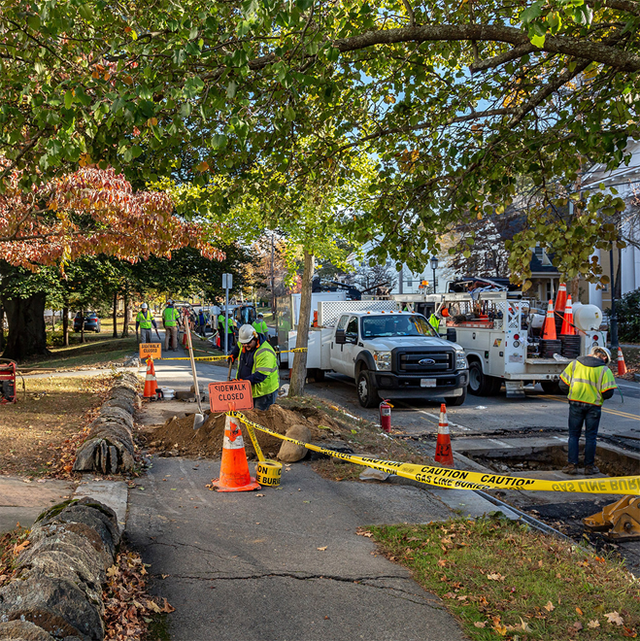
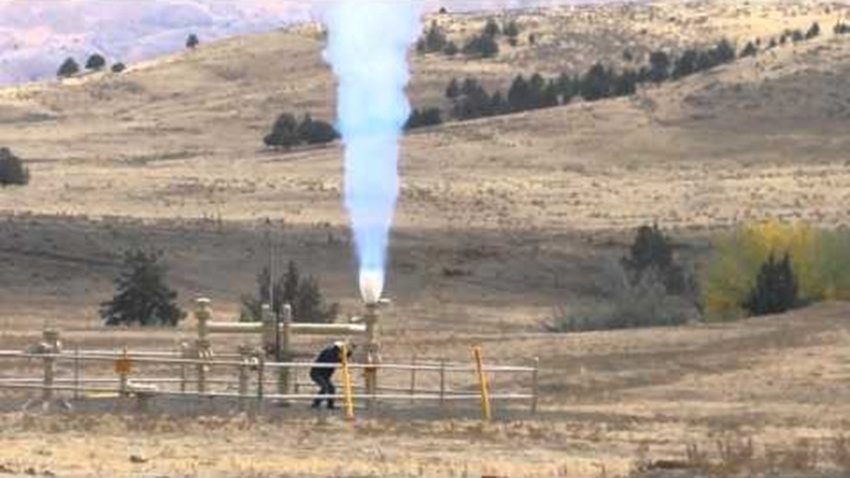
PIPES Act 2020
Major mandates or authority changes:
Leak Detection and Repair (LDAR) rule.
Innovative technology and operational practices evaluations.
Mandate to define “Idle”.
Enhance distribution integrity (Merrimack).
Study the implementation of PSMS and report on recommendations.

Slide 35
Pipeline Safety, Modernization, and Expansion Act of 2024*
Key items in the draft document:
CO₂ regulation enhancement and extension into gaseous transportation.
Establish “Worker Safety Zones”.
Clarity to the previous Act regarding the applicability of LDAR to “Natural Gas”.
Prevent imposition of terms in a Special Permit approval that do not address a known safety risk for the regulation under consideration for waiver.
Revisit the MAOP reconfirmation as related to previously tested pipelines.
Separate the “Testing Technology” program from SP requirements in part.
Establish and implement a process for Voluntary Information Sharing (VIS).
*Drafted as of March 13, 2024 – HR 7655

Slide 36
Pipeline Safety, Modernization, and Expansion Act of 2024*
Key items in the draft document (Continued…):
LNG Center for Excellence and working group (FERC,DOE, OSHA, Coast Guard)
Hydrogen – GAO to study a variety of hydrogen blending issues.
Finalize the Class Location change rule.
Numerous changes to damage prevention (e.g. tickets, exemptions, white line, etc.)
Add “impairment of operation” and “attempting” to damage a pipeline as criminal acts prosecutable by DOJ.
Prohibit states/municipalities from banning products transported in regulated pipelines.
Allow risk-based inspections of breakout tank bottoms.
*Drafted as of March 13, 2024 – HR 7655

Slide 37
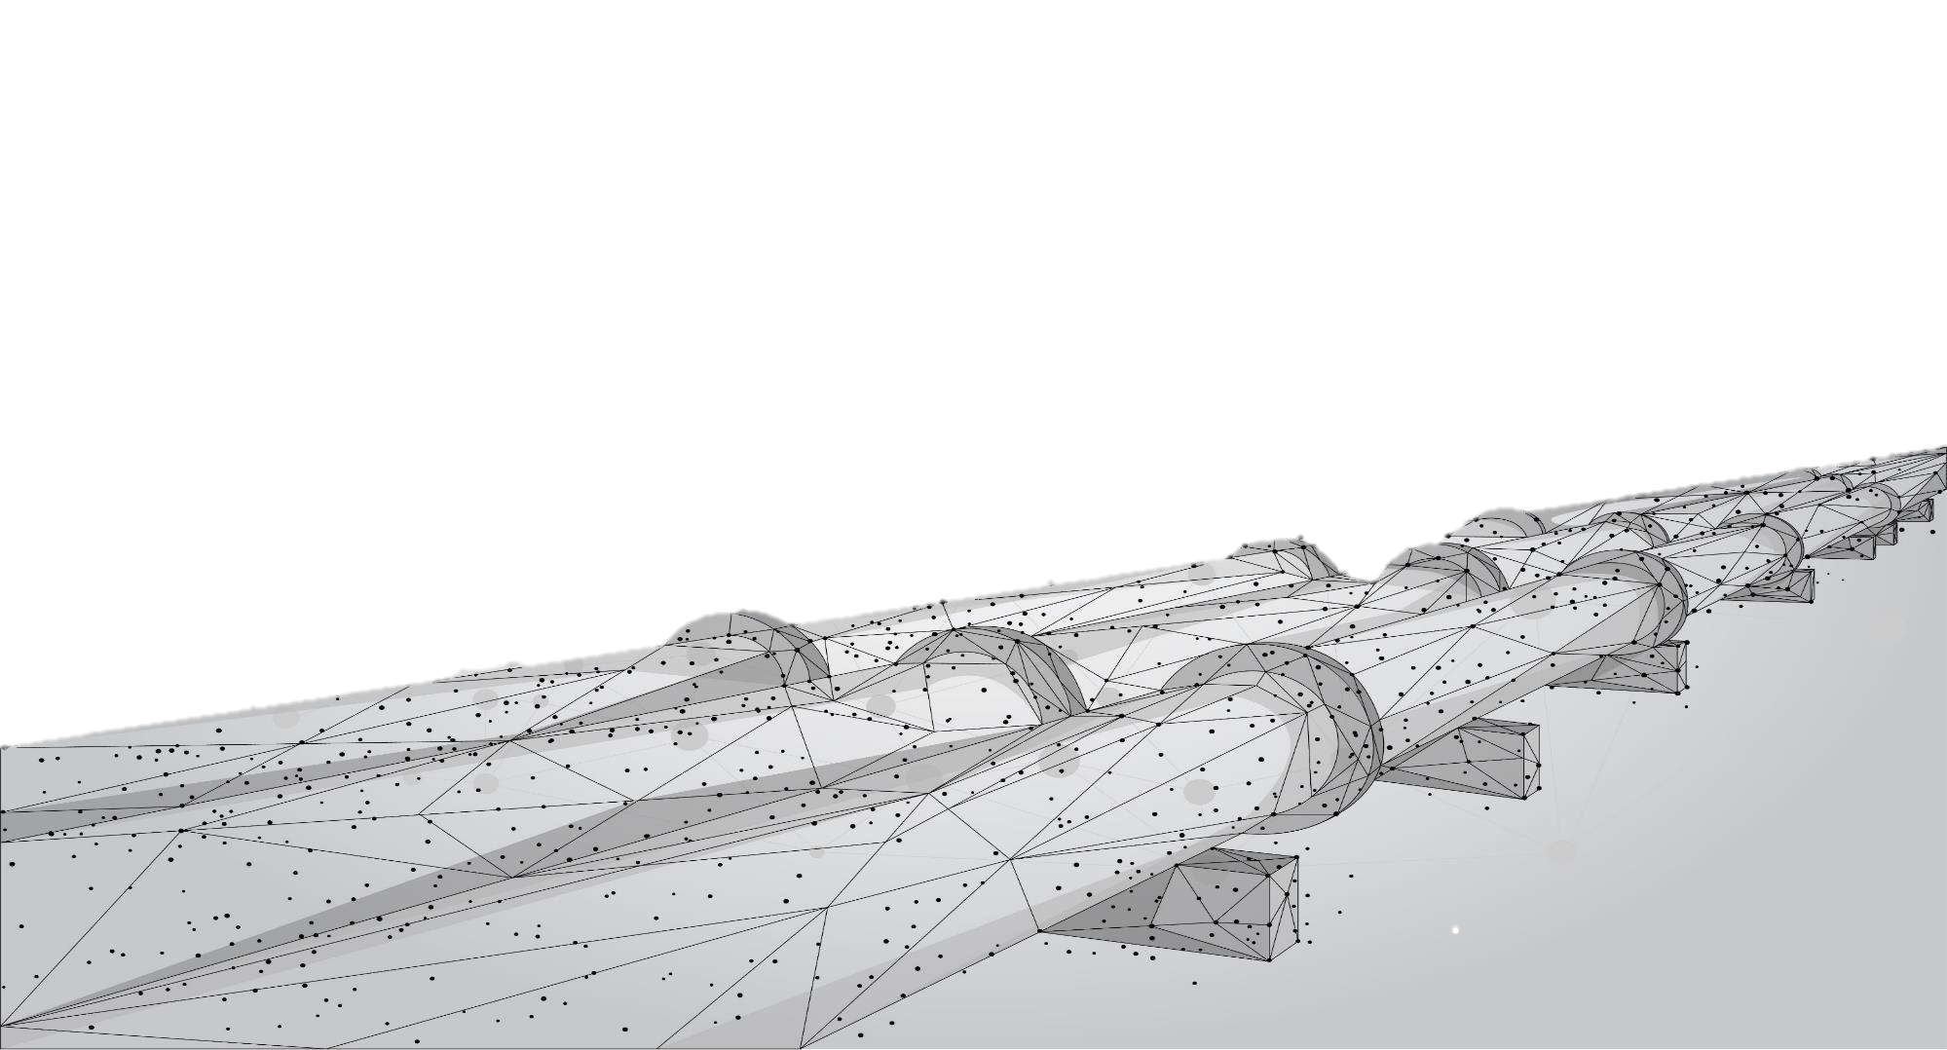

Chris McLaren
Executive Consultant, RCP Inc.
cmclaren@rcp.com
PROFESSIONAL ENGINEERS | REGULATORY EXPERTS | TRUSTED PARTNERS

