Slide 1
Data Analysis Western Region States
Matt Smith
August 19, 2025
Western Region Gas Conference

Slide 2
Topics
Incident and Excavation Damage Trending
Gas Distribution IA Data Analysis
AMI Predictive Leak Process

Slide 3
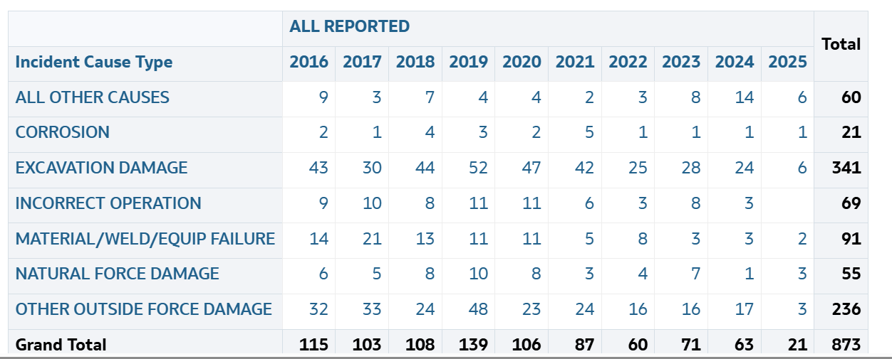
Gas Distribution Incident Trends - Cause
Notes:
Talk about trends as much or as little as you like. For distribution systems the top threat is “excavation damage”, followed closely by “other outside force damage” which is usually a car or truck hitting something.

Slide 4
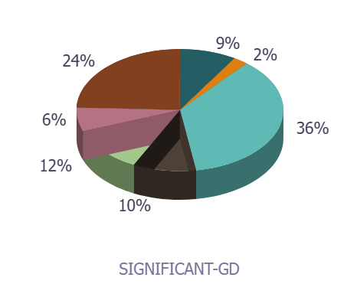

Gas Distribution Significant Incident Causes
Notes:
An increased emphasis on these risk categories (excavation practices and following procedures) would make the biggest impact on reducing the risk of GD incidents.
Excavation practices – No oncall ticket, excavator failed to hand locate prior to digging, knew where facility was but hit it anyways.
Procedures not followed - Procedure was accurate and appropriate, but not followed. (deviating from WPS and causing burn though, TPD caused from inaccurate staking)
Human error other – car jumping curb and hitting meter set.
Undefined – operator can't defend against (lighting).
Construction practices - Construction craftmanship error on new a pipeline and commissioning issues. (cold fuse)
Undetermined – under investigation
Integrity threat identification - When a threat exists, and the operator is not looking for it or is unaware of the threat and a failure occurs. (Internal corrosion, small diameter vibration fatigue)
Design – Improper design.

Slide 5

Distribution Data Analysis
Cause Significant Incidents
Notes:
We go to the PHMSA Pipeline Data Mart to acquire the results to analyze
Significant Incidents are those including any of the following conditions, but Fire First incidents are excluded: 1. Fatality or injury requiring in-patient hospitalization 2. $50,000 or more in total costs, measured in 1984 dollars 3. Highly volatile liquid (HVL) releases of 5 barrels or more 4. Non-HVL liquid releases of 50 barrels or more 5. Liquid releases resulting in an unintentional fire or explosion

Slide 6
Distribution Data Analysis
Total Leaks by Cause Annual Report
Notes:
We go to the PHMSA Pipeline Data Mart to acquire the results to analyze
Equipment leaks is increasing. May be due to older equipment either not being maintained or replaced when needed.

Slide 7
Distribution Data Analysis
Hazardous Leaks by Cause Annual Report
Notes:
We go to the PHMSA Pipeline Data Mart to acquire the results to analyze
Excavation damages being the top cause for hazardous leaks is not unusual, considering probably 95% of excavation damages requires immediate response and repair.

Slide 8
Distribution Data Analysis
Percent Steel versus Percent Plastic 2010-2022 Annual Report
Notes:
We go to the PHMSA Pipeline Data Mart to acquire the results to analyze

Slide 9
One Call Information Data
 | AZ | CA | IL | NV | Overall
Number of Excavation Tickets | 902,082 | 2,463,301 | 1,612,781 | 238,560 | 34,701,733
Number of Excavation Damages | 700 | 4,100 | 3,850 | 346 | 86,145
One Call Not Sufficient | 248 | 2,423 | 988 | 114 | 30,127
Locate Not Sufficient | 90 | 358 | 977 | 37 | 20,447
Excavation Not Sufficient | 317 | 1,236 | 1,796 | 161 | 33,401
Other Not Sufficient | 45 | 83 | 98 | 34 | 2,170

Slide 10
One Call Information Percentages
 | AZ | CA | IL | NV | Overall
Number of Excavation Tickets | 902,082 | 2,463,301 | 1,612,781 | 238,560 | 34,701,733
Excavation Damages per 1,000 locates | 0.78 | 1.66 | 2.39 | 1.45 | 2.48
One Call Not Sufficient | 35% | 59% | 26% | 33% | 35%
Locate Not Sufficient | 13% | 9% | 25% | 10% | 24%
Excavation Not Sufficient | 45% | 30% | 47% | 47% | 39%
Other Not Sufficient | 6% | 2% | 2% | 10% | 2%

Slide 11
Gas Distribution IA Data
Data from PDM 06/02/2025

Slide 12
Gas Distribution Inspection Data
Gas Distribution Inspection result data from the PDM
Includes all closed IIs
If module or Inspection Year Started were missing these records were delete
There have been more and more closed IIs going back to 2012 and
even some from 2025
The analysis is by questions not by inspections
By inspection name there are 6852 closed inspections 2012-June 2025
1
 | 2012 | 2013 | 2014 | 2015 | 2016 | 2017 | 2018 | 2019 | 2020 | 2021 | 2022 | 2023 | 2024 | 2025
All | 4 | 11 | 40 | 55 | 210 | 389 | 473 | 574 | 669 | 695 | 1184 | 1096 | 1089 | 362
States |  | 4 | 29 | 44 | 200 | 382 | 451 | 567 | 656 | 688 | 1165 | 1086 | 1082 | 362
Notes:
The presenter should provide detailed information in presenter notes

Slide 13
Gas Distribution Inspection Data
Percent of questions answered with NC or NA or Blank or Concern
Overall 34%
Total
117,737 questions answered includes the NC/NA/Blank/Concern
230,557 SAT/UNSAT questions
For the following analysis
NC/NA/Blank answers were removed
SAT+ and SAT are combined
UNSAT
Concern were removed
2015 | 2016 | 2017 | 2018 | 2019 | 2020 | 2021 | 2022 | 2023 | 2024 | 2025
38% | 30% | 33% | 29% | 31% | 33% | 31% | 32% | 36% | 36% | 42%
Notes:
The presenter should provide detailed information in presenter notes

Slide 14
Following Data includes States ONLY

Slide 15
3 Module Names
Module ID | Name
AR | ASSESSMENT AND REPAIR
CR | CRM, SCADA, AND LEAK DETECTION
DC | DESIGN AND CONSTRUCTION
EP | EMERGENCY PREPAREDNESS AND RESPONSE
FS | FACILITIES AND STORAGE
GDIM | GAS DISTRIBUTION INTEGRITY MANAGEMENT
GENERIC | GENERIC QUESTIONS
MMLPGIM | MASTER METER AND SMALL LPG DISTRIBUTION INTEGRITY MANAGEMENT
MO | MAINTENANCE AND OPERATIONS
PD | PUBLIC AWARENESS AND DAMAGE PREVENTION
RPT | REPORTING
TD | TIME-DEPENDENT THREATS
TQ | TRAINING AND QUALIFICATION
Notes:
The presenter should provide detailed information in presenter notes

Slide 16
Module Data (Percent) SAT and UNSAT
Module ID | SAT | UNSAT
AR | 4138 (99%) | 57 (1%)
CR | 5136 (99%) | 52 (1%)
DC | 30872 (97%) | 830 (3%)
EP | 9514 (96%) | 374 (4%)
FS | 394 (99%) | 6 (1%)
GDIM | 30087 (98%) | 758 (2%)
MO | 35822(97%) | 1022 (3%)
PD | 16430 (96%) | 609 (4%)
RPT | 4362 (98%) | 71 (2%)
TD | 31921 (97%) | 1027 (3%)
TQ | 33099 (97%) | 880 (3%)
Notes:
The presenter should provide detailed information in presenter notes

Slide 17
Top Code Cited for UNSAT
2012-Present sorted by count
Cited Code | Count
192.616(c) | 344 | Public Awareness
192.605(a) | 215 | Procedures
192.353(a) | 145 | Meters and Regulators – Location
192.13(c) | 143 | Meters and Regulators - Location
192.481(b) | 133 | Monitoring Atmospheric Corrosion Control
192.147(a) | 104 | Flanges and Flange Accessories
192.805(b) | 104 | Qualification Program
192.1007(c) | 97 | Integrity Management Rank Risk Threats
192.615(b)(2) | 91 | Emergency Plans
192.1007(e) | 88 | Integrity Management Rank Risk Threats
192.1007 (f) | 85 | Integrity Management Rank Risk Threats
192.807 | 84 | Recordkeeping
192.747(a) | 82 | Valve Maintenance
192.355(b)(2) | 80 | Meters and Regulators - Protection
192.357(a) | 76 | Meters and Regulators - Installation
Code 49 U.S.C. 60108(a) with 1435
Notes:
The presenter should provide detailed information in presenter notes

Slide 18
Type of Question Number (Percent) SAT and UNSAT
` | SAT | UNSAT
Observation | 44194 (97%) | 1252 (3%)
Procedures | 69803 (95%) | 3706 (5%)
Records | 96662 (97%) | 3099 (3%)
Notes:
The presenter should provide detailed information in presenter notes

Slide 19
Type of Question Number (Percent) SAT by Year
 | 2013 | 2014 | 2015 | 2016 | 2017 | 2018 | 2019 | 2020 | 2021 | 2022 | 2023 | 2024 | 2025
OBSERVATION | 8 (89%) | 46 (92%) | 79 (95%) | 787 (99%) | 2153 (99%) | 3654 (98%) | 4681 (96%) | 4953 (97%) | 5892 (97%) | 5055 (96%) | 6077 (97%) | 8344 (98%) | 2465 (96%)
PROCEDURES | 36 (97%) | 230 (92%) | 453 (94%) | 1649 (95%) | 2938 (96%) | 5622 (99%) | 4154 (98%) | 4732 (99%) | 5887 (96%) | 12062 (93%) | 9136 (91%) | 16130 (96%) | 6762 (93%)
RECORDS | 86 (97%) | 417 (85%) | 758 (94%) | 3565 (96%) | 7386 (97%) | 8843 (99%) | 10055 (97%) | 10407 (98%) | 10973 (97%) | 10834 (96%) | 12285 (96%) | 17222 (98%) | 3825 (95%)
Notes:
The presenter should provide detailed information in presenter notes

Slide 20
Top 5 Questions with UNSAT based on Number of Responses
Question ID | SAT | UNSAT | Total | Percent_SAT | Percent_UNSAT
TD.ATM.ATMCORRODEINSP.O | 986 | 212 | 1198 | 82% | 18%
DC.METERREGSVC.CUSTMETERREGLOC.O | 1043 | 156 | 1199 | 87% | 13%
DC.METERREGSVC.CUSTMETERREGPROT.O | 1082 | 148 | 1230 | 88% | 12%
MO.GM.DISTVALVEINSPECT.R | 1300 | 98 | 1398 | 93% | 7%
TQ.OQ.RECORDS.R | 1011 | 97 | 1108 | 91% | 9%
Notes:
The presenter should provide detailed information in presenter notes

Slide 21
Top Asked Questions
Question ID | SAT | UNSAT | total | Percent_SAT | Percent_UNSAT
TQ.PROT9.QUALIFICATIONSTATUS.O | 2596 | 38 | 2634 | 99% | 1%
TQ.PROT9.AOCRECOG.O | 2616 | 18 | 2634 | 99% | 1%
TQ.PROT9.TASKPERFORMANCE.O | 2603 | 16 | 2619 | 99% | 1%
TQ.PROT9.VERIFYQUAL.O | 2453 | 19 | 2472 | 99% | 1%
EP.ERG.LIAISON.R | 1570 | 85 | 1655 | 95% | 5%
MO.GM.DISTVALVEINSPECT.R | 1300 | 98 | 1398 | 93% | 7%
TD.ATM.ATMCORRODEINSP.R | 1300 | 93 | 1393 | 93% | 7%
MO.RW.DISTPATROLLEAKAGE.R | 1320 | 62 | 1382 | 96% | 4%
MO.GO.OMHISTORY.R | 1347 | 28 | 1375 | 98% | 2%
TD.CPMONITOR.TEST.R | 1278 | 84 | 1362 | 94% | 6%
PD.PA.EVALEFFECTIVENESS.R | 1256 | 81 | 1337 | 94% | 6%
MO.GOODOR.ODORIZE.R | 1278 | 56 | 1334 | 96% | 4%
TD.CP.RECORDS.R | 1293 | 34 | 1327 | 97% | 3%
MO.GMOPP.PRESSREGTEST.R | 1271 | 55 | 1326 | 96% | 4%
Notes:
The presenter should provide detailed information in presenter notes

Slide 22
Top 10 States in Gas Distribution PE Main Mileage by Diameter
UNK | <2IN | 2-<4IN | 4<8IN | 8<12IN | 12+ | Total
MS | TX | TX | NY | NY | IL | TX
TX | CA | OH | TX | OH | PA | CA
MA | MI | CA | PA | PA | NY | MI
LA | GA | PA | OH | MA | MO | OH
AR | WI | MI | MA | NJ | DC | WI
KS | CO | WI | NJ | IL | KS | GA
AL | MN | NY | MI | VA | ND | NY
OH | TN | MN | NC | TX | MT | MN
NM | IL | IN | CA | MD | IN | PA
NE | IN | GA | WI | ND | CO | TN

Slide 23
AMI Predictive Leak Process
Mitigating Gas Leaks for Customers
July 7, 2025

Slide 24
AGENDA
Goals and Scope of Project
Key Wins
Overview of Process
Summary of Results

Slide 25
GOAL
Utilize AMI gas meter data to identify high volume leaks occurring inside of a premise to mitigate and improve customer and co-worker safety.
CRITERIA
The predictive analysis targets AMI gas meters that have higher than normal flow, with minimum sustained flow of 30CFH.

Slide 26
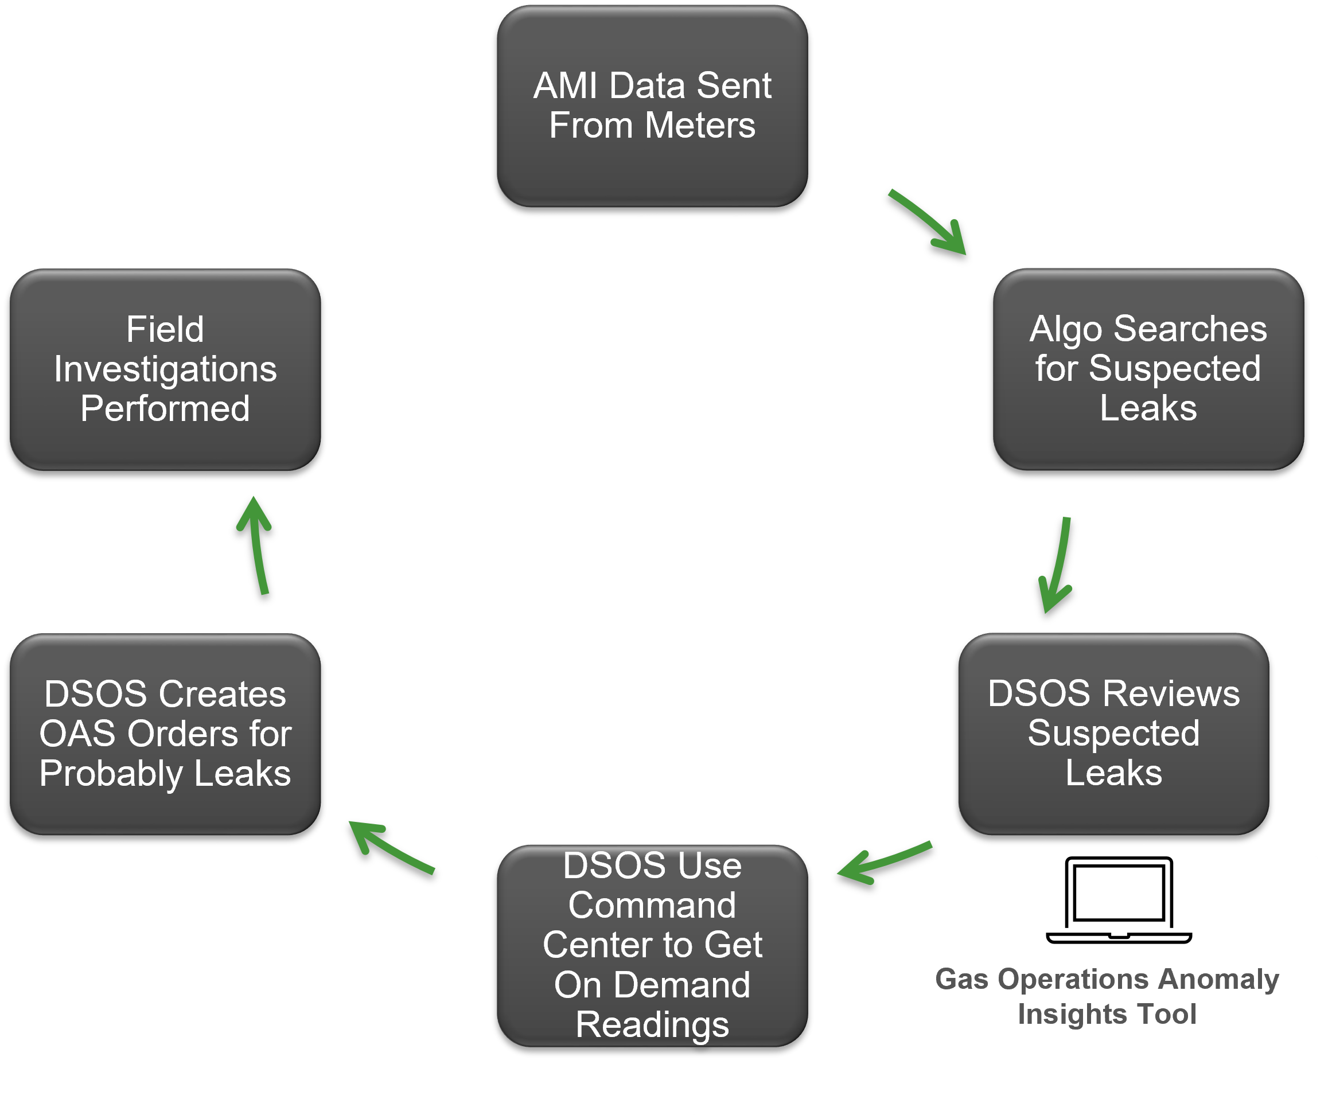
DAILY PROCESS FLOW

Slide 27
EXAMPLES – Gas Leaks
8/29/24 - Madison, IL
Copper fuel lines had been stolen out of the customer's basement.
9/23/24 - Carlinville, IL
50% LEL reading inside customer's house - several gas leaks were found at the stove and water heater.
10/4/24 - Cuba, IL
Customer's boiler had two broken lines and the gas valve was stuck wide open – customers were both asleep upon arrival to investigate.
4/19/25 - Mount Vernon, IL
Copper fuel lines had been stolen from vacant residence – property was condemned.
6/26/25 - Timewell, IL
Customer had removed their furnace and left an open fuel line in their trailer - customer did not have gas appliances but turned on the gas to cook food.

Slide 28
EXAMPLES – Unusual Gas Usage
July 2024 – Peoria, IL
Customer suspects cat turned on the hot water faucet while they were out of town for several days.
May 2025 – Peoria, IL
Ameren Illinois journeyman found water leaking excessively under the customer's trailer.
June 2025 – Peoria, IL
Customer's thermostat was wired incorrectly causing furnace and air conditioning
unit to run simultaneously.

Slide 29
PERFORMANCE HIGHLIGHTS (since process inception June 2023)
1306 Field Investigations
389 Leaks Mitigated (99/389 responses required implementation of Emergency Response Plan)
239 Hot Water Leaks Mitigated

Slide 30
2025 YTD PERFORMACE
324 Field Investigations
74 Leaks Mitigated (15/74 responses required implementation of Emergency Response Plan)
57 Hot Water Leaks Mitigated
49 Positive Customer Interactions

Slide 31
2025 FIELD INVESTIGATION RESULTS

Slide 32
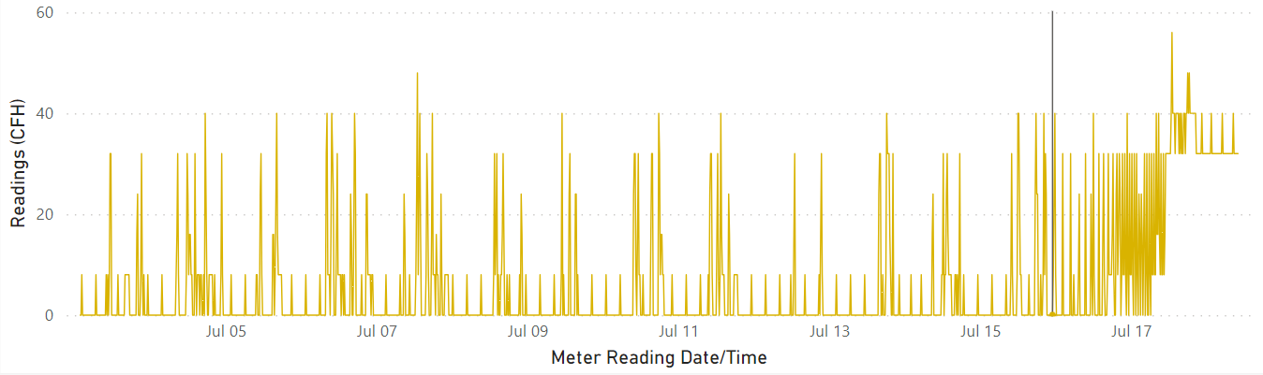
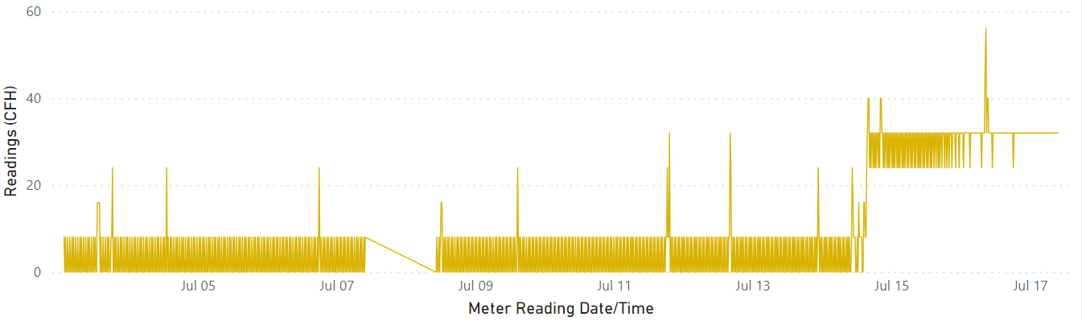
LESSON LEARNED
Hot Water Leak
Hot Water Leak vs. Gas Leak
Hot water leaks and gas leaks show similar patterns however gas leaks have been found to have high LEL levels.
Gas Leak with 35%LEL

Slide 33

Questions

