Slide 1
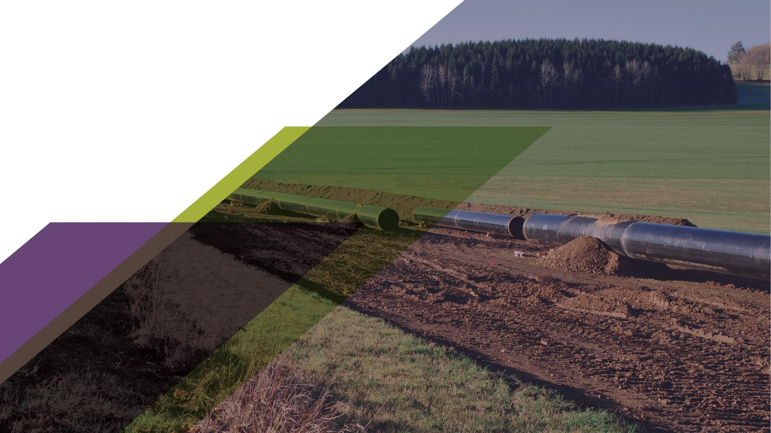

AC Corrosion During Construction
  Mark Anderson – Sr Project Manager
  Western Region Gas Conference
  August 20, 2025

Slide 2
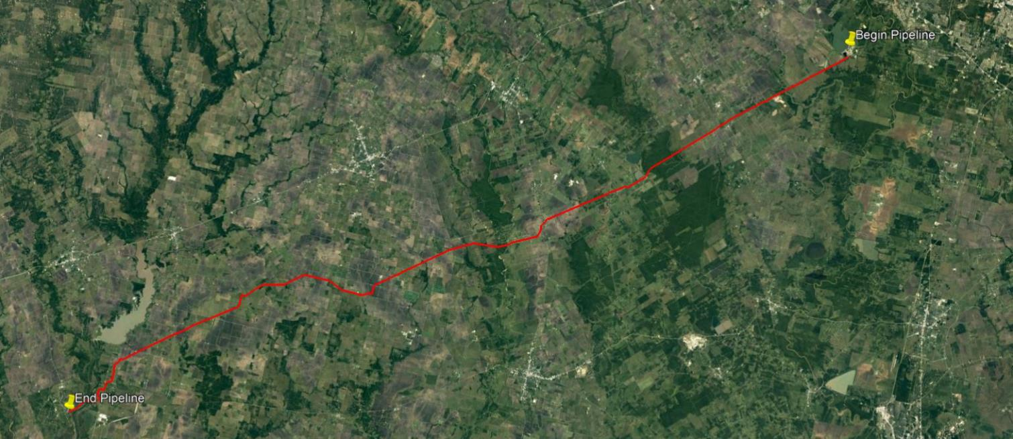
Pipeline Route
80 miles, 12 - inch OD, steel, Fusion Bonded Epoxy pipeline

Slide 3
ILI MFL Tool Run
Tool ran
Hundreds of exterior metal loss features reported

Slide 4
ILI External Metal Loss

Slide 5
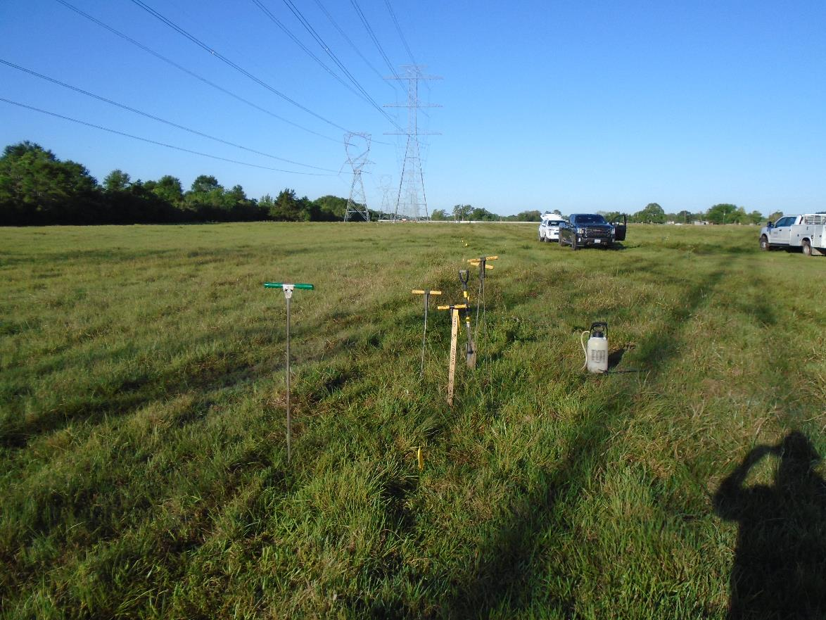
Typical Dig Site

Slide 6
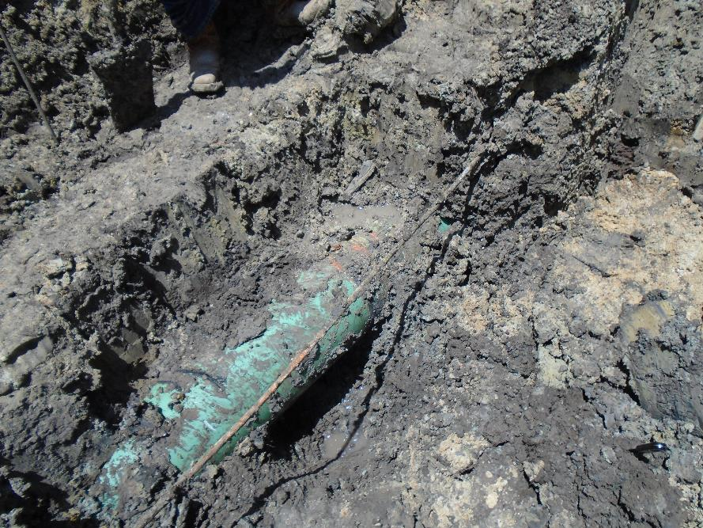
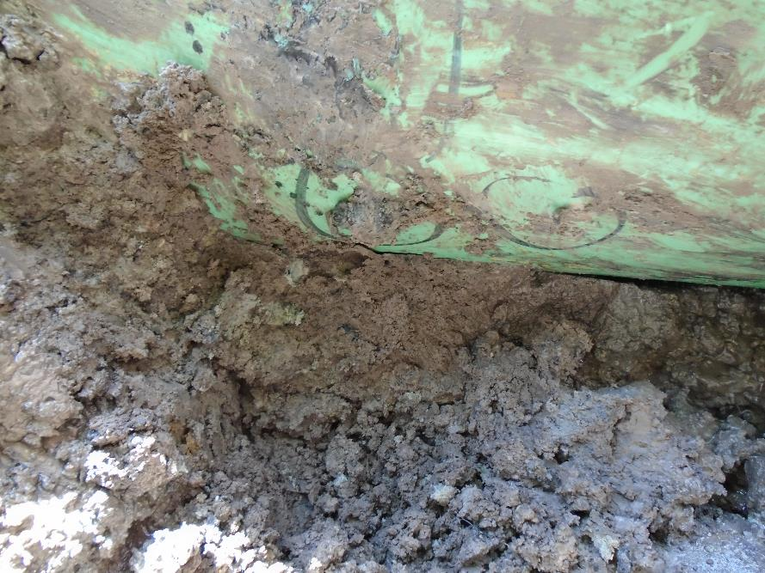
Typical Dig Site (Day Light Pipe at Anomaly)

Slide 7
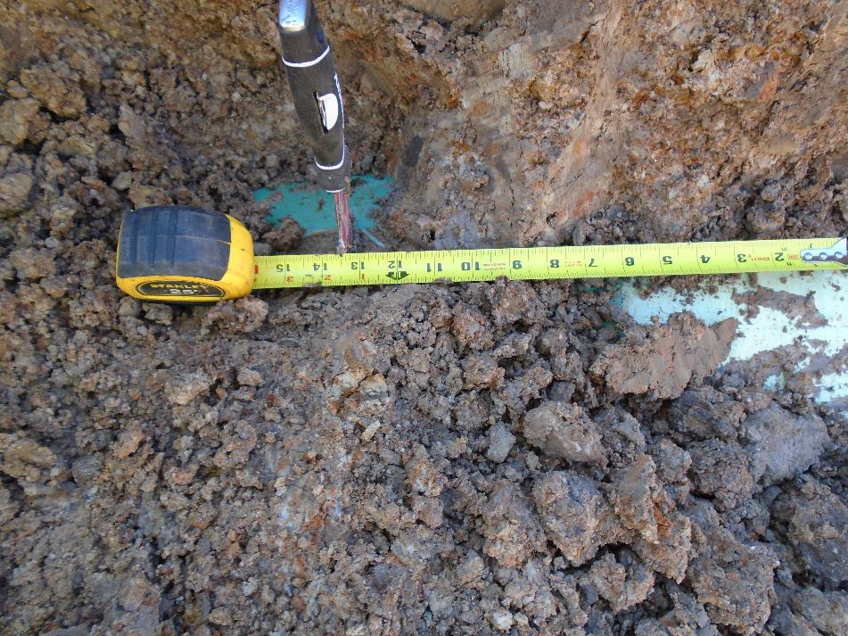
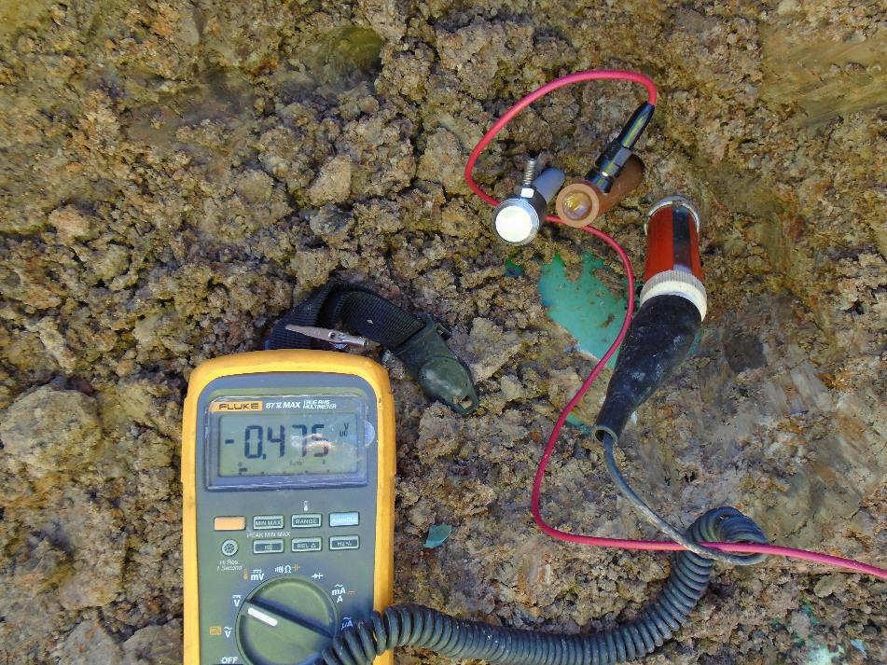
Typical Dig Site (Verify Location and Take Initial Readings)

Slide 8
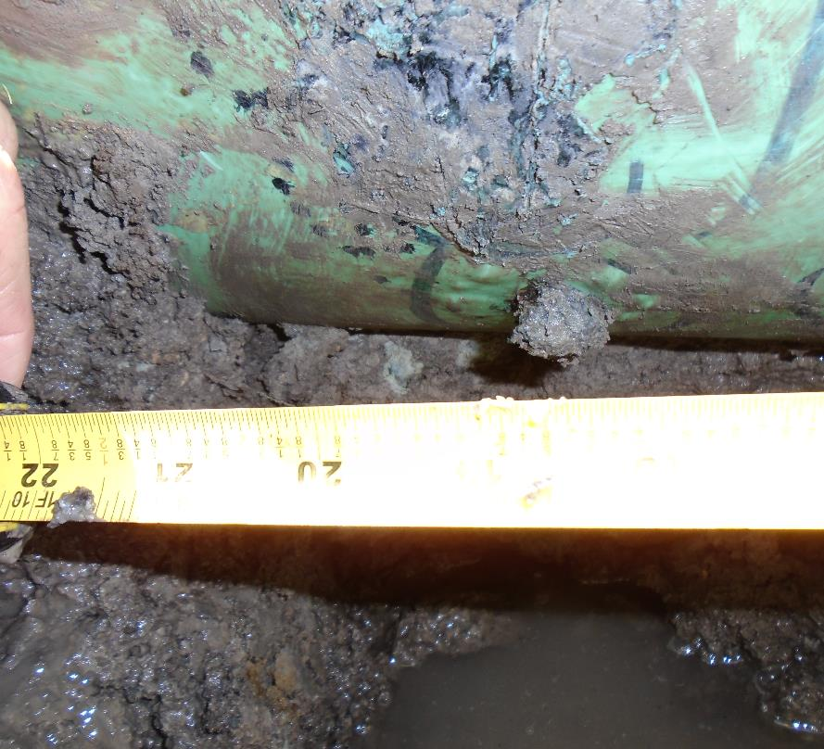
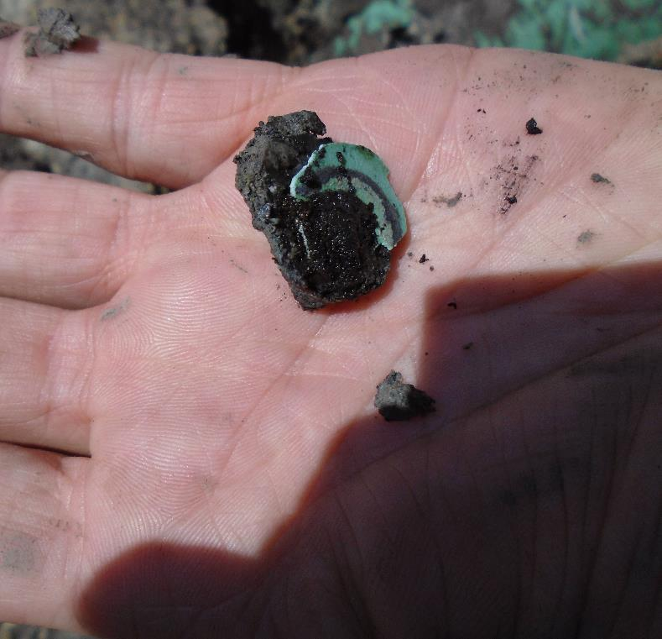
Typical Dig Site (Evaluate Corrosion Product)

Slide 9
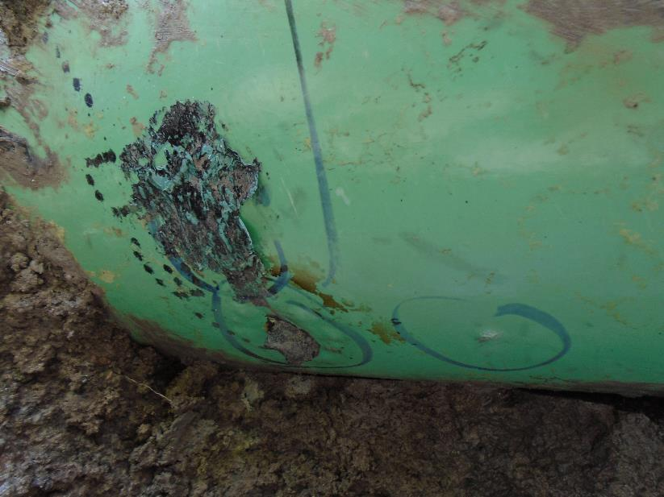
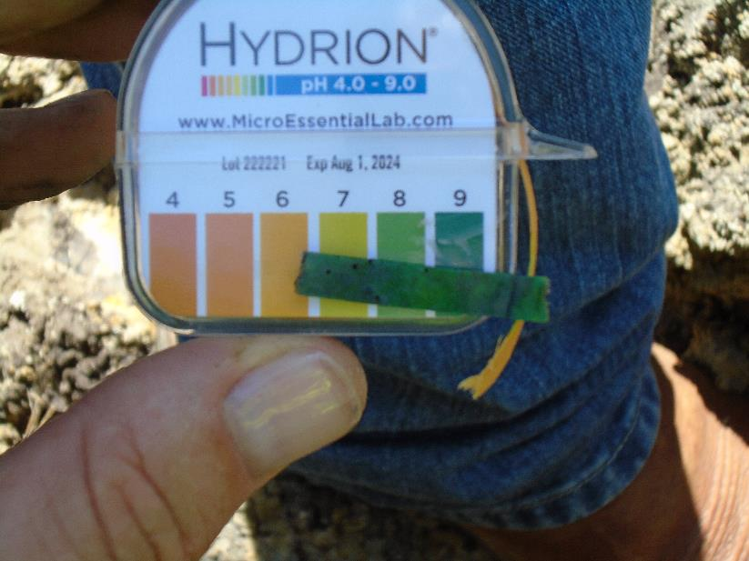
Typical Dig Site (Evaluate Coating and Take pH Readings at Anomaly

Slide 10
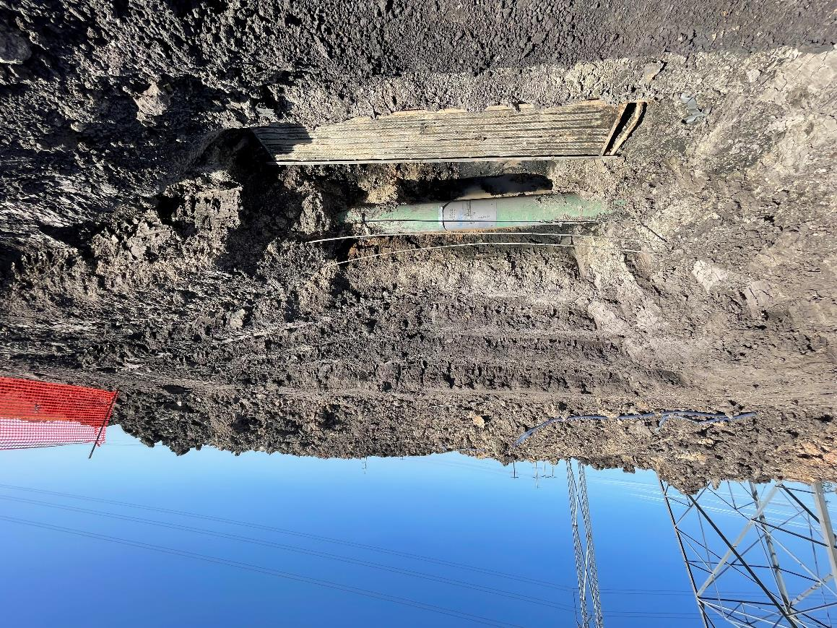
Typical Dig Site (Expose Pipe 360 deg)
Zinc Ribbon-
Installed over the
Pipeline

Slide 11
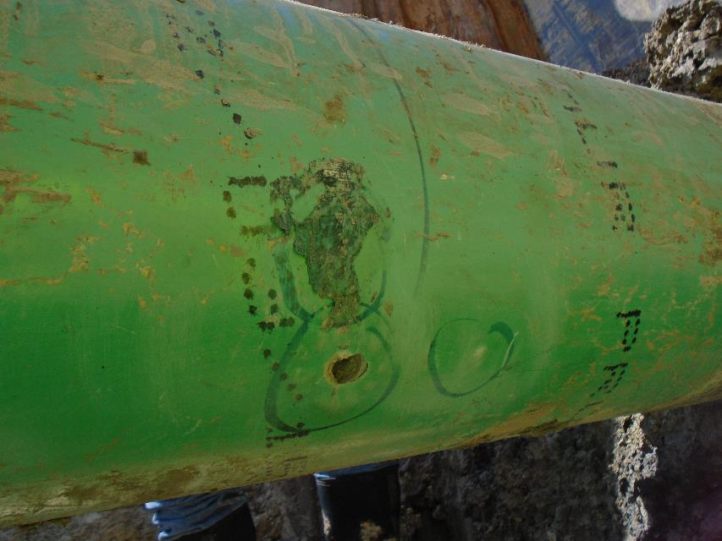
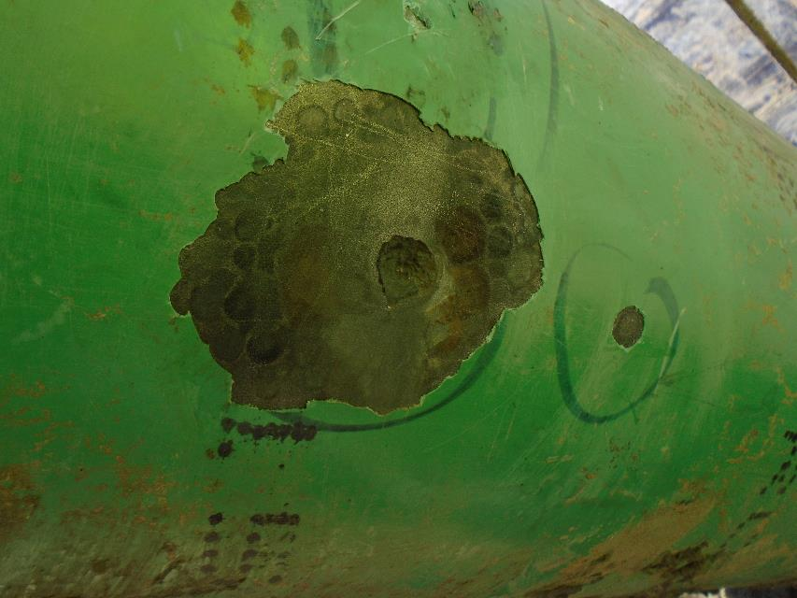
Typical Dig Site (Coating Evaluation)
Note on Pipe from Original Construction - “Jeep”

Slide 12
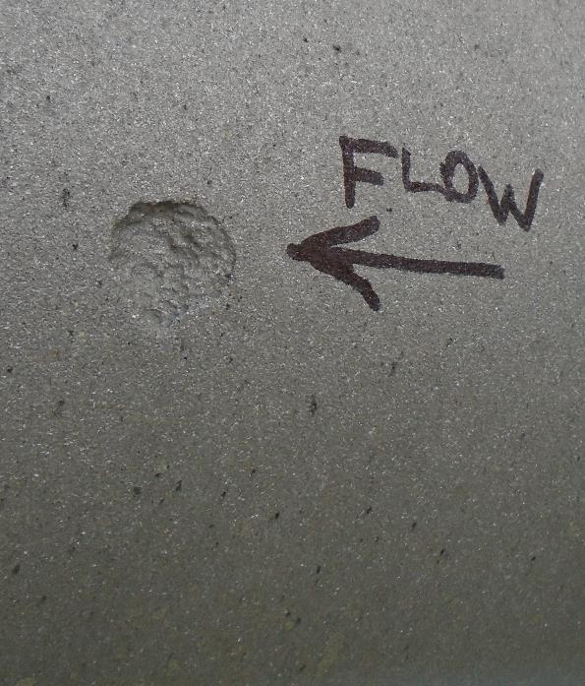
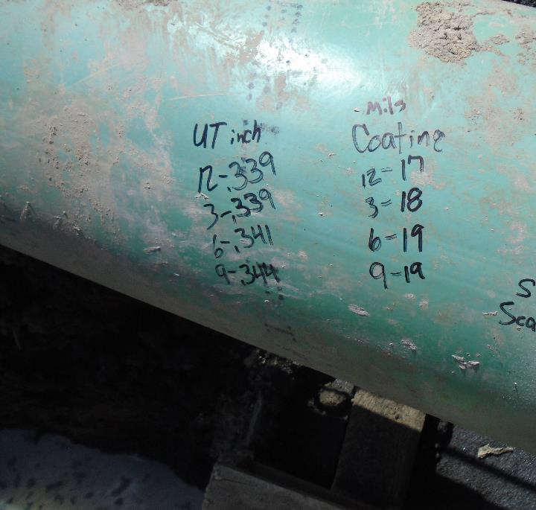
Typical Dig Site (Anomaly Cleaned for Final Measurements)

Slide 13
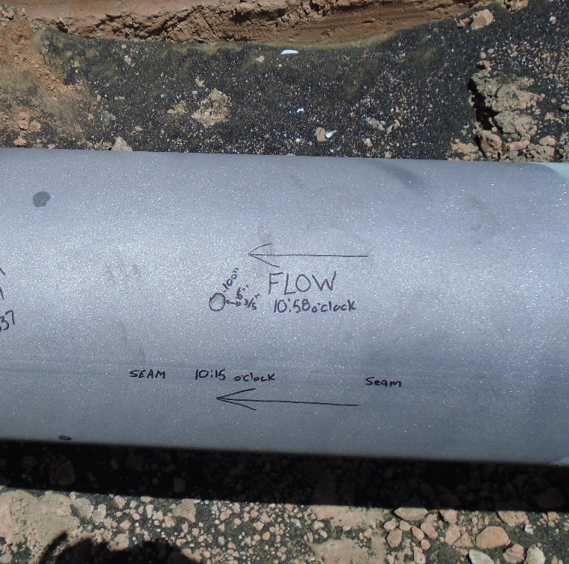
Metal Loss at Long Seam

Slide 14
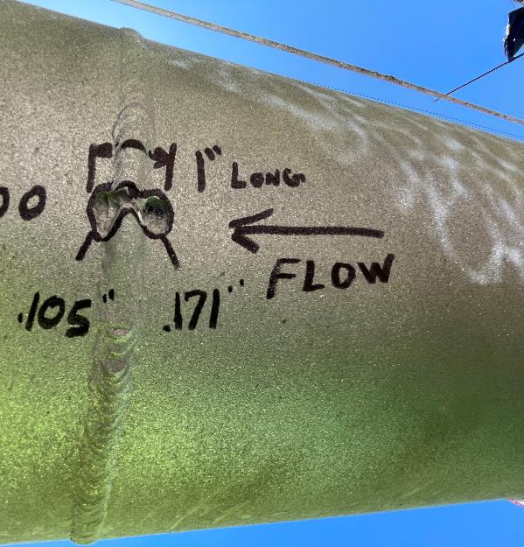
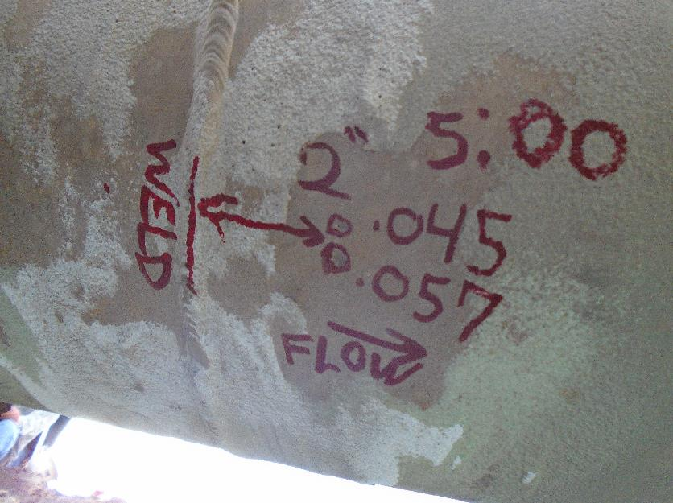
Metal Loss at Girth Weld

Slide 15
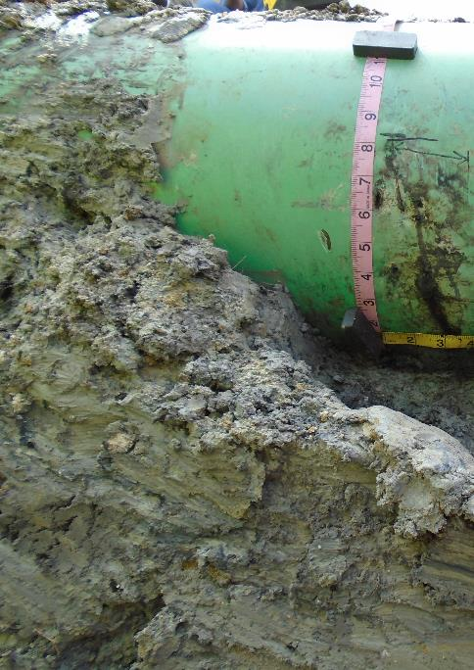
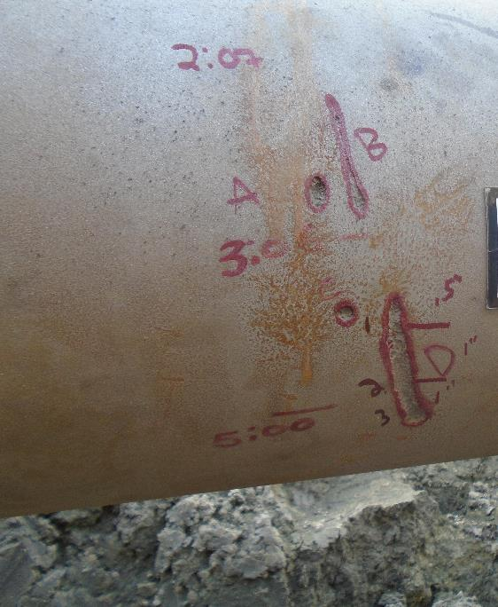
Metal Loss Around Pipe (Maybe Gouge / Turned into AC Corrosion)

Slide 16
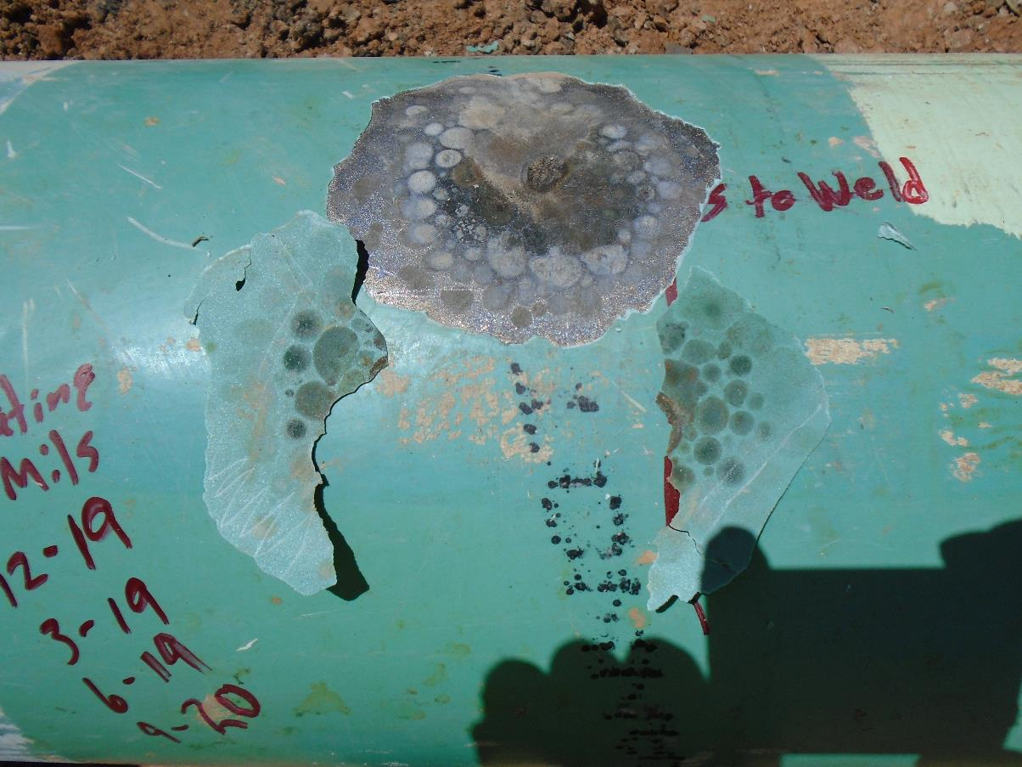
Cathodic disbondment

Slide 17
Summary of Field Evaluation
25 External Metal Loss Indications exposed
  All 25 metal loss indications were caused by AC corrosion
  AC Current Density measured with AC-10 portable density prob
    Highest reading was 0.1 A/m²
  pH of pipe at metal loss, all 9+
  Soil Resistivity ranged from 300 to 700 Ωcm, average was 544 Ωcm

Slide 18
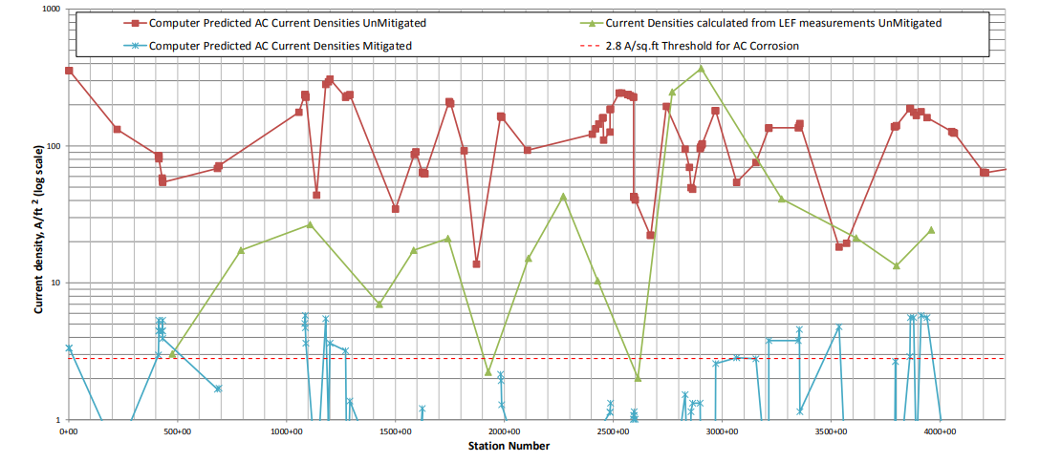
AC Model (Pre-Construction)
Note: 2.8 A/sq.ft – Lower threshold for AC corrosion – 30 A/sq.m
9.29 A/sq.ft – Upper threshold for AC corrosion – 100 A/sq.m

Slide 19
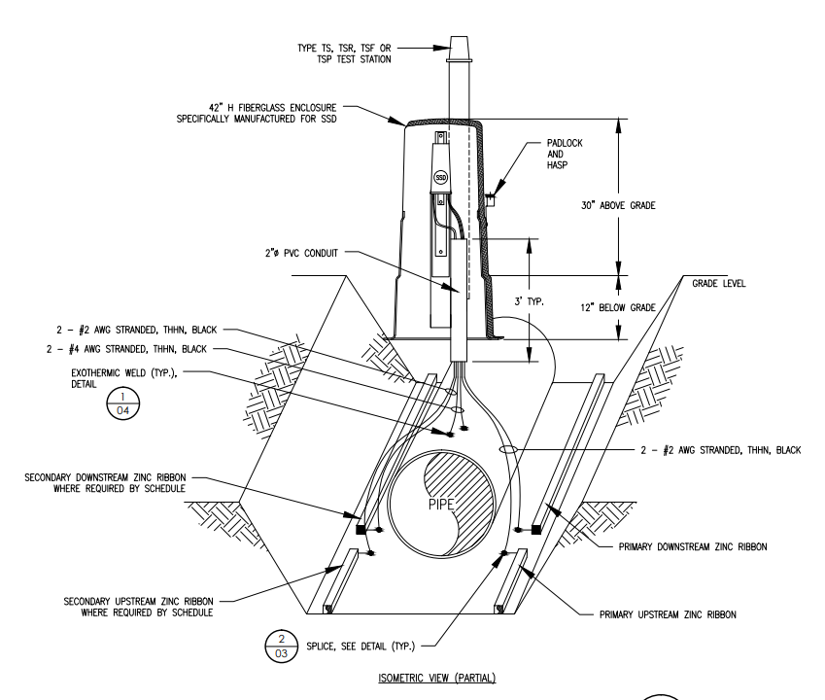
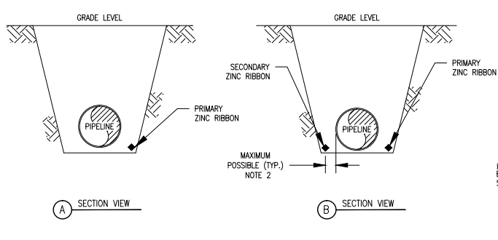
Installation of AC Mitigation System
Zinc ribbon along 60 miles of the route, total of 600,000 ft of zinc ribbon installed.
85 each solid state decouplers installed along the route

Slide 20
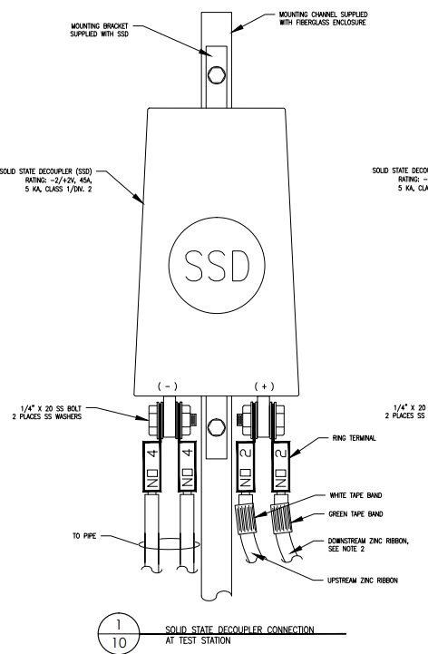
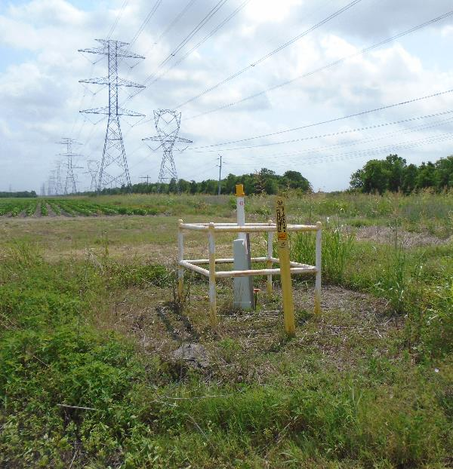
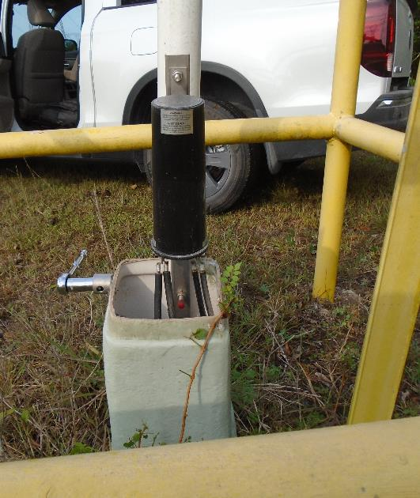
Installation of AC Mitigation System

Slide 21
AC Volts

Slide 22
AC Volts

Slide 23
AC Current Density

Slide 24
Questions Asked
  Why was there so many metal loss anomalies caused by AC corrosion?
  Is the AC corrosion active? - NO
  What mitigative action should be taken?

Slide 25
Corrosion Growth Rate
Total wall loss in mils / duration of active wall loss in years
Example:
85 mils of metal loss over a 10-year period –
85 mills/10 years = 8.5 mils per year

Slide 26
Corrosion Growth Rate
Adequate CP is a corrosion growth rate of less than 1 mil per year
  NACE SP0169
  Section 6: Criteria and Other Considerations for Cathodic Protection,
  6.1 Introduction …..A commonly used benchmark for effective external corrosion control is (a reduction in the corrosion rate to 0.025 mm per year (1 mil per year) or less.
Maximum galvanic corrosion is 16 mil per year
  NACE SP0502
  Appendix C
  C 2 Default Corrion Rate
  C3,2 When other data are not available, a pitting rate of 0.4 mm/y (16 mpy) should be used for determining reinspection intervals.

Slide 27
Corrosion Growth Rate
We needed to establish how long AC corrosion was active

Slide 28
Timeline
Timeline:
Construction started - AC Corrosion Start
Hydrostatic Test – .75 years
DCVG - 1 year
CIS Survey ON/OFF - 1.5 years
VAC at TS, highest reading was 4.114 Volts - 2.5 years
ILI – 6.5 years

Slide 29
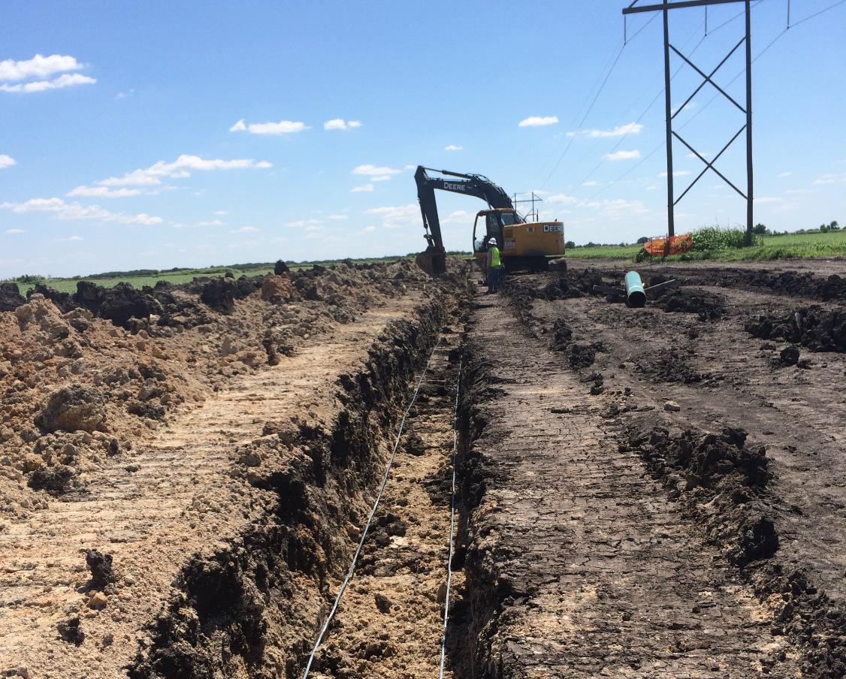
Installation of AC Mitigation System
Zinc ribbon was installed as pipeline was laid.
Decoupler were commissioned after hydrostatic test.

Slide 30
DCVG Indications Summary
Total of 503 Indications
%IR
  6% and greater - 0
  5% - 1
  4% - 1
  3% - 1
  2% - 11
  1% - 489

Slide 31
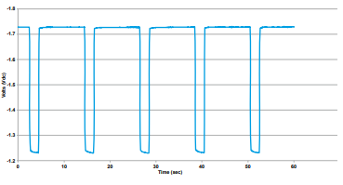
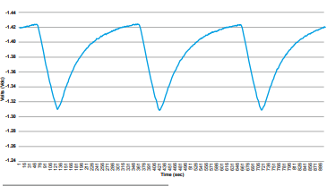
Decoupler Effect on ON/OFF Survey
Normal Wave Form
Wave Form of Pipeline being
Effected by Decouplers
Figures from DAIRYLAND Industry publication-
Testing and Evaluation of Decoupler Capacitive Effects and Utilization of the Dairyland Model PCRX | Published October 6, 2020

Slide 32
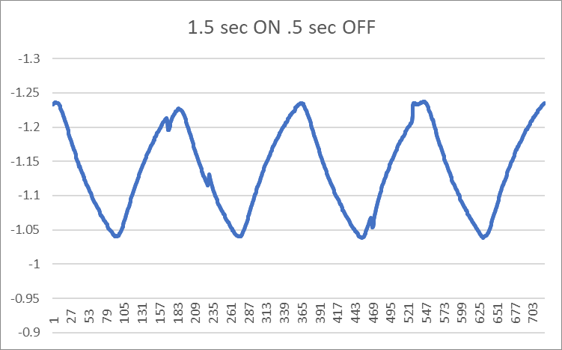
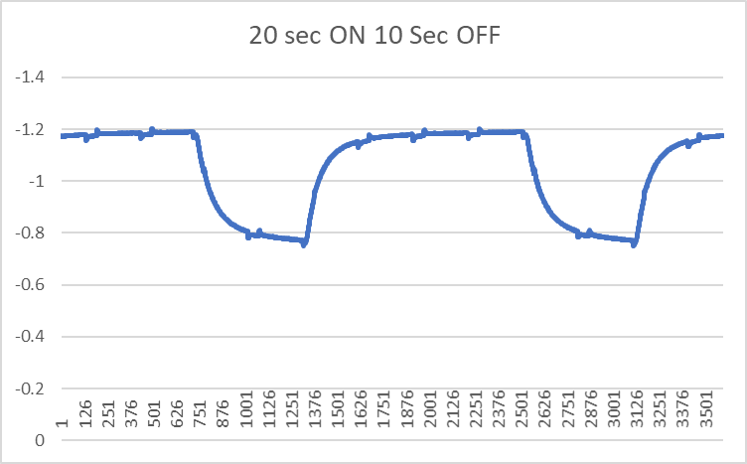
Wave Form at Various Interruption Cycles
14 wave forms at different ON/OFF cycles were taken

Slide 33
Current TP Survey vs Original CIS
Original CIS Summary:
No OFF Readings less
Negative than -0.850 VDC

Slide 34
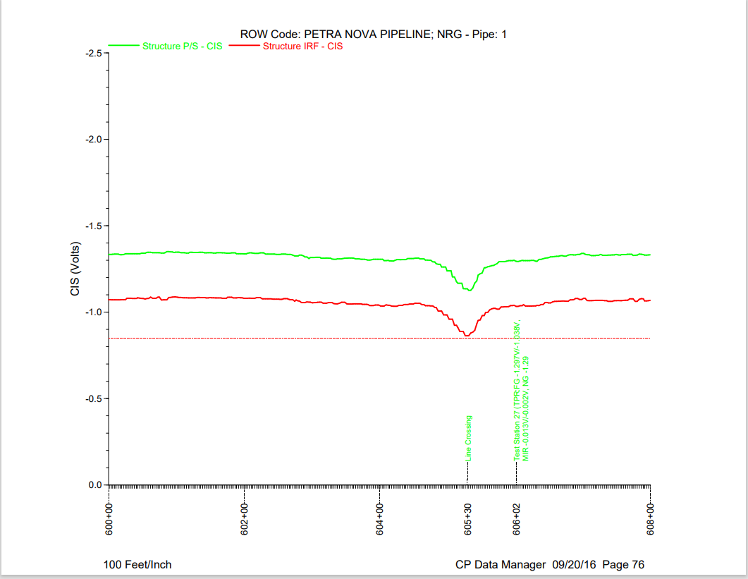
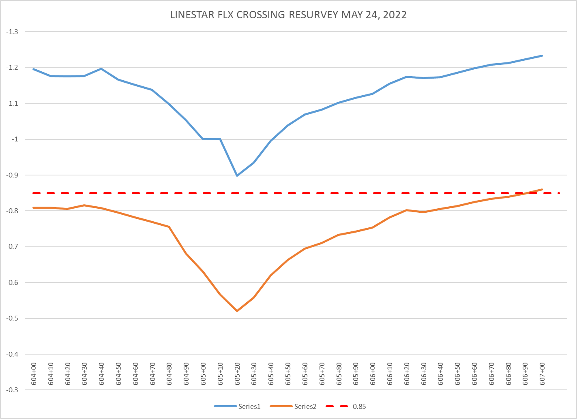
Original CIS vs Current CIS
Current CIS
Original CIS

Slide 35
Questions Asked
  Why was there so many metal loss anomalies caused by AC corrosion? –
  AC Mitigation System Was Not Operational When Pipe Was Put in Ground
  Is the AC corrosion active? - NO
  What mitigative action should be taken?

Slide 36
Corrosion Growth
 |  | Mils per Year
Activity | Duration Years | 70% | 50%
Start Construction
Hydro Test | 0.75 | 0.311 | 0.226
AC Mitigation System Put in Service | 1.00 | 0.233 | 0.170
ILI | 6.50 | 0.036 | 0.026

Slide 37
Questions Asked
  Why was there so many metal loss anomalies caused by AC corrosion?
  No AC Mitigation System Operational When Pipe Was Put in Ground
  Is the AC corrosion active? - NO
  What is the expected life of the pipeline? –
  Less than 1 year if AC is not mitigated
  What mitigative action should be taken? – Active Monitoring

Slide 38
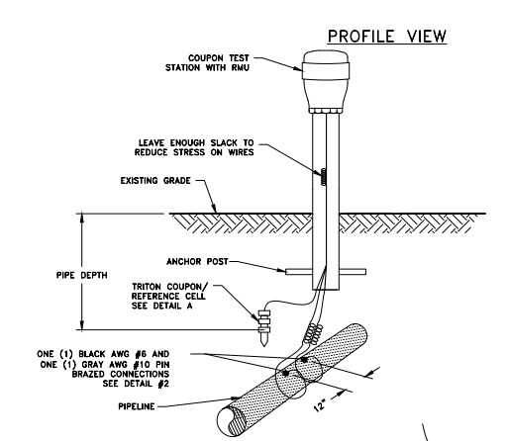
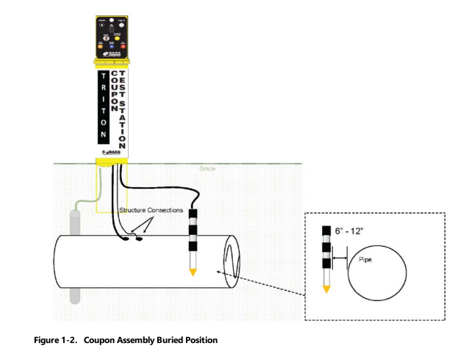
Active Monitoring

Slide 39
Summary
  AC corrosion starts as soon as the pipe is buried
  AC mitigation is not active until system is commissioned
  Plan on AC mitigation as the pipe is buried (maybe temporary)
  Metal loss due to AC corrosion can be magnitudes greater than galvanic corrosion

Slide 40
Thank You!
Mark Anderson
manderson@entrustsol.com

