Slide 1

CGA Damage Prevention Institute Metrics/Updates and Other Committee Proceedings
Louis Panzer
Executive Director, NC 811
louis@nc811.org
336-707-1736

Slide 2
Overview
Introduction
Common Ground Alliance Committees
Best Practices/Next Practices
DIRT Data and Evaluation
Education
OCSI
DPI (Damage Prevention Institute)
DPAC (Damage Prevention Action Center)
Today we will focus on Best Practices, Next Practices and DIRT Data and Evaluation.

Slide 3
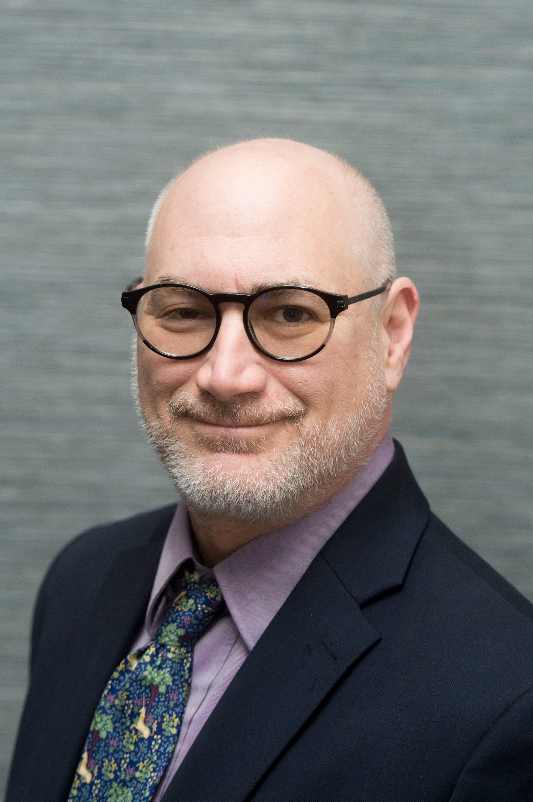

Introduction
Hi!
Executive Director at NC 811 since 2011
Member of CGA since 2002
Friend to WRGC since 2004 (20 years?? Is that possible?)
Currently Co-Chair of Data and Evaluation
Serving on multiple committees

Slide 4
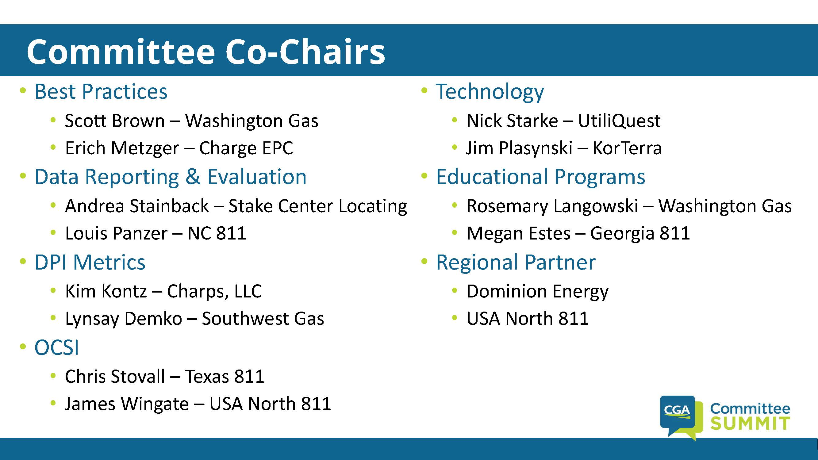
Meghan Rafinski – GA 811

Slide 5


Slide 6
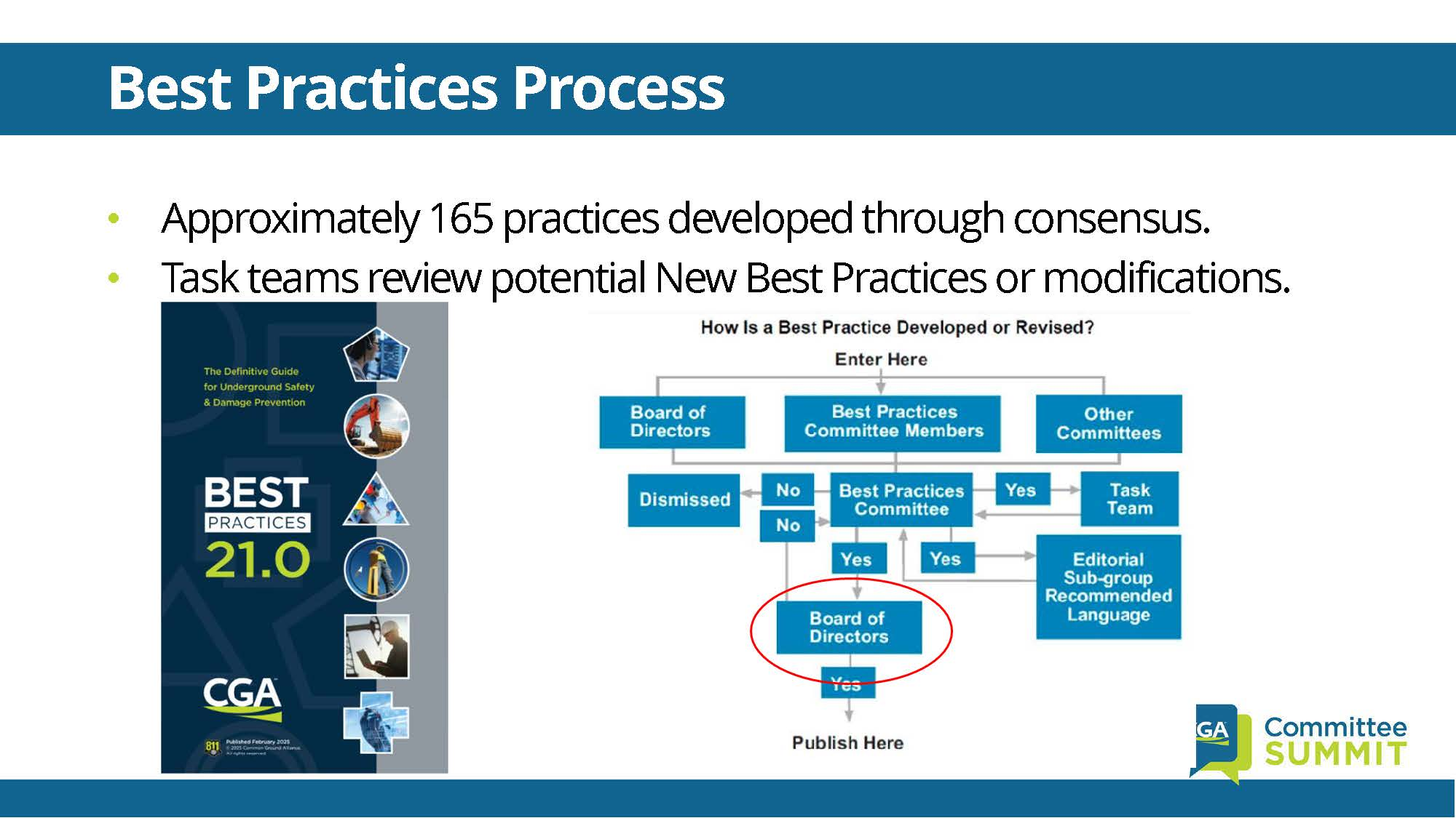

Slide 7
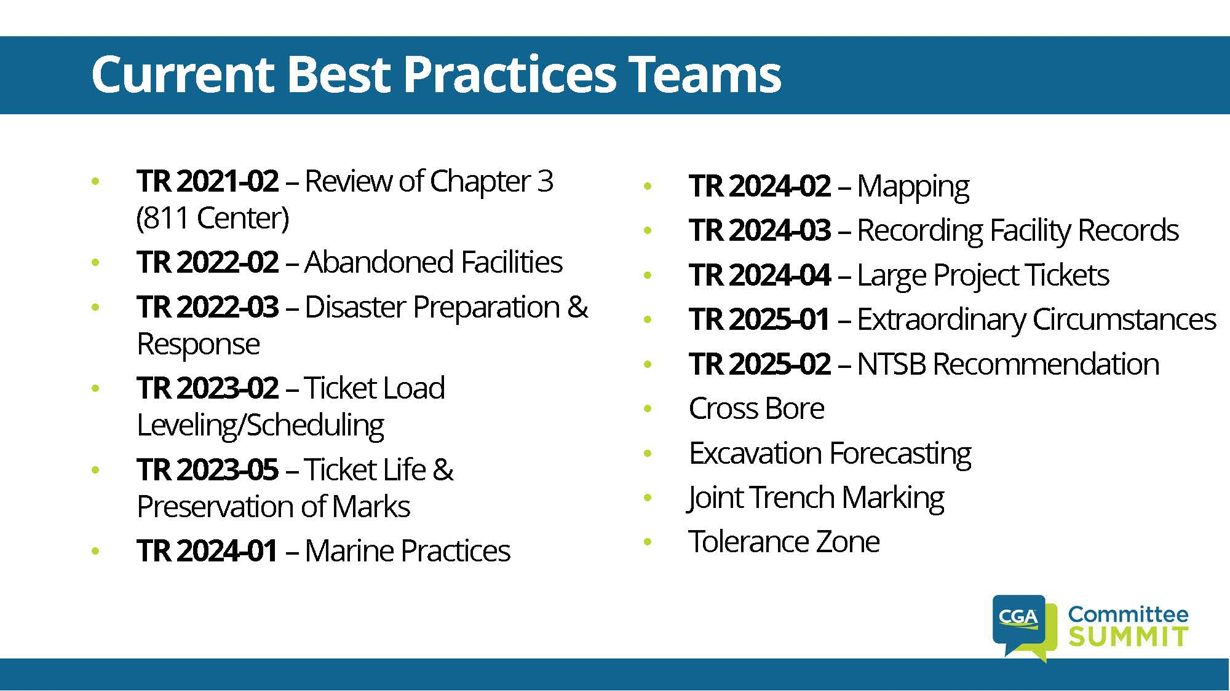

Slide 8
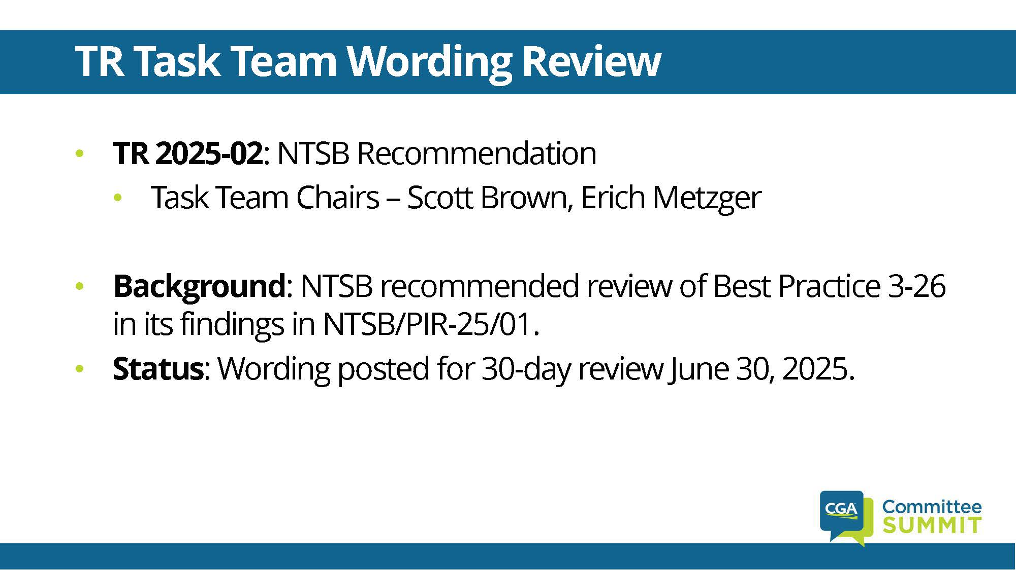

Slide 9
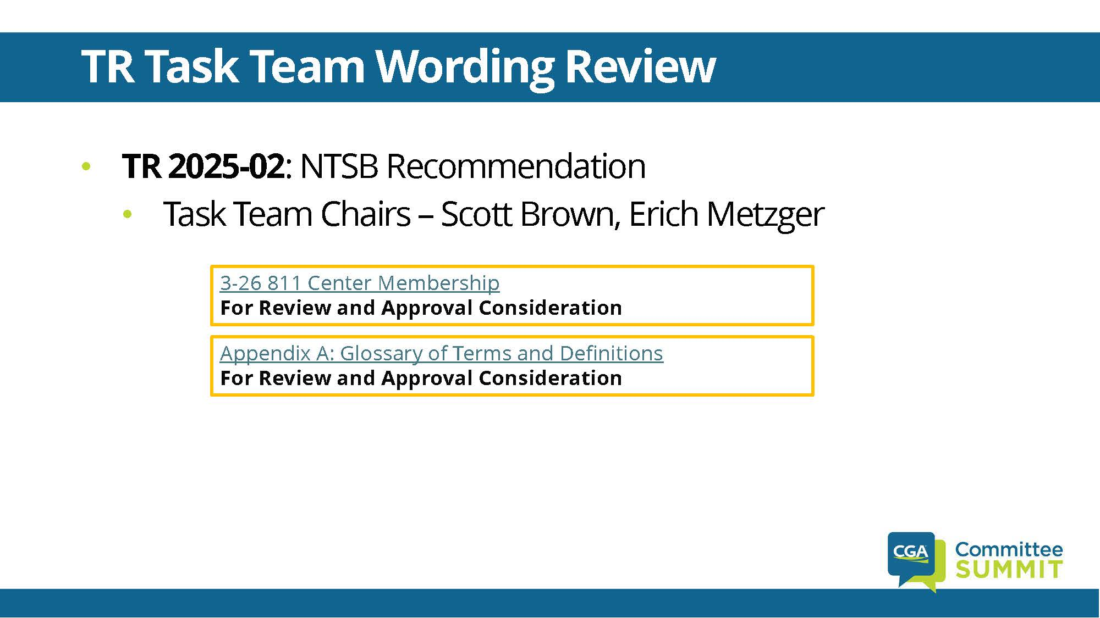

Slide 10
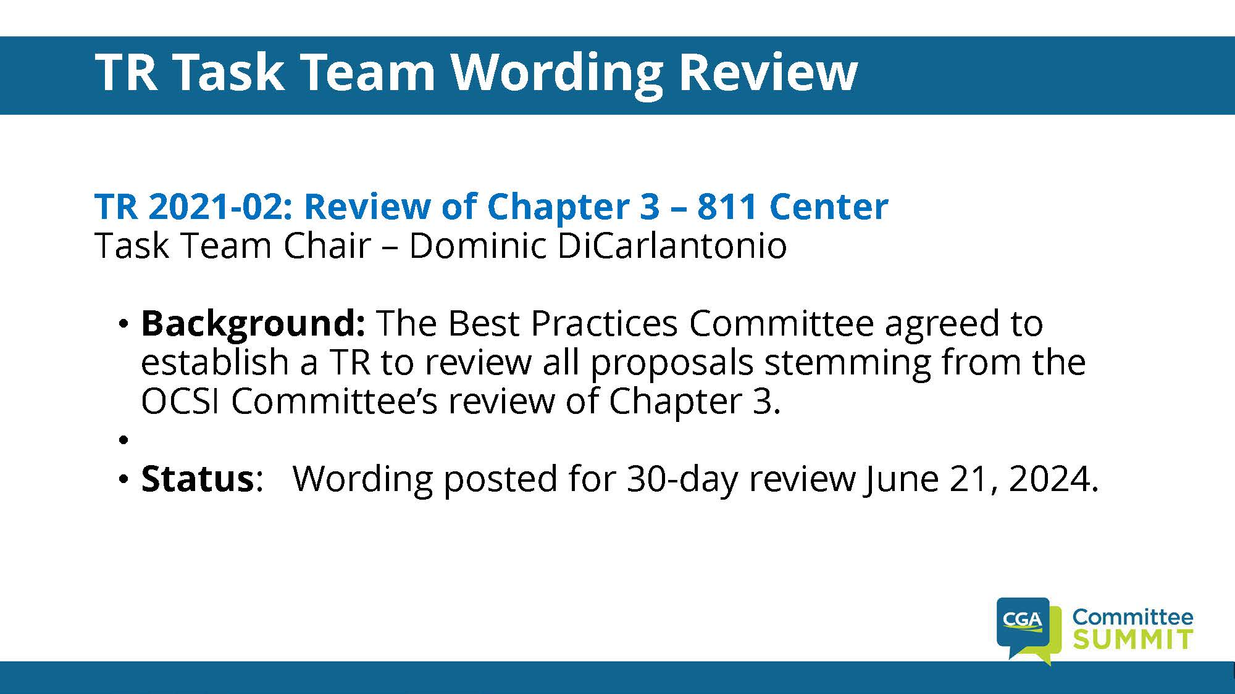

Slide 12
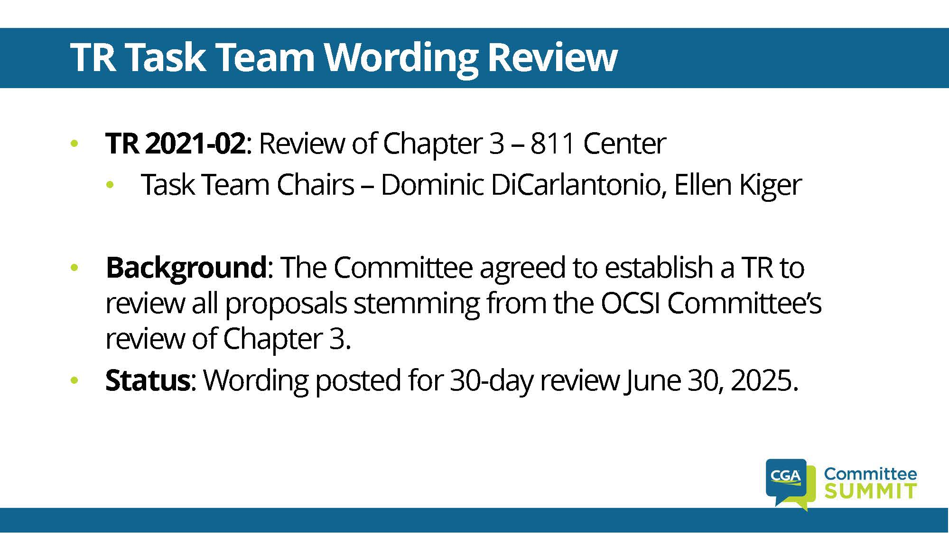

Slide 17
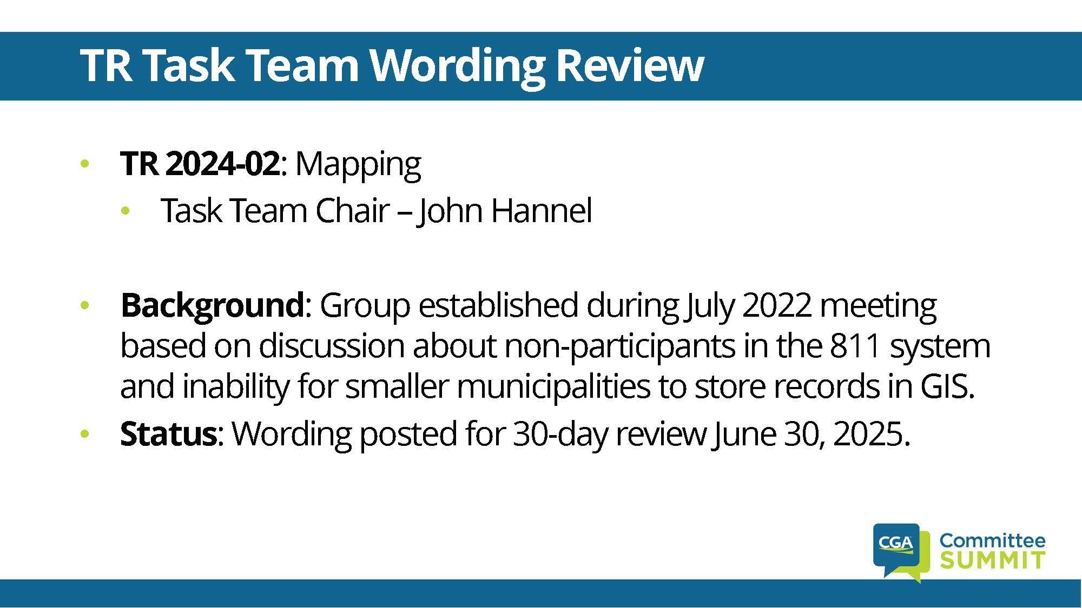

Slide 26
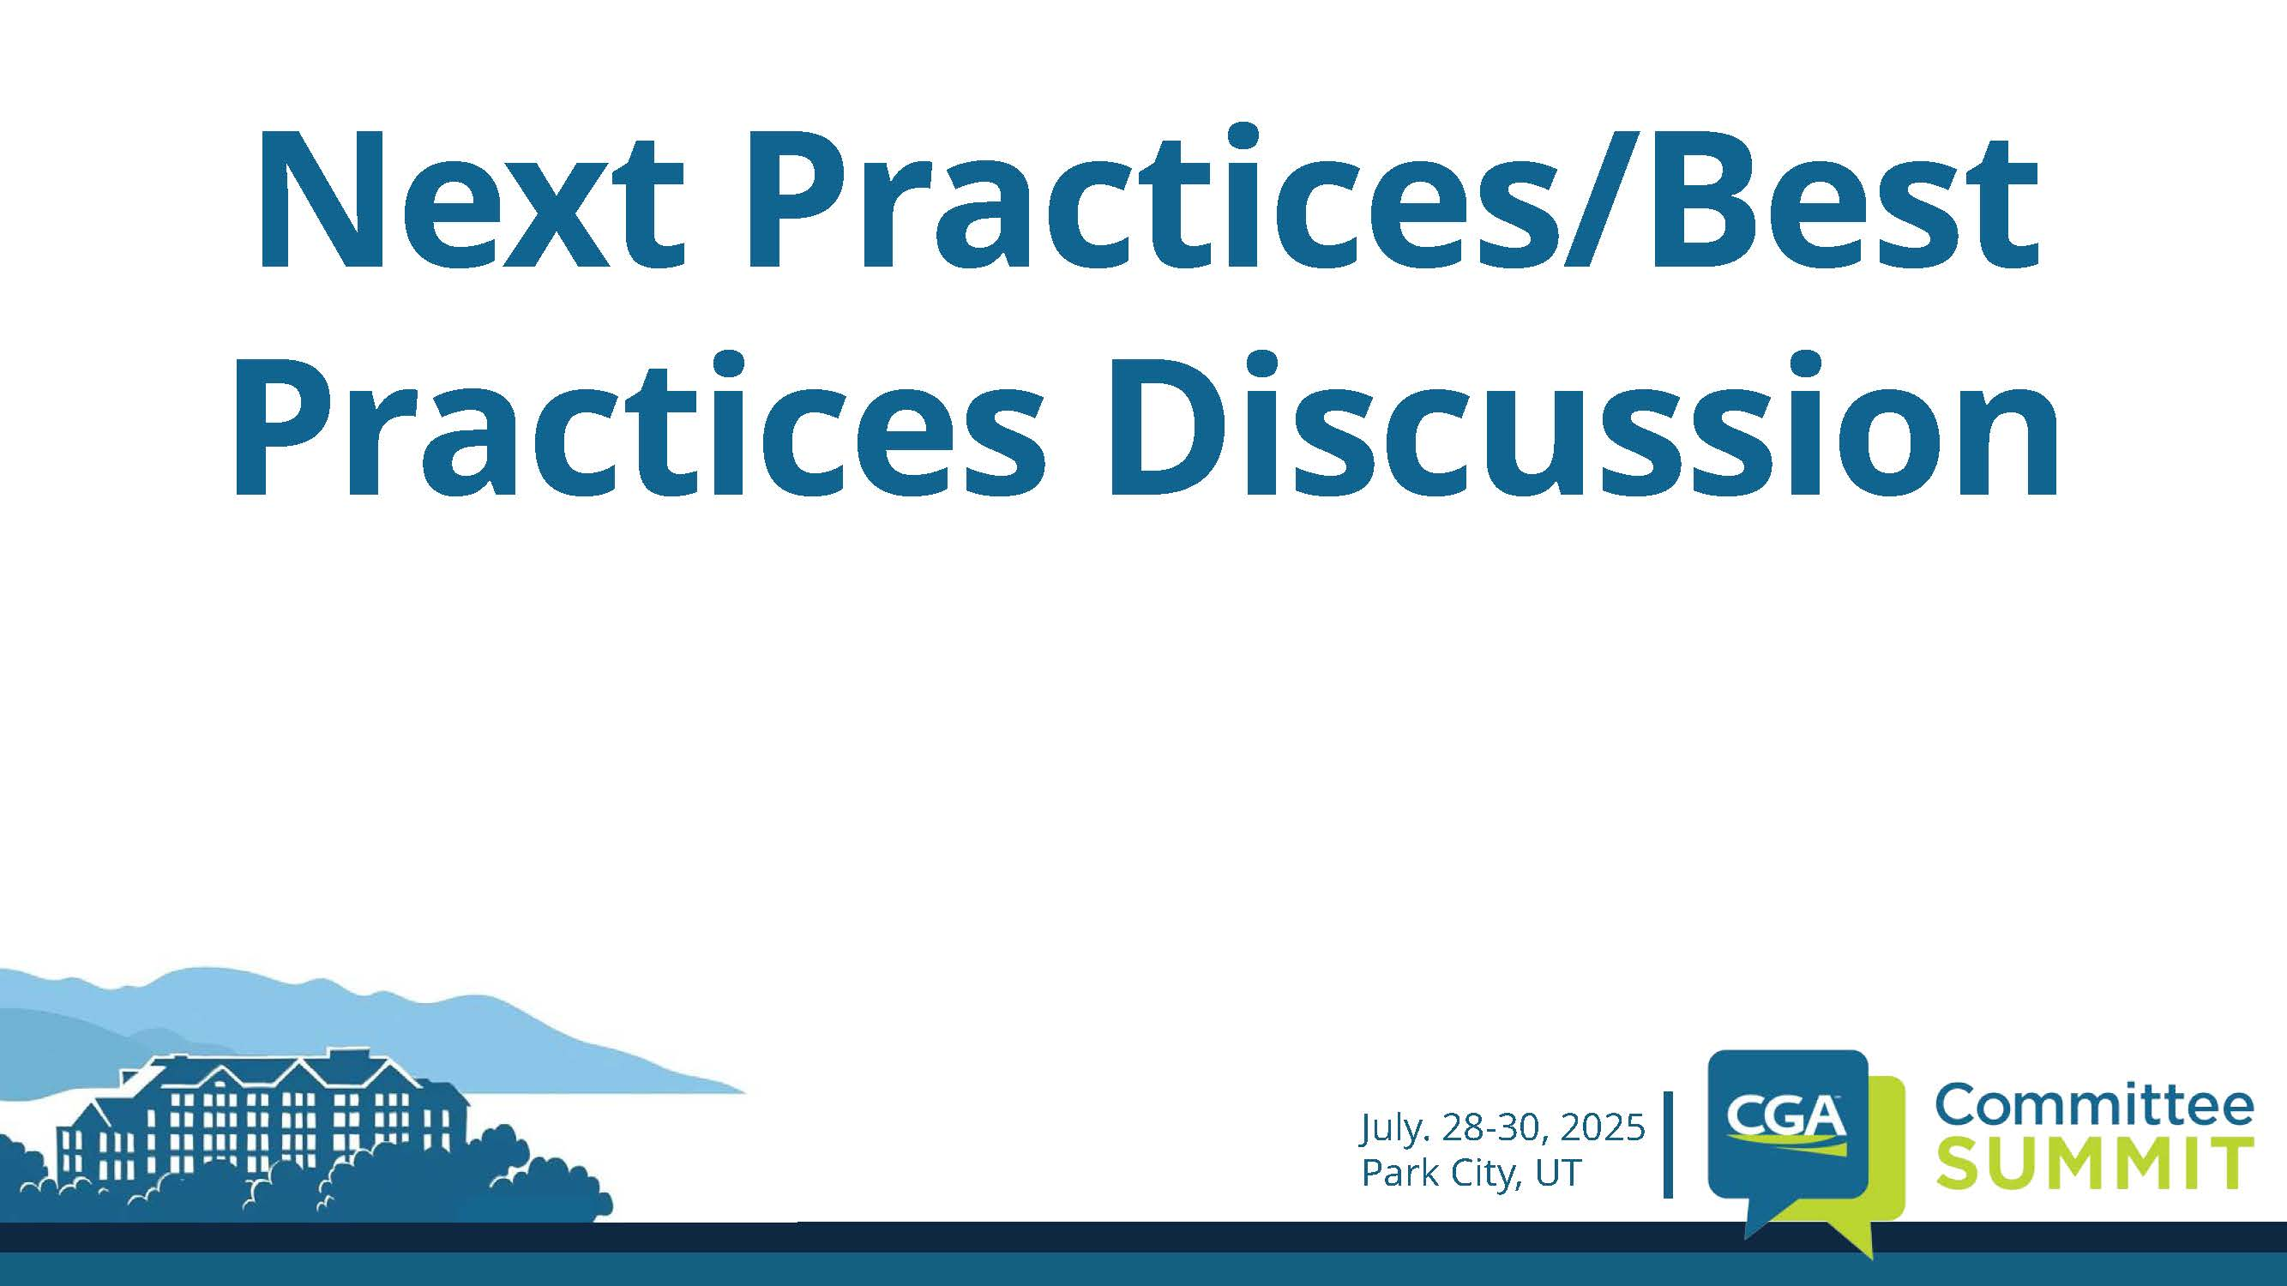

Slide 27
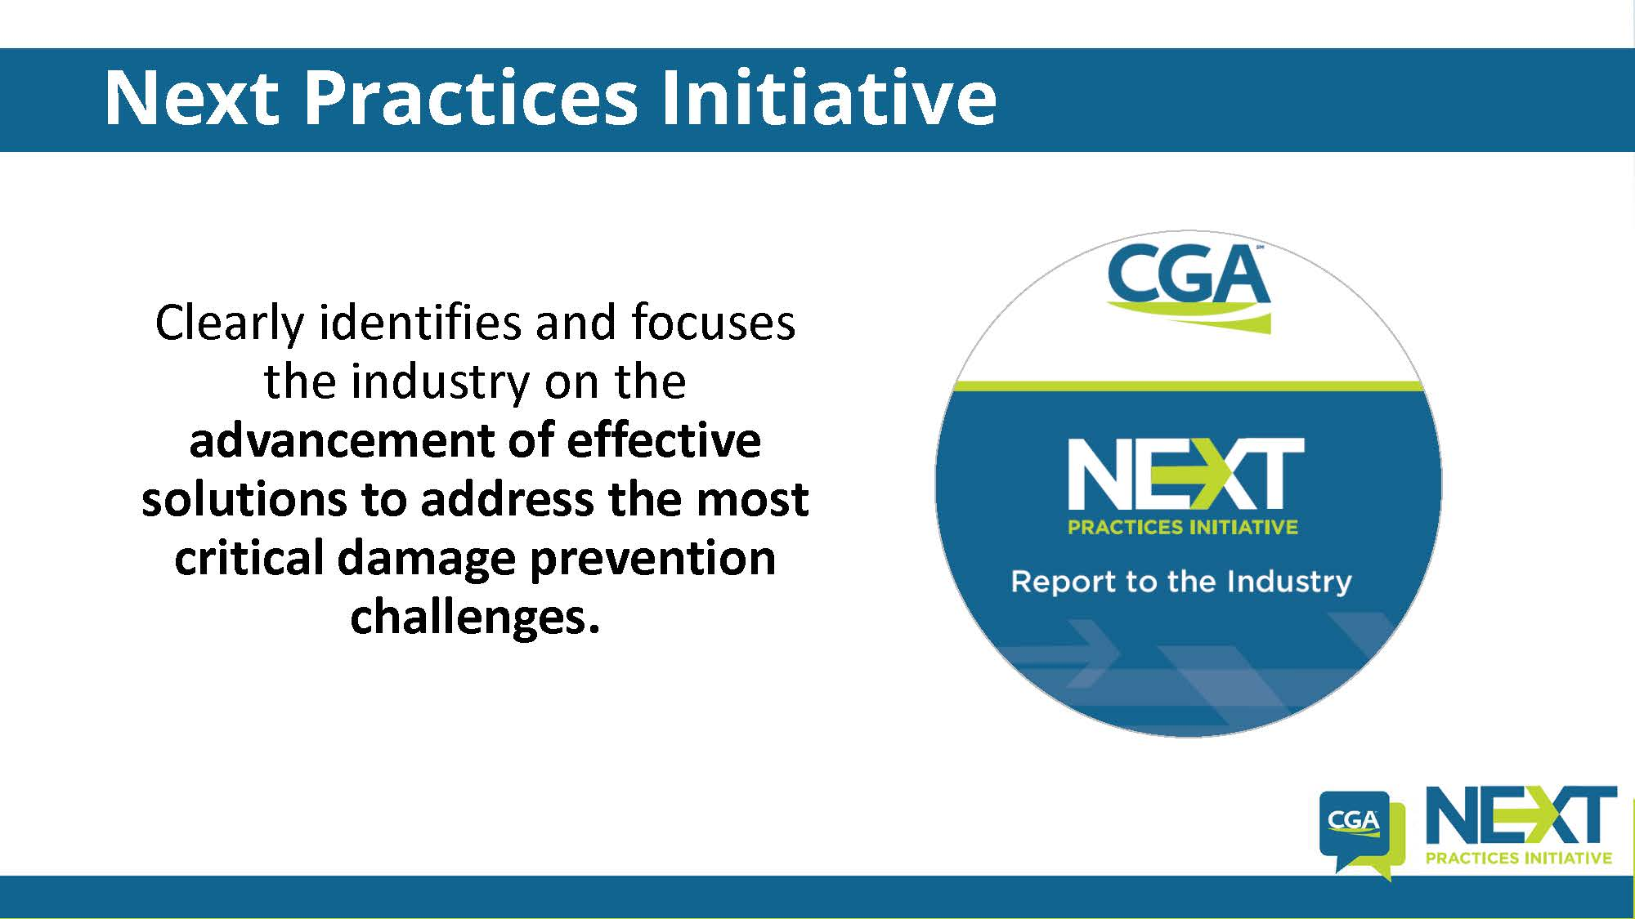

Slide 28
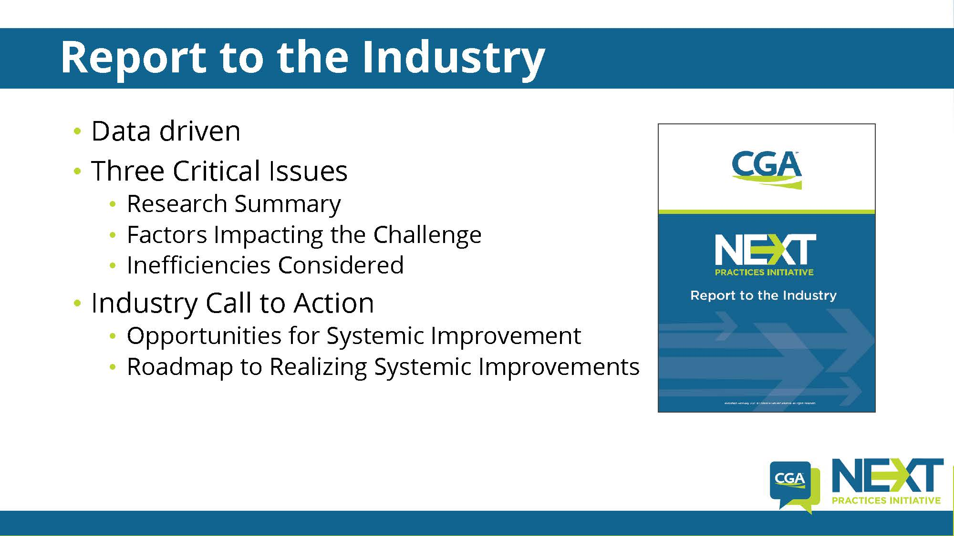

Slide 29
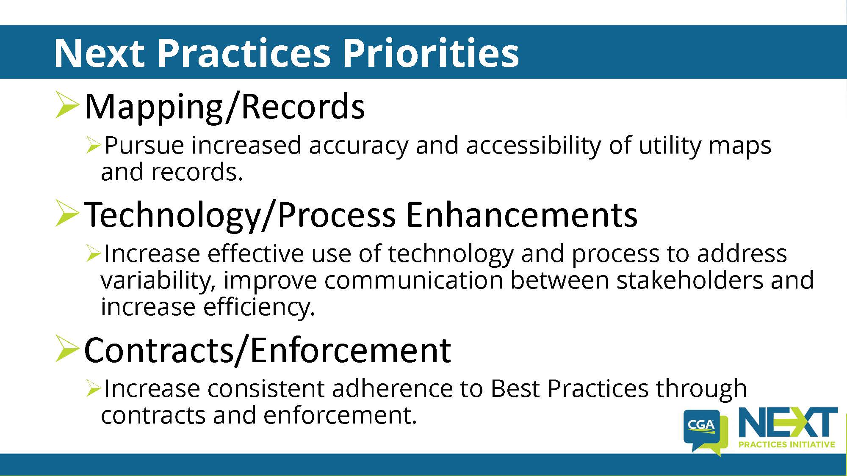

Slide 30
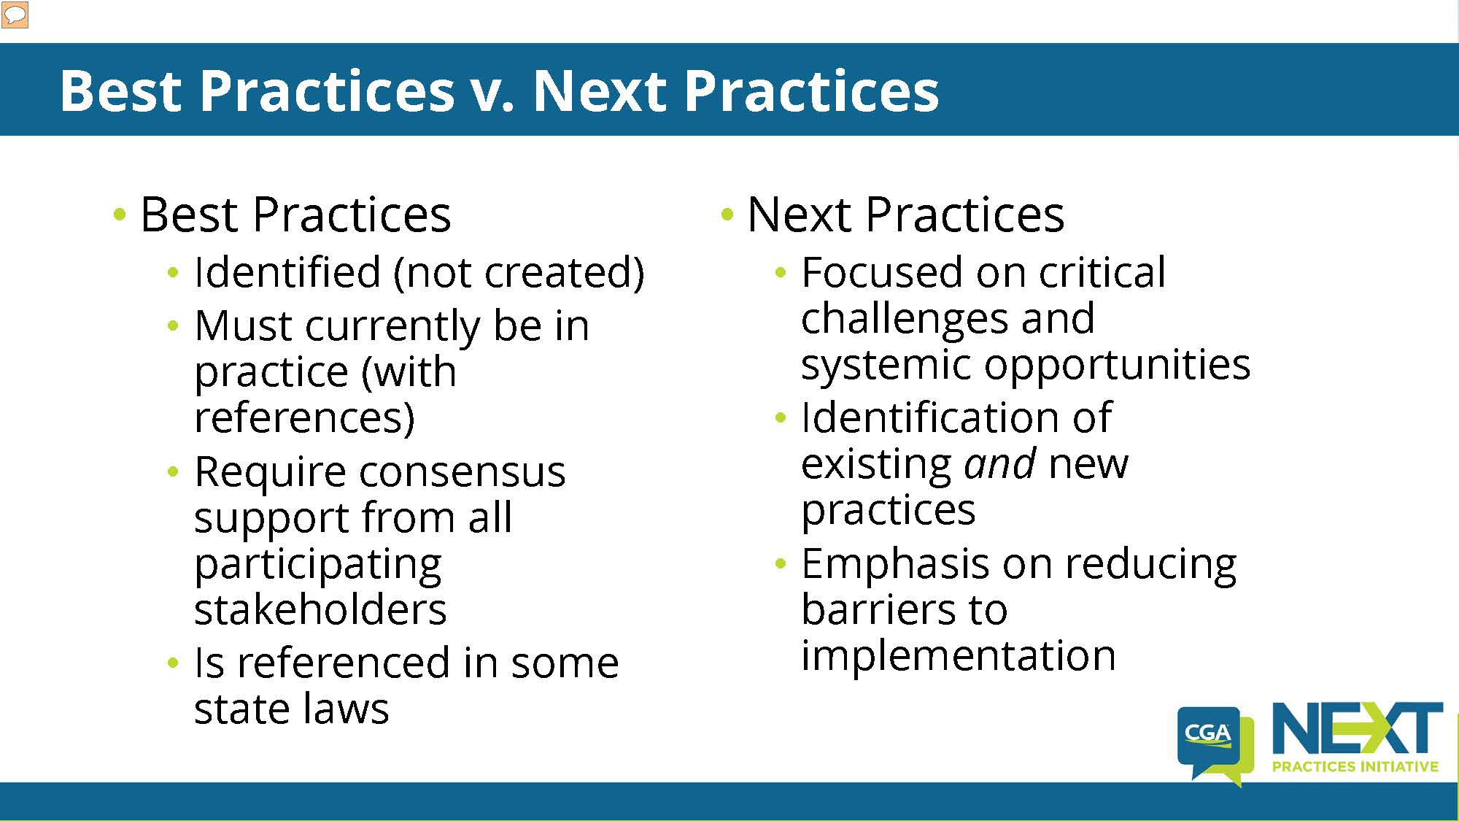

Slide 31
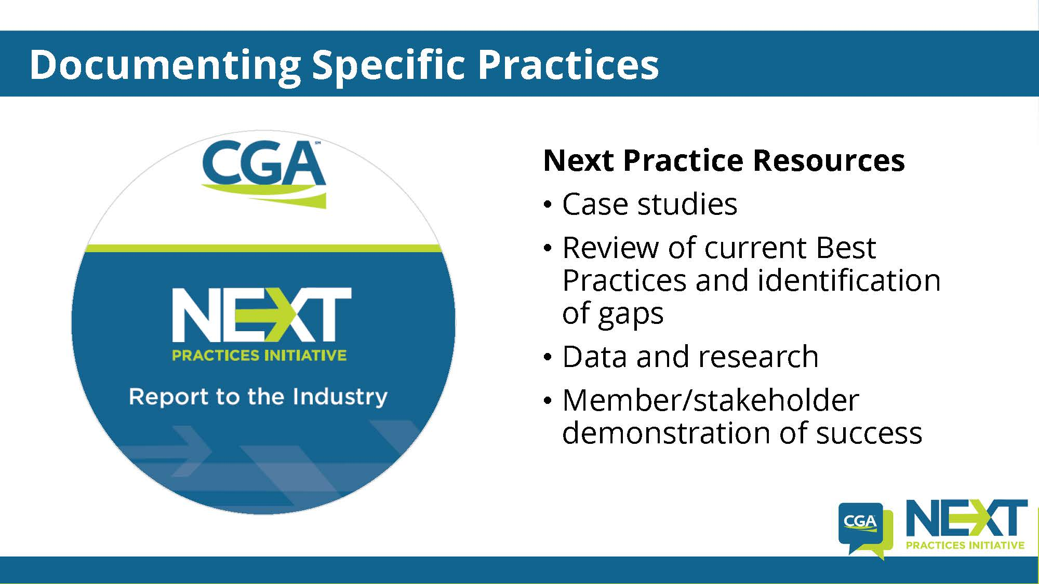

Slide 32
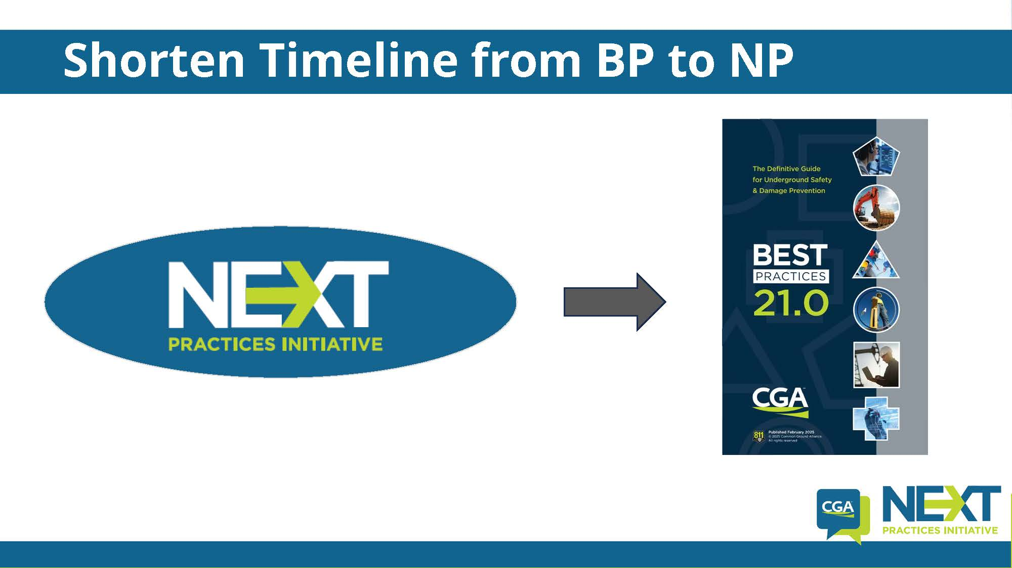

Slide 33
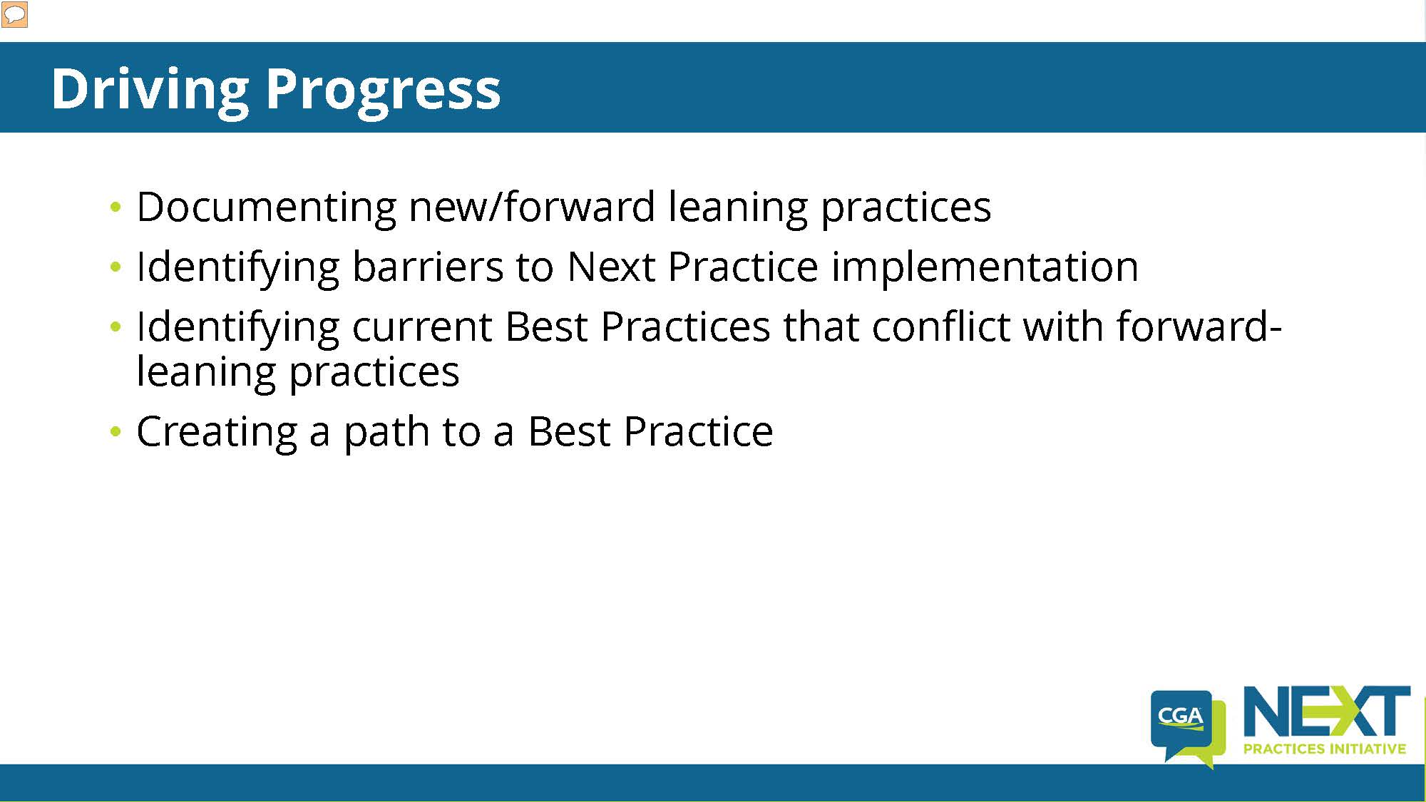

Slide 34
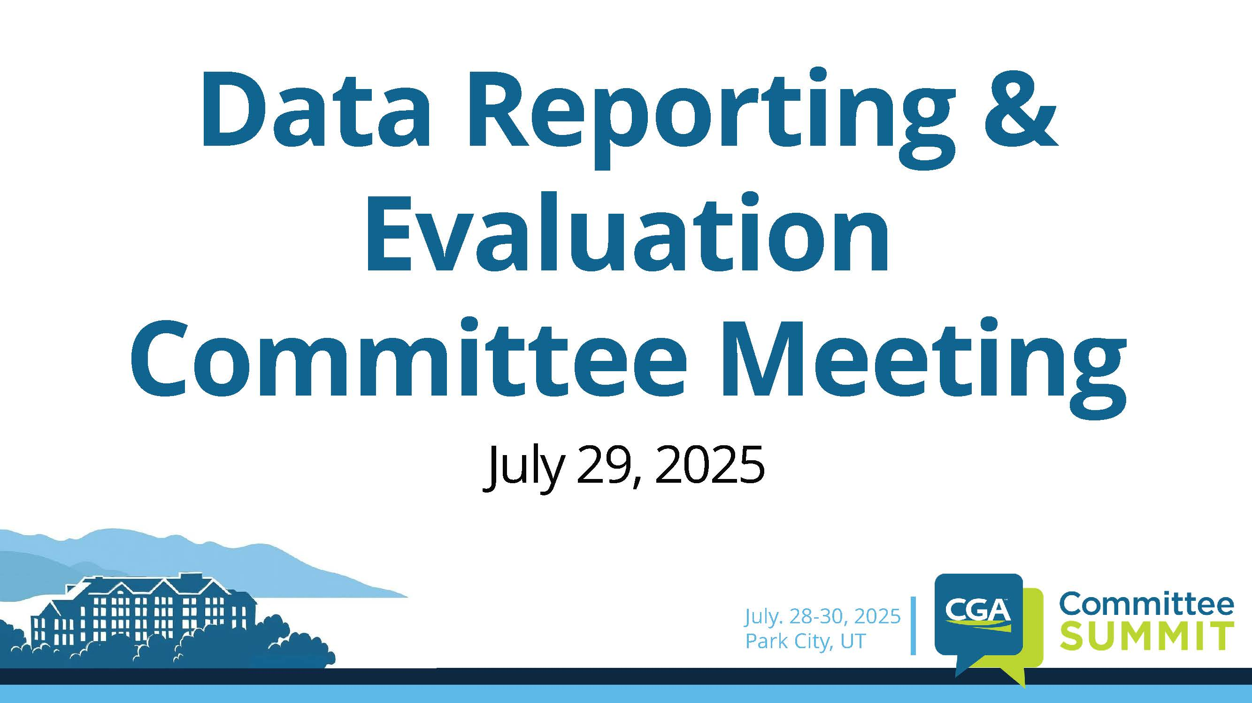

Slide 35
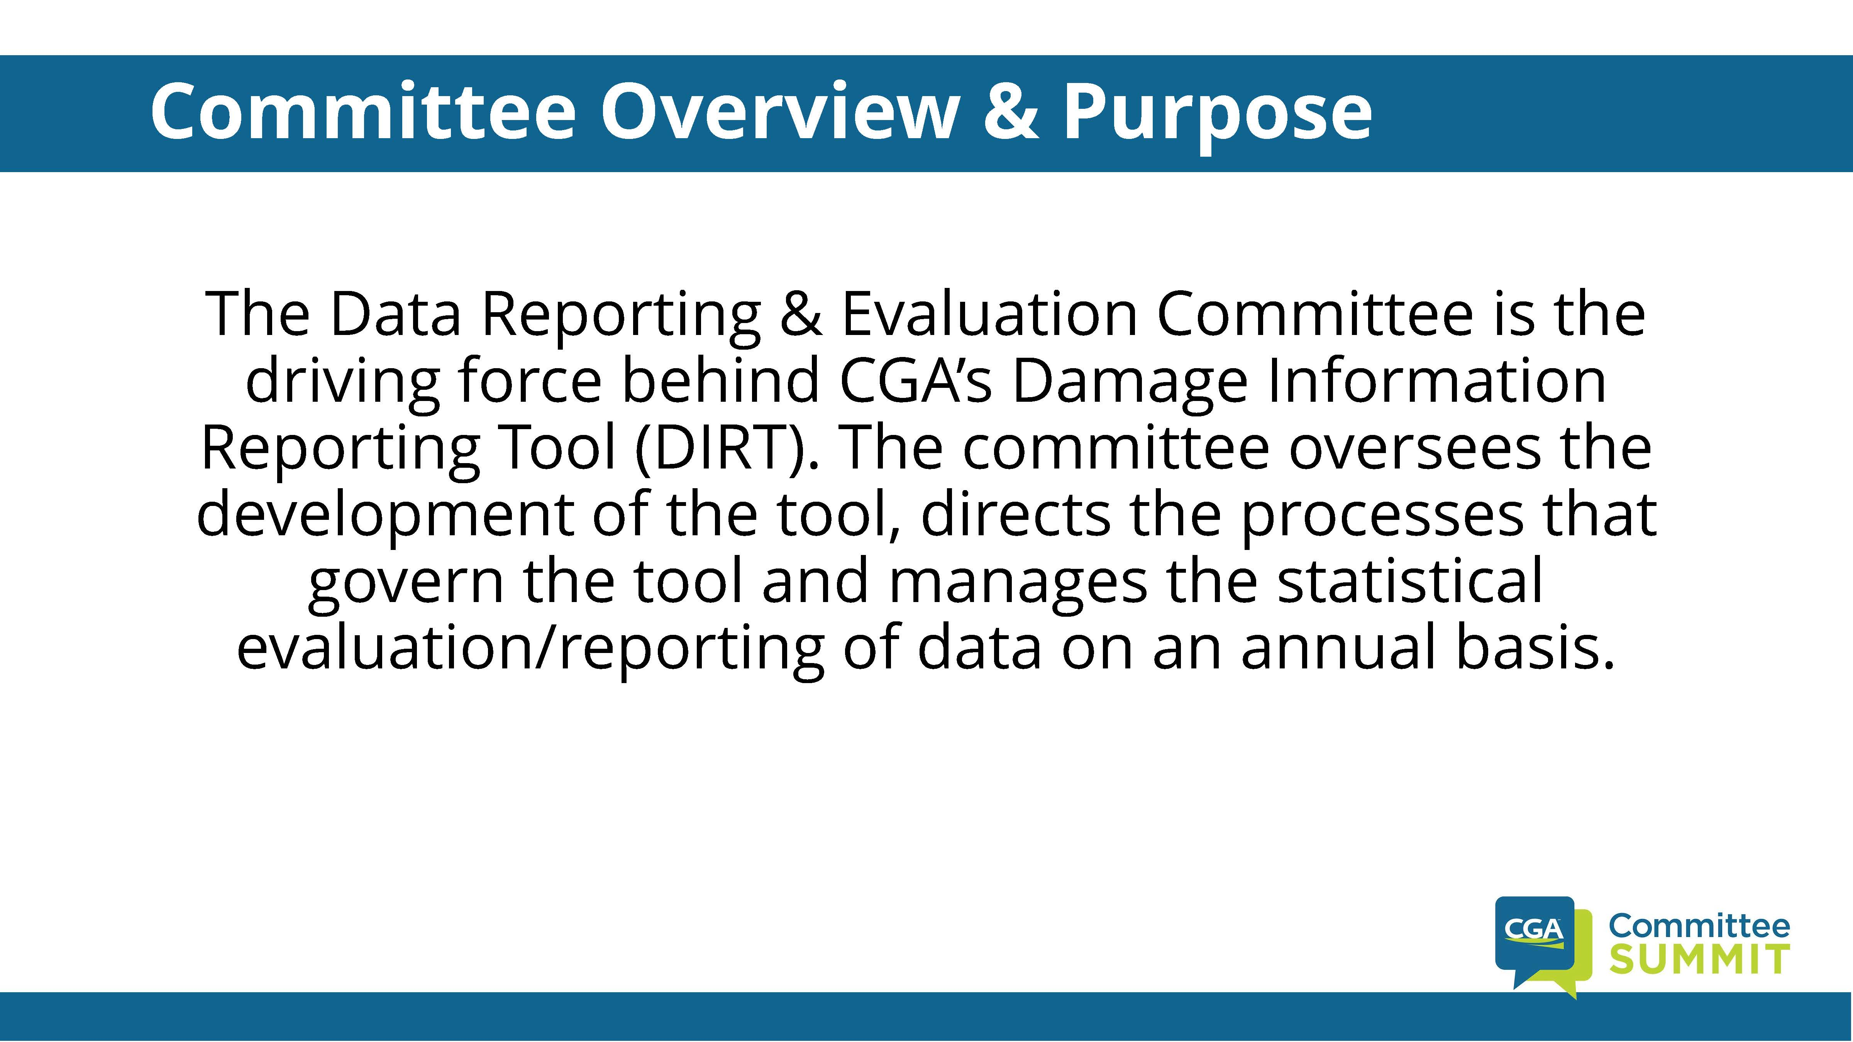

Slide 36
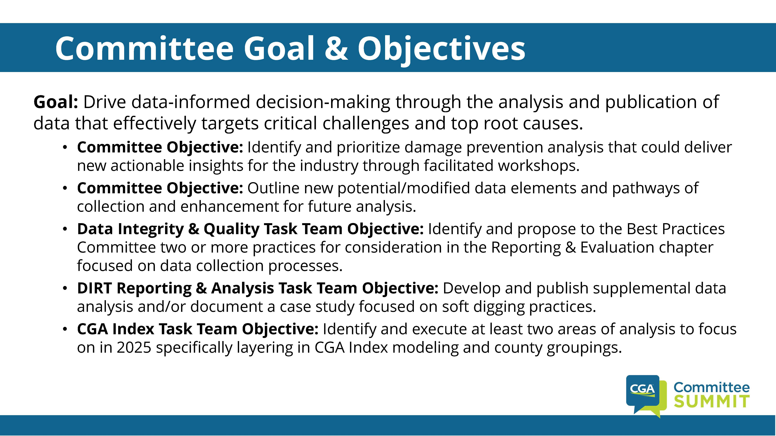

Slide 37
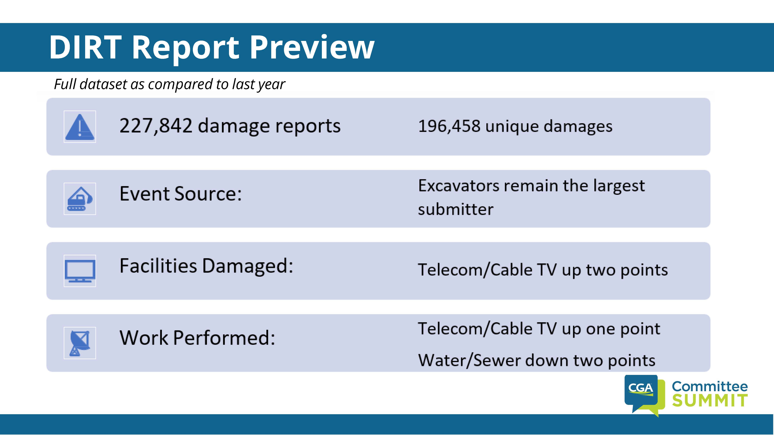

Slide 38
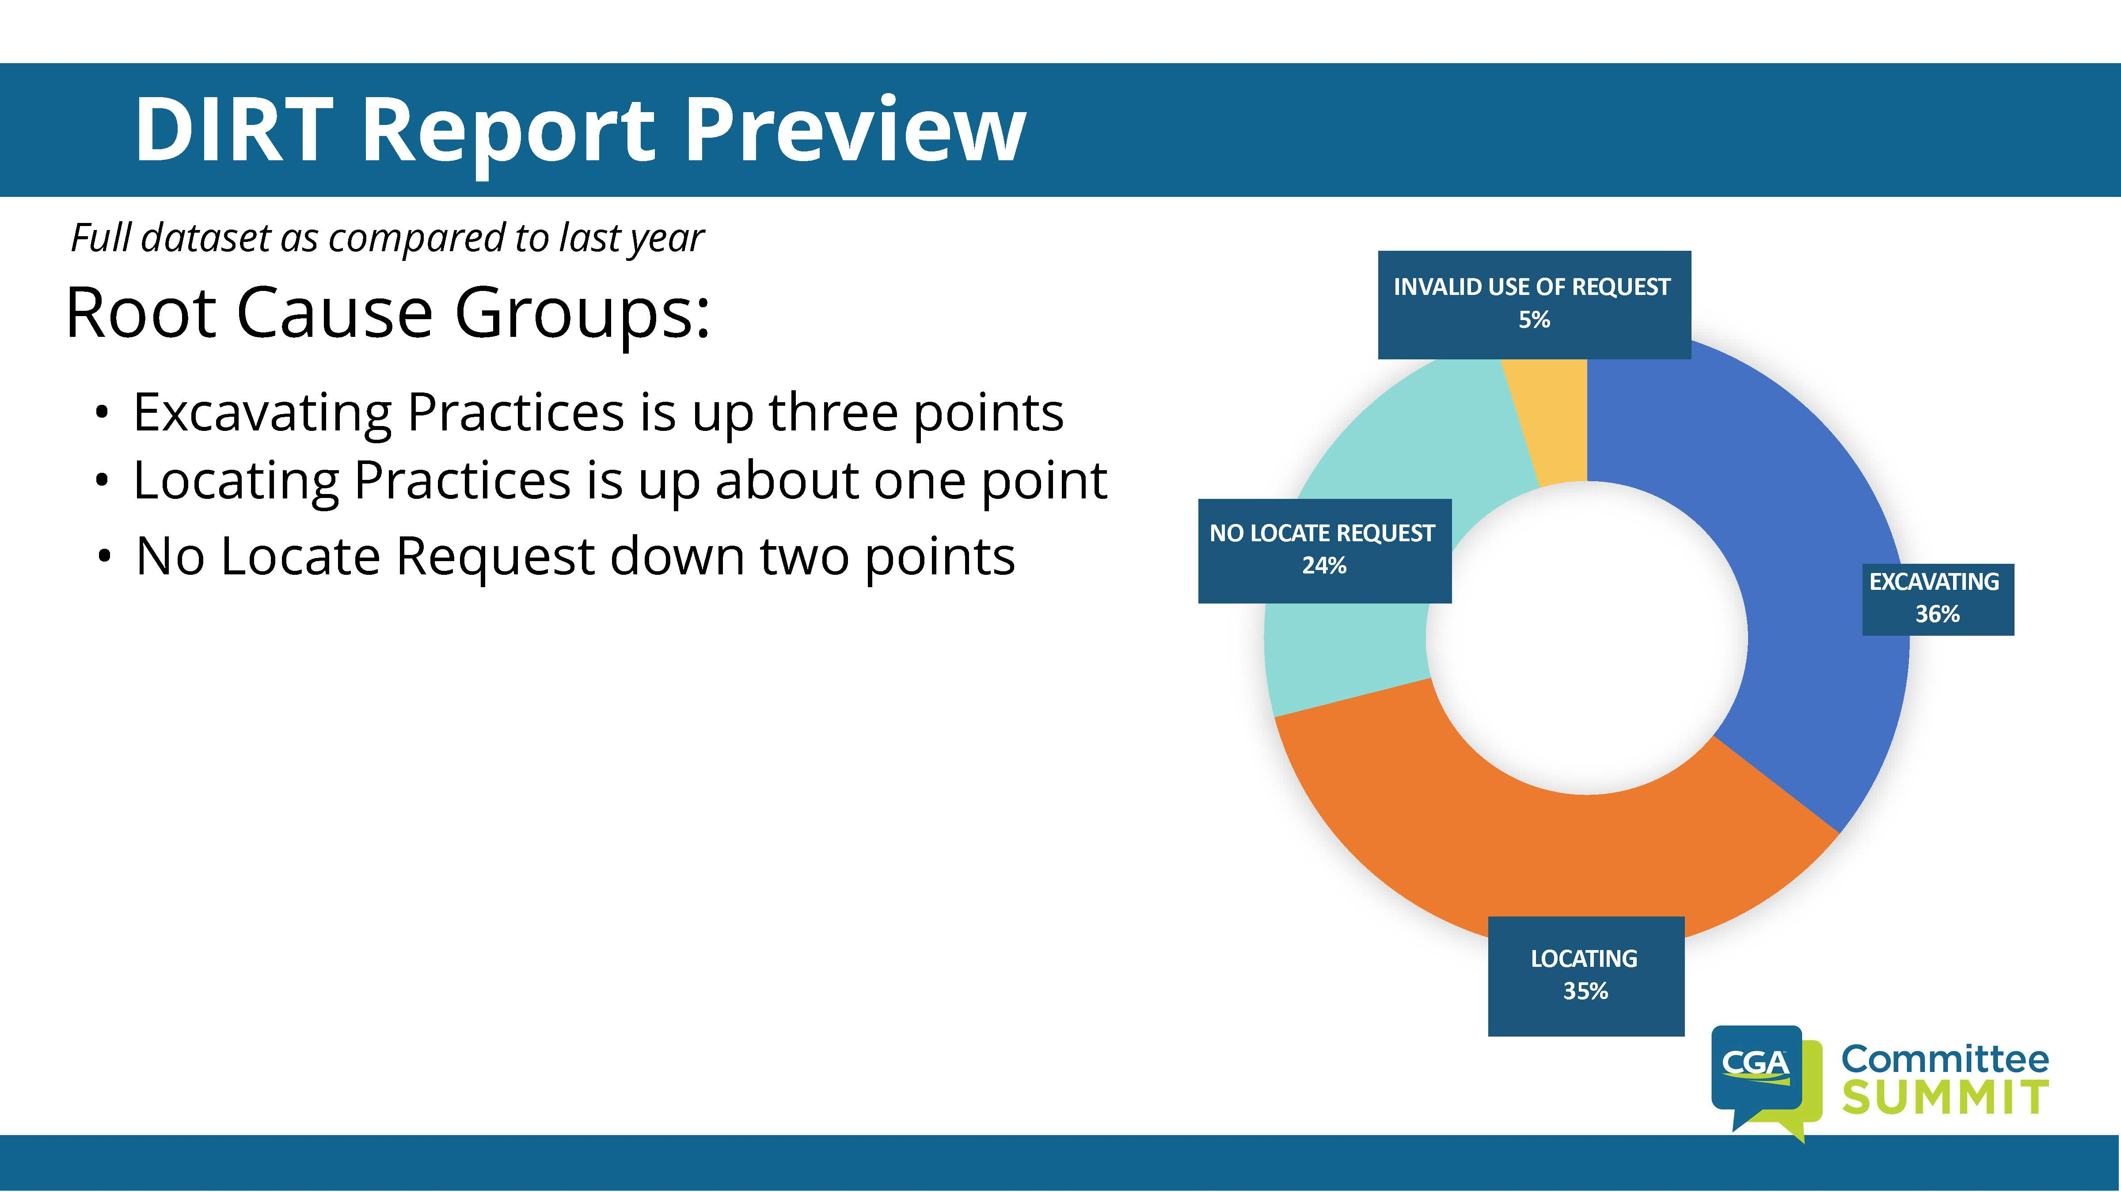

Slide 39
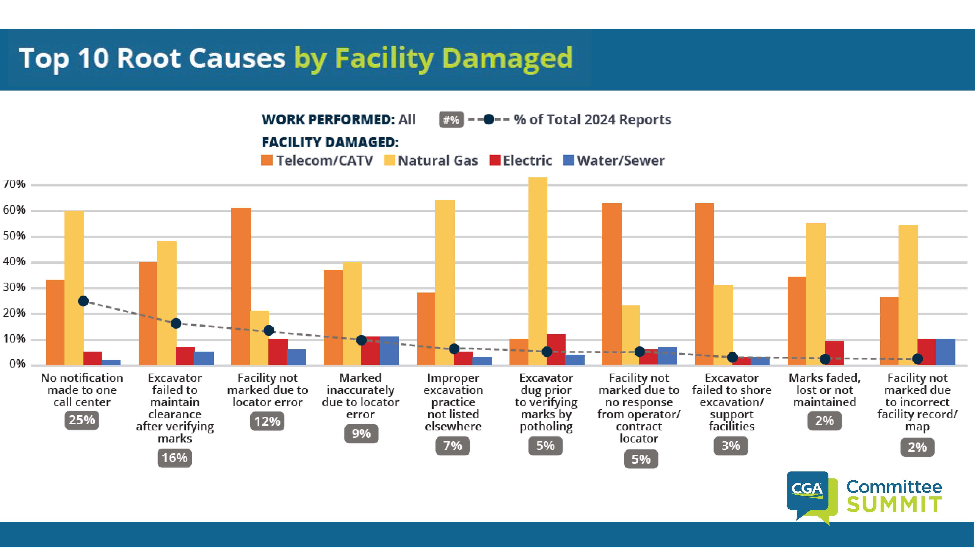

Slide 40
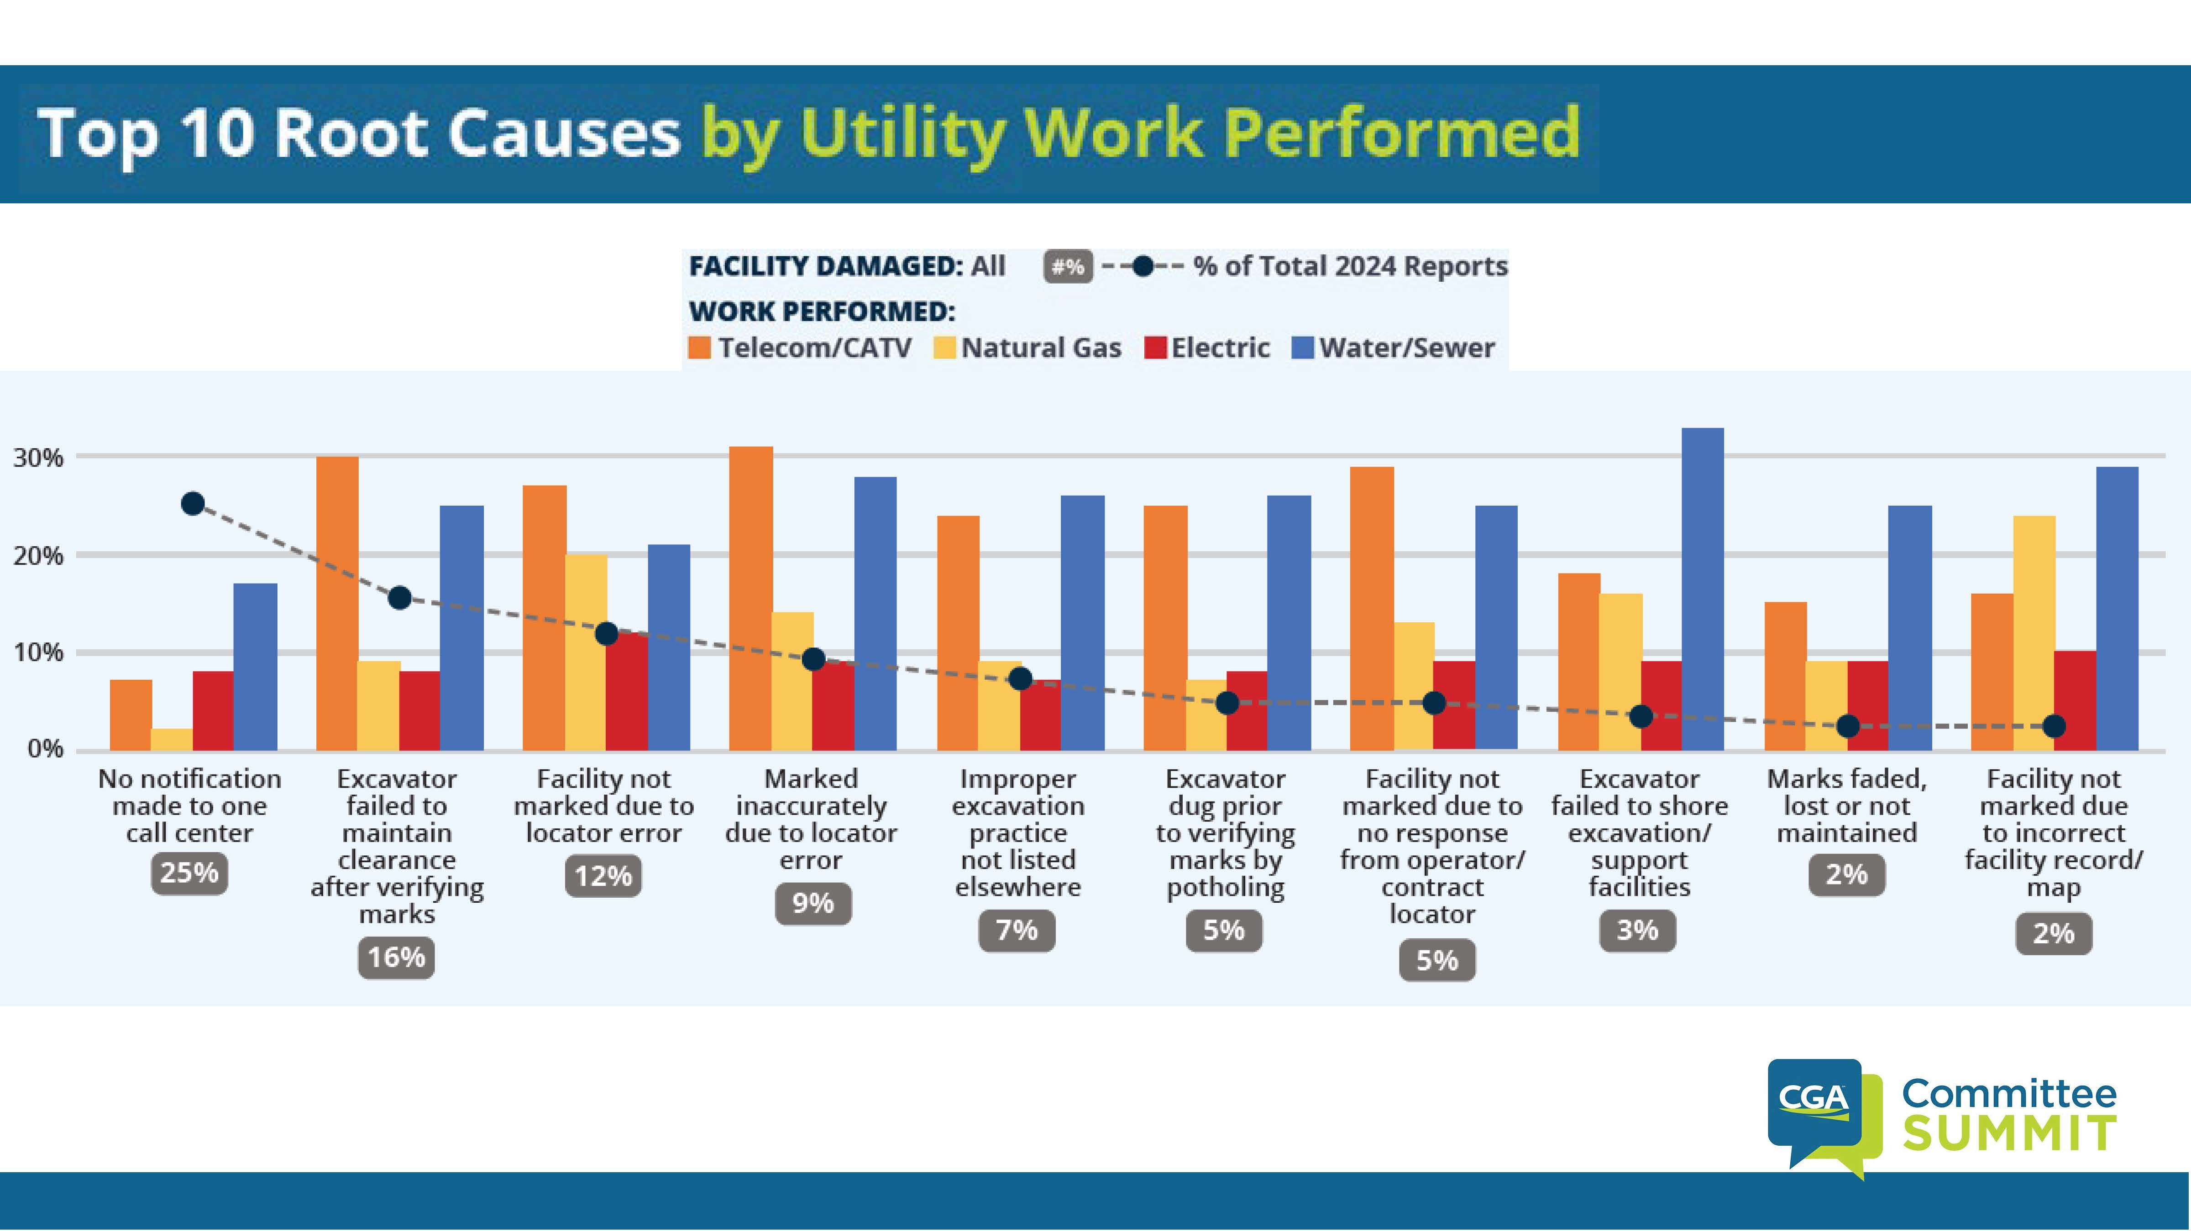

Slide 41
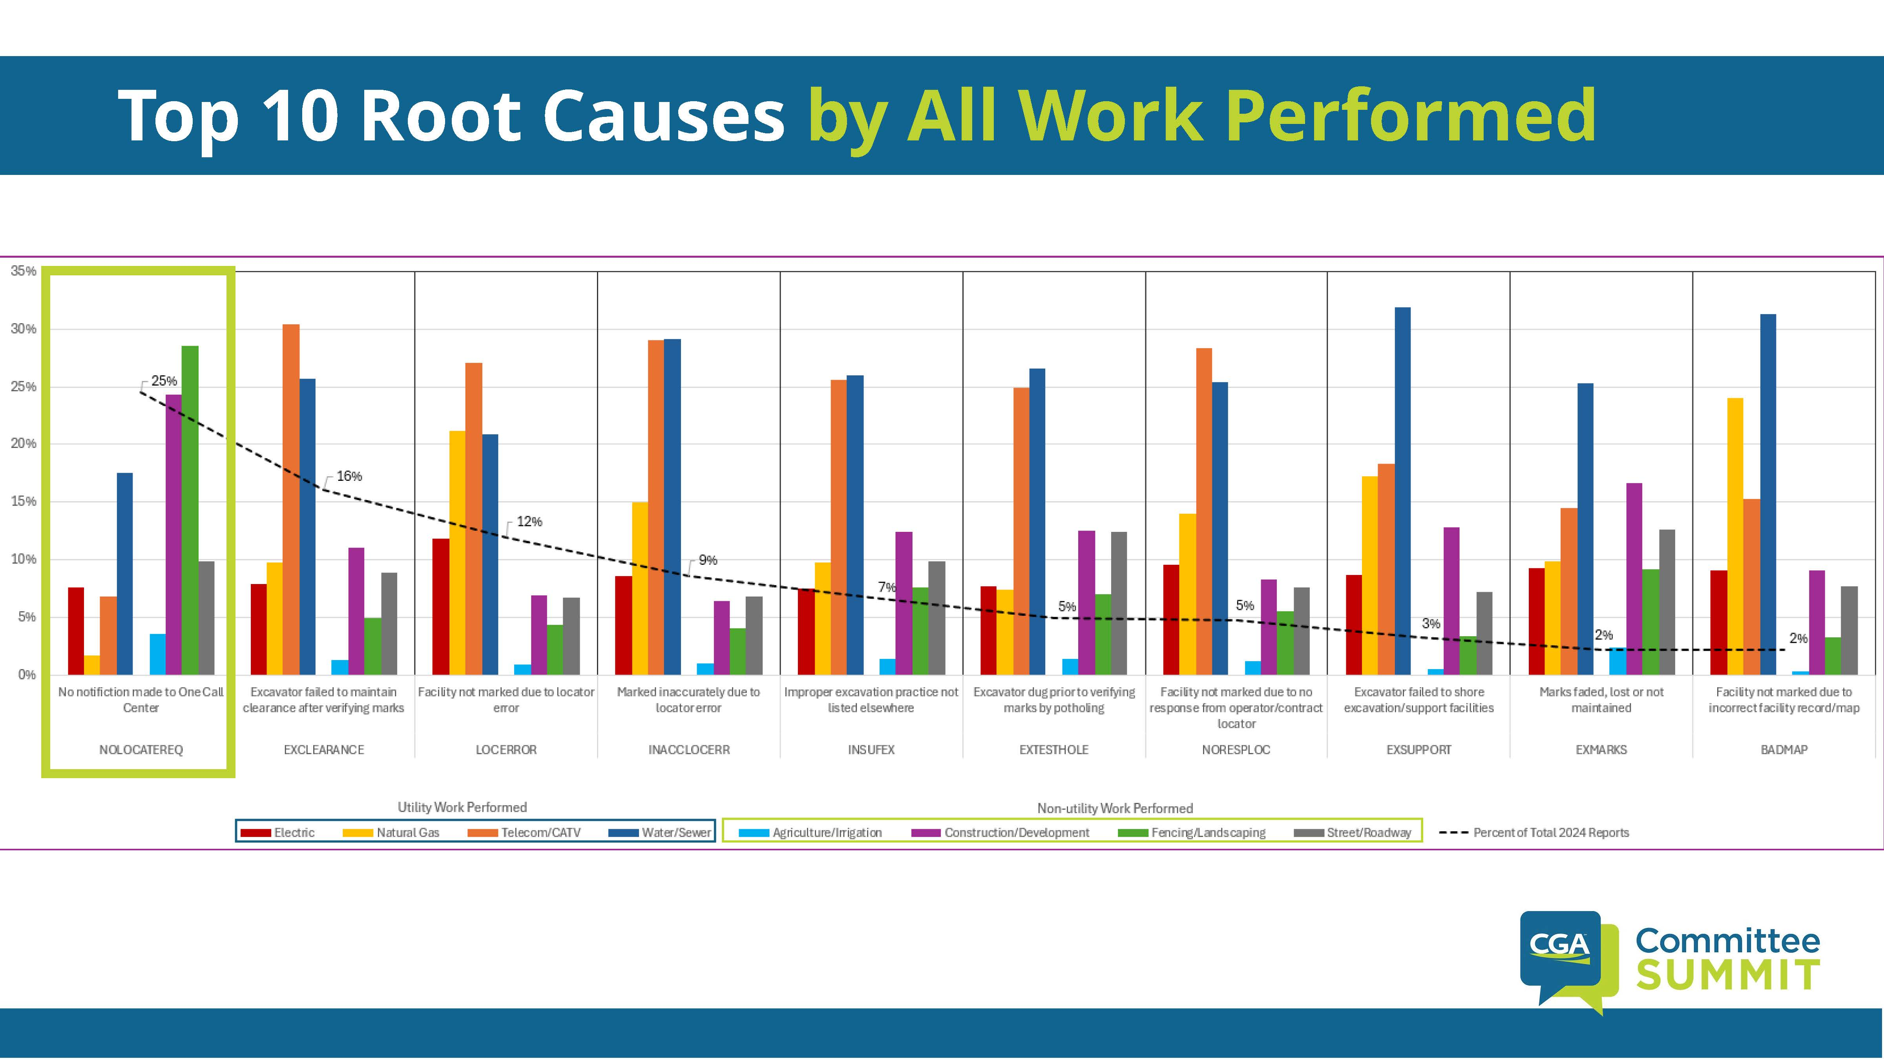

Slide 42
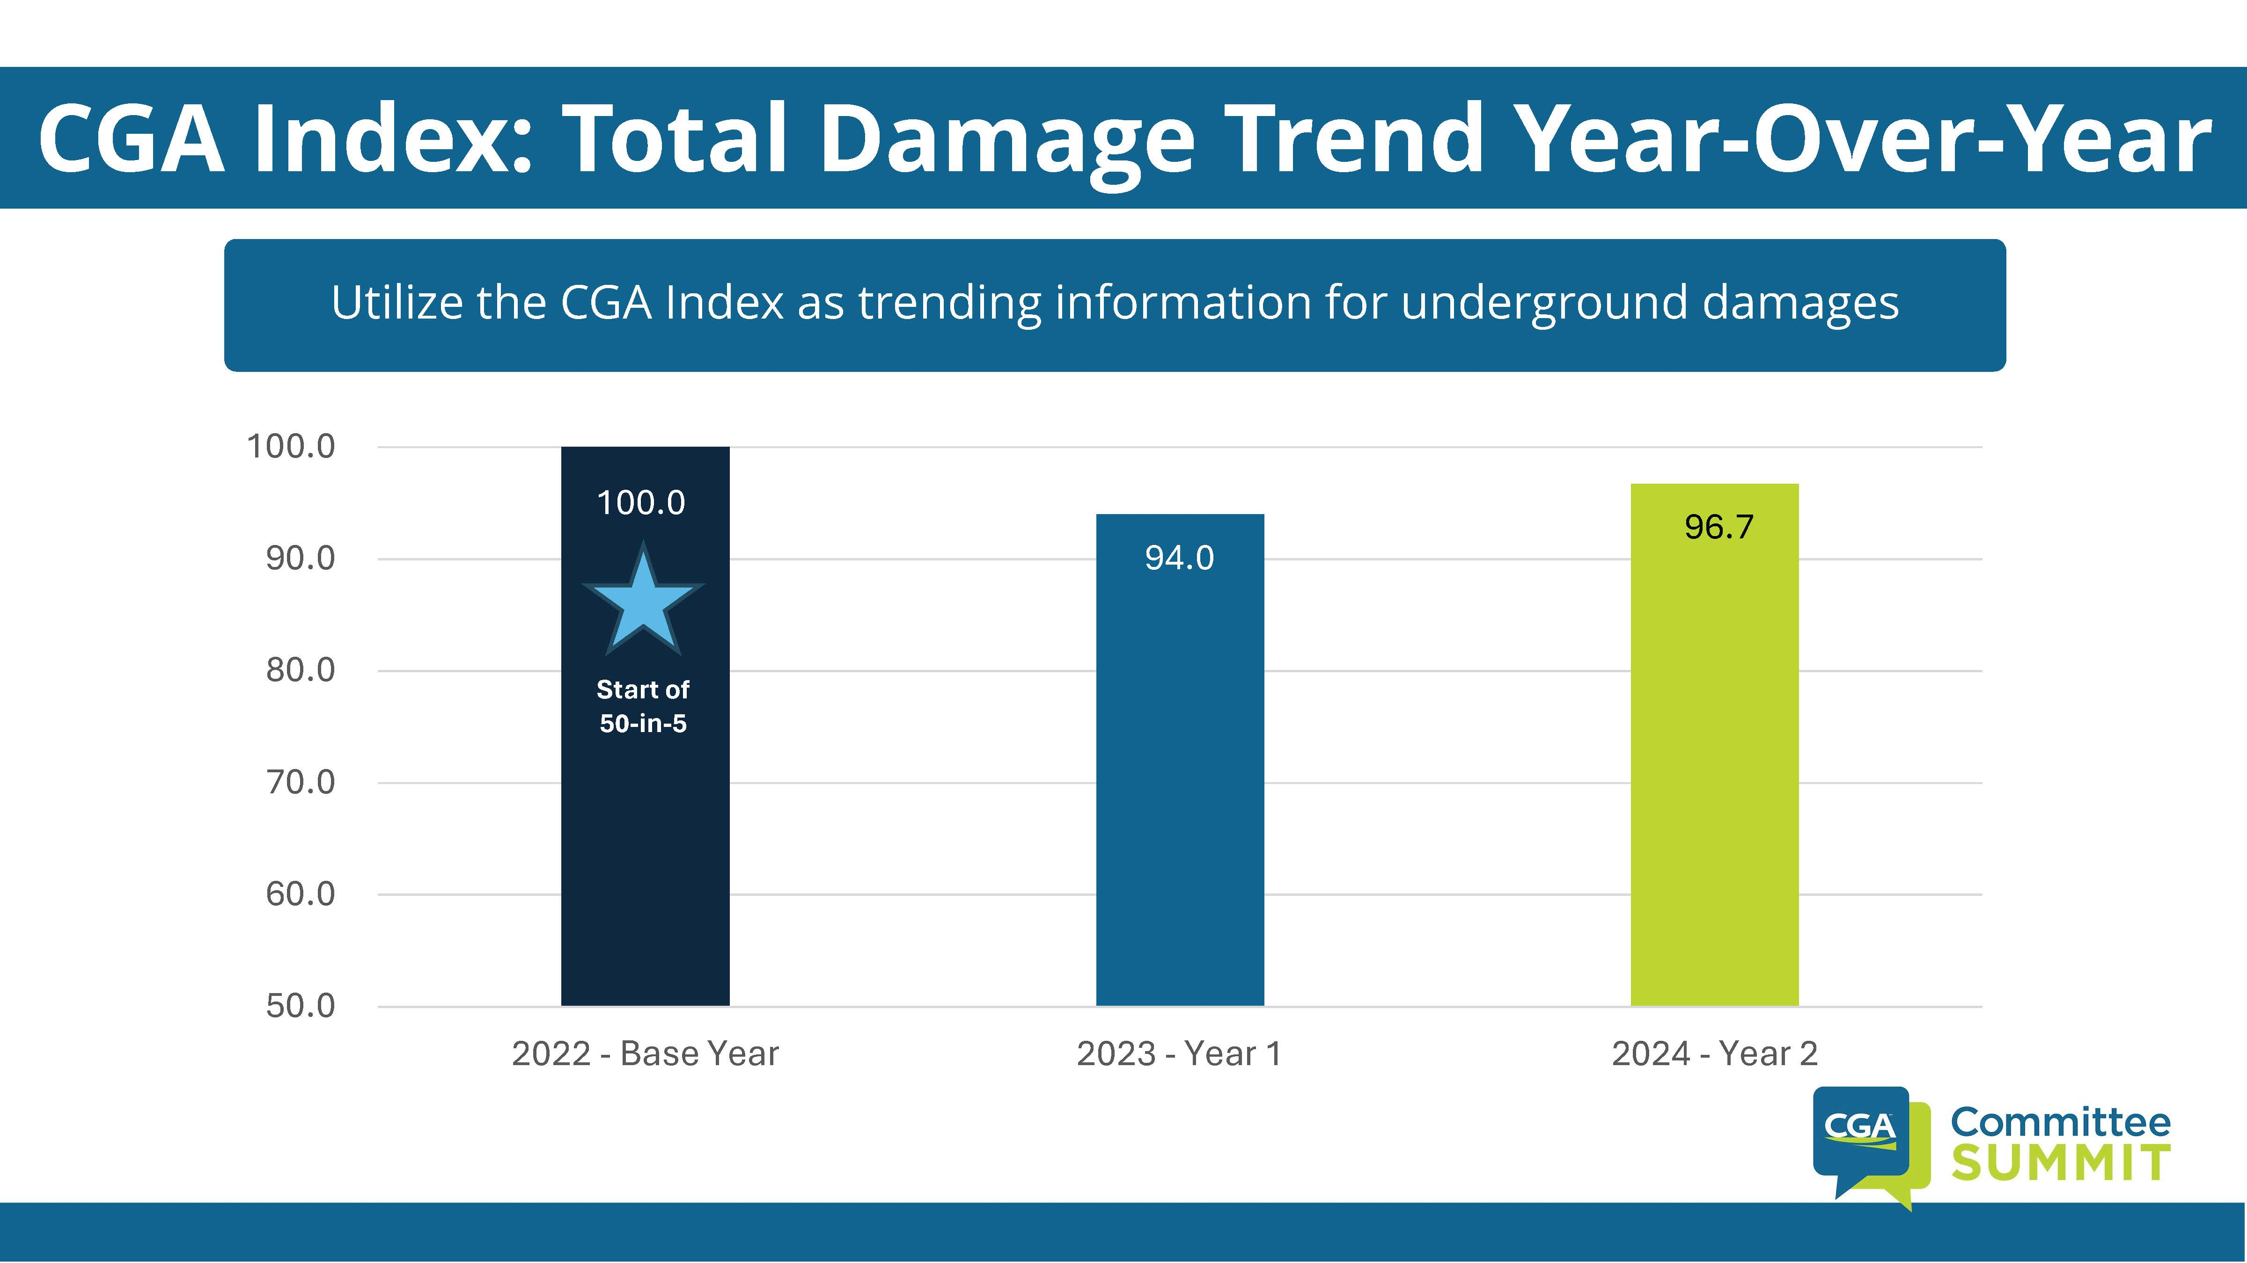

Slide 43
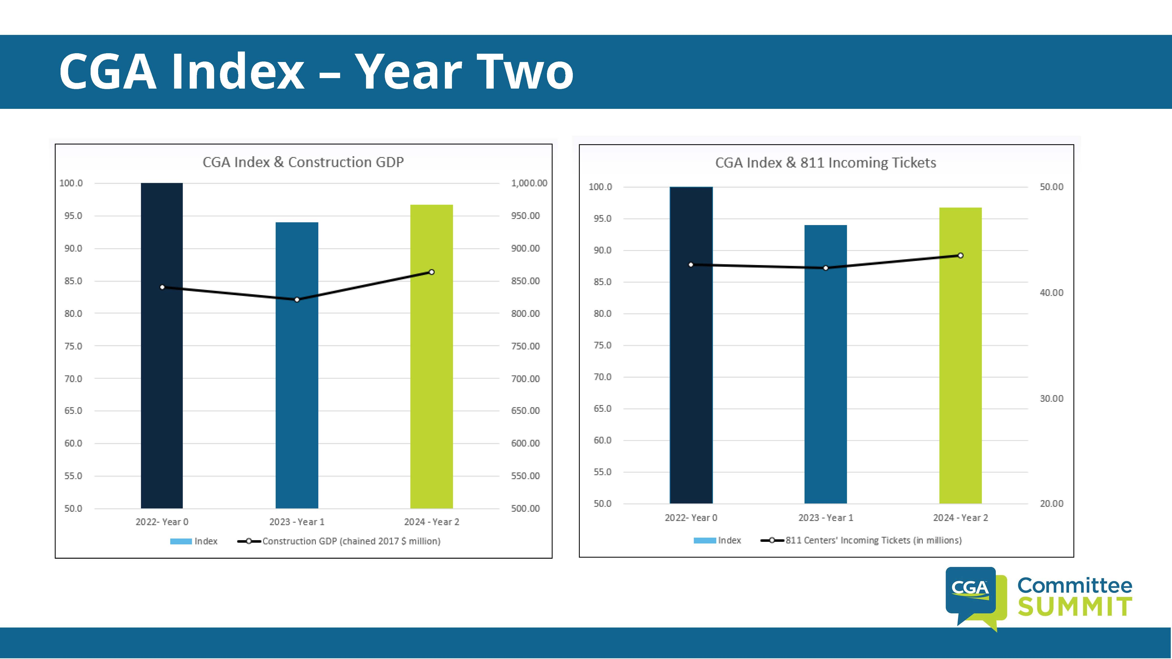

Slide 44
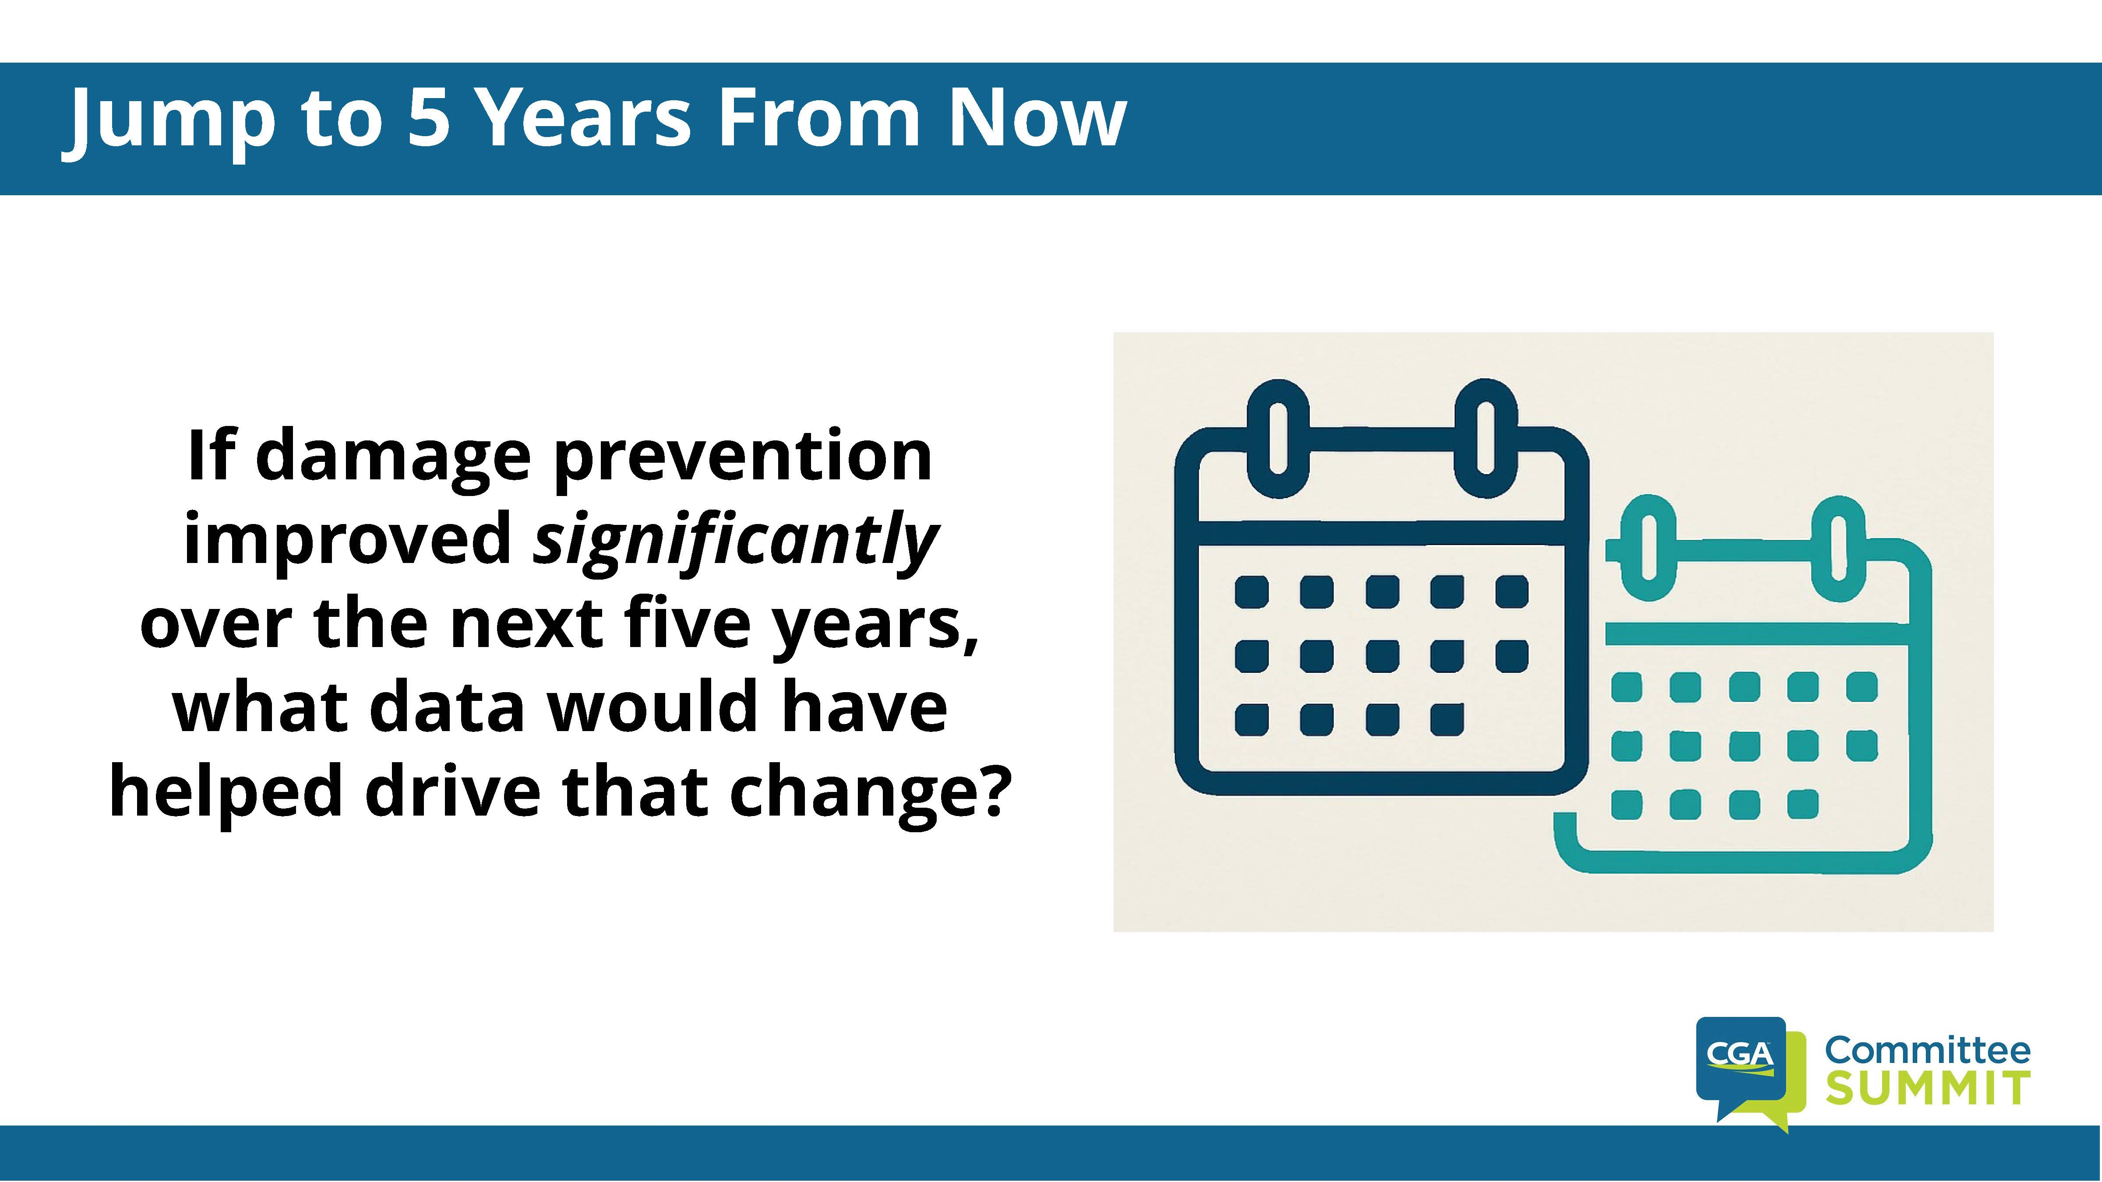

Slide 45
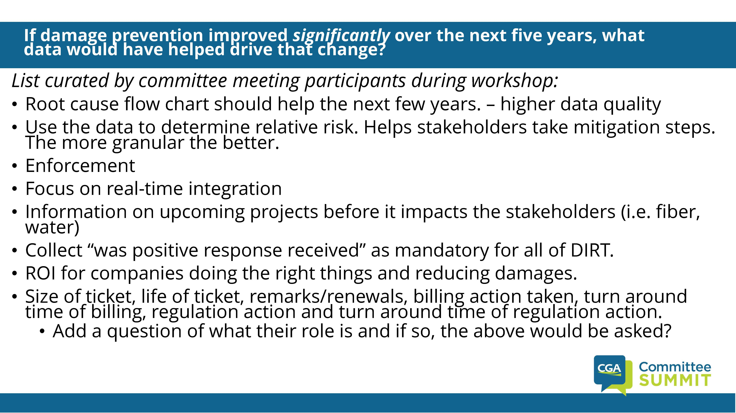

Slide 46
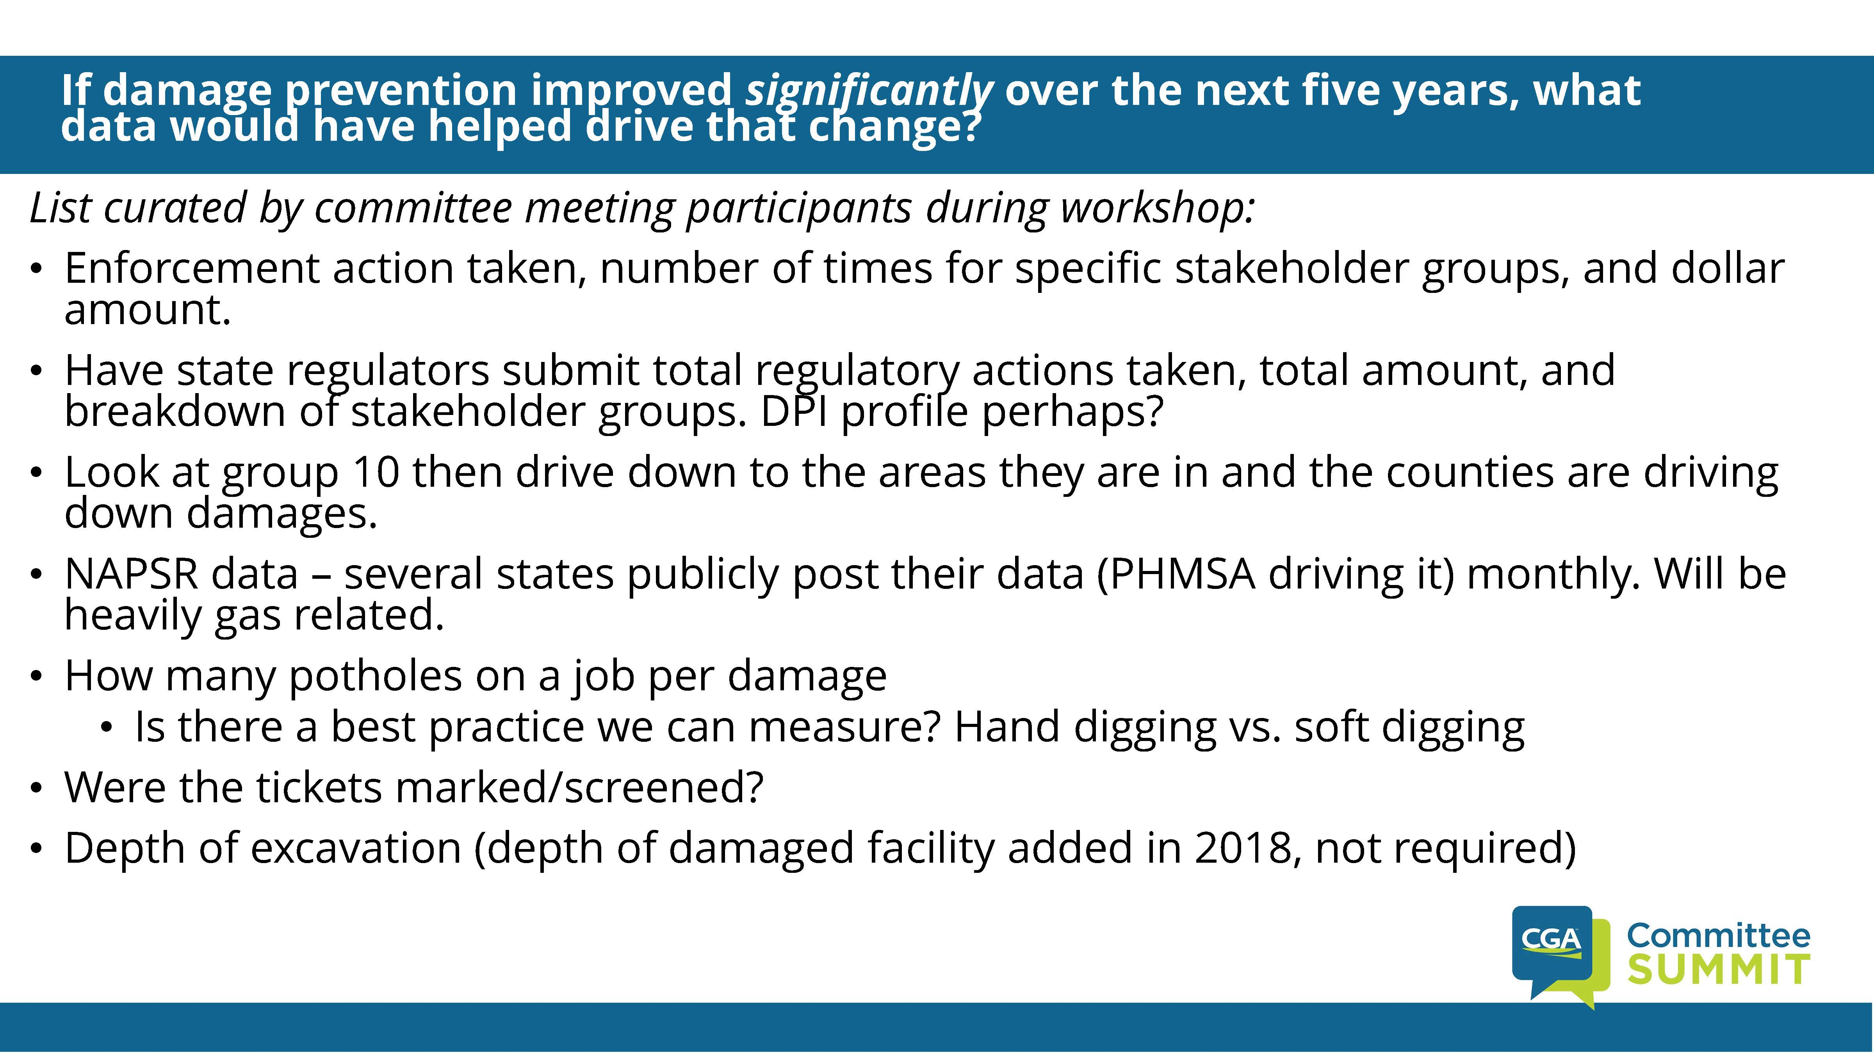

Slide 47
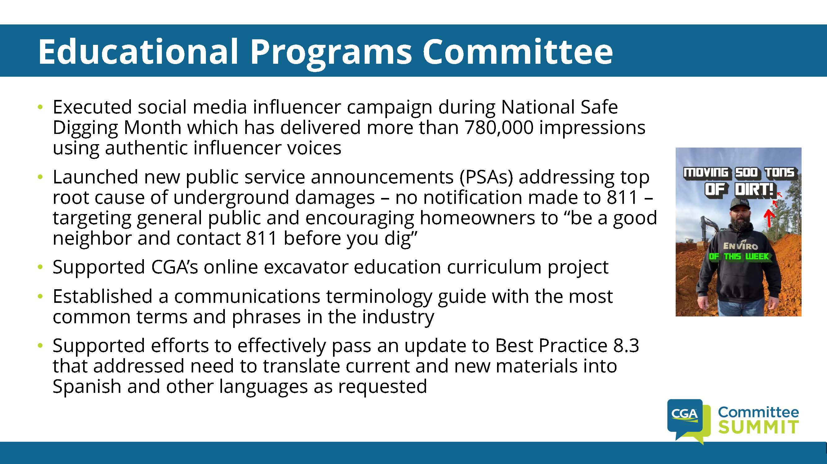

Slide 48
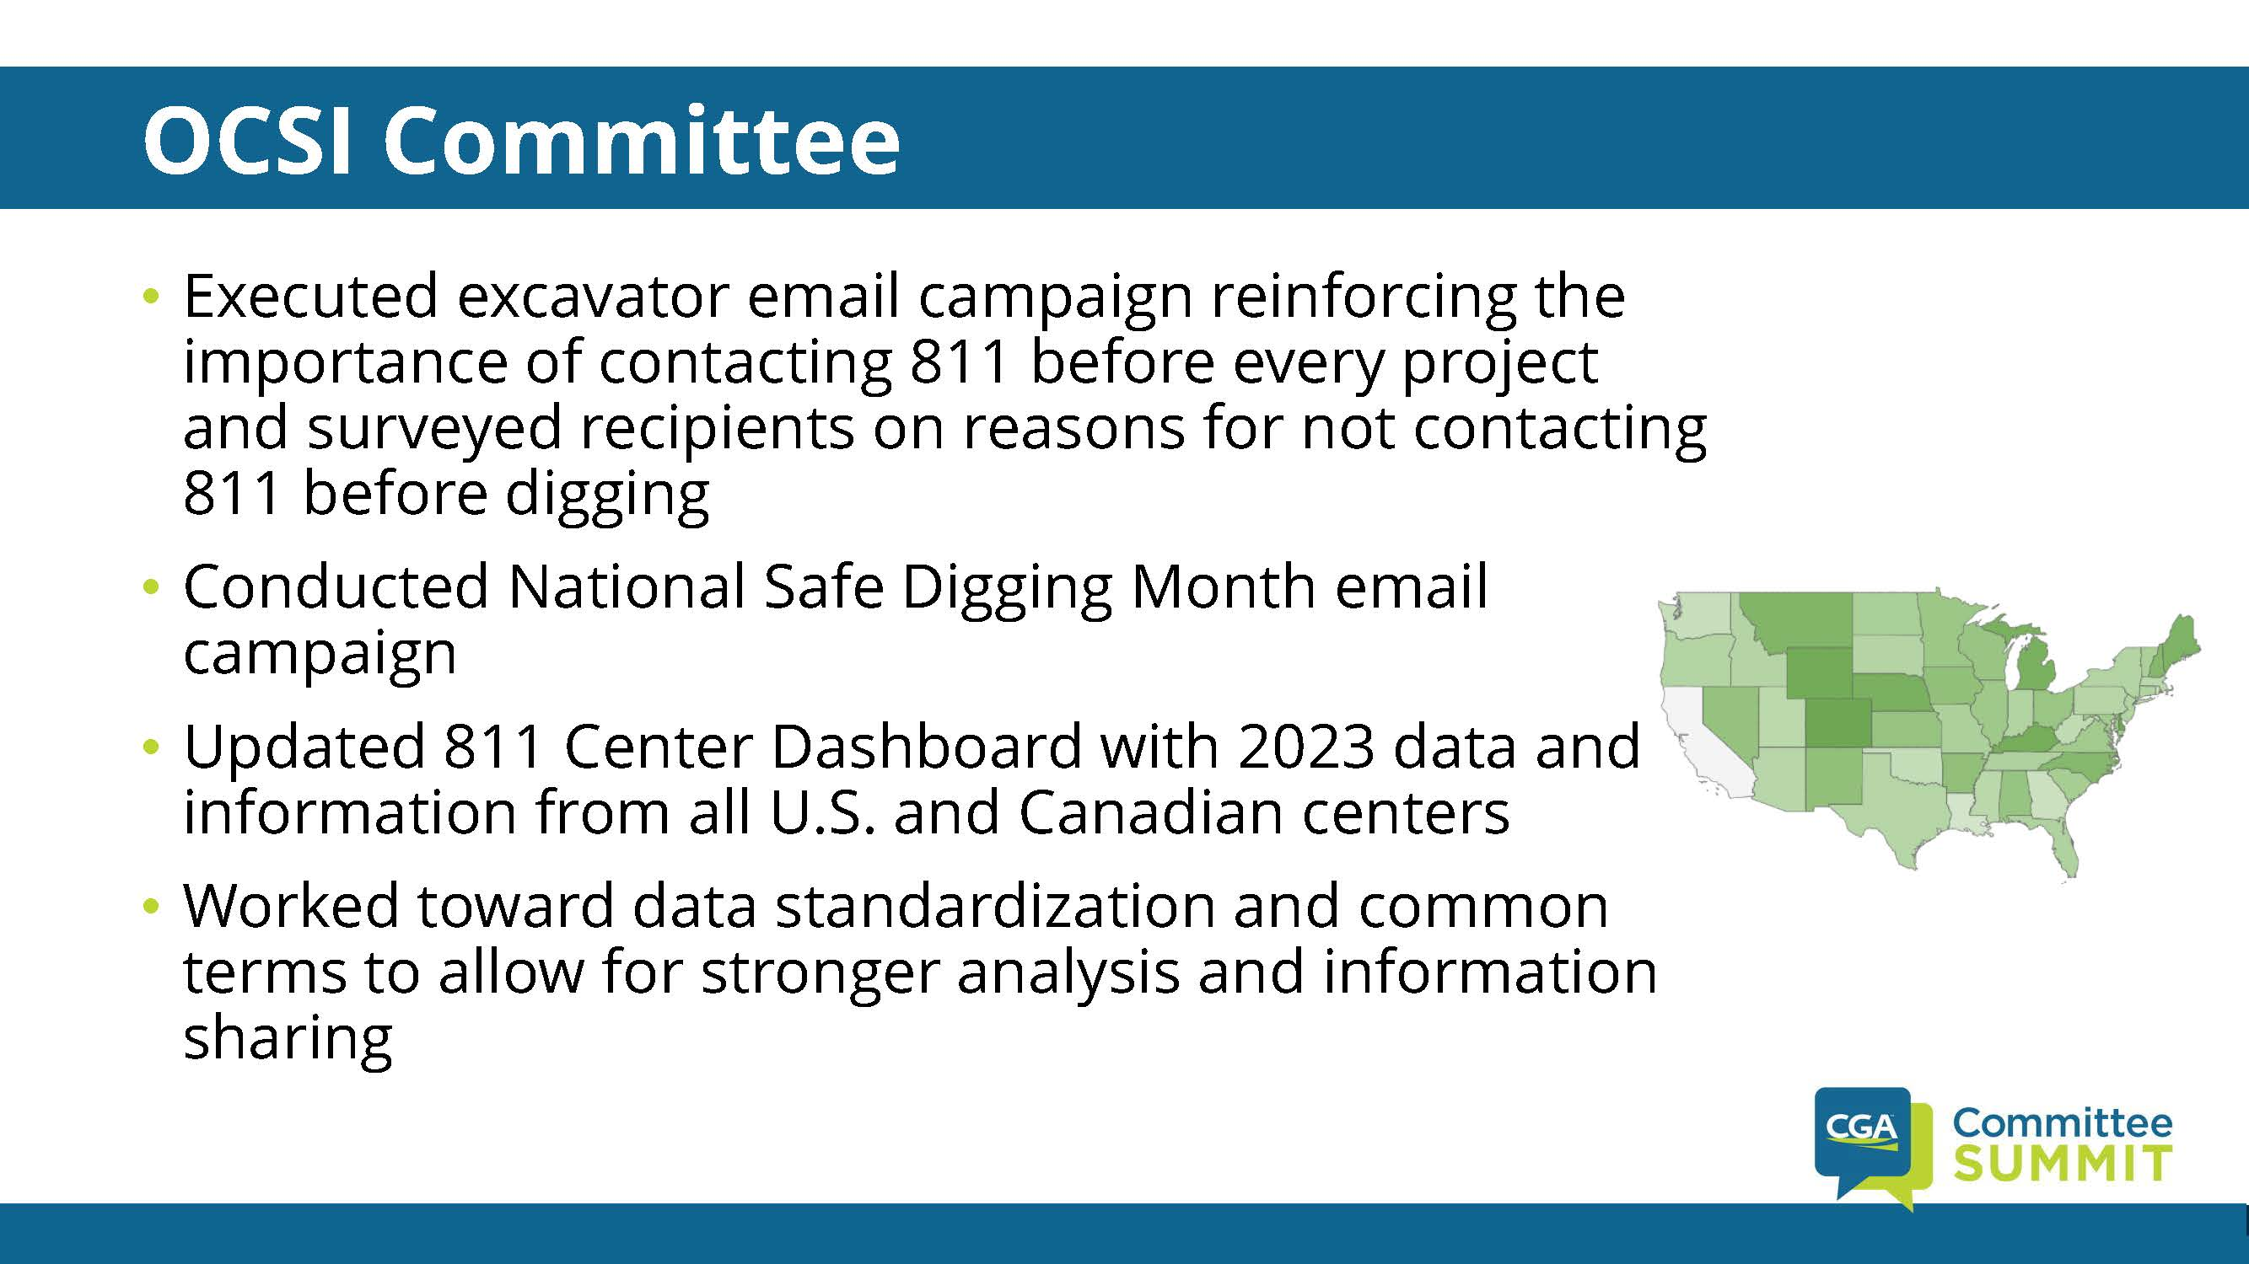

Slide 49
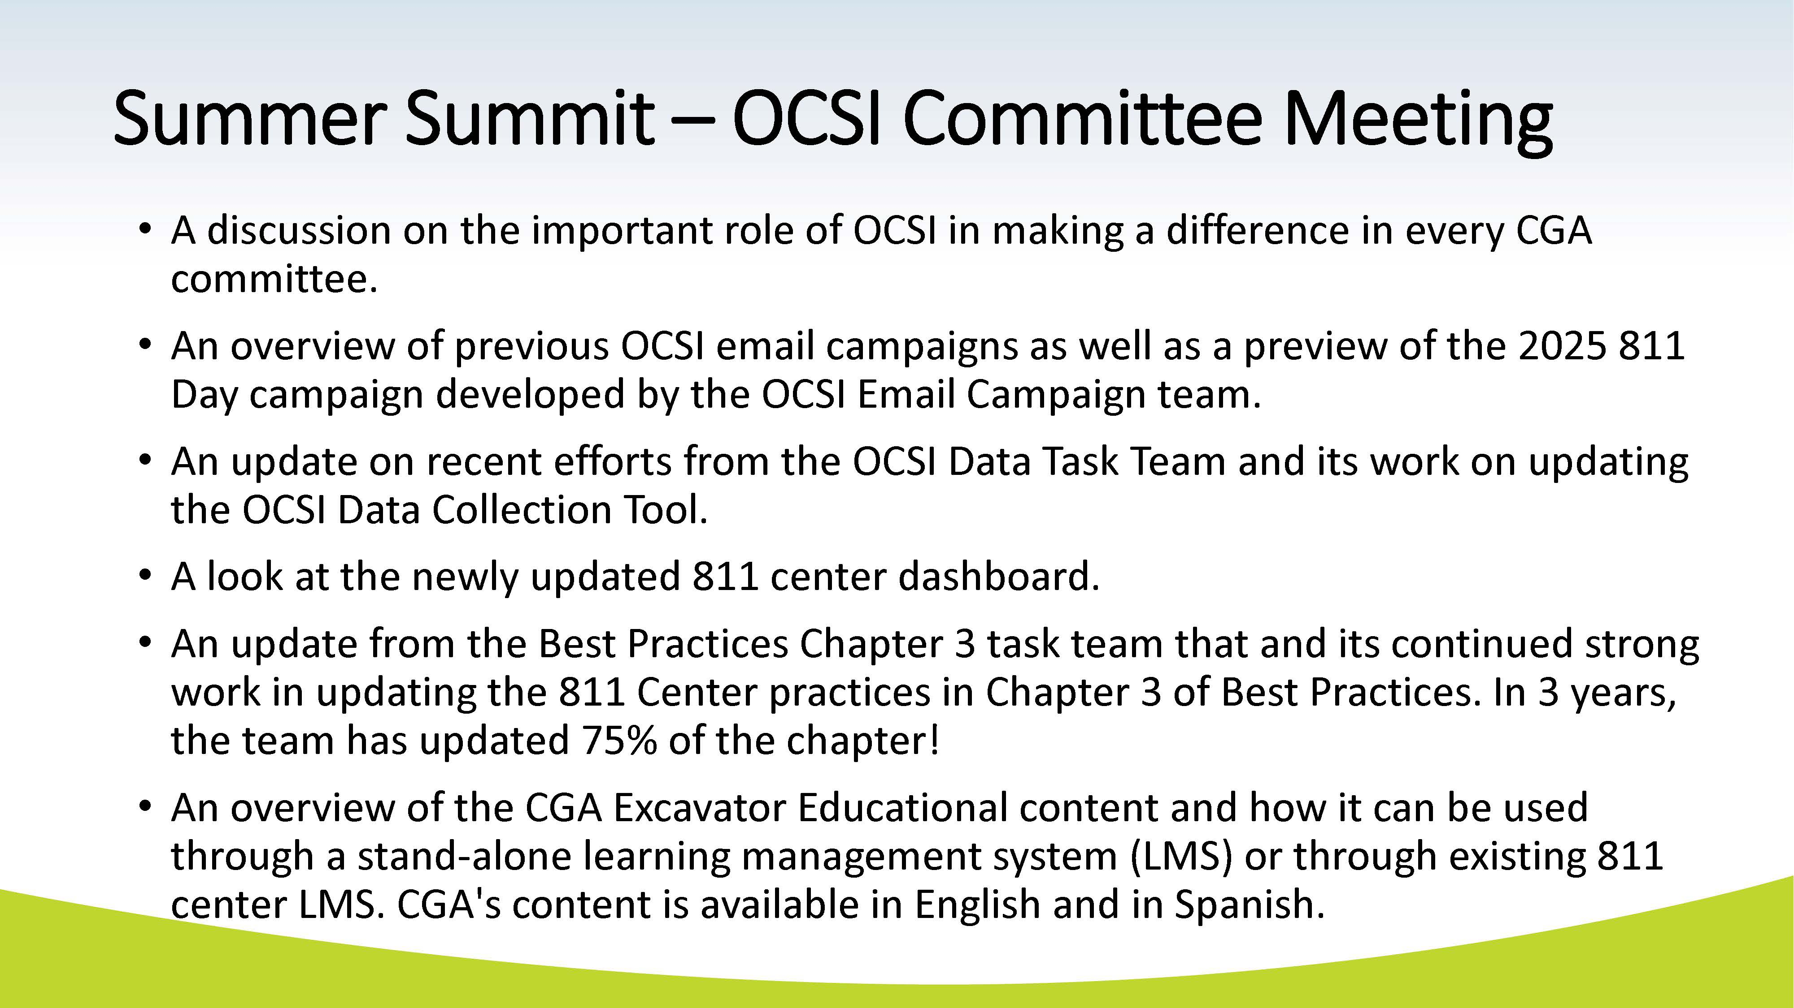

Slide 50
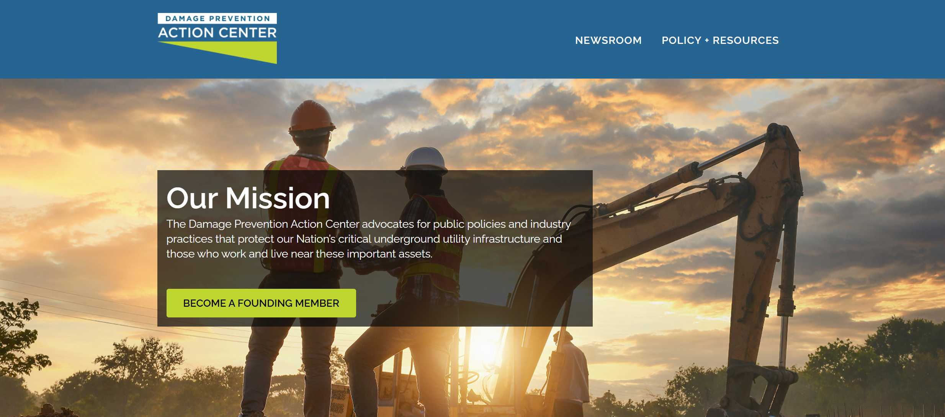

Slide 51
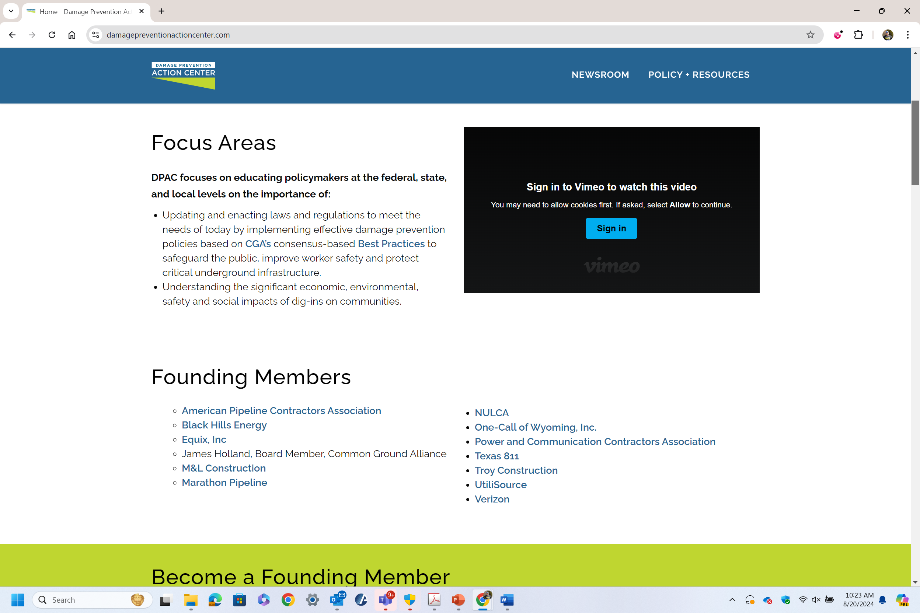

Slide 52
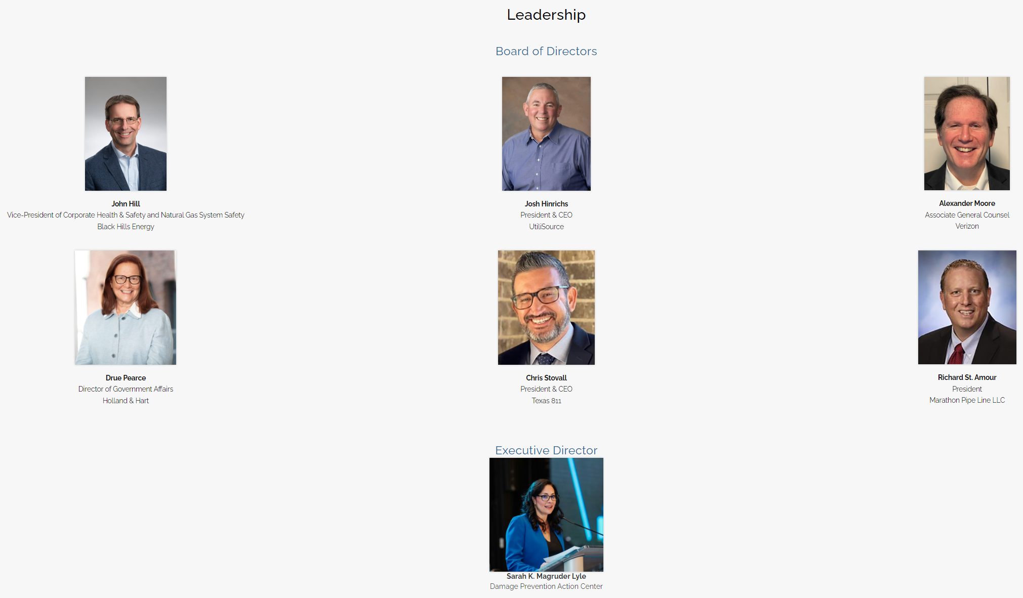

Slide 53
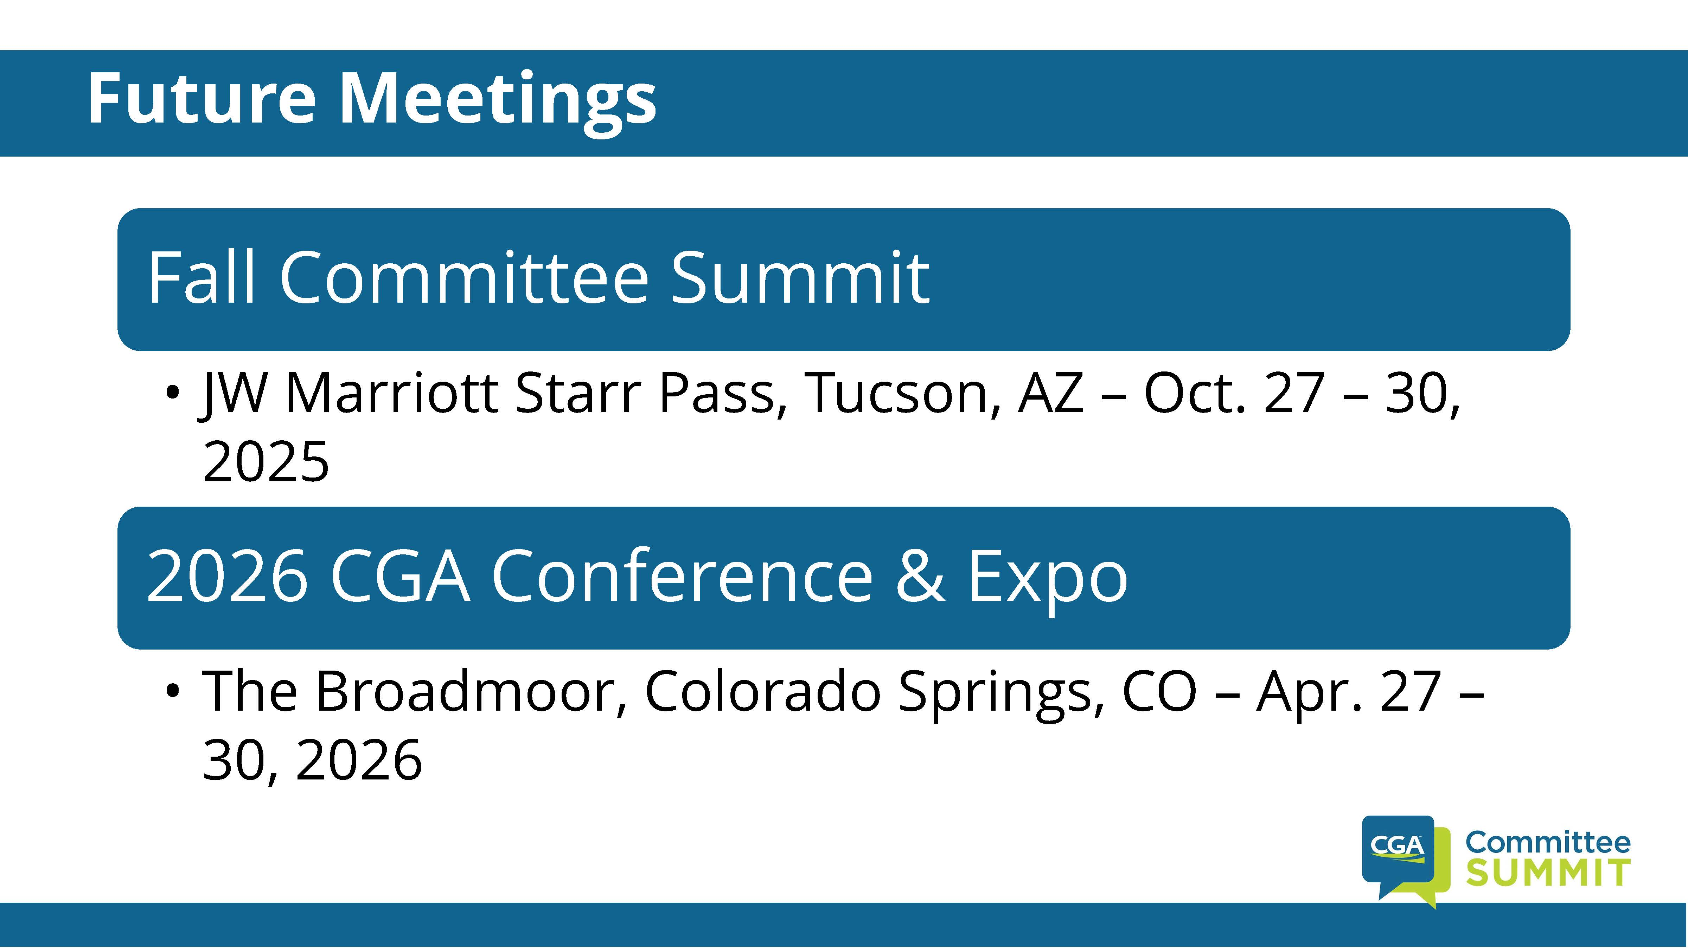

Slide 54

CGA Damage Prevention Institute Metrics/Updates and Other Committee Proceedings
Louis Panzer
Executive Director, NC 811
louis@nc811.org
336-707-1736

Slide 55
CGA Damage Prevention Institute Metrics/Updates and Other Committee Proceedings
Louis Panzer
Executive Director, NC 811
louis@nc811.org
336-707-1736
THANK YOU!

