Slide 1
NAPSR-PHMSA Distribution Team Updates
Matt Smith
August 19, 2025
Western Region Gas Conference

Slide 2
Topics
Team Purpose
Team Composition
Team Activities
Distribution Team Annual State Seminar Presentation
  Incidents
  Advisory Bulletins
  Interpretations

Slide 3

Distribution Team Mission Statement
The NAPSR / PHMSA Distribution Team is a collaboration of State and Federal Regulators to support improvements in the integrity of the Nations’ gas distribution pipeline systems through the conduct of investigations and research to develop educational materials as well as improving our inspection methods and guidance for evaluation of Operator’s Distribution systems
Disclaimer
The document is intended to provide clarity to the public regarding existing pipeline safety standards. The contents of this document do not have the force and effect of law and are not meant to bind the public in any way, but pipeline operators must comply with the underlying safety standards.
The materials contained in this work product are for educational and awareness purposes only.
Notes:
The development of educational materials for information purposes, such as presented herein, is part of the Distribution Team Mission.

Slide 4
Distribution Team Objectives
Analyze inspection results data and industry Performance Measures to identify risks
Develop continuing education materials
Develop and maintain inspection forms and inspection Guidance
Maintain Frequently Asked Questions (FAQs) to provide consensus expectations of operator’s programs
Support PHMSA and NAPSR as Subject Matter Experts
Support consistent implementation of distribution Regulations
Provide feedback to stakeholders on Best Practices and Lessons Learned and support stakeholders

Slide 5
Distribution Team Meetings
Monthly Team teleconference meetings
Working Groups typically meet monthly
Tri or bi-Annual face to face meetings
  Depending on workload and travel restrictions
Meetings annually with AGA and APGA
Meet with GTI annually
  Working on similar projects

Slide 6
NAPSR Participation with PHMSA
Various Interpretations
Incidental Subject Matter Expert tasks
PIPES Act 2020, Section 113 support activities
PIPES Act 2020, Section 114 Implementation Team
PIPES Act 2020, Leonel Rondon Act regulatory support activities (Sections 202-206)
Distribution related Inspection content
Notes:
We can now go to Pipeline Data Mart to grab the results to analyze

Slide 7
Distribution Team Composition
PHMSA
Zach Barrett (Sponsor) – Director State Programs
Brooks Tate (Lead) – Eastern Region
Michael Thompson – State Programs
Sayler Palabrica – Standards & Rulemaking
Jason Grant – Enforcement
Katherine Roth – Engineering & Research
Vincent Holohan – Engineering & Research
Lori Hutwagner – Data Analyst, Southern Region
Heather David – Accident Investigation Division
Lane Miller – Training and Qualifications
John Harper – Training and Qualifications
Clifford Dolchok – Western Region
Ian Curry – Legal
Notes:
Many diverse backgrounds
Access to the correct groups at PHMSA
Aids in speeding up any project

Slide 8
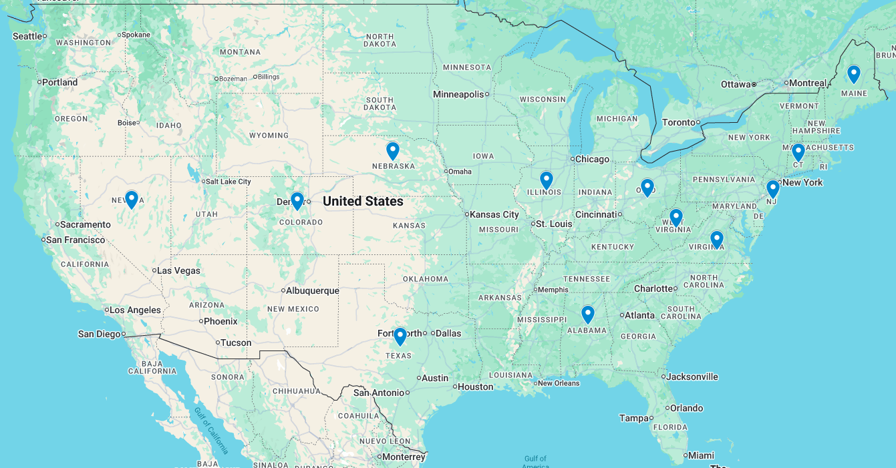
Distribution Team Composition
NAPSR
Matt Smith - IL
Kelly Everson - NV
Dan Nivison - CT
Michael Purcell - OH
Daniel Trapp - AL
Nathan Dore - ME
Andre Moses - NJ
Jessica Nesvold - CO
Kevin Bumgardner - NE
Greg Lago- WV
David Bishop - VA
Mark Herrin - TX

Slide 9
Inspector Digest
Identify interesting discoveries
Potential issues
Improve the knowledge of analysts
Share perspective
Build consistency

Slide 10
Emergency Valve Designation
Incidents related to significant delays shutting down gas pipelines in a timely manner
Operators failed to use emergency valves
192.181 (a) - Each high-pressure distribution system must have valves spaced so as to reduce the time to shut down a section of main in an emergency. The valve spacing is determined by the operating pressure, the size of the mains, and the local physical conditions.
Regulation has been required since 1971
Operators have failed to install valves per 192.181
Procedures are lacking
New installations

Slide 11
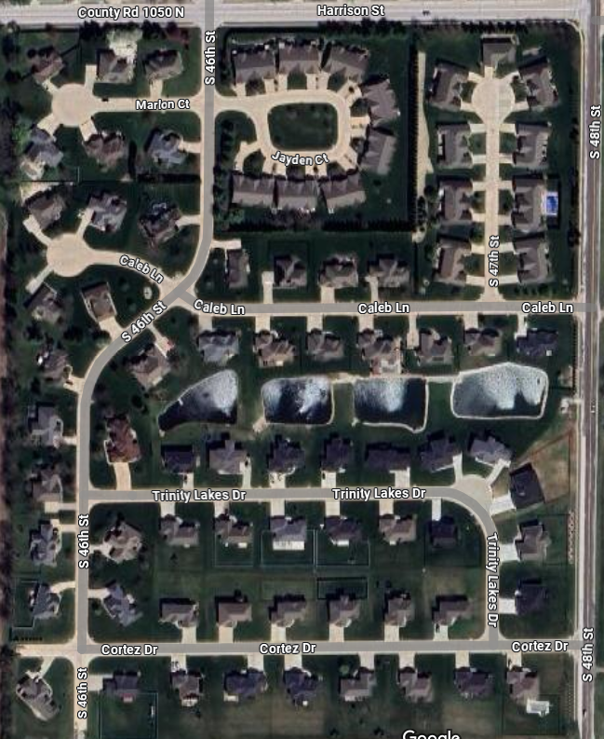

Slide 12
Contract Locators
Concerns raised regarding timeliness and quality of locates by contractors
Collected data from various sources
  Indications point to contract locator errors
Gathering information from states
States are taking varied approaches to the problem related to timeliness and accuracy of locates
States requiring gas located only by in-house or a portion of the locates by in-house

Slide 13
Sulfur and Di-thiazine Deposits
In 2019 deposits of what appeared to be sulfur (visually and by smell in some cases) was identified by Regulators
  This was the cause of equipment failures in natural gas transmission and distribution pipelines
Regulators began investigating
Samples of the solids formed in pipelines have not been regularly collected for testing
Continuing to capture data related to equipment failures
Notes:
During field inspections In 2019, Inspectors in the western US observed what appeared to be Sulfur deposits on regulator and relief devices in gate stations and regulator stations.
When Inspectors tried to understand the extent of the issue they found that very little collection or testing of the deposits found had been conducted.
During field inspections when regulator stations within distribution systems failed, Inspectors were present to identify a foreign material unknown to the operator or Inspector. The foreign material was the cause of the regulator failure. In one system of about 30,000 people, two regulator stations on opposite ends of the system had regulator failures during a routine field inspection. In both cases, foreign deposits were discovered. It was believed to be either Sulfur or Di-thiazine. Although the Inspector suggested the operator test the foreign material, the operator failed to conduct tests and the foreign material was not properly identified.
At this time, PHMSA and NAPSR members began discussing and identifying areas with possible Sulfur or Di-thiazine deposits are in natural gas distribution systems.

Slide 14
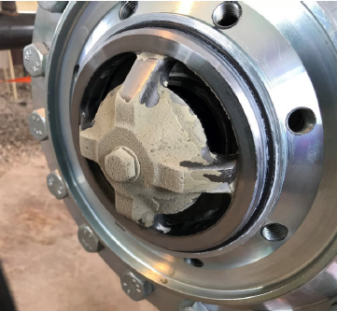
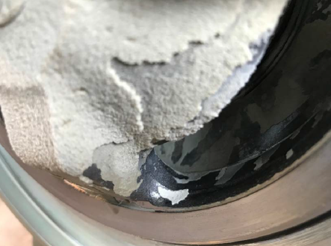
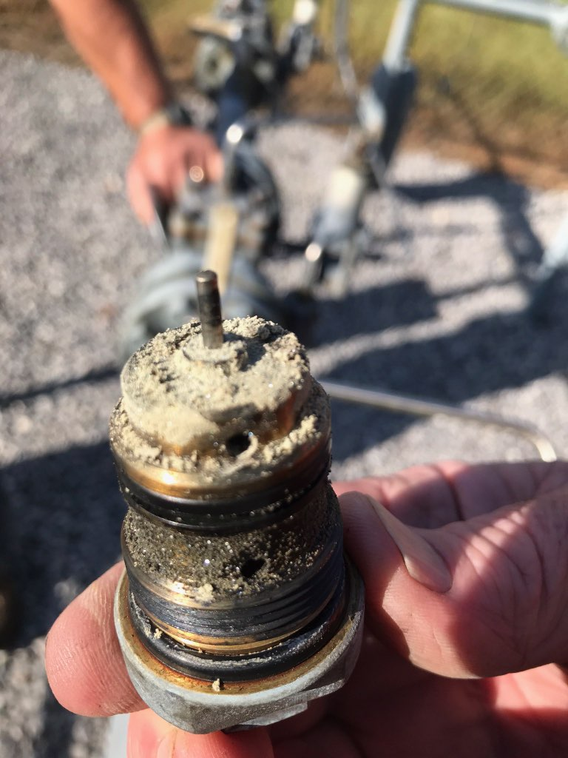
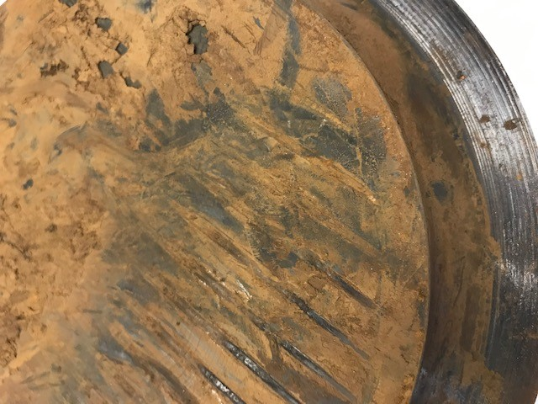
Photographs of Recent Deposits
Notes:
The photographs show various Elemental Sulfur and Di-thiazine Formation in Natural Gas distribution regulators which cause the failure of the equipment to meet it design requirements.
Layers of deposits are identifiable indicating a problem occurring over a period of time.
You are also able to identify in the bottom right photograph where the operator attempted to remove the foreign material, but the deposits were too thick and the boot had to be replaced.

Slide 15
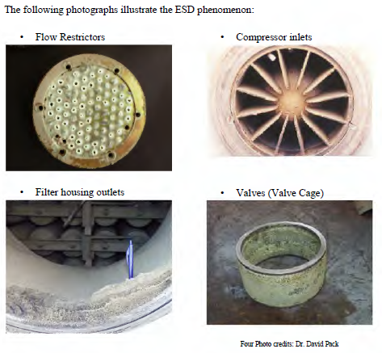
Photographs of Sulfur Deposits
Image from An Effective Solution for Elemental Sulfur Deposition in Natural Gas Systems, Kimtantas and Taylor, 2014, Bechtel Hydrocarbon Technology Solutions, Inc.
Notes:
These pictures identify areas where elemental Sulfur, previously in the vapor phase, condensed on components. Pressure reduction through a regulator or a filter can cause deposition, and the cooling associated with the pressure drop allows the Sulfur to change from a vapor to a solid and deposit on surfaces.

Slide 16
Varying Appearances and Odors of Solid Deposits
Observed colors of deposits vary from white to yellow to yellow-brown apparently depending on constituents in the gas stream and where the deposits forms (condenses) in pressure reduction equipment
In some cases, the only odor is a normal pipeline odor or in a distribution system only the smell of odorant.
H₂S has a rotten egg smell, and the lack of a rotten egg smell should not alleviate the need for analysis of the deposits
Notes:
The pictures on the slide before clearly identify the various colors of deposits of Elemental Sulfur and Di-thiazine Formation in Natural Gas Pipelines that have been identified varying from white to yellow to yellow-brown.
Odor can vary as well as color from a normal metallic pipeline odor to the smell of odorant, in a distribution system, to the smell of H₂S hydrogen sulfide, which has a rotten egg smell.
The lack of a rotten egg smell, indicating the presence of Sulfur in the form of H₂S, does not alleviate the need for analysis of the deposits as chemical composition of the deposits varies and is important to document quantitatively.

Slide 17
Perspective
The issue of solids formations in gas pipelines, upstream processing equipment, and downstream user facilities is well documented and appears to have been occurring for decades.
There are solutions offered by industry to remove or mitigate the issue of solids formation in pipeline pressure reduction equipment.
Incident reports submitted to PHMSA provide limited data and information on the significance of the threat that Sulfur and/or Di-thiazine deposits pose to pipeline safety.
  Due to a lack of understanding related to the issue
Notes:
Although it appears the issues related to both Sulfur deposition and Di-thiazine have occurred for decades, some operators and inspectors were not aware of the cause.
As operators and inspectors are educated on this possibility, proper identification of a failure due to Sulfur and/or Di-thiazine deposition may be considered a cause of failures more frequently in the future.
Some solutions to remove or mitigate the issue that have been offered by industry include; Sulfur absorbent technology, filters, heating of the gas stream, accelerated maintenance, chemical cleaning, mechanical cleaning, etc.
Review of incident data represents the threat at a minimum level as PHMSA can only search incident report comment fields for the occurrence of certain words to identify when Sulfur and/or Di-thiazine depositions were a cause or contributory cause to an incident

Slide 18
Summary
Sulfur or sour gas requires treatment
The treatment via adding Triazine may allow a by-product called Di-thiazine to change from a gas to a solid in the pipeline
Both Sulfur and Di-thiazine have accumulated in the pipeline after large pressure reductions or very high flows of gas at regulator stations
This has caused failures in pressure reduction equipment
The failures have over pressured gas systems or caused excessive amounts of gas to relieve into the atmosphere
Operators are failing to investigate failures and identify the root cause, which may be Sulfur or Di-thiazine
The information on failures and the cause is needed for the operator to take appropriate actions to prevent a recurrence
Education is needed for both the gas operators and the regulators
Notes:
Reaffirm the reports and information that are available for review and references.
That incidents have been documented.
That operators are expected to investigate failures per 192.617 completely.
DIMP programs need to address this threat, and information on abnormal operations and failures must be collected and used.

Slide 19
Path Forward
While the issue of solids formations in gas pipelines, upstream processing equipment, and downstream user facilities is well documented, the recent upward trend in incidents needs to be evaluated and the threat understood
Regulators will continue to gather information from inspections and investigations into failures and take compliance actions, as appropriate
Regulators will continue to review DIMP programs for the identification of potential and existing threats, including the reliability of pressure control equipment and formation of solids within the equipment
PHMSA will review research and development options and continue to learn more about the threat of solids deposition in pressure reducing equipment
Notes:
More information needs to be gathered and evaluated.
Please continue identifying locations where Sulfur and Di-thiazine deposition occurs, and contact a member of the NAPSR / PHMSA Distribution Team to support continued information gathering activities.

Slide 20



Distribution Systems – Annual Regulatory Snapshot
National Association of Pipeline Safety Representatives
PHMSA Office of Pipeline Safety
(Add your name, title and event here)
Notes:
You may add your state logo, NAPSR logo, etc. on this page.

Slide 21
Summary
Maintain information for the last three years
States are required to conduct meetings every three years (min.)
Incident Investigations and Lessons Learned
PHMSA Advisory Bulletins
PHMSA Interpretations

Slide 22
Incident Investigations and Lessons Learned
Notes:
The deck in this section was provided by PHMSA AID (Heather David) on 5/7/25

Slide 23
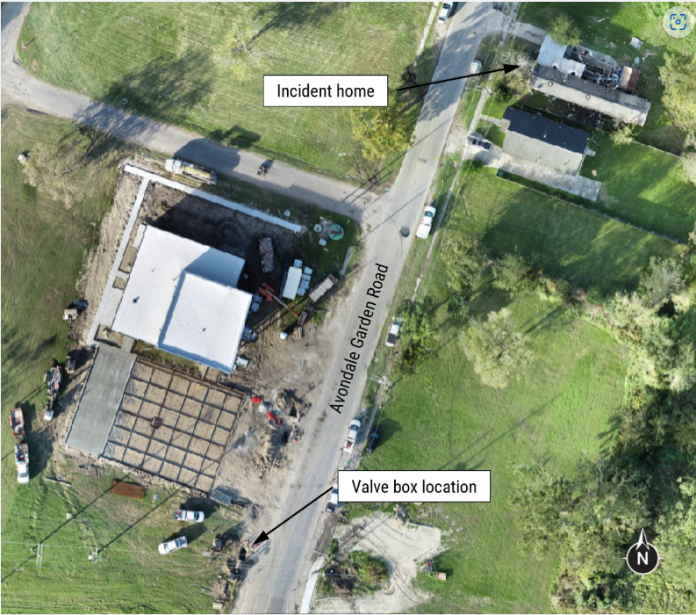
12/2/24 Natural Gas Distribution with Fatality
Avondale, LA
NTSB Investigating
  LA DNR and PHMSA are Party
Incident overview
  Cement truck ran over a NG junction box
  Junction box damaged 2-inch coated steel
  main operation at 80 psig
  Natural gas entered sewer system
  A house approximately 340 feet away
  exploded.
  2-inch coated steel main operation at
80 psig
1 fatality, 5 injuries
AID Lead Investigator - Blesson Mathew

Slide 24
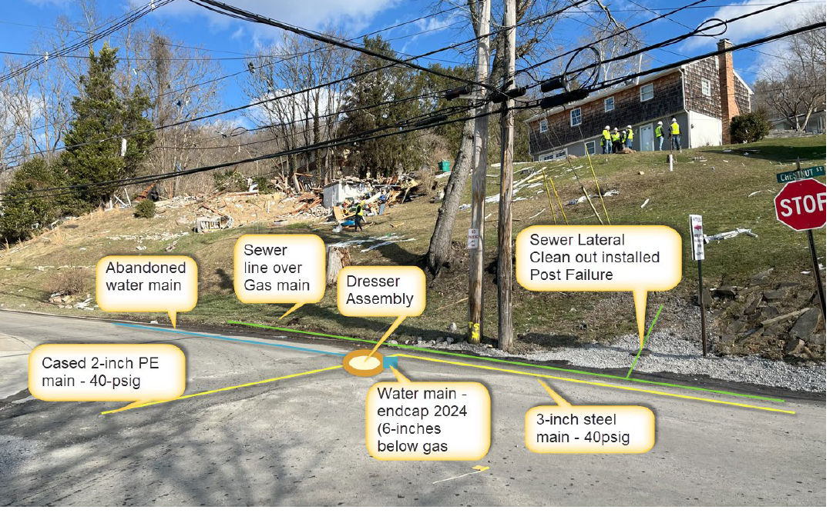
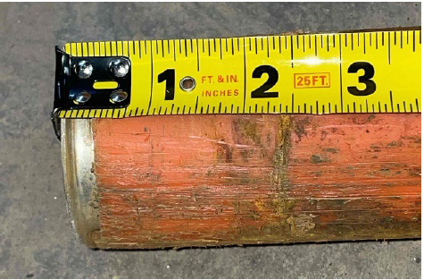
1/26/25 Natural Gas Distribution with Fatality
Clarksburg, West Virginia
West Virginia Public Service Commission Investigating
  PHMSA supporting
Incident overview
  Home explosion with a fatality
  Low pressure system supplied gas to the house
  Medium pressure system down gradient of home
  AID Lead Investigator – Heather David
Notes:
Gas in 3 adjacent houses.
Grade 1 leak on medium pressure distribution system at a 2-inch dresser compression coupling that pulled out of a cased 2-inch plastic main installed in 1980.
While performing the leak repair, operator identified a 6-inch clay tile sanitary sewer line above their natural gas main and an abandoned capped water main below.
Holes were identified in the clay tile sewer line a few feet from the failed gas main.
Witnesses observed flames coming out of a toilet following the explosion.

Slide 25
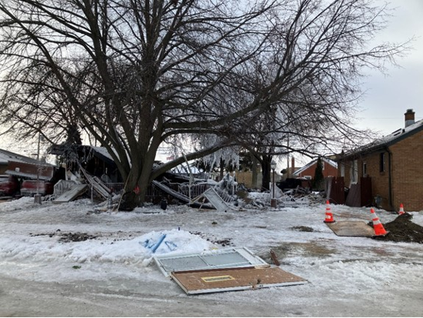
2/18/25 Natural Gas Distribution
Racine, WI
Public Service Commission of Wisconsin Investigating
  PHMSA supporting
Incident overview
  Duplex home explosion with two injuries
  2-inch PE service with MAOP of 60 psig
  Freezing conditions delayed investigation
  Per neighbor interviews and video, a new stove was delivered
  earlier in the day
  AID Lead Investigator – Marisa Skillman

Slide 26
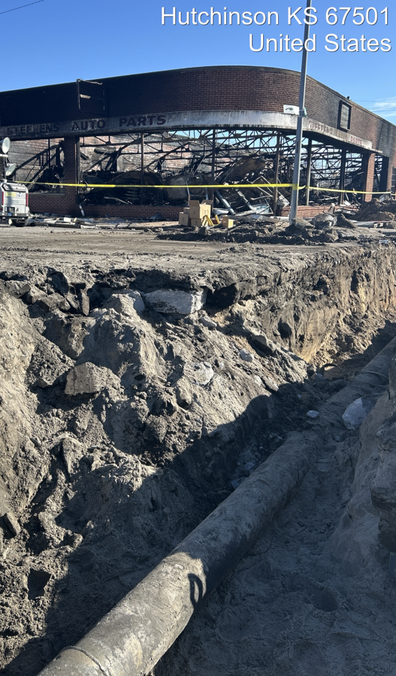
2/22/25 Natural Gas Distribution
Hutchinson, KS
NTSB Investigating
  PHMSA supporting
Incident overview
  10-inch distribution main, installed in 1938
  Building exploded just after an occupant was evacuated
  Girth weld failure
  AID Lead Investigator – Wes Mathew

Slide 27
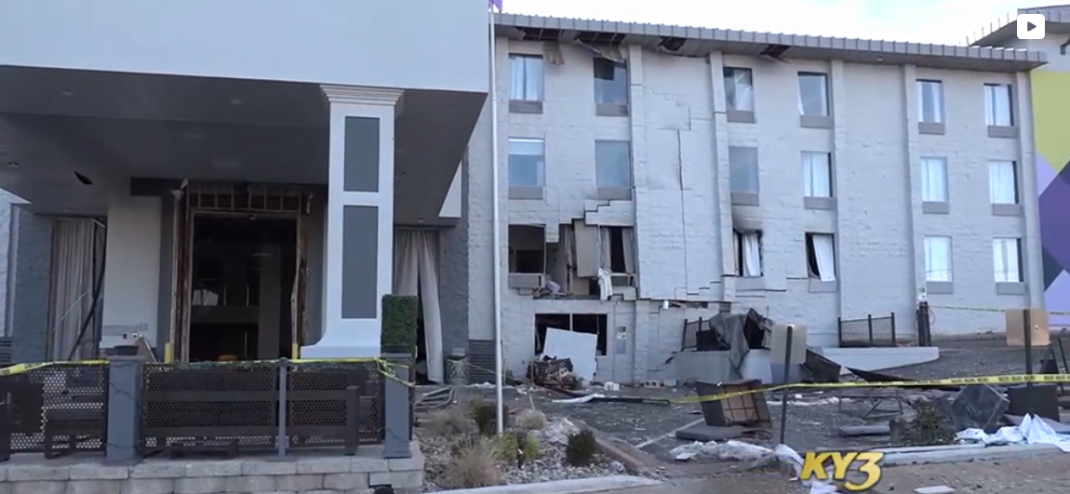
2/24/25 Natural Gas Distribution
Branson, MO
Missouri Public Service Commission
  PHMSA supporting
Incident overview
  Third Party excavation damage – fiber optics install
  6 injured (5 fire fighters, 1 hotel employee)
  Relatively new hotel
  Service line located correctly
  Service line located just below the concrete
  Hotel is a complete loss
  PHMSA Lead – Sean Rivers

Slide 28
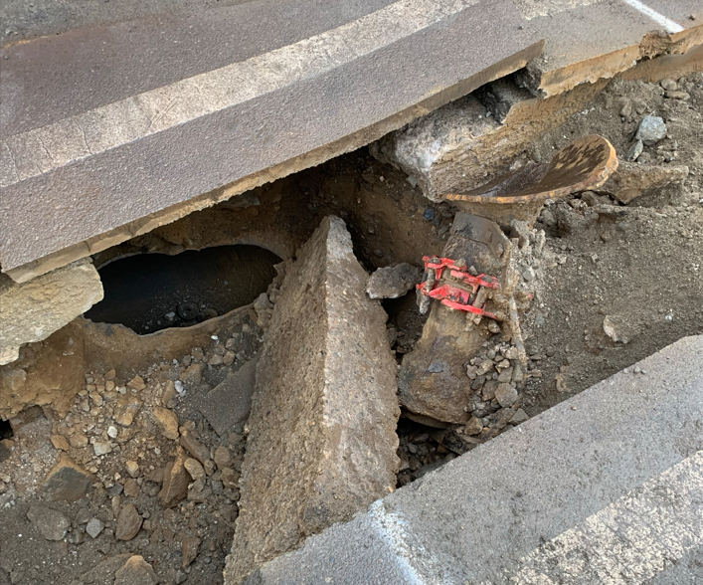
2/27/25 Natural Gas Distribution
Philadelphia, PA
PA PUC investigated
  PHMSA supporting
Incident overview
  2nd party strike while replacing a 20-inch cast iron main
  No fire or injuries
  3,000 people evacuated
  PHMSA Lead – Abey John

Slide 29
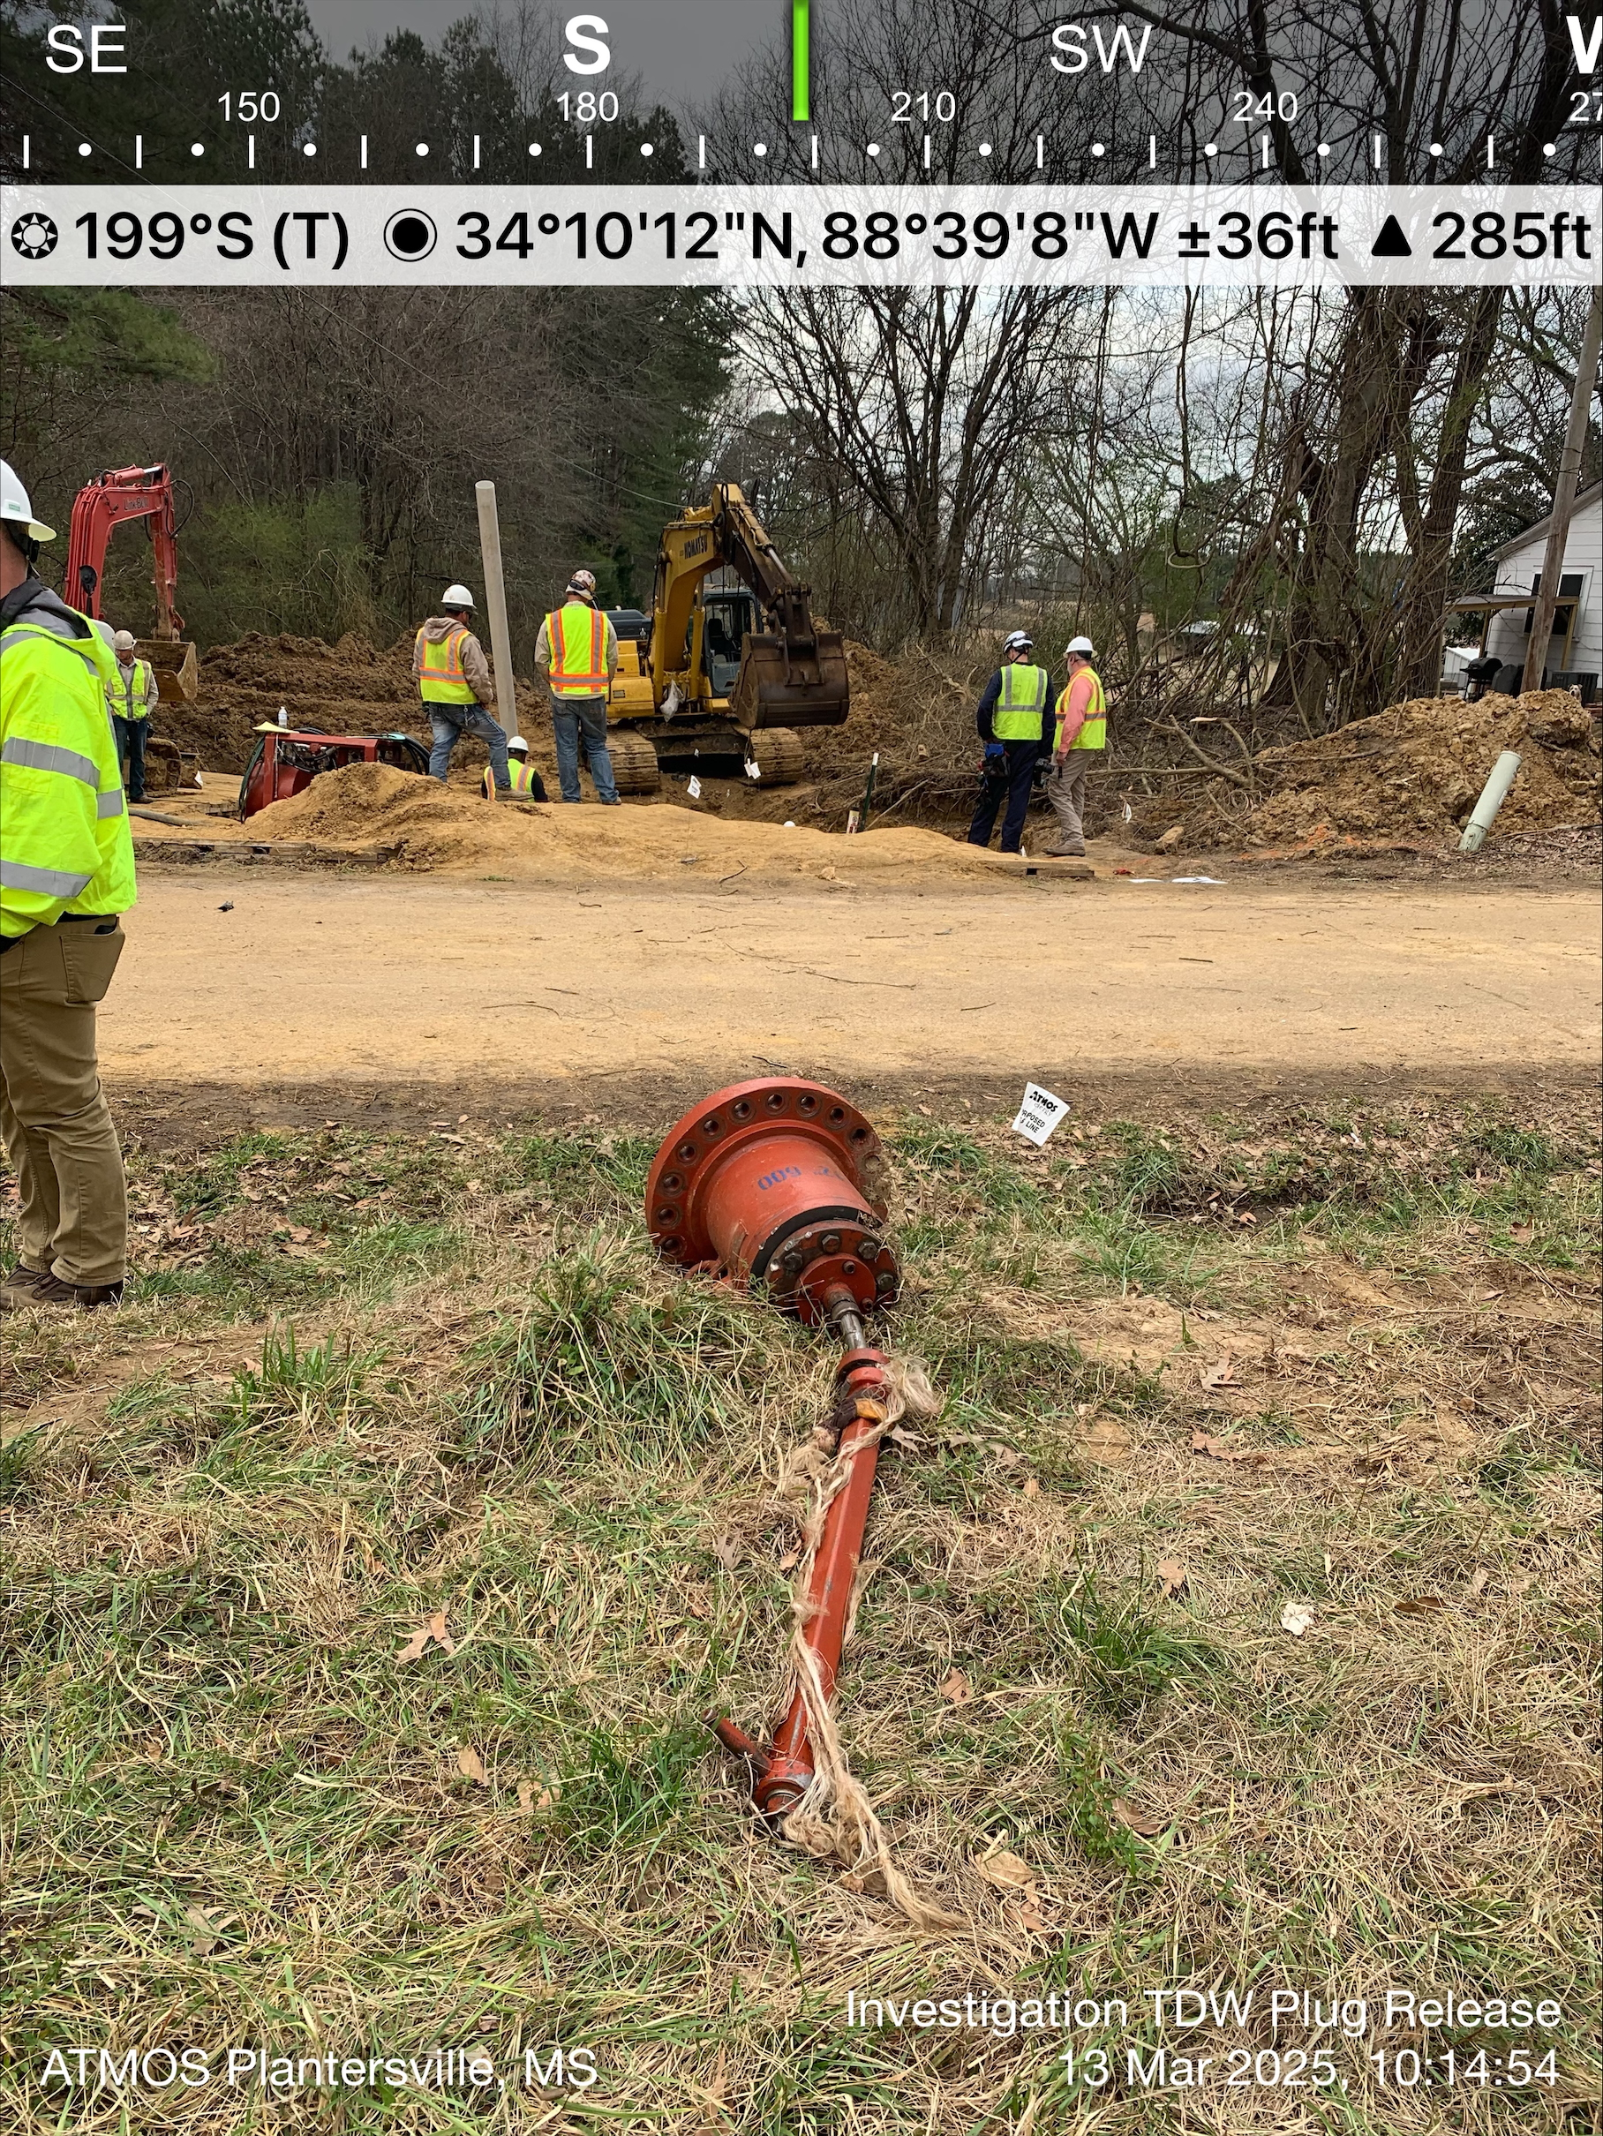
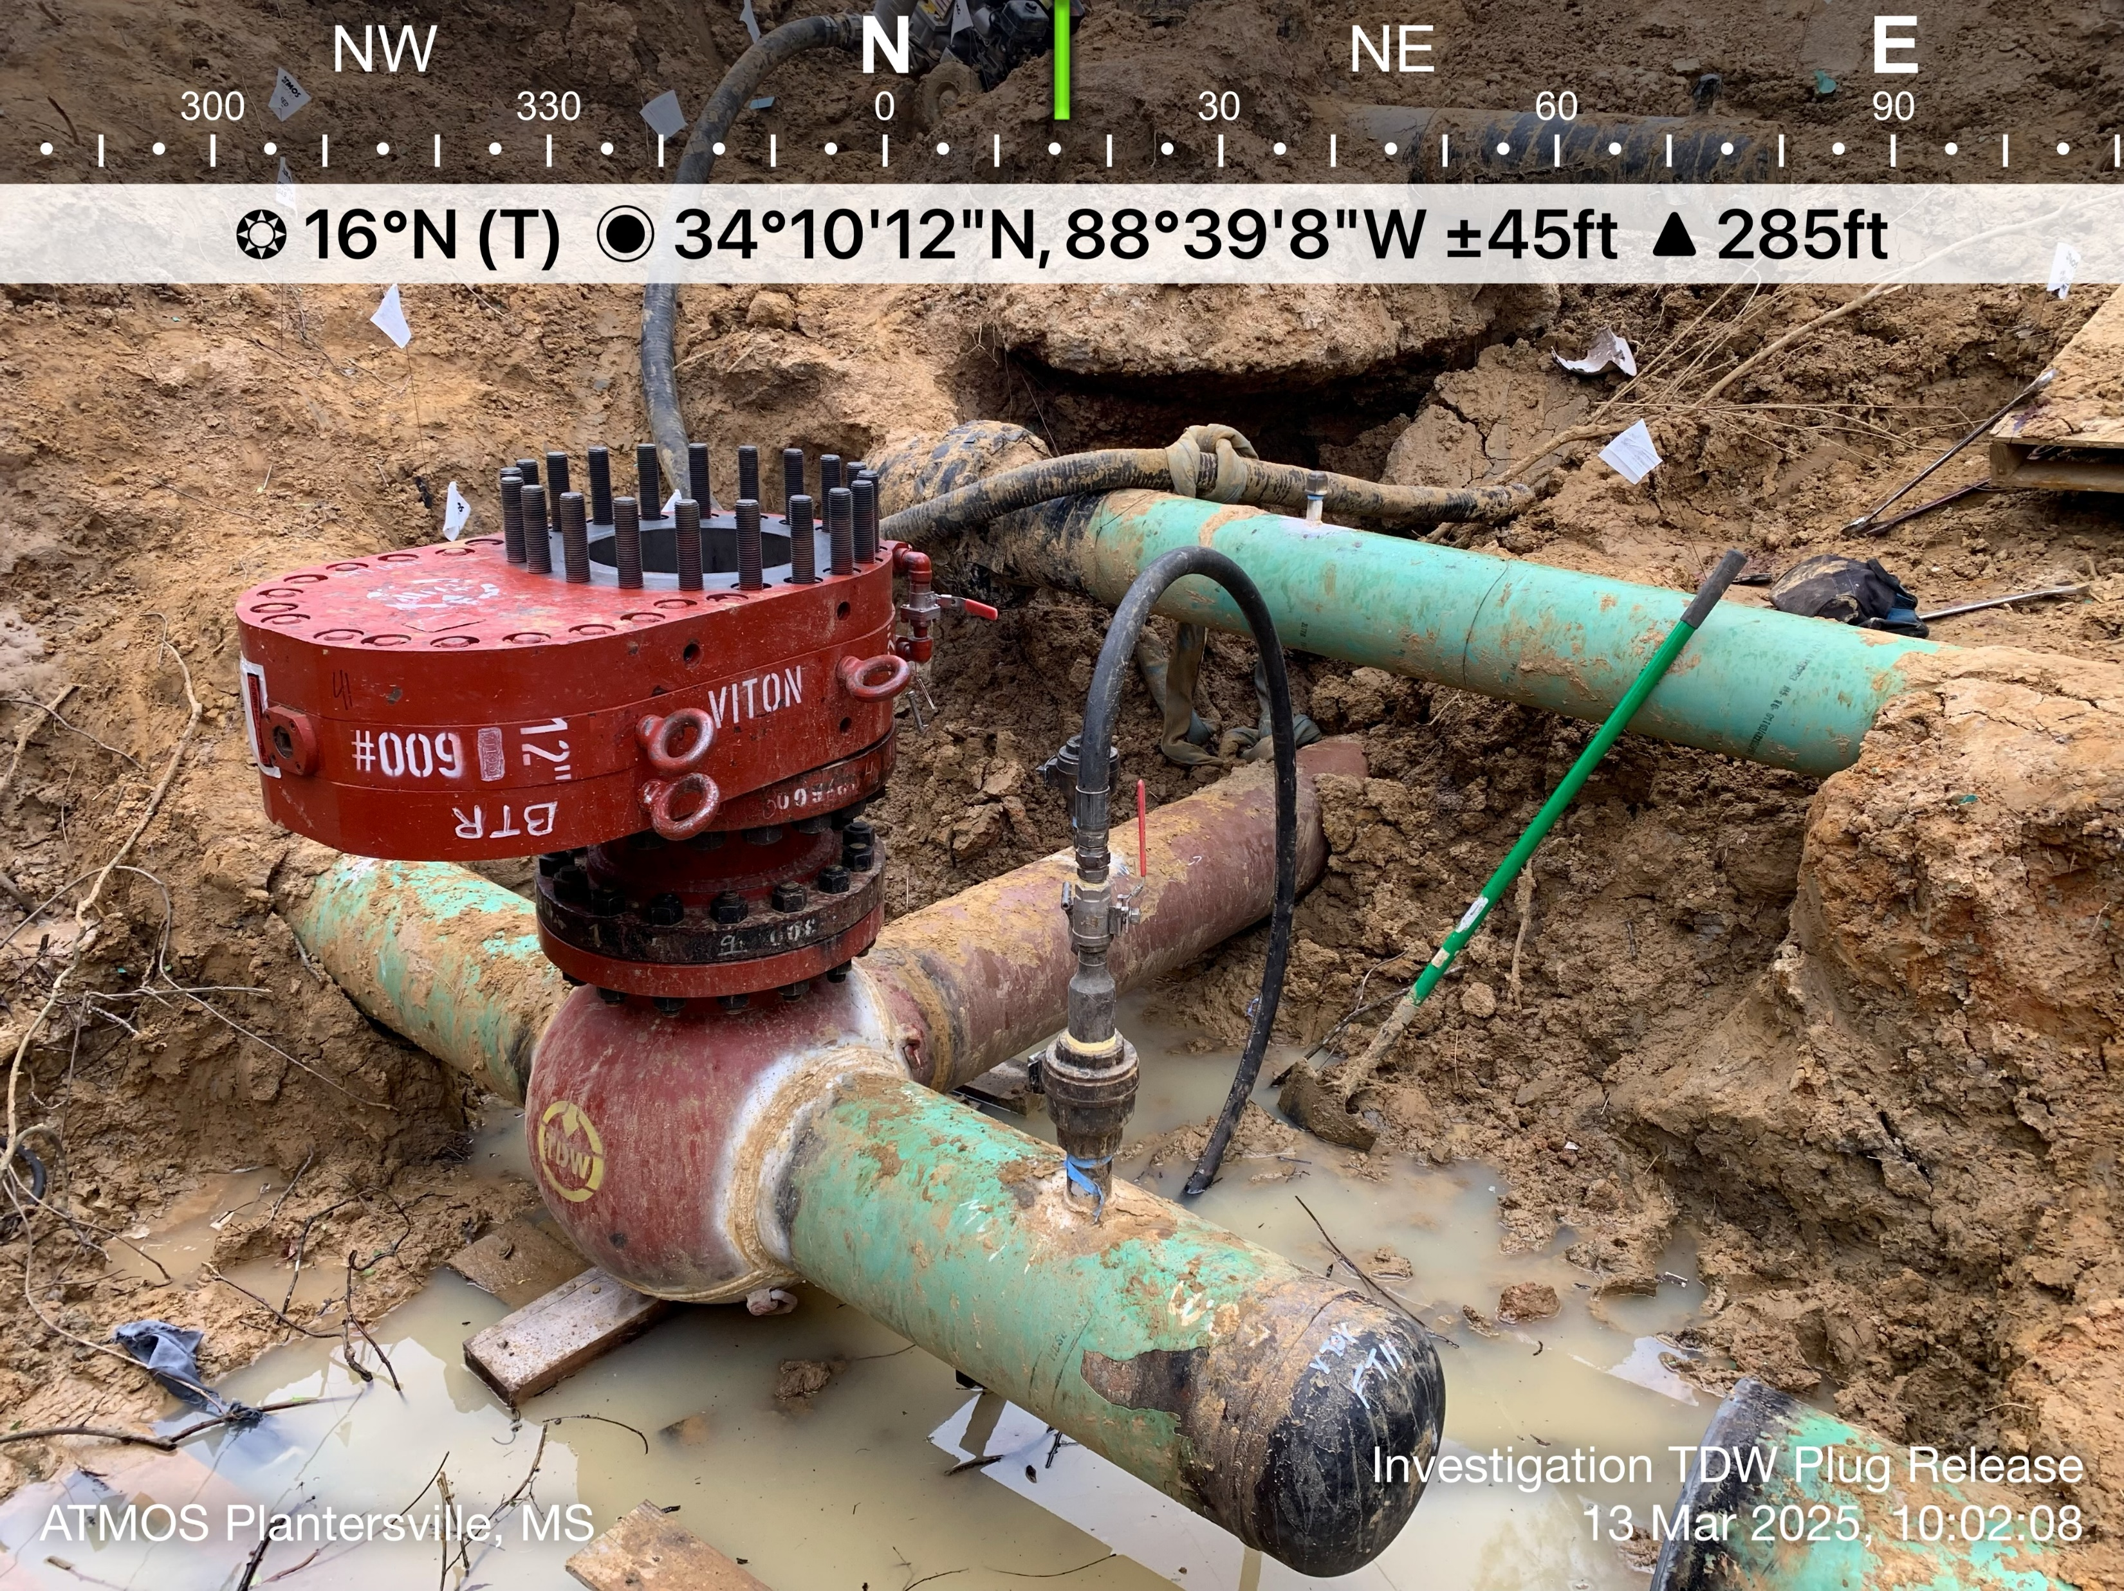
3/12/25 Natural Gas Distribution
Plantersville, MS
MS PSC investigated
  PHMSA supporting
Incident overview
  Hot tapping of 12-inch distribution main
  3 contractors performing work injured
  17,500 customers without gas service for extended
  period
  AID Lead Investigator – Jake Jorgensen

Slide 30
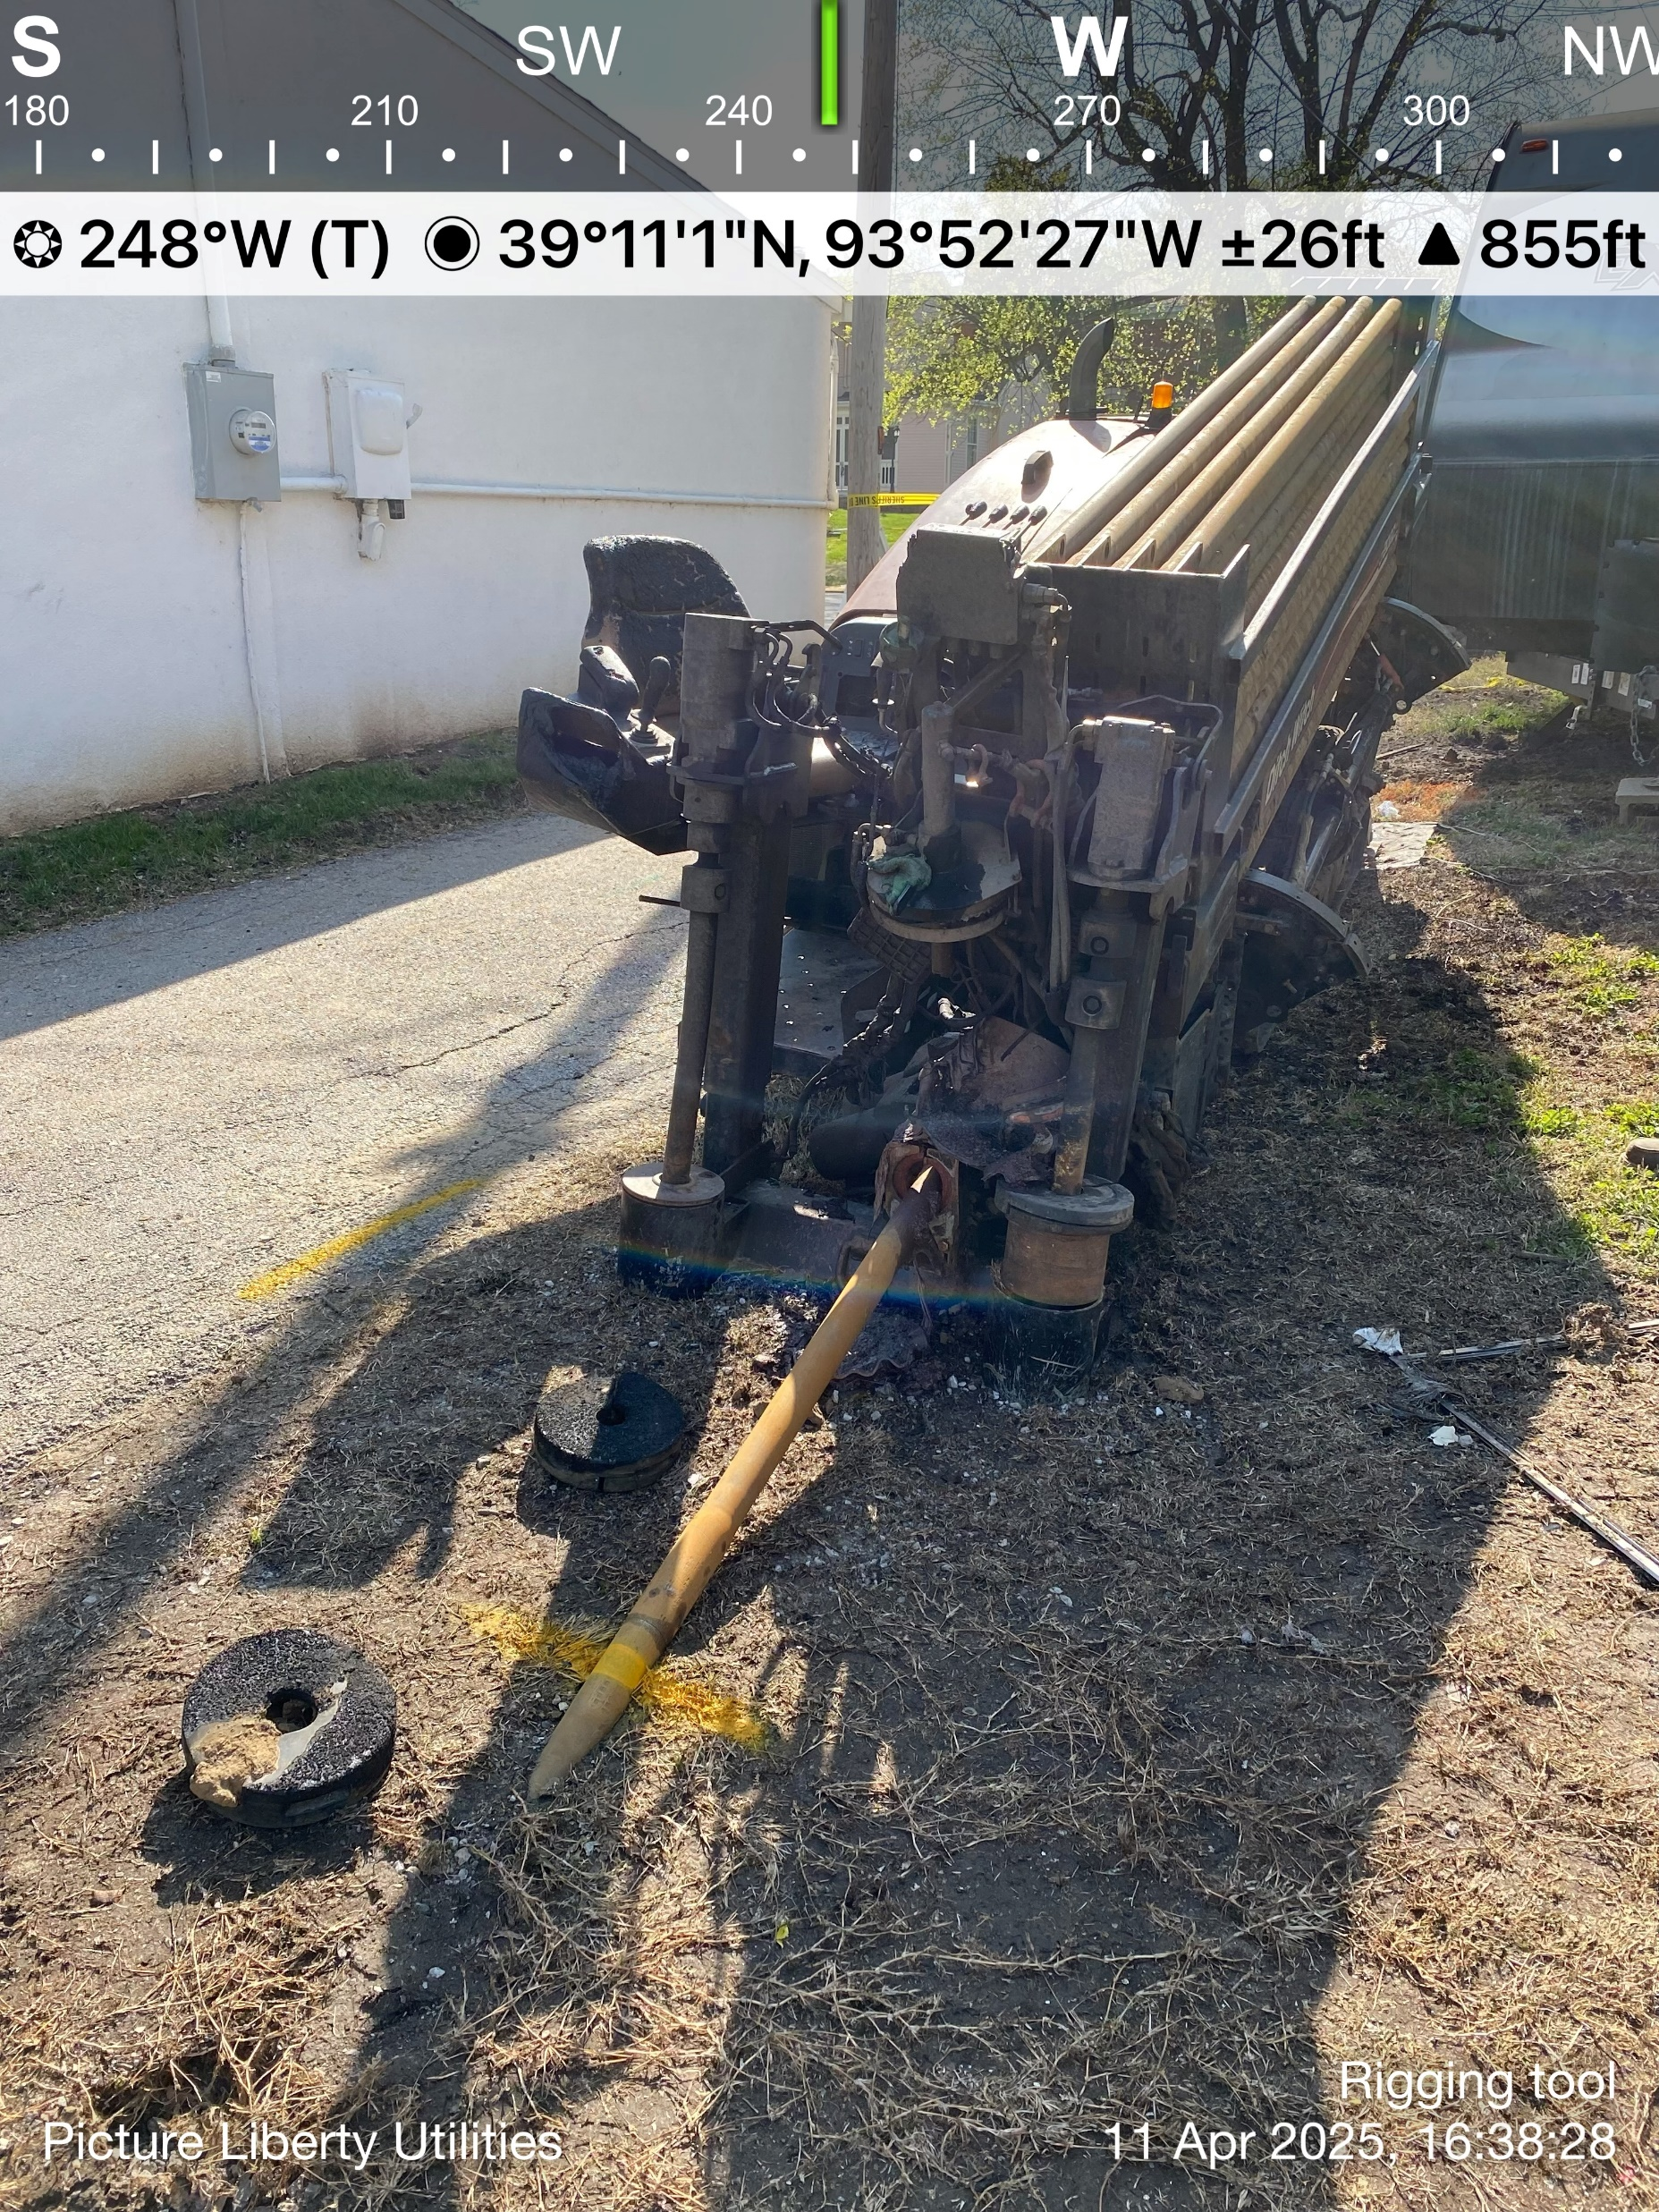
4/10/25 Natural Gas Distribution Explosion
Liberty, MO
NTSB investigating
  MO PSC and PHMSA are Party
1 Fatality, 2 injuries
5,000 customers impacted
3rd Party HDD excavation damage of unmarked line
AID Lead Investigator – Blesson Mathew

Slide 31
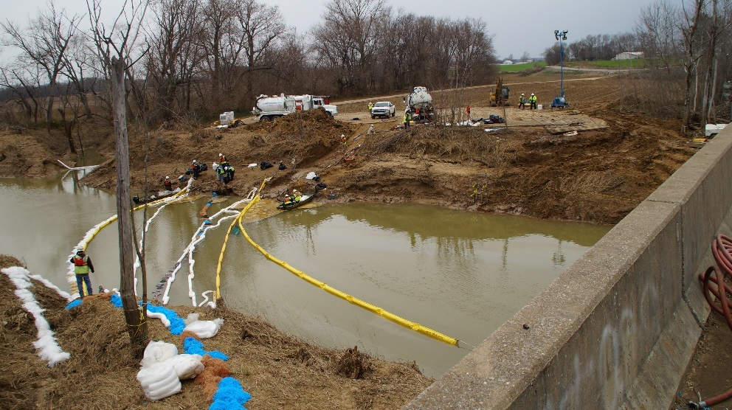
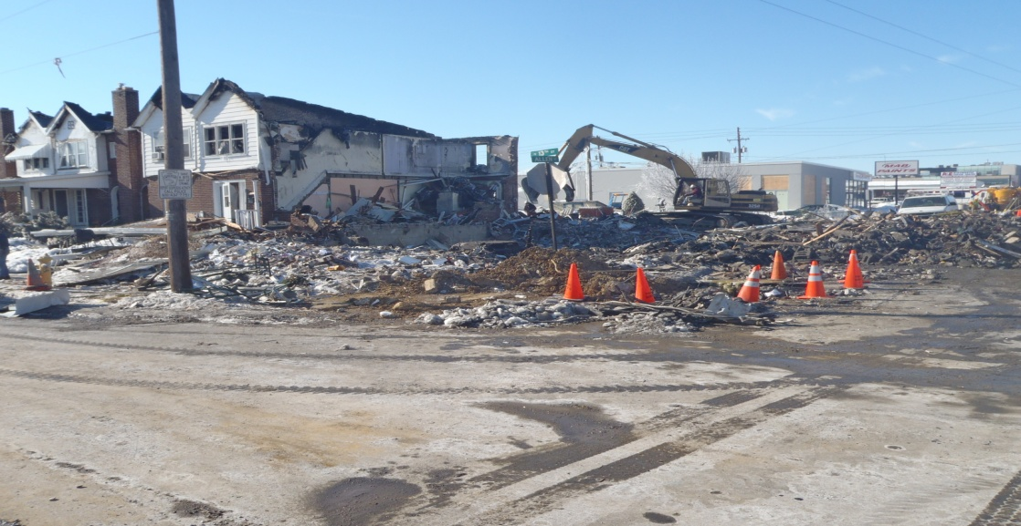
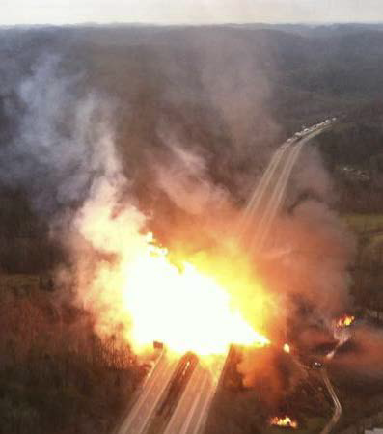
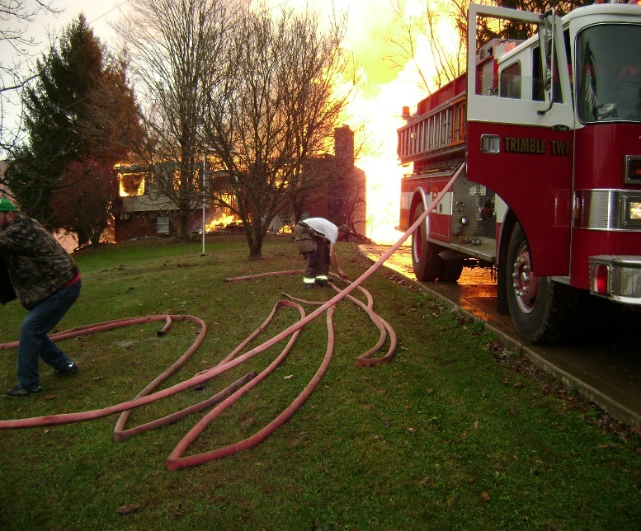
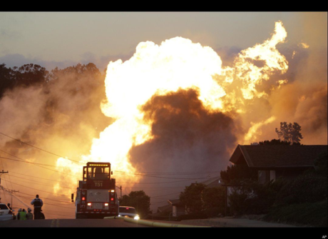

What We are Trying to Prevent!
31
Notes:
What we want is good strong pipes with no leaks. These are some of the photos when something went wrong.

Slide 32
PHMSA Advisory Bulletins
Notes:
Removed ADBs more than 3 years old.
Added 2022-0063, which was not included in the consolidated deck.
This section is updated by Distribution Team Seminar Presentation Working Group.

Slide 33
Pipeline Safety: Pipeline Safety Management System
Advisory Bulletin 2025-0018 - 3/25/25
Response to NTSB Investigations in 2010 (Marshall, MI; San Bruno, CA), as well as more recent NTSB Safety Recommendations and Safety Alerts and 2020 PIPES Act
Advisory issued to attempt to address alignment of weaknesses or failures across multiple activities, resulting in accidents with serious consequences
Recommendation encourages regulated pipeline operators to develop and implement Pipeline Safety Management Systems, points to RP 1173
Ensure that PSMS continuously evolves and improves
Recommends that operators maintain a positive safety culture
Encourages voluntary adoption; emphasizes that advisory bulletin does not have the force and effect of law

Slide 34
Potential for Damage to Pipeline Facilities Caused by Earth Movement and Other Geologic Hazards
Advisory Bulletin 2022-0063 - 6/2/22
Response to geological-related incidents, accidents, and SRC
Advisory issued in part as a result of changing weather patterns due to climate change
Reminder of regulatory requirements related to design, patrols, continuing surveillance, integrity management, and remediation
Recommendation to identify and monitor areas prone to earth movement
Recommendation to monitor environmental conditions in proximity to operator facilities and use available data and resources to assess vulnerability
Recommendation to implement site specific mitigation measures

Slide 35
PHMSA Interpretations
Notes:
You may include Interpretations of interest to the target operator audience.
The first five slides are duplicates of the Consolidated Deck. Interpretation summaries include 2021-2024 PHMSA interpretations most directly relevant to distribution pipelines.
This section is updated by Distribution Team Seminar Presentation Working Group.

Slide 36
PI-12-0005
Publish Date 10-07-2024
Kansas Corporation Commission requested interpretation of 192.3
Related to definition of a farm tap.
Ruled that PHMSA has traditionally viewed Farm Taps as distribution service lines, the specific configuration in the interpretation qualifies as a transmission line.

Slide 37
PI-24-0002
Publish Date 6-10-2024
MO Public Service Commission requested interpretation of 192.3
Related to definition of a master meter system.
Ruled that a pipeline system at the Kansas City Airport is a master meter system because the operator purchases metered gas from an outside source and distributes the gas for resale through a gas distribution pipeline system.

Slide 38
PI-22-0015
Publish Date 3-31-23
Anheuser-Busch, LLC requested interpretation of 192.1
Related to limits of safety jurisdiction
Ruled that federal minimum standards do apply to pipeline downstream of compression facility (as transmission line), but do not include compressors and other upstream equipment

Slide 39
P-23-0001
Publish Date 4-06-23
Pacific Gas & Electric requested interpretation of 199.1 related to applicability of D&A programs for backup emergency dispatchers
Ruled that back-up employees should be classified in the same manner to standard duty personnel (in this case, subject to D&A requirements)

Slide 40
P-22-0010
Publish Date 8-23-23
Navajo Tribal Utility Authority requested an interpretation of 192.1
Asked whether tribally operated pipelines operating outside of tribal national borders are subject to minimum federal standards
They are

Slide 41
PI-23-0017
Publish Date 01-17-24
US Bureau of Land Management requested an interpretation of 192.1 regarding whether helium pipelines are regulated under 192
They aren’t

Slide 42
PI-11-0013
Publish Date 3-13-2023
New Mexico Gas Company requested an interpretation of 192.3 and related to classification of pipelines as transmission or distribution pipelines
Included detailed information concerning specific regulated pipelines.
PHMSA determined that the lines are distribution lines.

Slide 43
PI-23-0010
Publish Date 10-04-23
B3PE LLC requested an interpretation of 192.3 related to the specific wording of the definition of “transmission line.”
PHMSA indicated that the wording intends operators to evaluate “MAOP that produces a hoop stress of 20 percent or more of SMYS” and that PHMSA will consider clarifying the definition in future rulemaking.

Slide 44
PI 22-0001
IBEW Local Union 503 Requested interpretation of §192.615 (Actually Part 199.3)
Whether Customer Service Representatives are subject to drug testing
Ruled that covered employees are operations, maintenance, and emergency response personnel
Personnel who do not dispatch response personnel are not performing response “on the pipeline”

Slide 45
PI-22-0004
Requested interpretation of Part 199 – Drafters subject to drug testing?
PHMSA ruled that the position did not perform work “on a pipeline” and therefore was not covered by the Part

Slide 46
PI-22-0008
NTSB requested interpretation of 192.801 and 195.501
NTSB inquired whether launching and receiving pigs is a covered task for Operator Qualification.
PHMSA ruled that covered tasks need not be specifically prescribed in regulations or in operators O&M, if they are integral to meeting regulatory requirements
PHMSA ruled that launching and receiving pigs is a covered task

Slide 47
PI-22-0011
Union of Operating Engineers, Local 49 requested PHMSA interpretation on whether Gas Distribution Designers are covered under drug testing requirements of Part 199
PHMSA ruled that the position did not appear to require random drug testing under Part 199

Slide 48
PI-22-0014
Requested interpretation of 192.517(a) and 192.624(a) regarding whether recording charts must be included pressure testing records to represent TVC records
PHMSA ruled that correspondence letters asserting compliance with testing requirements is insufficient without accompanying test records.

