Slide 1
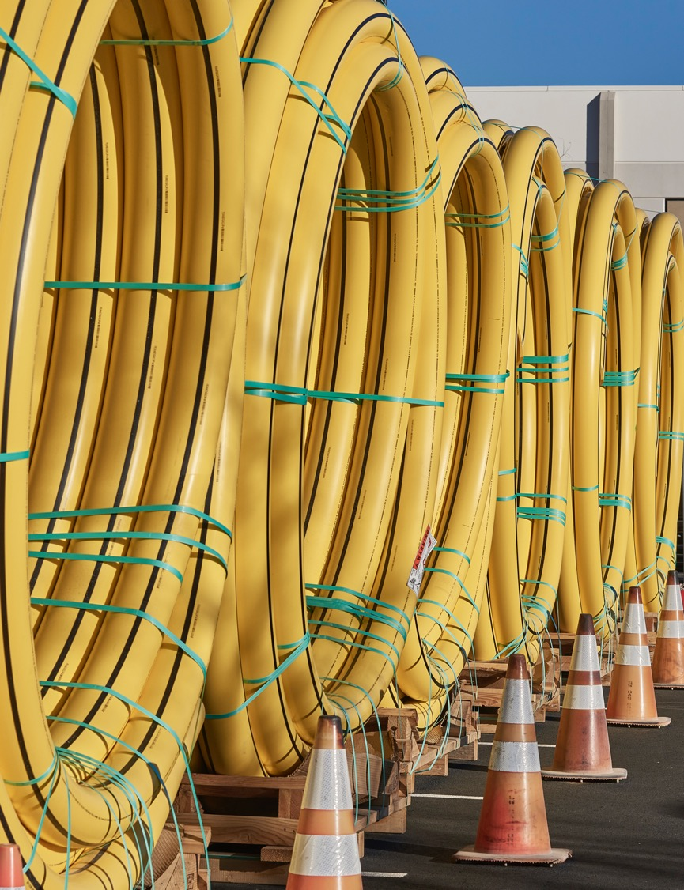
Advancements in Failure Analysis, Laboratory Testing and Artificial Intelligence
Laboratory Services
Aaron Mee
Greg Efthemes

Slide 2

Technology in the Lab
Characterization, Analysis and Data Management
With the advent of artificial intelligence (AI), testing appliances and processes are making quantum leaps forward before our eyes.
Subsequently, technology and techniques for materials testing and material investigations are developing rapidly.

Slide 3
Four Types of AI
Reactive Machines: capable of reacting to situations based on predefined rules. No memory or ability to learn. Chess Playing program can only respond to opponents moves.
Limited Memory: learn from past experiences and use that knowledge to improve decision making. Self driving cars.
Theory of Mind: advancing and aims to understand human emotions, beliefs, and intentions. It goes beyond simply reacting to inputs and tries to grasp the "why.” Honking horn = likely impatient person.
Self-Aware: most advanced and hypothetical type of AI and would possess consciousness, self-awareness, and the ability to understand its own internal states. Theoretical and yet to be realized.

Slide 4
Three Stages of AI – Development Pattern
Scaling Laws have been Deciphered: data and math to achieve the next level AI is now known.
Think Time: allowed AI to run inferential computations to calculate scaling scenarios.
Mastered Distillation: one AI teaches the next generation AI; the student becomes exponentially smarter than the teacher “evolution in fast forward.”
Each generation of AI will grow in unfathomable orders of magnitude form the previous generation.

Slide 5
GPT’s Exponential Growth – Orders of Magnitude
GPT-1 (2018): 10² - 117 million additional parameters.
GPT-2 (2019): 10⁹ - 1.5 billion additional parameters.
GPT-3 (2020): 10¹¹ – 175 billion additional parameters.
GPT-4 (2023): 10¹² – 1.76 trillion additional parameters (~10x GPT-3).
*GPT-4.5 (2025): 10¹³ - 2.00 trillion+ additional parameters (mainly an architectural refinement & optimization for GPT 5 capacity).
*GPT-5 (2025): 10¹⁴ - projected 4-5 trillion additional parameters.

Slide 6
Growth Enablers
AI Companies Developed Simultaneously
Independent of One Another
Therefore, No Restrictions.
No Moats Compartmentalizing Development.

Slide 7




AI in the Lab
AI Products:
    GPT 3, 4, 4.5 & 5: exceptionally broad bandwidth, understanding the ask, low error rate, great problem solving.
    Gemini: good with Google ecosystem & long context reasoning.
    Grok: humor, casual use, and real-time insights (by X).
    DeepSeek: multimodal analysis, complex reasoning, strategic planning; Chinese owned, distilled from Open AI, banned in 9 states.
    Claude: safety, ethical considerations, and detailed, nuanced reasoning; good for coding.
    Chat on AI: powered by GPT, good with image generation, real-time web search and document processing.

Slide 8
AI Case Study I
Creating an Email in MS Outlook using an Excel Spreadsheet to Extract Failure Analysis Database Details

Slide 9
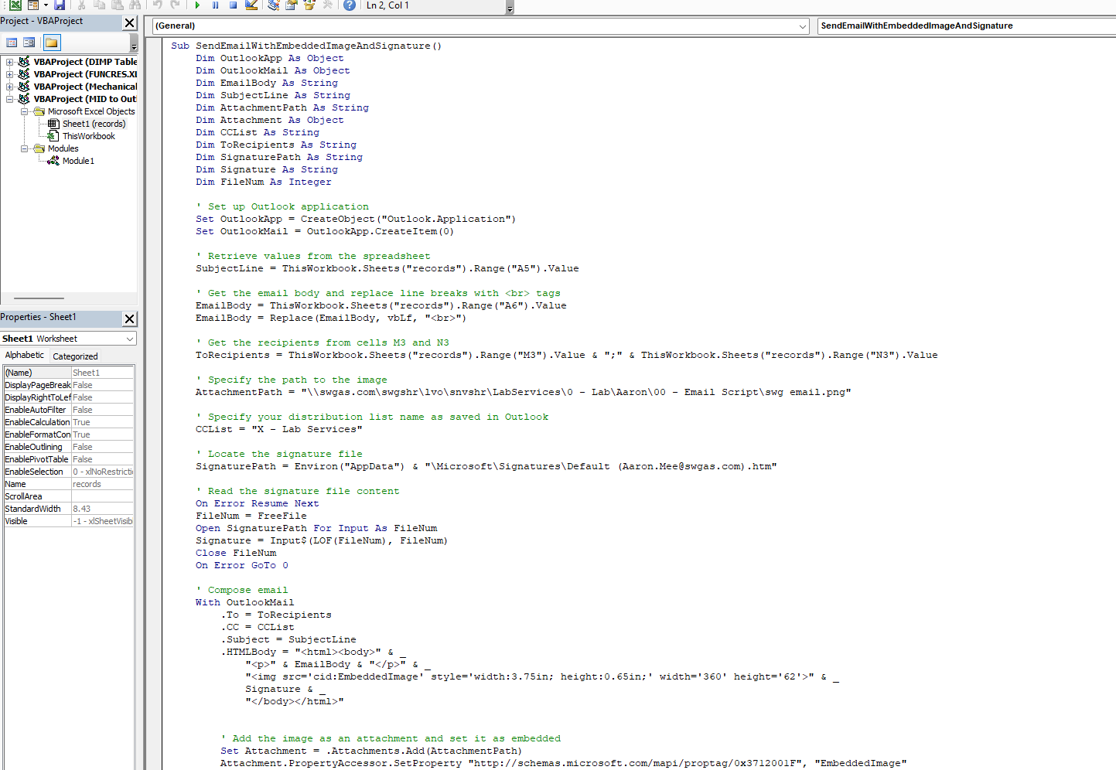
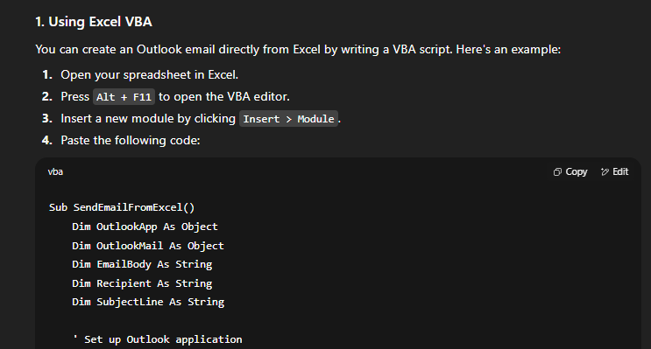
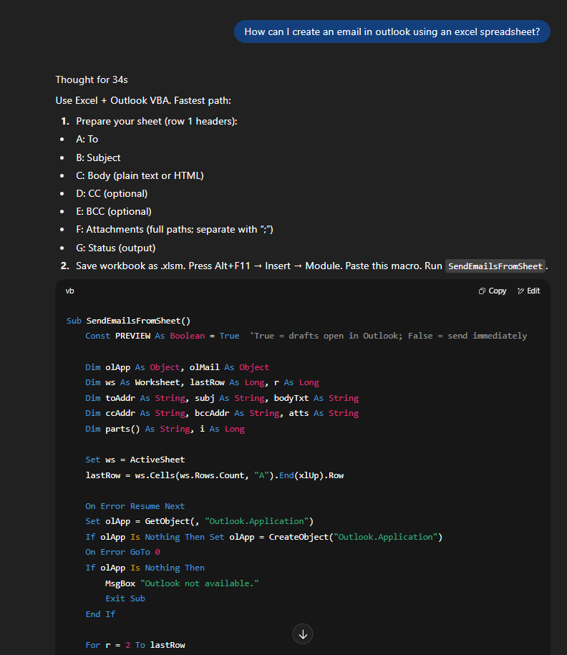
Excel Visual Basic for Applications (VBA) Task Automation Screenshot
ChatGPT
Thinking…
Excel macros once took hours of VBA study,
Followed by hours of trial and error.
Today, they are a few questions away.

Slide 10
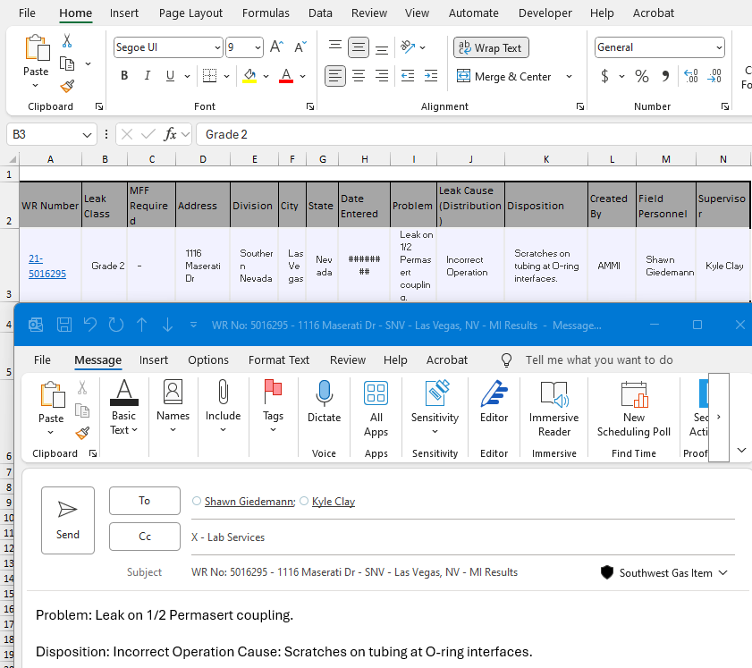
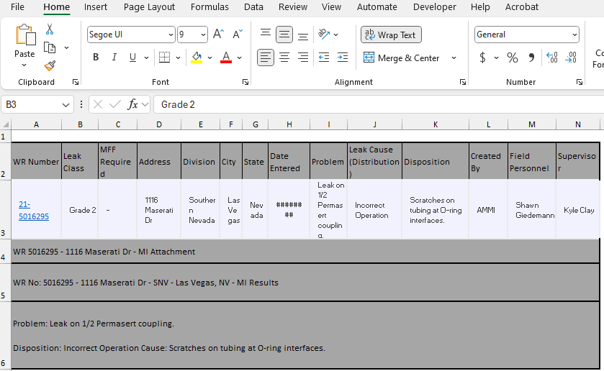
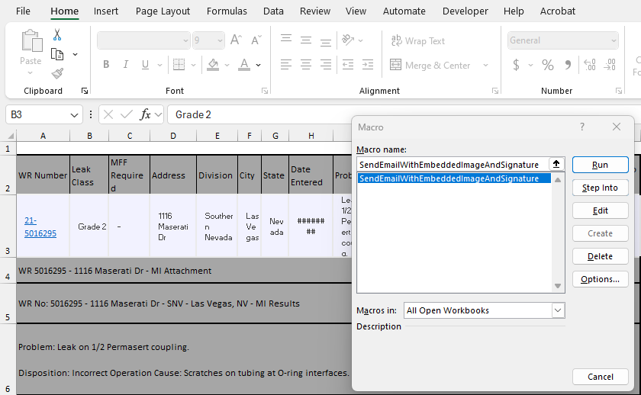
End Result
ALT + F8

Slide 11
AI Case Study II
Teaching AI to Read Electrofusion Coupling Digital X-Rays
A Joint Research Project

Slide 12


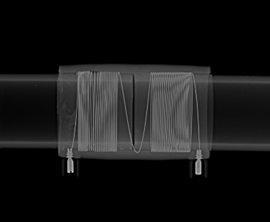
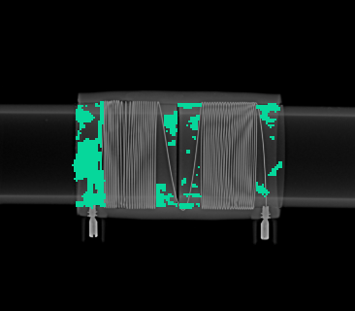
Transforming Electrofusion Joint Inspection with AI
Sand Contamination Detected

Slide 13



Transforming Electrofusion Joint Inspection with AI
NYSEARCH, along with Southwest Gas and peer utilities, is piloting AI, from Cogniac, to flag EF joint defects.
Utility SMEs annotated EF X-rays.
  Models were trained to detect sand, wire-walk, short stab, and similar anomalies.

Slide 14
Transforming Electrofusion Joint Inspection with AI
Training Methodologies
Box Model Training
Area Model Training
- Boxes are drawn around defects.
- Pro: Quicker to label.
- Con: Less precise.
Exact defect pixels traced.
Pro: More precise.
Con: Slower to label

Slide 15
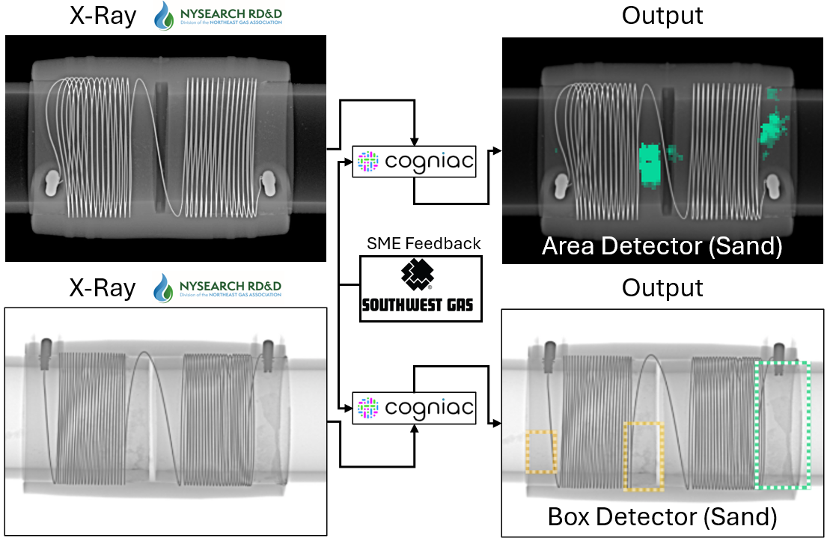
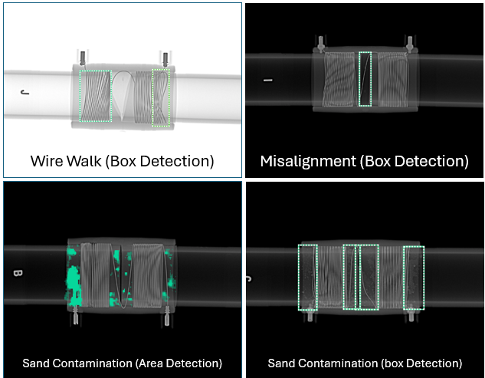
Box Model Training

Slide 16
Area Model Training

Slide 17


Transforming Electrofusion Joint Inspection with AI
Once trained, the models achieved fast & consistent pass/fail guidance, regardless of training methodology
Image recognition software trained with the area detection methodology was able to predict sand contamination 86% of the time.
  These early results are outstanding given the prevalence of human error in X-ray interpretation, and the limited amount of training media provided to the models thus far.

Slide 18
Transforming Electrofusion Joint Inspection with AI
New Developments
Cogniac experts will continue working with utility SMEs to fine-tune models for even higher success rates.
Further field testing with Utility SMEs will validate these advances in real-world conditions.
AI model accuracy and reliability will continue to improve with each x-ray image submitted to the dataset.
Utilities may soon be able to upload X-ray images to Cogniac and get rapid, objective pass/fail results.

Slide 19
AI Case Study III
Residential Meters with an Insert Issue: Statistical Lot Inspection

Slide 20
Quarantine: Residential Gas Meter Insert Issue
The manufacturer reported their meters had a series of inserts (spuds) breaking before installation.
22,000 meters with 17,700 initially quarantined.
While affected lot numbers were available to quarantine, additional inspection was needed to achieve a LOC for the remaining lots.

Slide 22
Hypergeometric Probability Distribution
Xxxx – Residential Meters
Sample Size by Batch Size Table
Assuming the following:
100,000 units (meters with a singular component potentially affected)
Estimated Proportion of Defectives (p): 0.3333
95% Confidence Level
Batch Size | Number of Fittings per Batch | Sample Size (E=0.01) | Sample Size (E=0.02) | Sample Size (E=0.03) | Sample Size (E=0.05)
5 | 5 | 5 | 4 | 3 | 2
10 | 10 | 6 | 5 | 3 | 2
15 | 15 | 7 | 6 | 3 | 2
20 | 20 | 8 | 6 | 4 | 2
25 | 25 | 9 | 7 | 4 | 2
50 | 50 | 12 | 8 | 5 | 3
75 | 75 | 14 | 9 | 6 | 4
100 | 100 | 17 | 11 | 7 | 4
250 | 250 | 28 | 14 | 9 | 5
500 | 500 | 39 | 19 | 12 | 7
750 | 750 | 47 | 23 | 15 | 9
1,000 | 1,000 | 56 | 27 | 17 | 10
Explanation of the Table:
Batch Size: The total number of fittings in each box or batch.
Sample Size: The number of fittings that should be inspected based on different margins of error, calculated as a proportion of the fittings in each batch.
Examples:
1. If there is a box with 25 fittings:
 | For E = 2%: Sample Size = 7 fittings should be inspected.
 | For E = 5%: Sample Size = 2 fitting should be inspected.
2. If a location has 30 boxes, each containing 25 fittings:
 | Total fittings: 30 boxes × 25 fittings/box = 750 fittings.
 | For E = 2%: Recommended Sample Size = 4 fittings per box × 30 boxes = 120 fittings should be inspected.
 | For E = 5%: Recommended Sample Size = 1 fitting per box × 30 boxes = 30 fittings should be inspected.

Slide 23
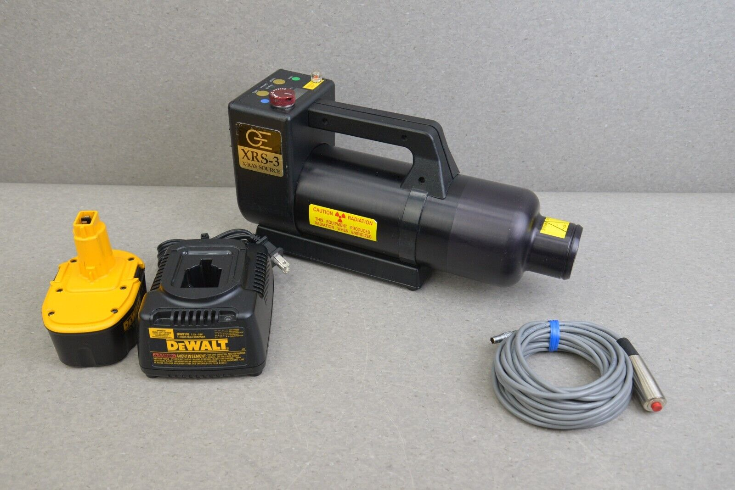
Digital Radiography in the Lab
Golden Engineering: XRS3 GFX 20V Portable X-ray

Slide 24

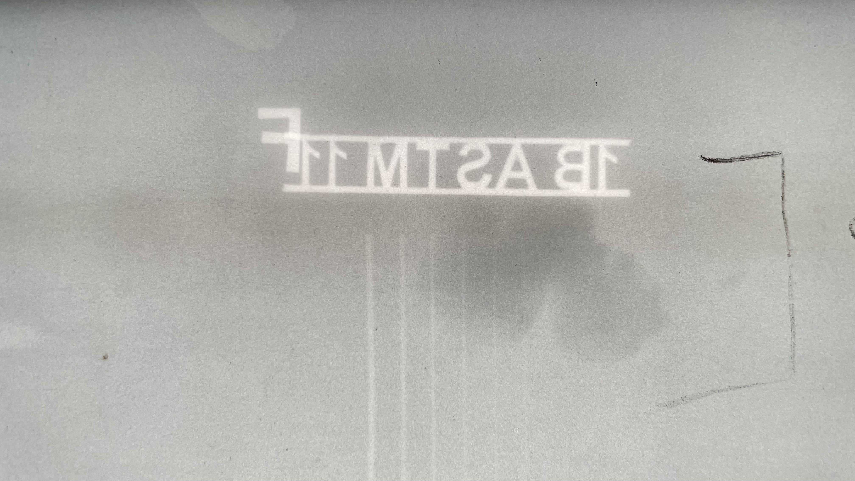
Wall Loss – Pitting or Mill Scale

Slide 25
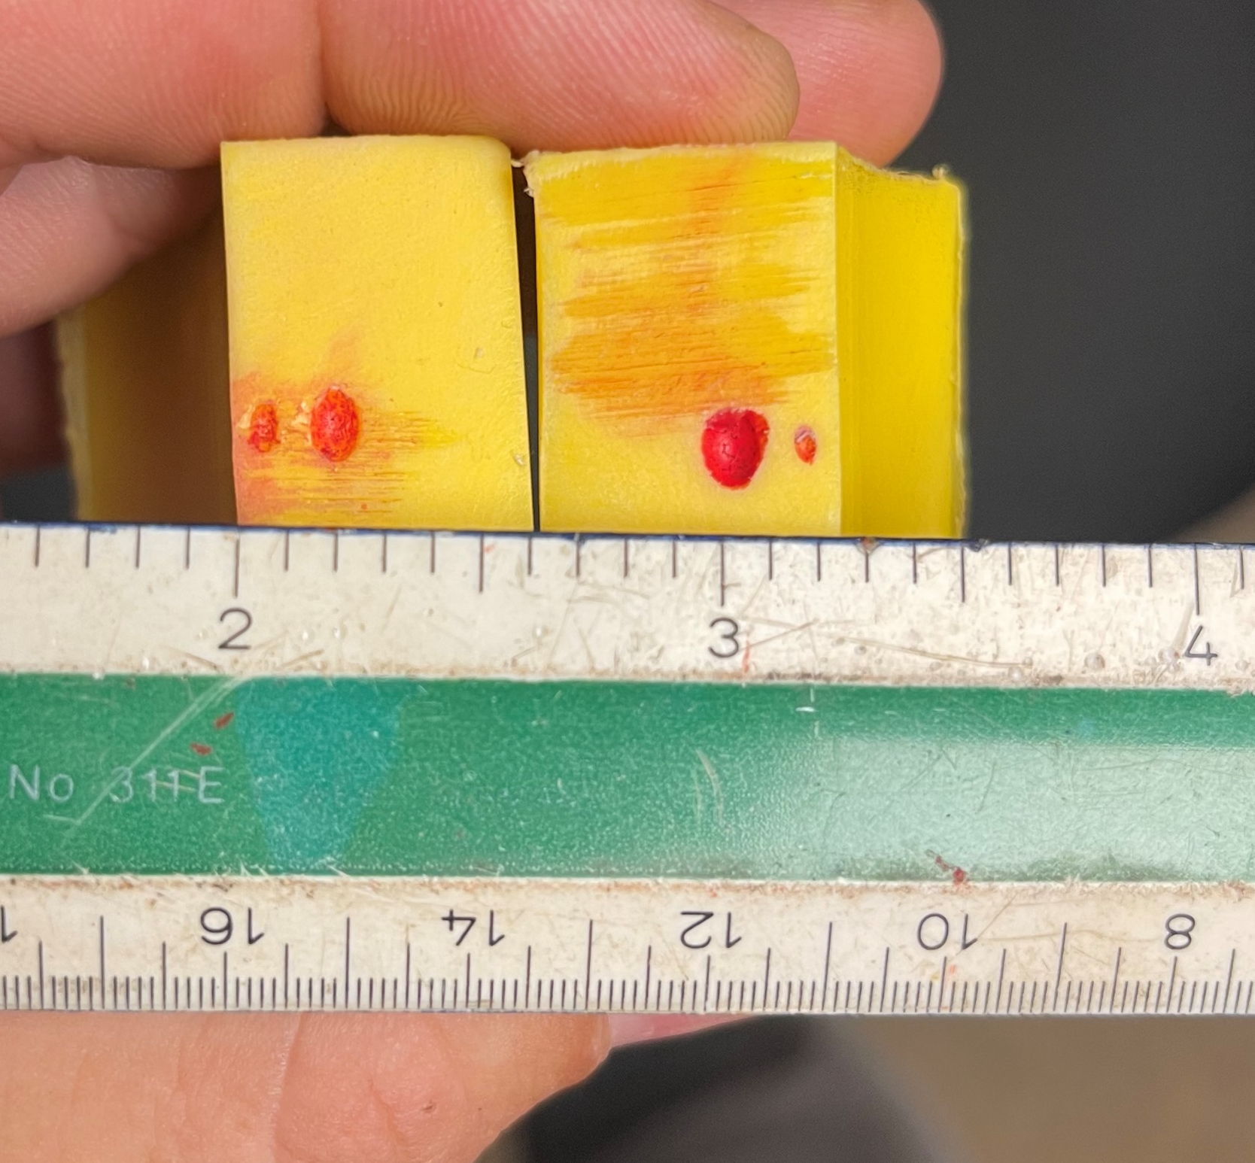
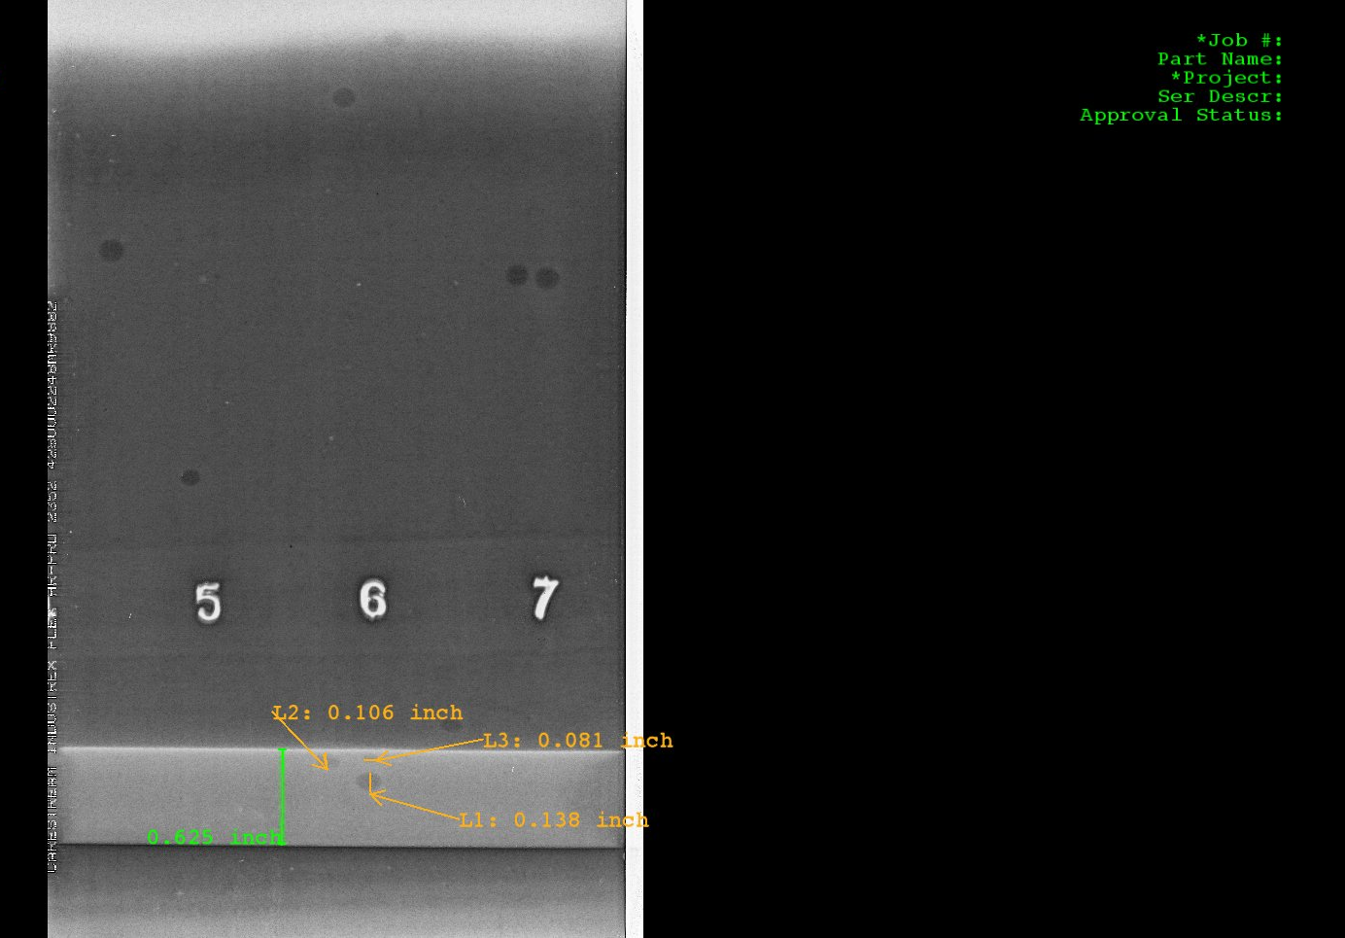

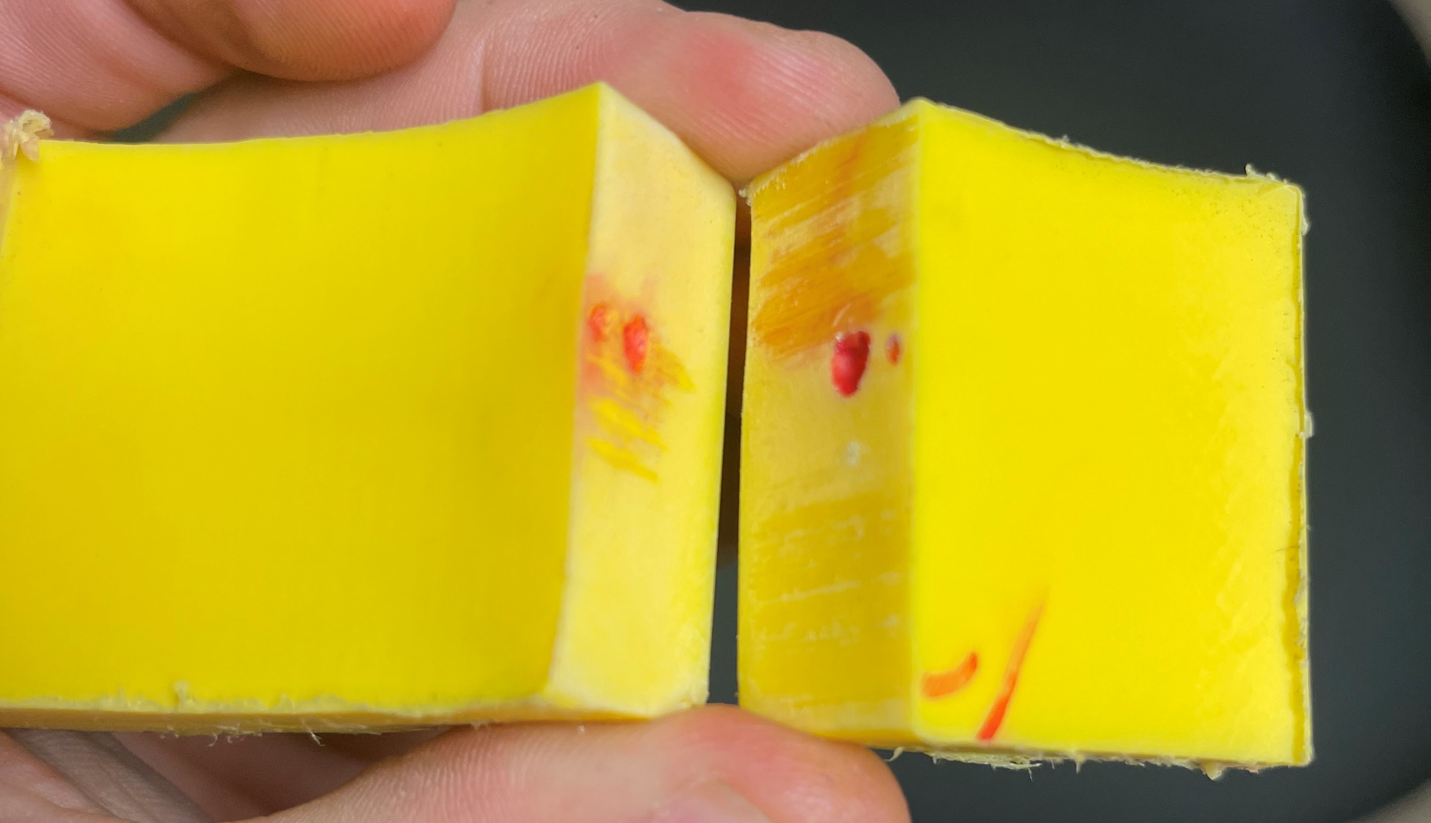
AI Interpretation for All Radiography is No Longer a Bridge too Far?

Slide 26
UT Instruments and Scanning
USM100, MENTOR UT FLAW DETECTION
COMPACT PAUT

Slide 27
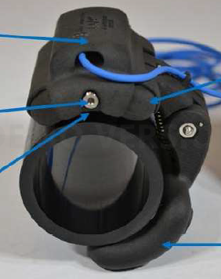

Slide 28
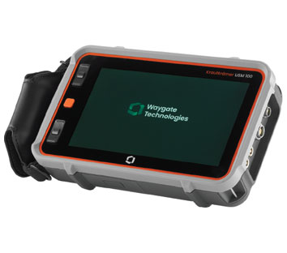
USM 100 Shear & Longitudinal Wave
Waygate Krautkramer (Formerly GE Inspection)
Equivalent to USMGO in terms of UT testing capability
New capabilities - custom apps and ability to do Encoded Scans along length or circumference
Fully programmable display features and active ultrasonic variables.
Onboard datalogging
Graphic Image Capture & Storage.
Bluetooth communication and interface.

Slide 30
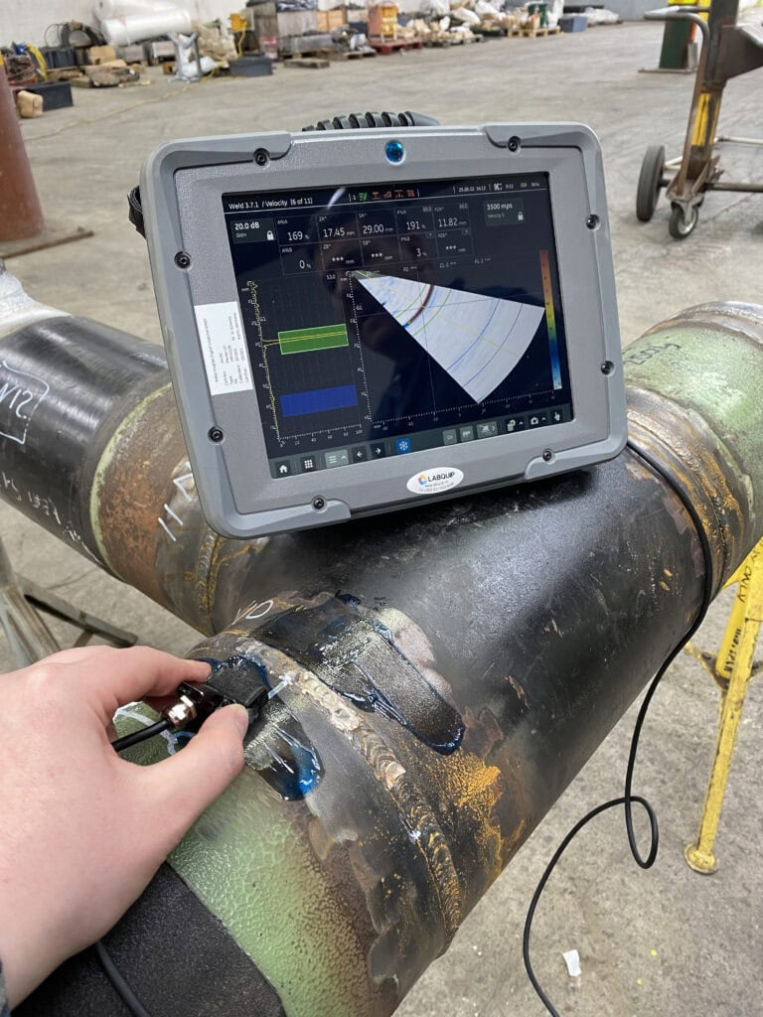
Mentor UT Phased Array
Phased Array - Sectorial and Linear scans.
Common Applications:
Weld investigation - lack of fusion, porosity, cracks, typically 40°-70°
Castings
Composites
Plastics

Slide 31
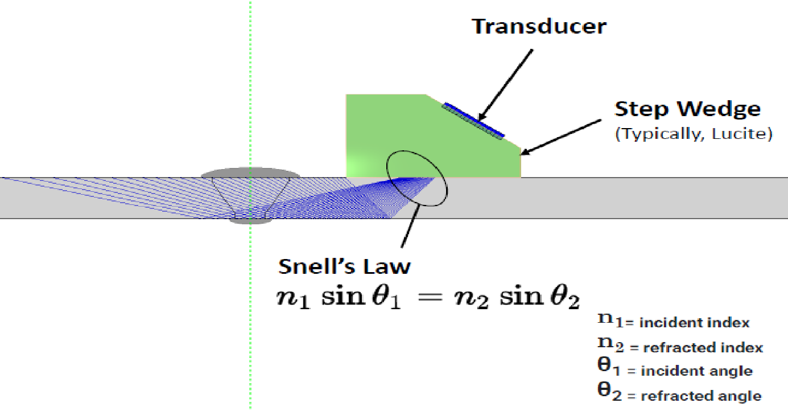
Phased Array Ultrasonic Testing (PAUT) Anatomy
Mode Convergence

Slide 32
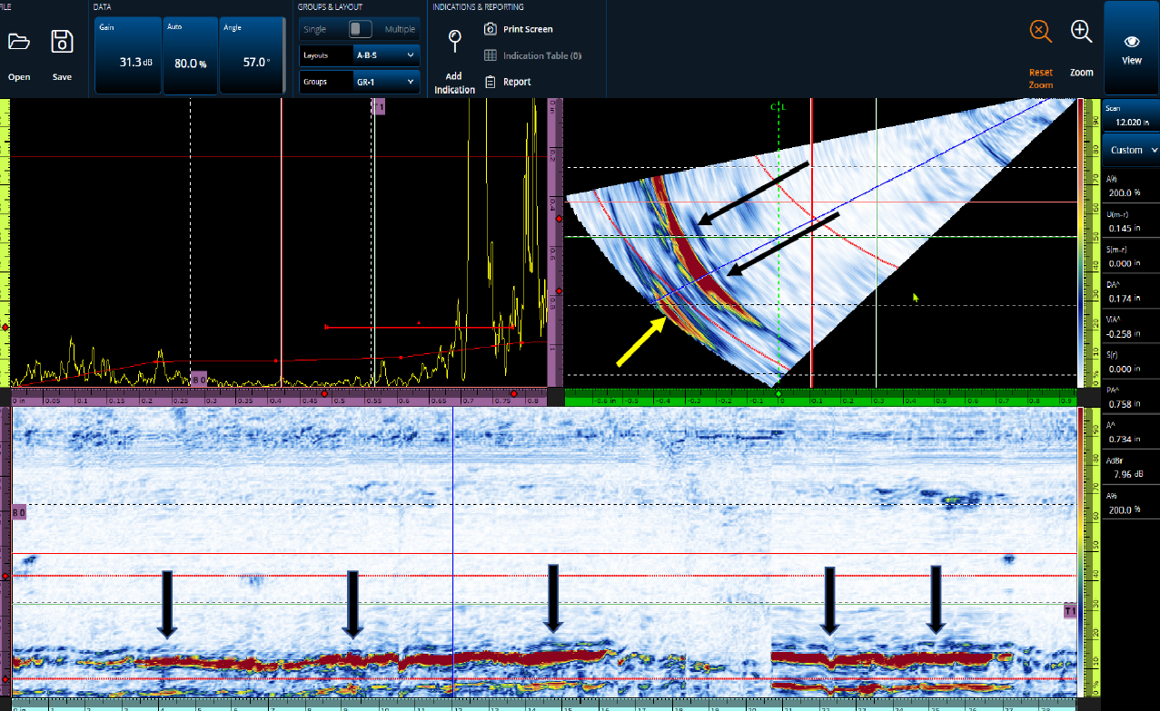
PAUT – Layout ABS-Scans
A-Scan
S-Scan
B-Scan

Slide 33
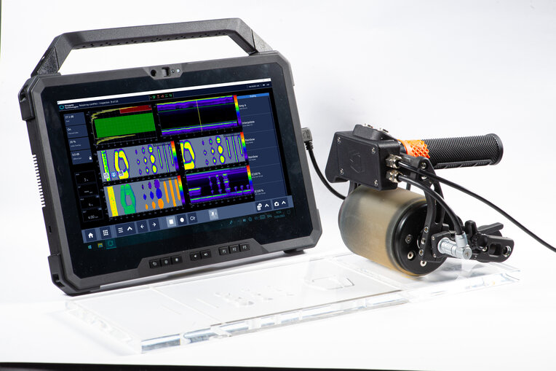
RotoArray
Embedded UT transducer and Bladder for C-scan
32/64 elements
Common Applications
Volumetric Flaws –
Flaw based hardness (FBH)
Surface based hardness (SDH)
Porosity
Thickness mapping and measurement
Delamination

Slide 34
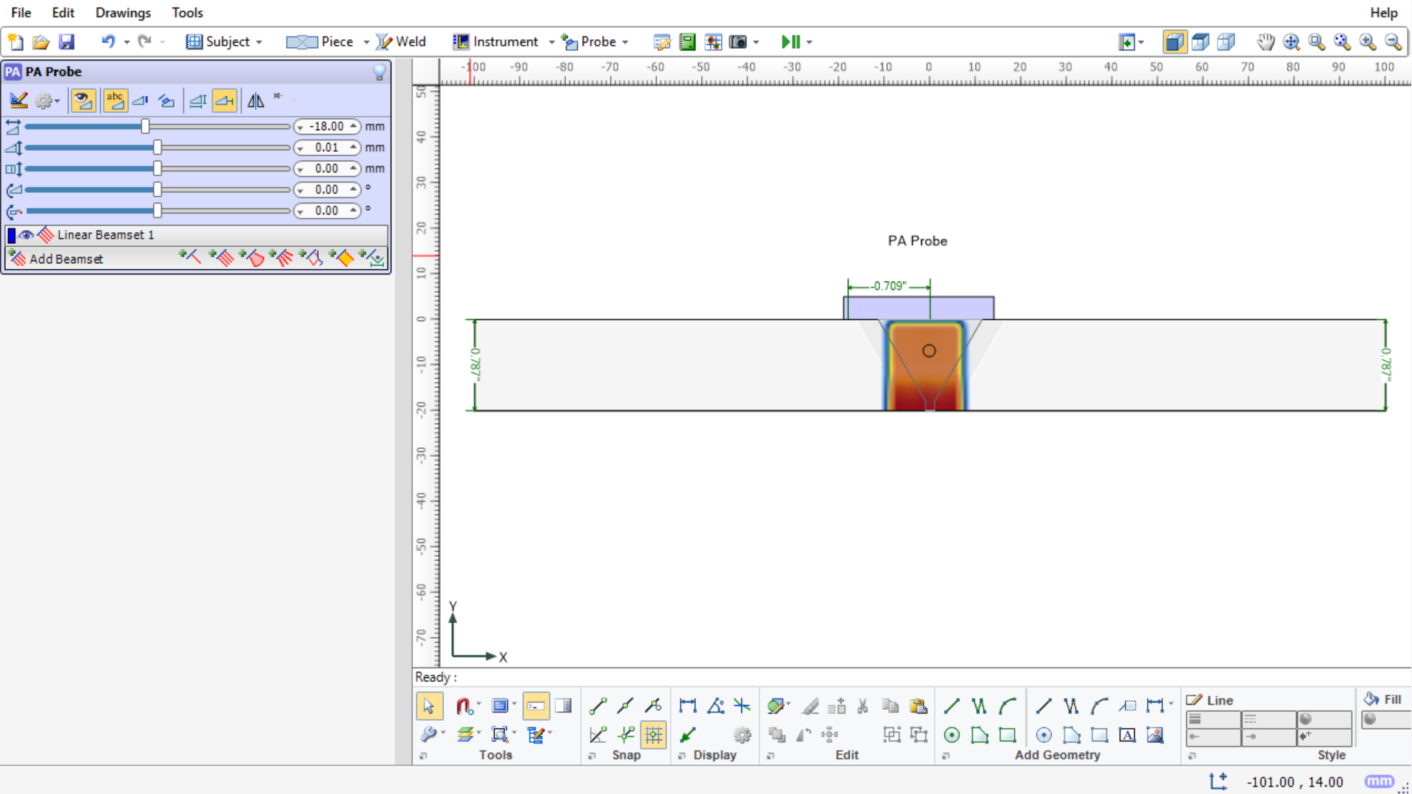
RotoArray(Compact CONT)

Slide 35
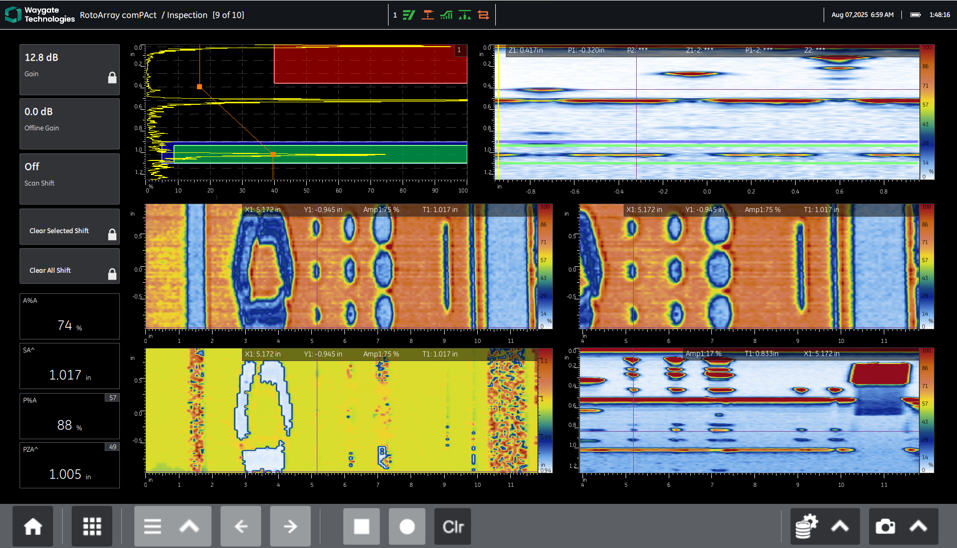
RotoArray(Compact CONT)

Slide 36
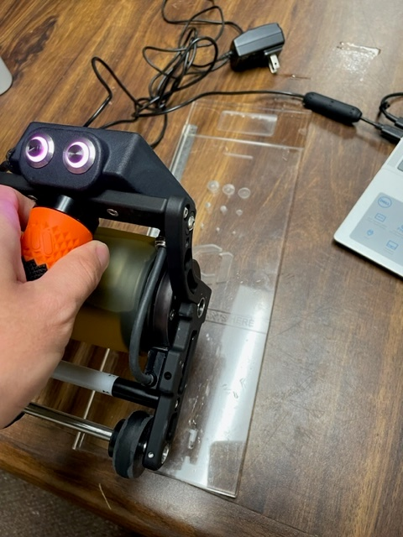
RotoArray(Compact CONT)

Slide 37

Closing Thoughts
This a Transformative Era
Biggest changes since the Industrial Revolution, beyond the Information Age and Cloud Computing.
Future belongs to those that are first to recognize, adapt and pivot.
Woody Kuntz, 1996
This Photo by Unknown Author is licensed under CC BY

Slide 38

Questions & Answers

Slide 39




Slide 40
AI Vernacular
Agenetic AI - development of intelligent agents that can operate autonomously and make decisions based on their environment. Now
Generative AI - focused on creating new content, such as images, text, music, or other media, based on patterns learned from existing data. Now
Robots – first generation autonomous ~$80K, FY26-27 Boston Dynamics & NVIDIA

Slide 41
Quantum Computers, Quantum Timing & Measurement
Quantum mechanics being developed for its potential to enhance faster computing
Quantum bits (qubits) perform calculations at speeds far beyond those of classical computers.
The principles of superposition and entanglement enable qubits to represent and process information in ways that classical bits cannot.
Quantum clocks enhance timing mechanisms in quantum processors. provide highly accurate timing signals, which could improve the overall performance and reliability of quantum computers, using photon emissions & detectors.
Wave particle duality.

Slide 42
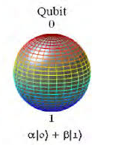
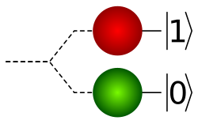
Bit vs Qubit

