Slide 1

Regulator Station and Industrial Design Concepts
Presented by:
Sam Hegje
Product Line Manager

Slide 2





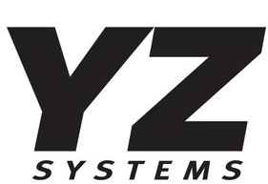


Who we represent

Slide 3
Discussion points
Codes and Regulations
Initial Factors and Issues to Consider
Pressure Limiting Monitor Designs
Station design consideration
Conclusion

Slide 4
Codes and Regulations
What governs us on station design and pipeline safety?
Who guides us in how to design and install equipment?
  Code of Federal Regulations (CFR)
    49CFR Part 192
  ASME Codes
    ASME B31
  Company Station Design Standards

Slide 5
Codes and Regulations
These documents provide guidelines on the materials, use and installation of equipment
Each company is tasked with ensuring that all standards required for their pipeline are met
  Generally, the station design engineer will ensure that compliance is met
A key issue in all designs is a single point of failure cannot result in exceeding MAOP (Maximum Allowable Operating Pressure)

Slide 6
Initial Factors to Consider for Station Design
Single feed run, Dual run, Loop feed
Over pressure protection
  Monitor setup
  Relief
  Slam Shut
Material selections
  Brass, Aluminum, Stainless, Coated
  Temperature considerations
Pressure limitations and differential pressure
Failure consequences
Etc…

Slide 7
Pressure Limiting Monitor Designs
There are six typical configurations when it comes to using a monitor regulator
  Standby Monitor – Two Pilot Operated Regulators (Single pressure cut)
  Working Monitor – Multiple pressure cuts with Two Pilot Operated Regulators (Three Pilots)
  Integral Monitor/Slam Shut – Use of a device that will monitor and slam shut
  Dissimilar Monitor Regulator - Self Operated Monitor with Pilot Operated primary regulator
  Control Valve Monitor – Fast acting pilot operated ball or globe valve monitor
  Low Differential Strategies - When Using a Standby Monitor Design

Slide 8
Standby Monitor Design
A Monitor System is any two regulators in series both sensing the same downstream pressure.
In the event of a failure of the Primary Regulator, the Monitor Regulator will take over and continue to provide gas flow
Pressure will be maintained and controlling at a slightly higher pressure.
  You must consider the pressure increase during design to ensure MAOP is protected

Slide 9

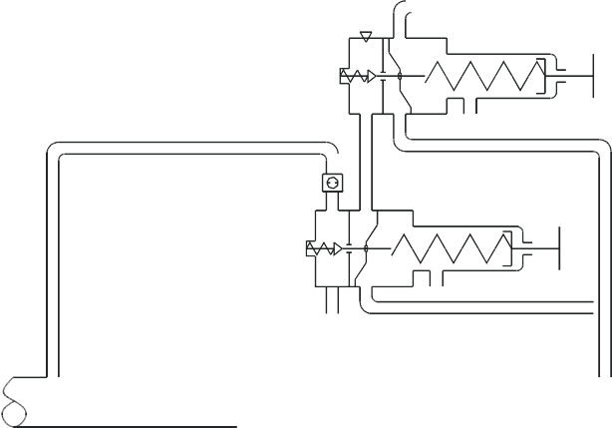
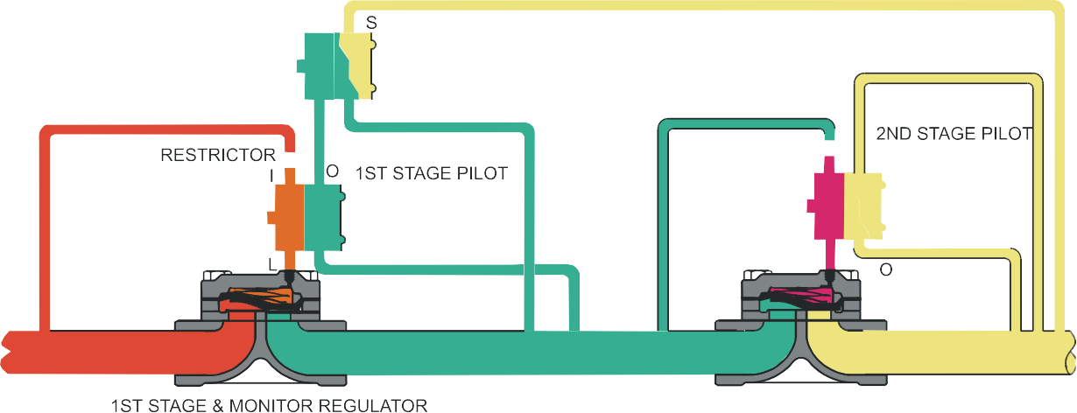
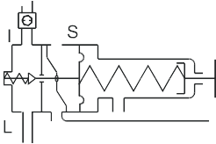
Working Monitor Design
Working Monitor Design is used when the normal pressure cut exceeds company station design standards or maximum manufacture recommendations
The benefits of a two-stage pressure cut
  Reduced noise
  Longevity of internal components
  Reduced sulfur build-up
The upstream regulator now has two pilots and serves two functions
  The first pilot acts as a working regulator making the first stage cut
  The second pilot acts a monitor incase the primary regulator fails, this pilot will take control of the upstream regulator and handle the entire station pressure reduction

Slide 10
Working Monitor Design
Interstage Piping Factors
  Since we are taking a first stage cut, the volume of this pipe plays a role in the stability of the system
  Interstage pipe taps should consist as a minimum of 3 ports, 1 sense port, 1 bleed port, 1 gauge port (sense and gauge can be combined)
  Because we are sensing the pressure in the Inter-Stage pipe for the first stage cut, we need greater volume to provide stability (commonly overlooked)
    It is recommended that the length of Inter-Stage Piping is 6 pipe diameters or 36 inches in length, whichever is greater
    It is also recommended that the Inter-Stage piping be increased 1 pipe diameter over the nominal port size of the regulator.
      For example, if the regulator is a 3” port, the Inter Stage pipe should be 36” and 4” nominal OD.

Slide 11
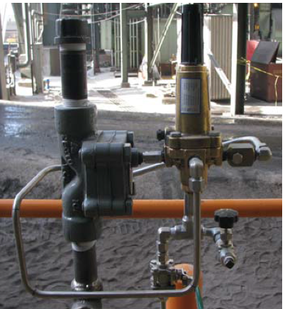
Use of Relief Valves
Relief Valves
The most common means of overpressure protection in the past has been a relief valve
  A Primary regulator and a downstream pressure relief set at a pressure below MAOP that vents to atmosphere
This method in has fallen out of favor in resent years due to:
  Noise of exhausting gas
  Greenhouse gas effects and regulations that limit release
  Lost Revenue
  Close proximity to housing and populated areas
  Correct sizing of the relief valve can be costly

Slide 12
Integral Monitor or SlamShut Design
Stand alone slam shuts can sit in line without having any regulation included
  Commonly seen at withdraw sites from 3rd party producers and storage fields
Integral Monitor/Slam Shut allows the user to have a Monitor Regulator as well as a Slam Shut Device that can be set at or near MAOP
Flexible Element Designs such as the Mooney Regulator and Shutoff Valve
  Mooney Design can be retrofitted to existing Flowgrid Regulators
Both device types provide Monitor Regulation and Pipeline Protection in the form of a Shut-Off Function.

Slide 13
Dissimilar Monitor and Regulators
The most popular dissimilar design is to use a pilot operated primary regulator and a self-operated monitor regulator
With this design, you get the benefits of a pilot operated primary valve for higher accuracy and lower droop, coupled with the robust design advantages of a self-operated regulator for the Monitor
Some of the advantages of a self operated regulator
  Faster Speed of Response on the Monitor
  Freezing will have little to no effect with the absence of a pilot
  Sulfur has little effect on Lock Up.
  Dissimilar designs mean less chance of an incident causing both regulators to fail under the same cause

Slide 14
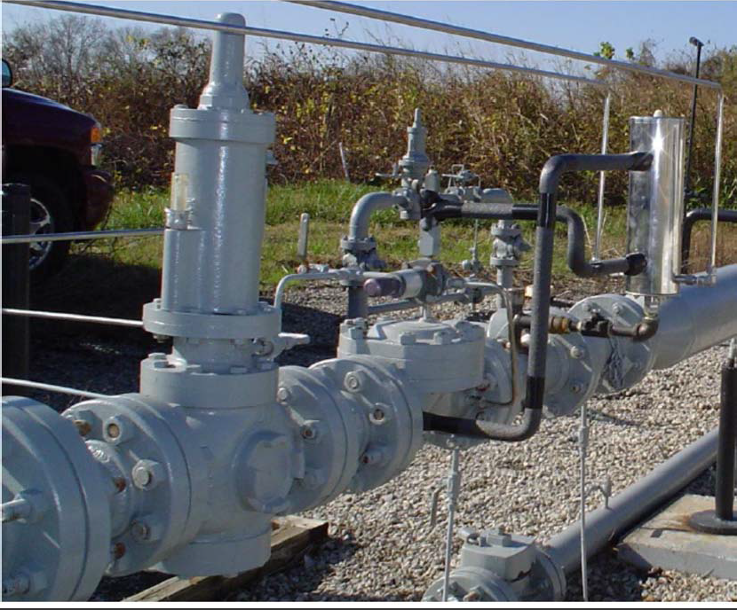
Dissimilar Monitor and Regulators

Slide 15
Control Valve Monitors
Control valve monitors can be used to eliminate any differential drop across the monitor
  A monitor control valve is in the wide open position eliminating any pressure loss through the monitor and acting as wide open pipe
  No longer have to size for 30% of lost capacity
Control Valve Monitors are also best used on larger loads with bigger pressure cuts
With a control valve you can define a failure position when using Spring Return Actuators or double acting actuators

Slide 16
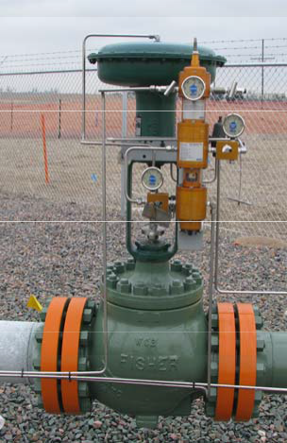
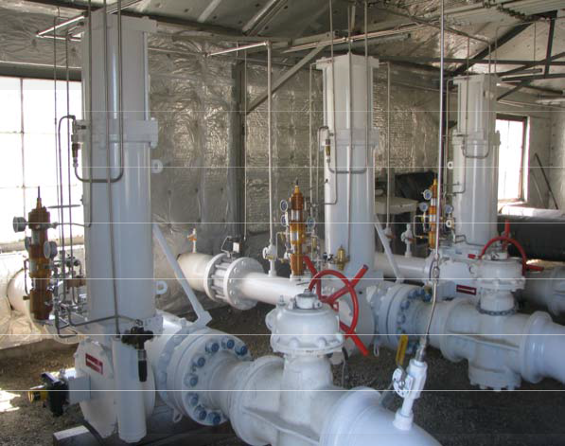
Control Valve Monitors

Slide 17
Material Selection
In regulation products there are multiple types of material to choose from
  Brass
  Stainless steel
  Aluminum (anodized or coated)
  Carbon steel (generally coated with paint, epoxy)
Regulators, pilots, pilot filters and restrictors should be reviewed for possible corrosion and material compatibility issues
Issues such:
  As are you close to an exhaust stack that uses ammonia injection for NOX pollution like at a power plant
  Is Methanol injected into the gas stream to prevent hydrates that could affect rubber goods
  Is there a catalytic heater that could cause temperature issues with soft goods
  Coastal regions or high moisture areas

Slide 18
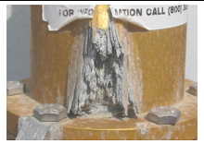
Material selections
Some specific instances are:
  When in coastal regions Stainless steel is going to be your best choice, even anodized aluminum can have issues
    All it takes if the anodizing to become scratched and the salt will attack the aluminum
  Chemical compatibility issues with soft goods always needs to be considered. Distillates, CO2, aromatic oils can cause loss of elasticity, hardening or swelling of rubber parts

Slide 19
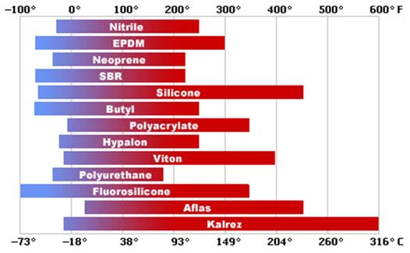
Material selections
  Temperature ranges of the gas, typically the gas range will be anywhere from 0F to 130F however there are times when this is not the norm, like in the exit of a compressor station or if a catalytic heater is left on during a no flow situation
    Nitrile rubber is the most common selection in pipeline applications due to its wide temperature band and excellent compatibility with natural gas

Slide 20
Temperature and Freezing Potential
Joules Thompson effect states that for every 100psi of pressure drop you will loose approx. 7°f
  Even with most pipelines running well below 7 lbs./MMcf of water in the gas there are still things to consider
  The average temp is 40°-60°f so for a pressure cut of 400psi this will reduce your pipeline temp by 28 degrees and can result in internal pilot freeze up depending on dew point of the gas
  Particular attention should be paid to pipelines that have been recently hydro tested as this will introduce moisture in the pipe walls sometimes for a couple of months after the test is completed even with drying

Slide 21
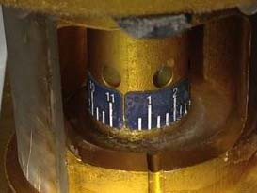
Considerations in Design
Temperature and Freezing Potential
External freezing can occur of gas supply regulators, pilots, and tubing
  While this is not usually a problem for controllability of the device some products have external moving parts that if frozen would hinder movement and thus preventing the device from controlling properly
  Ensure vent ports are extended or positioned to prevent freeze up
    If the vent freezes up your pipeline pressure will not be controlled effectively by the pilot or regulator

Slide 22
Pressure & Differential Pressure Limits
All regulators and pilots have pressure and differential pressure limitations
These limitations can affect the ability of the monitor regulator
  Is it possible to flow the required amount of gas with the minimum DP?
  What is the minimum DP required to open the regulator fully?
  What is the minimum DP to crack the regulator open on low flows?
Maximum Differential pressure across the flexible element or seat
  Even though a regulator may have a flange and body ANSI 600 rating the rubber goods may not have a maximum operating differential may only be rated for 800, 1000, or 1200 psi under normal conditions
    Most companies will have internal standards on how large individual pressure cuts can be
    You must also consider what freezing effects each pressure cut will have

Slide 23
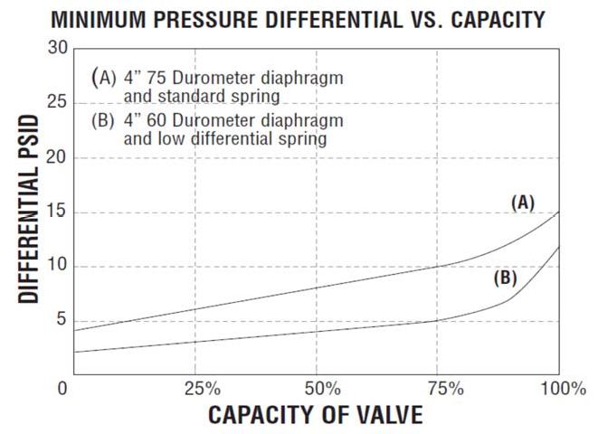
Pressure & Differential Pressure Limits
Each manufacture should have a Min/Max DP chart for each regulator make sure you check each regulator for:
  Min DP for the given diaphragm and bias spring to crack open the regulator
  Max DP for the given diaphragm and bias spring to fully open the regulator
Notes:
Go into why min dp is important

Slide 24
Pressure & Differential Pressure Limits
All regulators and pilots have pressure and differential pressure limitations
These limitations can affect the ability of the monitor regulator
  Is it possible to flow the required amount of gas with the minimum DP?
  What is the minimum DP required to open the regulator fully?
  What is the minimum DP to crack the regulator open on low flows?
Maximum Differential pressure across the flexible element or seat
  Even though a regulator may have a flange and body ANSI 600 rating the rubber goods may not have a maximum operating differential may only be rated for 800, 1000, or 1200 psi under normal conditions
    Most companies will have internal standards on how large individual pressure cuts can be
    You must also consider what freezing effects each pressure cut will have

Slide 25
Pressure & Differential Pressure Limits
Each manufacture should have a Min/Max DP chart for each regulator make sure you check each regulator for:
  Min DP for the given diaphragm and bias spring to crack open the regulator
  Max DP for the given diaphragm and bias spring to fully open the regulator
Notes:
Go into why min dp is important

Slide 26
Pressure & Differential Pressure Limits
Check the required DP across the regulator to Lock up the regulator
NOTE: Sizing software does not always take minimum differential pressures into consideration
Check the Pilot inlet & loading pressure ranges
Pilot spring set pressure ranges and pilot spring housing pressure limits
  All of these pressures must be confirmed to ensure proper equipment selection

Slide 27
Considerations in Design
Presence of Sulfur
Sulfur (yellow cake) has been a growing problem. Elemental sulfur is present in the gas stream and drops out as a solid under certain pressure and temperature conditions.
When sulfur fallout occurs a yellow or gray substance will attach itself to items in the gas stream and may effect the equipment’s ability to move freely or in some case completely lock up
Sulfur will show up yellow or gray (due to gas contaminants) in color and can be a soft cake, dusty form or a hard packed substance

Slide 28
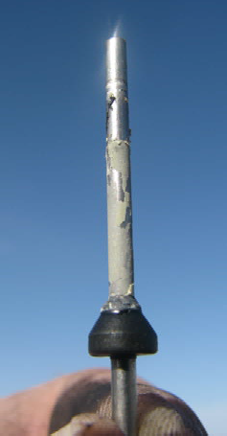
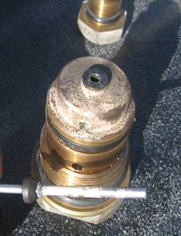
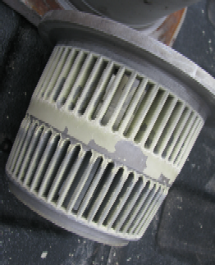
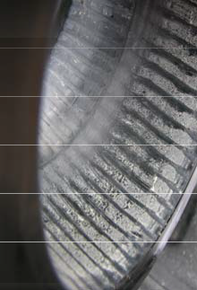
Considerations in Design
Presence of Sulfur
Some regulators and pilots maybe better suited for dealing with sulfur however what you gain in sulfur handling you may lose in regulator control or regulator turndown
A better way to deal with sulfur is to treat it before it gets into the pilots or regulators
  For pilot gas the use of Welker Sulfur-Gon™ works well to treat the pilot gas before it enters the pilot
  Reducing single high pressure cuts
    Total station reduction of 500psi, instead of making a single pressure cut use a working monitor setup and have two 250psi cuts
  It is thought that use of heaters can also work well in keeping sulfur fall out from happening
  By keeping the gas above 90°f on the outlet side of the station

Slide 29
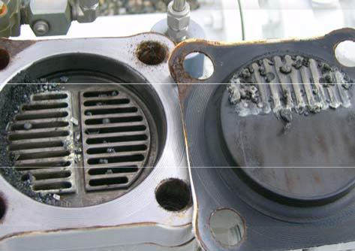
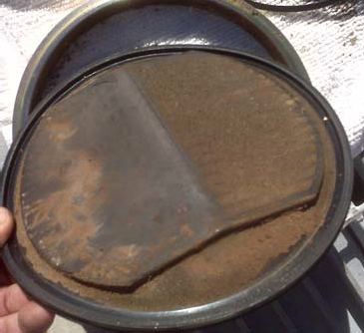
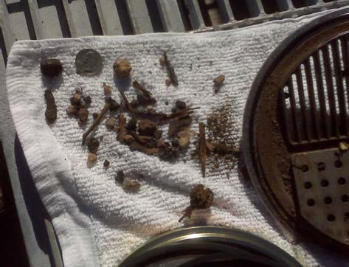
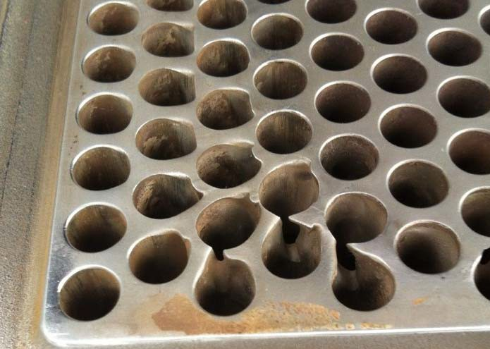
Considerations in Design
Filtration
Filtration is one of the most important components in a regulator station
  Pilot filters should always be used due to small passageways
    Typically 5-10 micron
    Particulate filters
    Sulfur/moisture filters
  Pipeline filters (Typically 5 micron)
    Regulators should be protected from weld slag and other debris
    Dry Gas Filters provide filtration and drying where needed
    Coalescing Filters when liquids are heavier

Slide 30
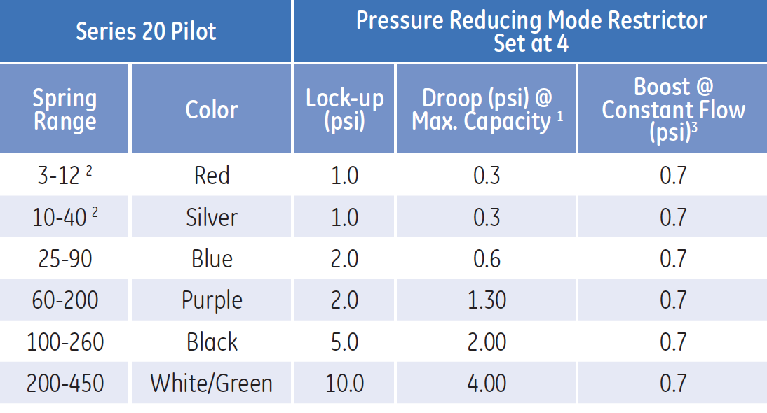
Considerations in Design
Pilot Lock-up Pressure
When designing a station it is important to understand that every regulator will have a “Lock-up” pressure that is higher than the pilot the flowing set point
  Each pilot and regulator should have published lock up percentages
When selecting monitor set pressure this must be taken into consideration along with MAOP of the pipeline
  If setpoint pressure needed is to be set close to MAOP then the option of a Monitor with intergraded Slam Shut should be considered

Slide 31
Failure Consequences
You must consider the consequences of a regulator failure and how you want the system to operate after a failure
  Consider the failure modes of not only the regulator but the monitor or slamshut that is being used
  When the regulator fails how do you want the pipeline to react
    With a monitor it will control with a slightly higher set pressure
    With a slamshut it will close off the pipeline shutting down flow
    With a relief it will control at a slightly higher pressure but will be bleeding the excess pressure to the atmosphere
  While there are many causes of failure these are the primary situations we are considering and planning to protect against
    If a primary regulator fails open
    If a primary regulator and monitor regulator both fail open
    Loss of power gas on control valve primary regulator or monitor actuator

Slide 32
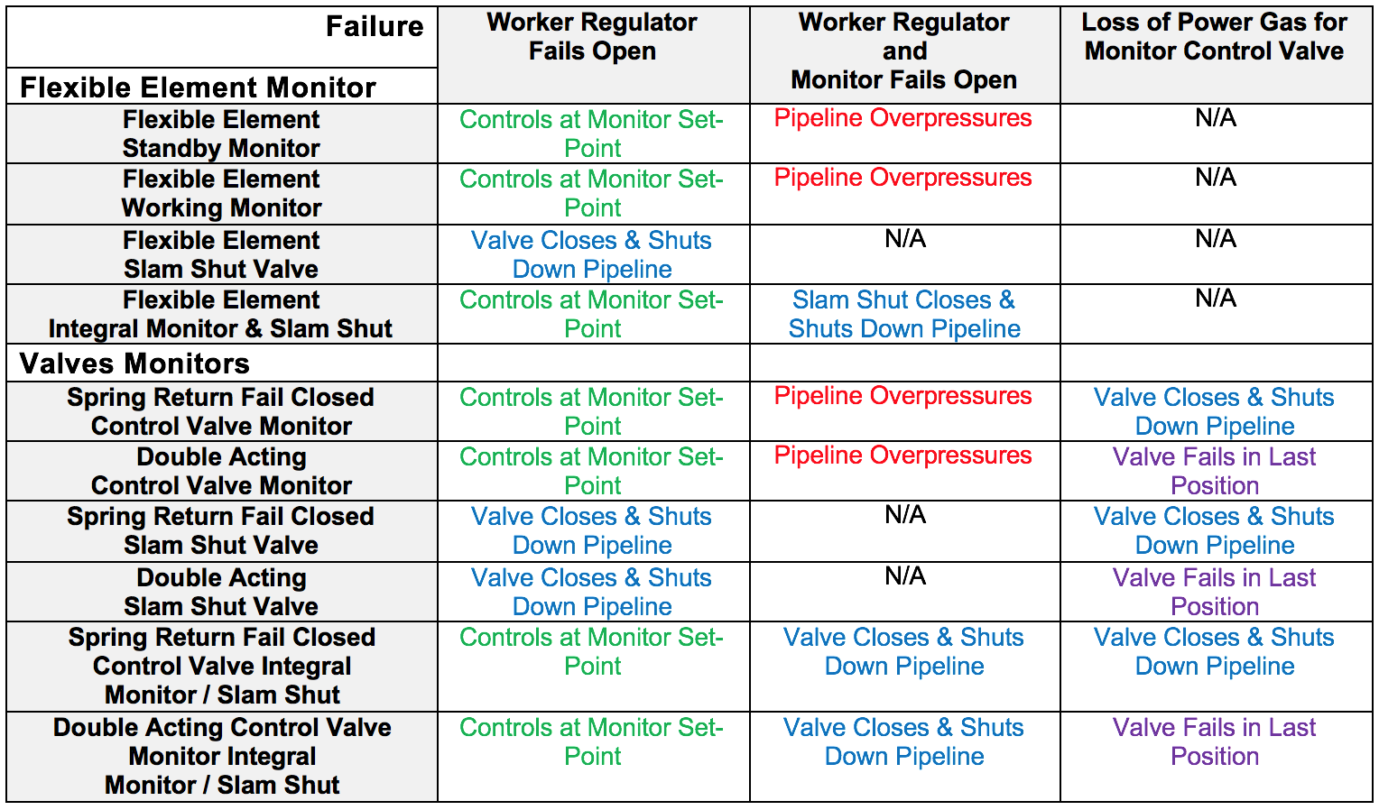
Failure Consequences

Slide 33
Conclusion
Monitor Strategies and the Implementation have become a large subject to tackle in Station Designs.
First you must investigate all Codes and Regulations as well as Engineering Design Standards of your company that are in place to protect the public and prevent pipeline overpressure conditions.
At times there will be many tough decisions and different options available for consideration before you put forth the best design for the application. Hopefully this paper will bring to light many of the concerns we encounter in station design, and offer solutions with options in Monitor Strategies available to the user.

Slide 34
Thank you for your time and attendance
Direct any questions to:
  Sam Hegje
  Tri Pacific, Inc.
  Sam.Hegje@tripacific.net
  916-675-2851

