Slide 1
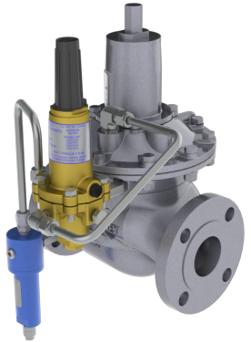

Measurement and Control Track: Regulators; Regulator Station and Commercial Applications
2025 Western Regional Gas Conf.
Presented By:
Howard Lyon
Tri-Pacific Sales Measurement, Regulation and Distribution Specialists 6121 Pacific St. Suite 101 • Rocklin, CA 95677 • Office: 916-630-2323

Slide 2
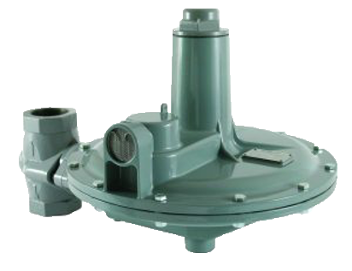
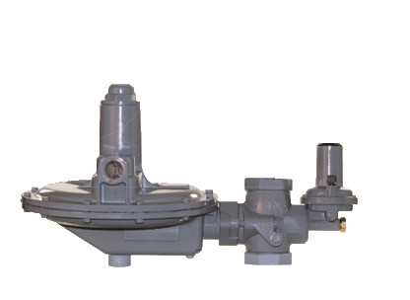
Regulators, Design criteria, Commercial Applications
Design Criteria, applications:
Flowrate & Pressure
Boiler feed
Low Differential, High Flow
Large single feed customer
Asphalt plant fuel
Process control
District regulator station
Single Reg or Standby Monitor
Type of Metering

Slide 3
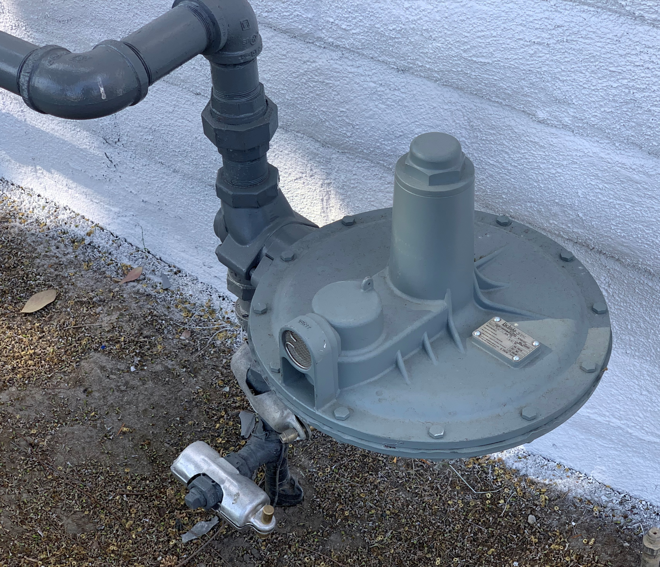
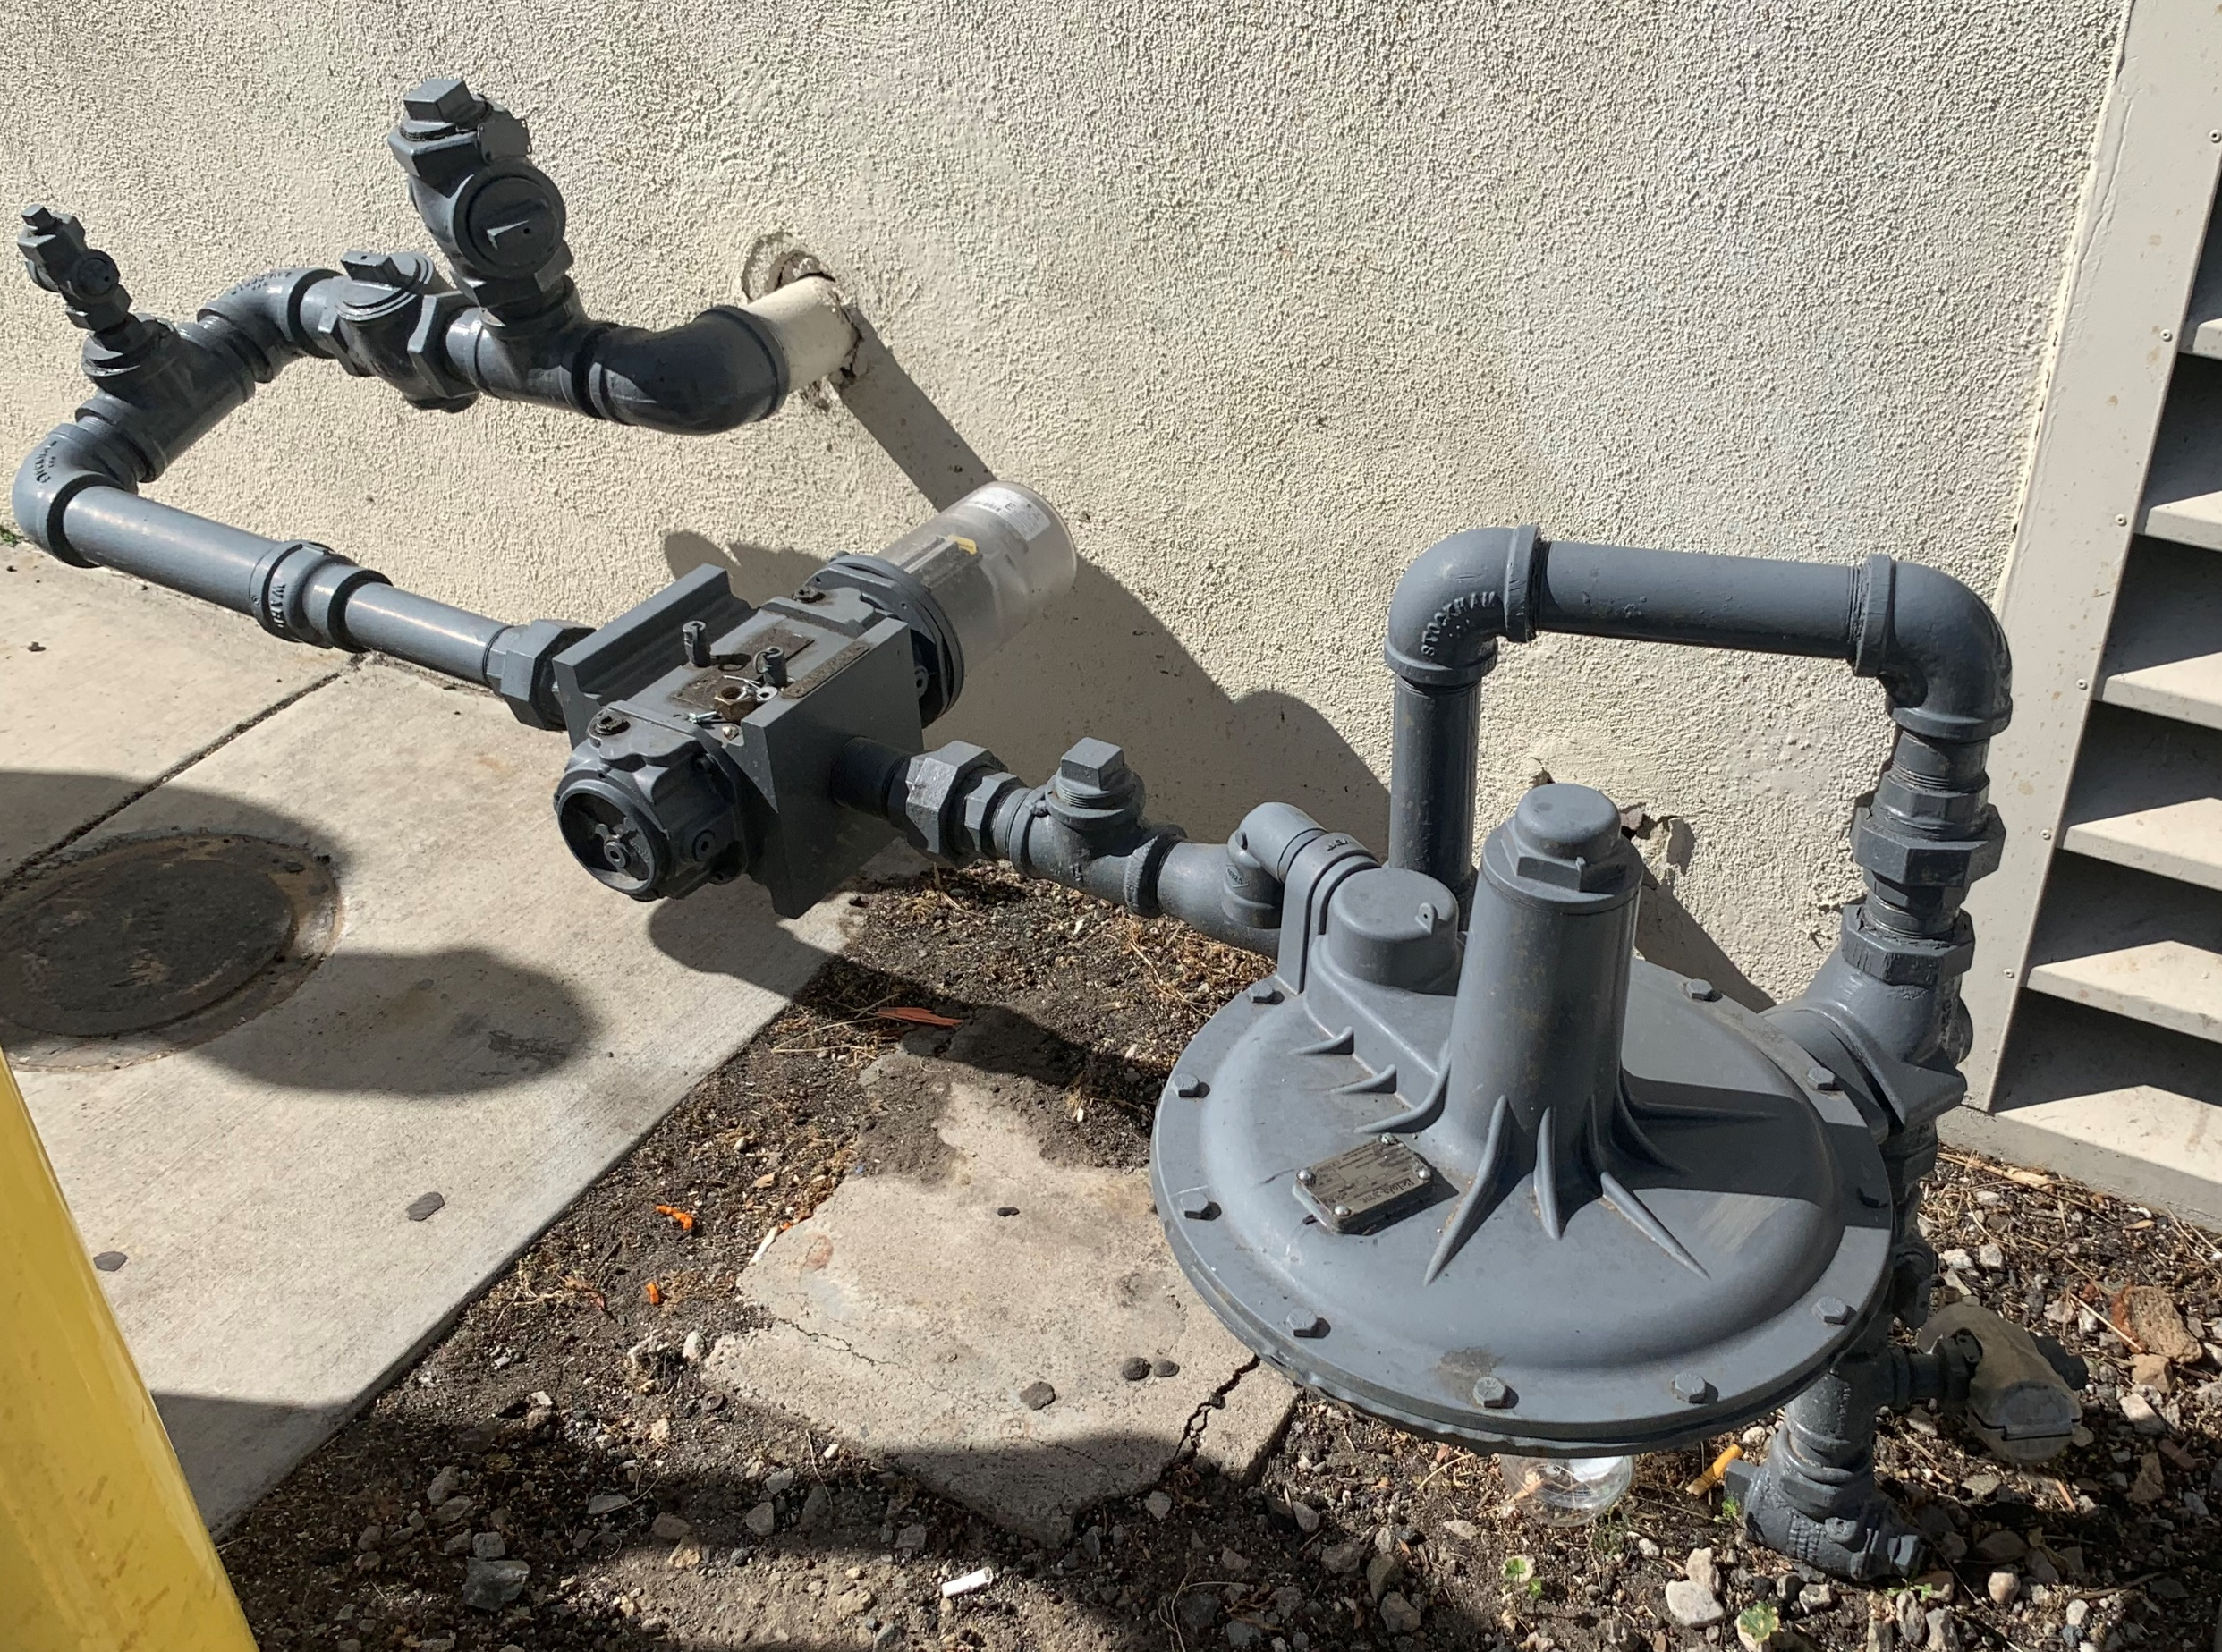
What are Commercial Regulators?
Commercial regulators are devices that reduce pipeline pressure to a safe level for use in restaurants, retail stores, apartment buildings, and light industrial applications.
Installed commercial regulators
Notes:
Regulators, as mentioned in our “What are Regulators video” are defined as “devices for controlling fluid flow”. BelGAS commercial regulators are ideal for natural gas service regulators such as retail and restaurants, as well as fuel gas regulators for compressors and engines. Pictured here are examples of installed commercial regulators, the one on the left is at a bakery and the one on the right is at a restaurant. Now. Let’s take a look at how commercial regulators work.

Slide 4
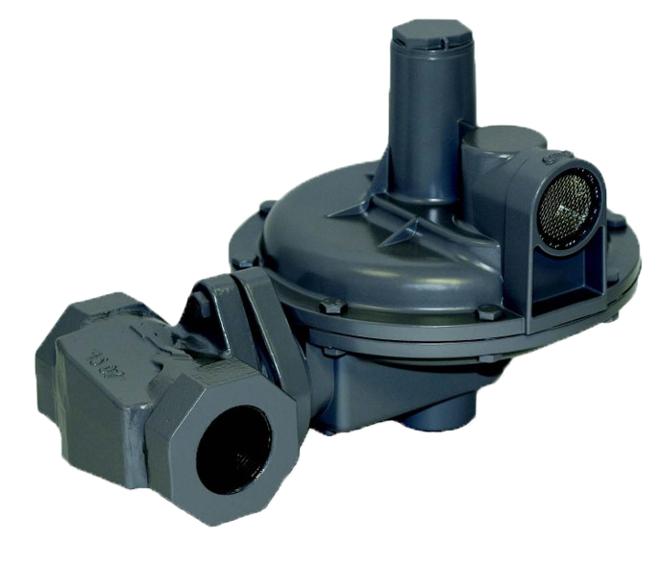
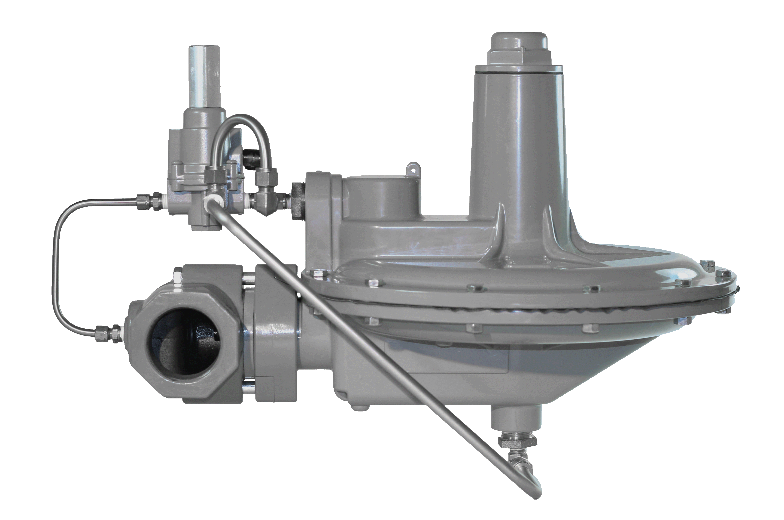
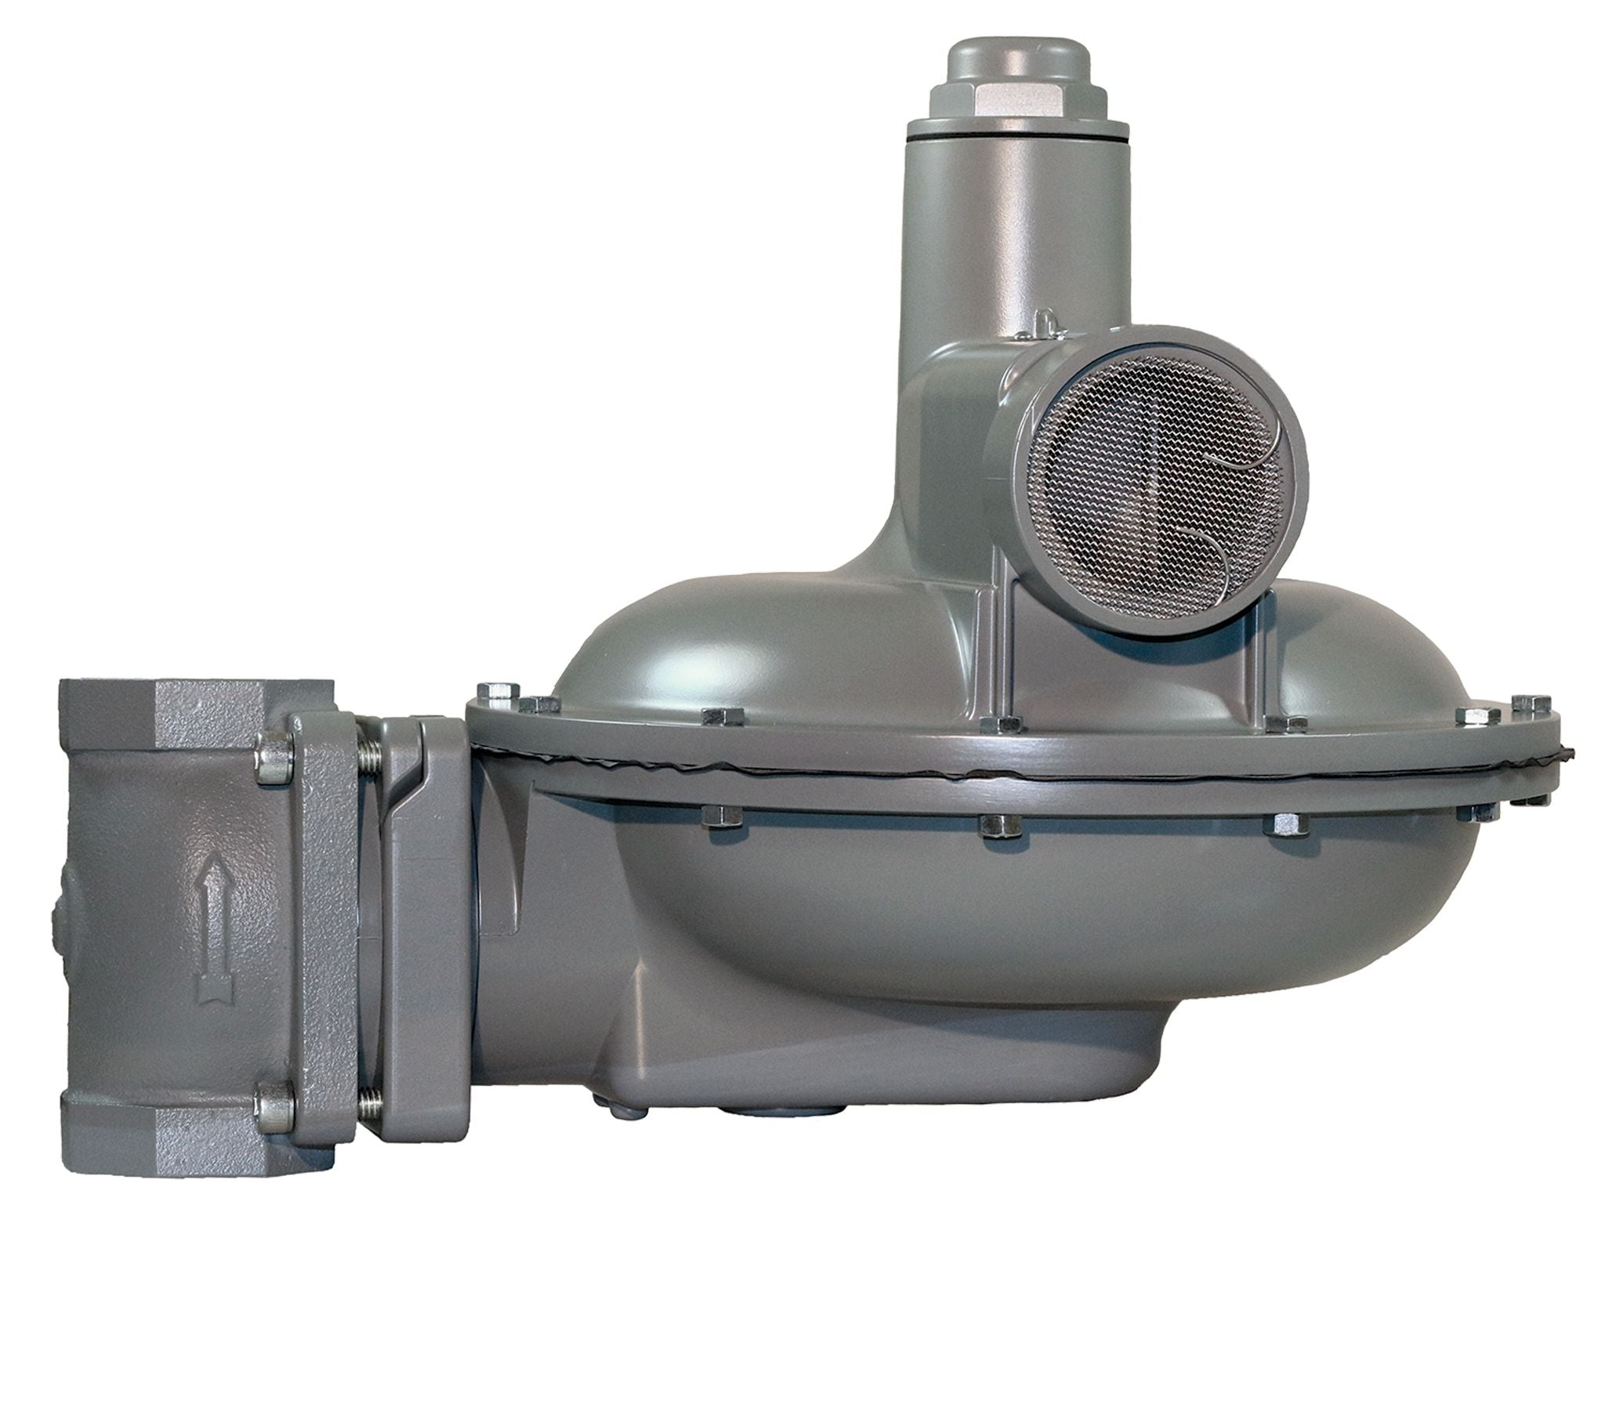
What are Types of Commercial Regulators?
Direct Acting
Integrated Monitor
Pilot Operated
Slam-Shut technology
Large Capacity Relief
Notes:
Tri-Pacific offers several products that can be used in commercial applications. Including a base BelGas spring / direct operated 200 & 300 series . Optional features include pilot operated, integrated monitor, integrated slam shut and enhanced relief.

Slide 5
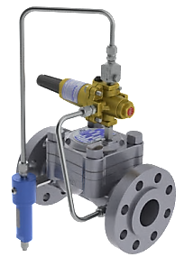
Regulator & system Features to Consider
Direct Acting spring or Pilot Operated
Relieving or Non-Relieving
Seat & Orifice vs Flexible Element
Over Pressure Protection method?
Internal Relief, Monitor , Full Relief , Slam Shut?
Minimum differential for open/closing
Bubble tight shutoff at all ΔP
Does station use full port , non-maintenance valving ?
Pilot Operated: Loading vs Unloading types
Loading Type – “fail closed” regulator

Slide 6
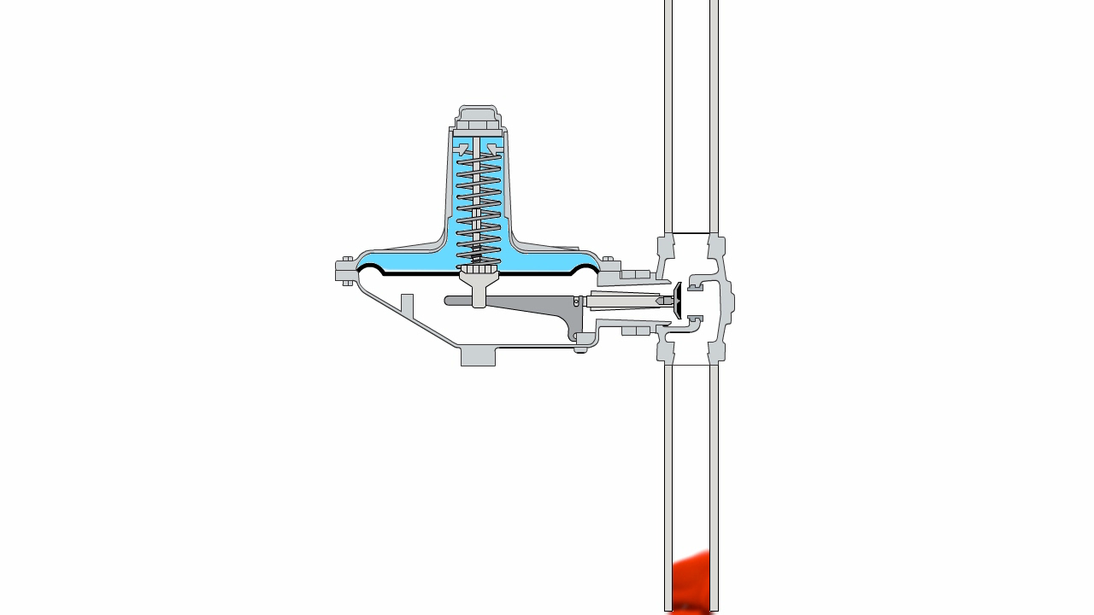
How does the Commercial Regulator Work?
Notes:
As higher-pressure gas moves into the body, the rising downstream pressure pushes against the diaphragm, balancing the spring force. As the diaphragm assembly raises from increased pressure, it lifts the lever which moves the seat towards the orifice. The downstream pressure and spring force meet at the regulator’s setpoint.
Next, we will discuss the different types of commercial regulators that BelGAS manufactures.

Slide 7
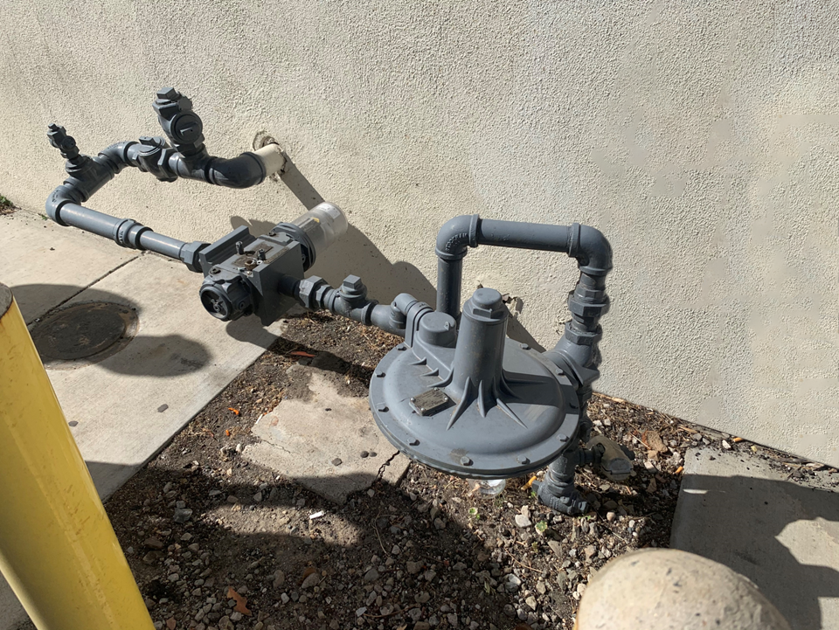
Self Operated , Direct Acting; Relieving or Non-Relieving
Typically large diaphragm commercial regulators used for low pressure delivery. The benefit of the large diaphragm allows consistent pressure through your flow range.
You can find this type of regulator ,for example, at multi-unit apartment complexes, midrise buildings, small to medium gas engines and compressors, and high-volume restaurants.
A regulator with “Internal Relief”, allows a release of excessive downstream output pressure typically caused by thermal expansion. A small spring mechanism allows diaphragm to separate from Relief Seat allowing extra pressure to escape through a screened vented in bonnet.
Regulators without an Internal Relief will require a dedicated Relief device downstream

Slide 8








Internal Relief Mechanism
Inlet Pressure Outlet Pressure
Atmospheric Pressure

Slide 9
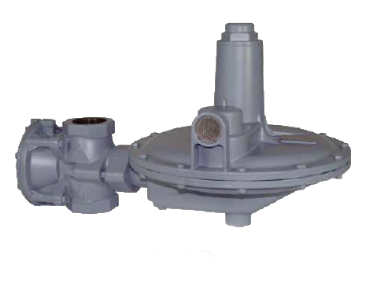
Regulators with Integrated Monitor
Gas pressure reducing regulators with an integrated or true monitor regulator, which acts independently of the main regulator. The monitor provides equivalent overpressure protection when compared to a standard two-regulator monitor setup. Should one regulator fail, the other internal, integrated regulator provides control and overpressure protection.

Slide 10
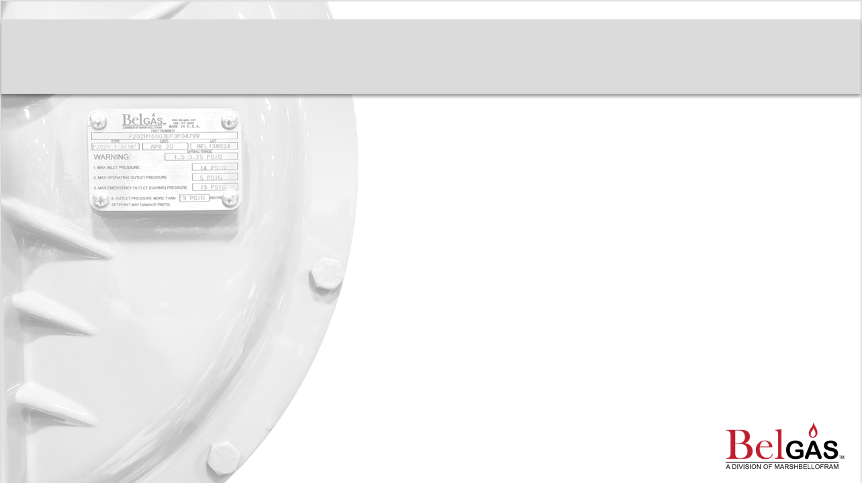
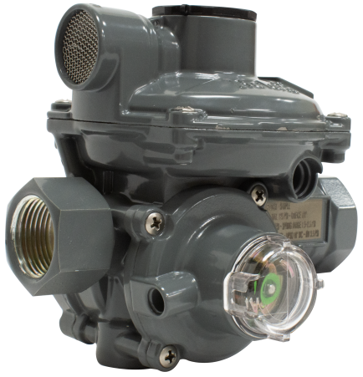
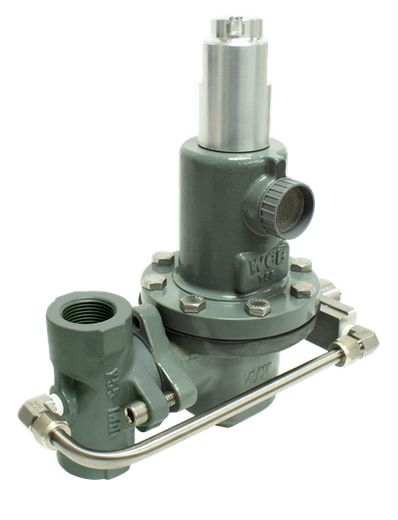
What are Integrated Slam Shut Regulators?
Typical Options:
Relieving or Non-relieving, Overpressure (OPSO)
Shutoff, excess flow device, Under Pressure Shutoff (UPSO)
Typical sizes 1 ¼”, 1 ½”, 2”
Delivery Pressure:
2” WC up to 10 PSIG
Overpressure:
12” WC to 16 PSIG
Under Pressure:
2” WC up to 10.8 PSIG
P208
Slam shut commercial regulators
Commercial regulator safety devices are back-up safety options that work alongside regulators acting immediately during an over or under pressure event. The unique feature of this regulator is that the slam shut is built into the body of the regulator. When the device is activated, it closes and remains shut until it is manually reset.
Notes:
Next, are integrated slam shut regulators. These Commercial regulator safety devices are back-up safety options that work alongside regulators acting immediately during an over or under pressure event. The unique feature of this regulator is that the slam shut is built into the body of the regulator. When the device is activated, it closes and remains shut until it is manually reset.

Slide 11
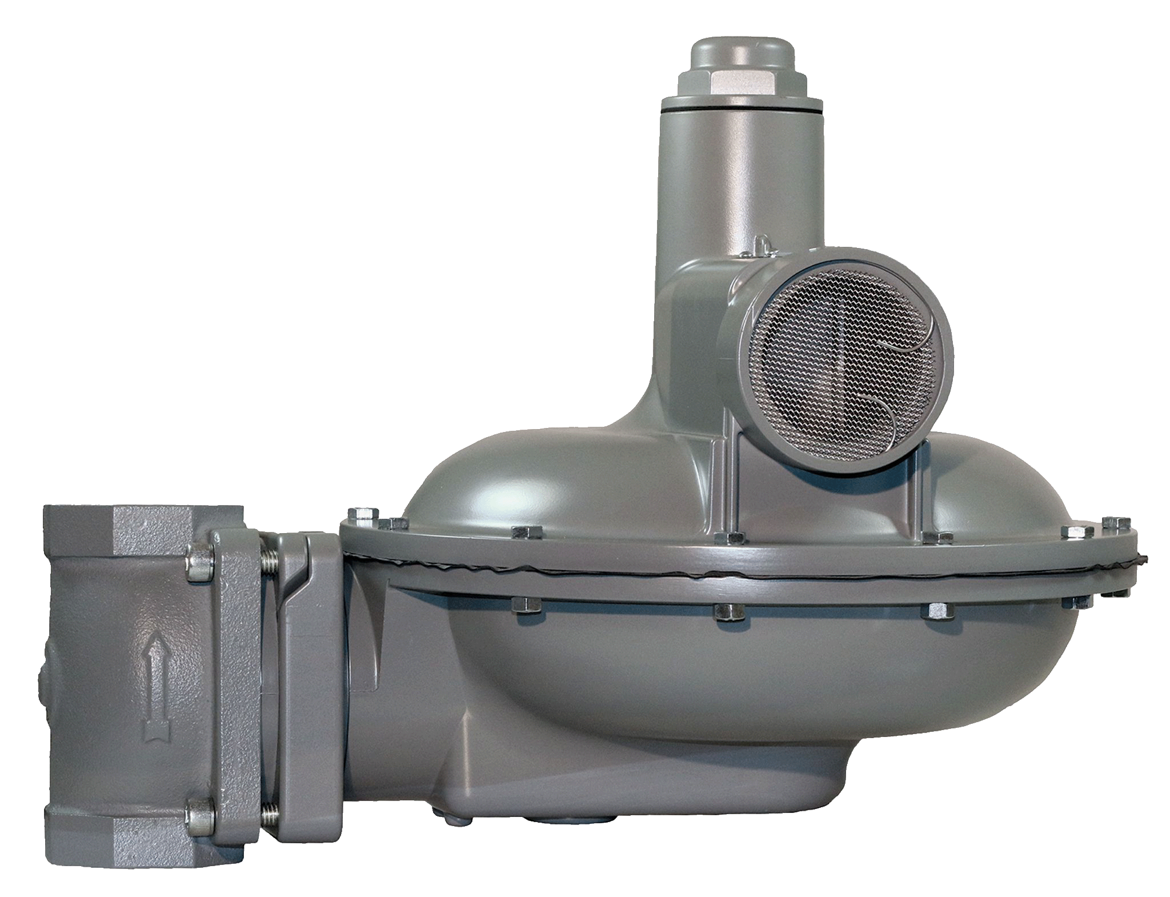
What is an Enhanced Relief Regulator?
In this case a 2-1/2” Vent
. An enhanced relief regulator is a relieving regulator with an optimized design Vent to maximize the relieving capabilities in an overpressure situation.

Slide 12
Pilot Operated Regulators
A pilot operated regulator is a regulator with a supplementary device, called a pilot, used to increase accuracy and flow of a regulator. These can often be found in high volume and/or fixed factor metering applications.
The Term “Pneumatic Amplification” is the combination of using a small pilot and restrictor to control a much larger pressure regulator. This is true for both “loading” type and “unloading” type regulators. The amplification is because a small change in the pilot can open the large main regulator and result in a very large change in pipeline flow

Slide 13
Regulator: Pilot Operated “Loading” Style Principles of Operation
Upstream
Downstream

Slide 14
Pilot Operated Regulator- Unloading Type
When Variable Orifice ( pilot) opens.... the
jacket pressure is “Unloaded ”
VARIABLE
ORIFICE (Pilot)
FIXED
ORIFICE (FO)
REGULATOR

Slide 15
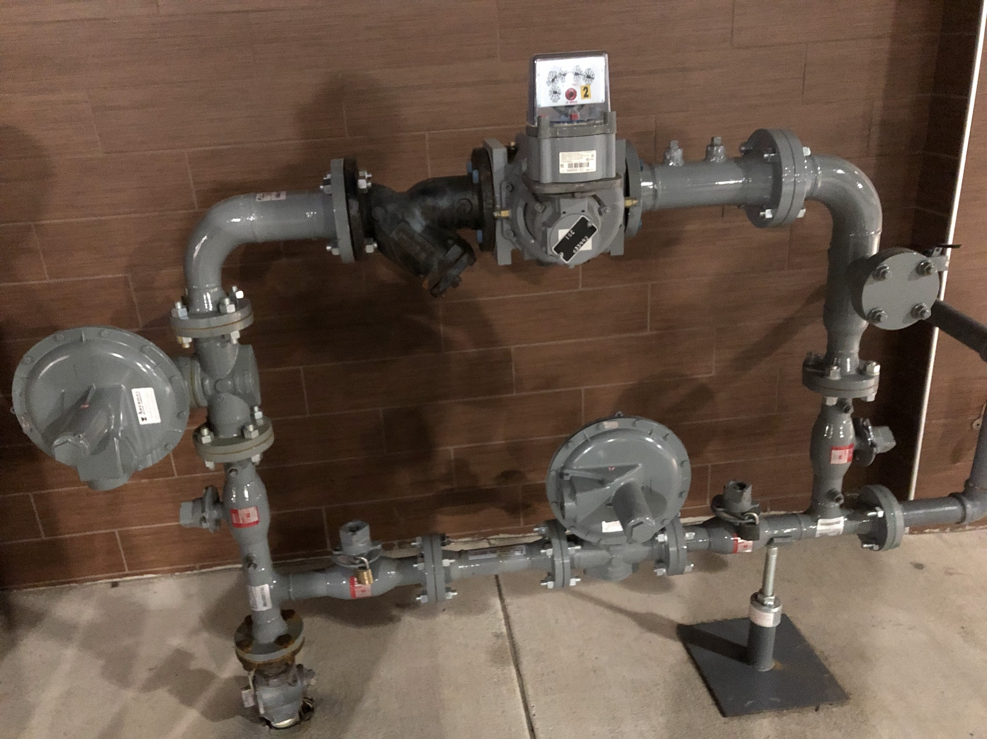
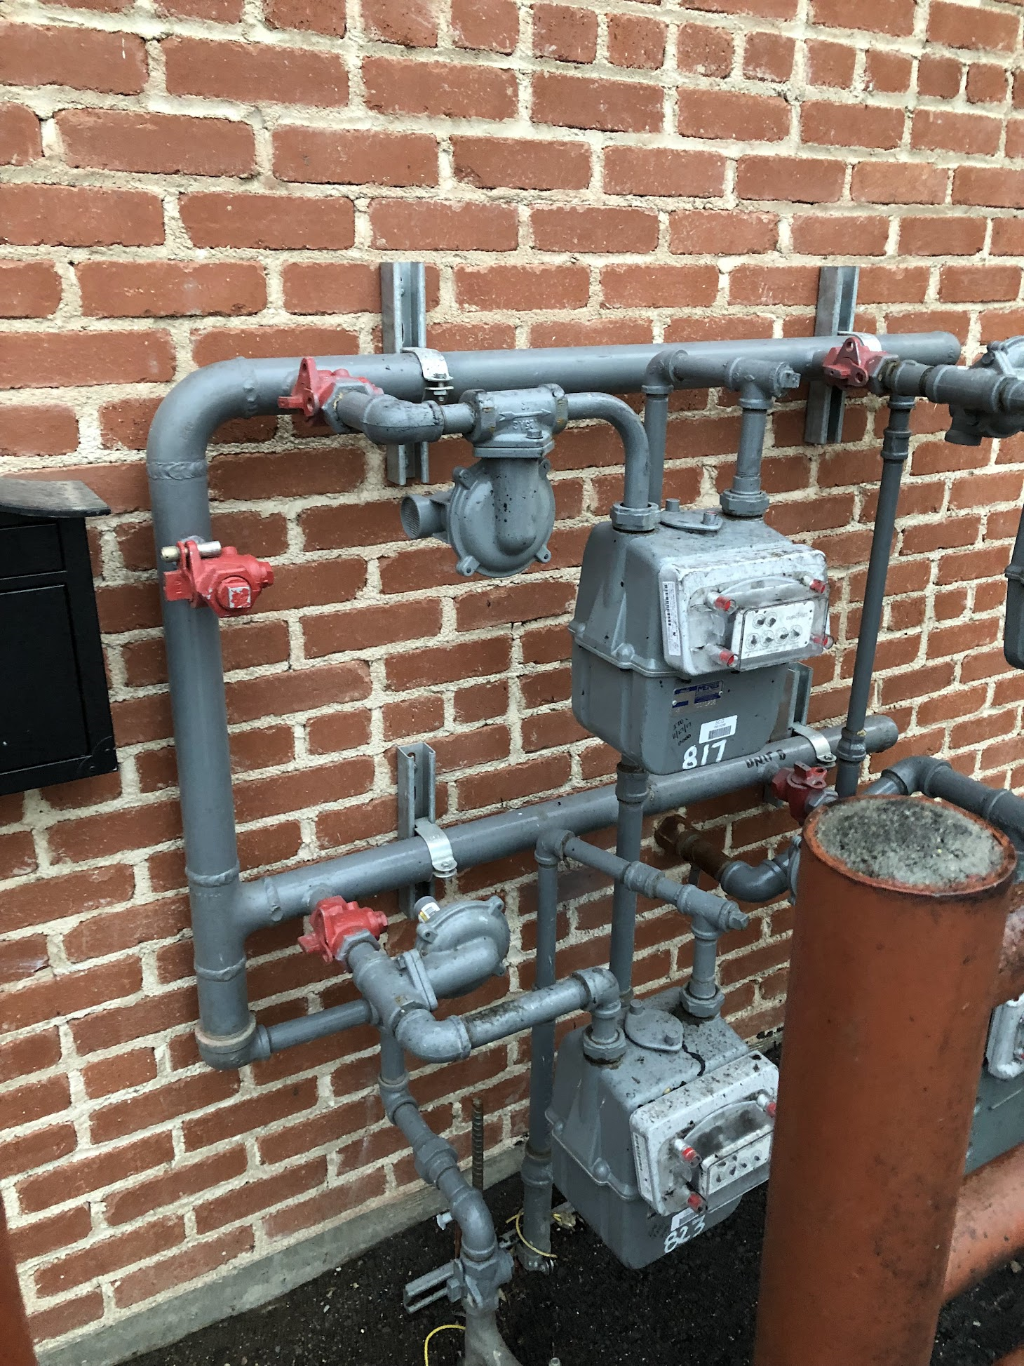
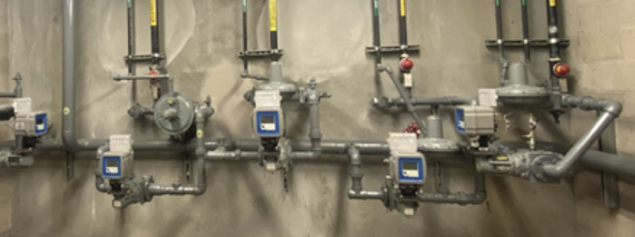
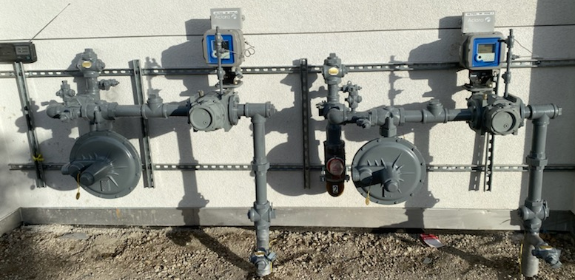
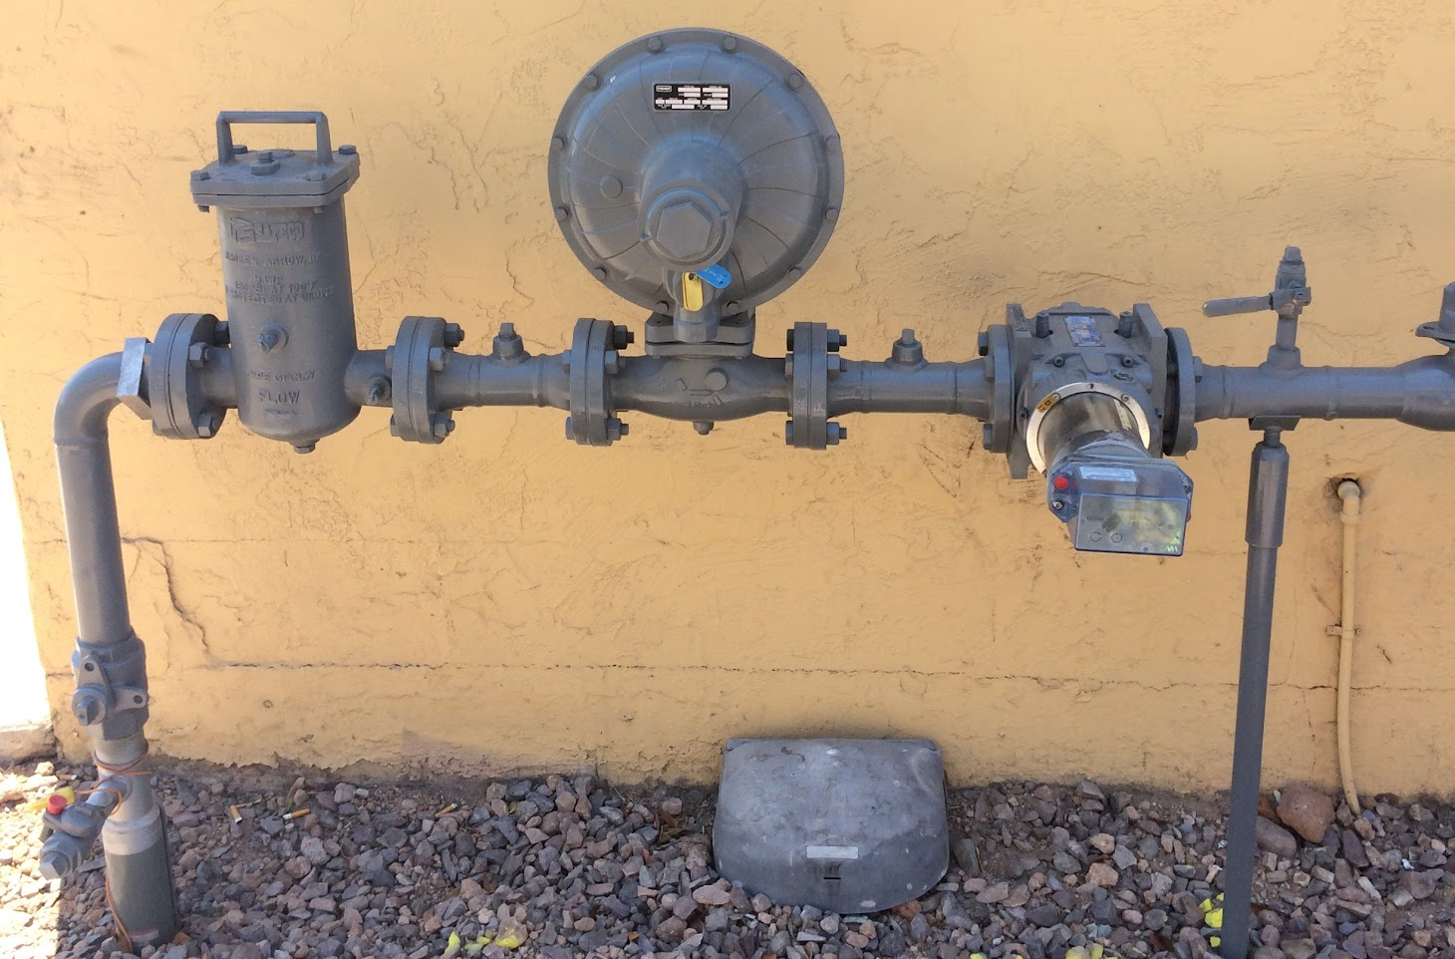
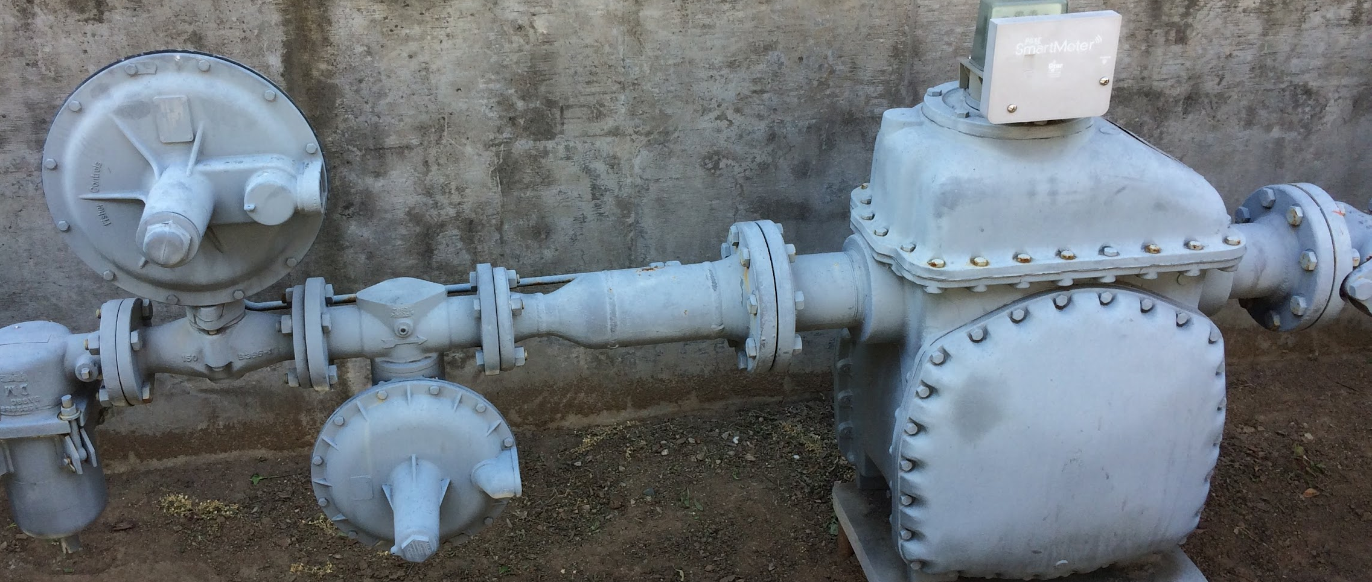
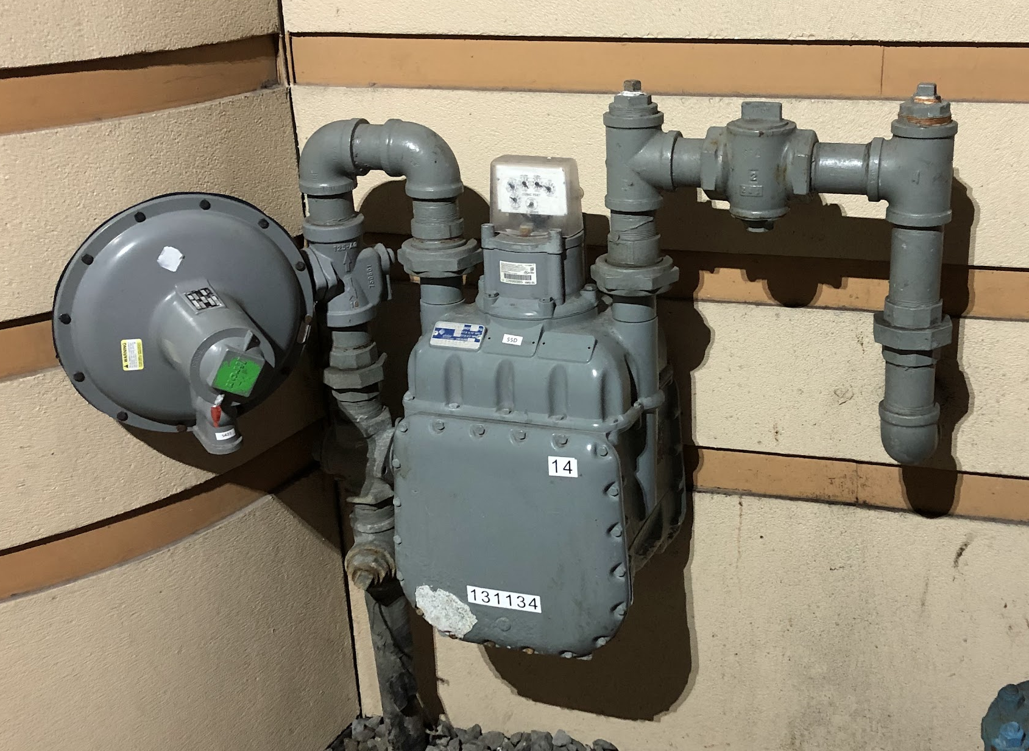
Commercial MSA & Regulator Stations
Self Operated

Slide 16
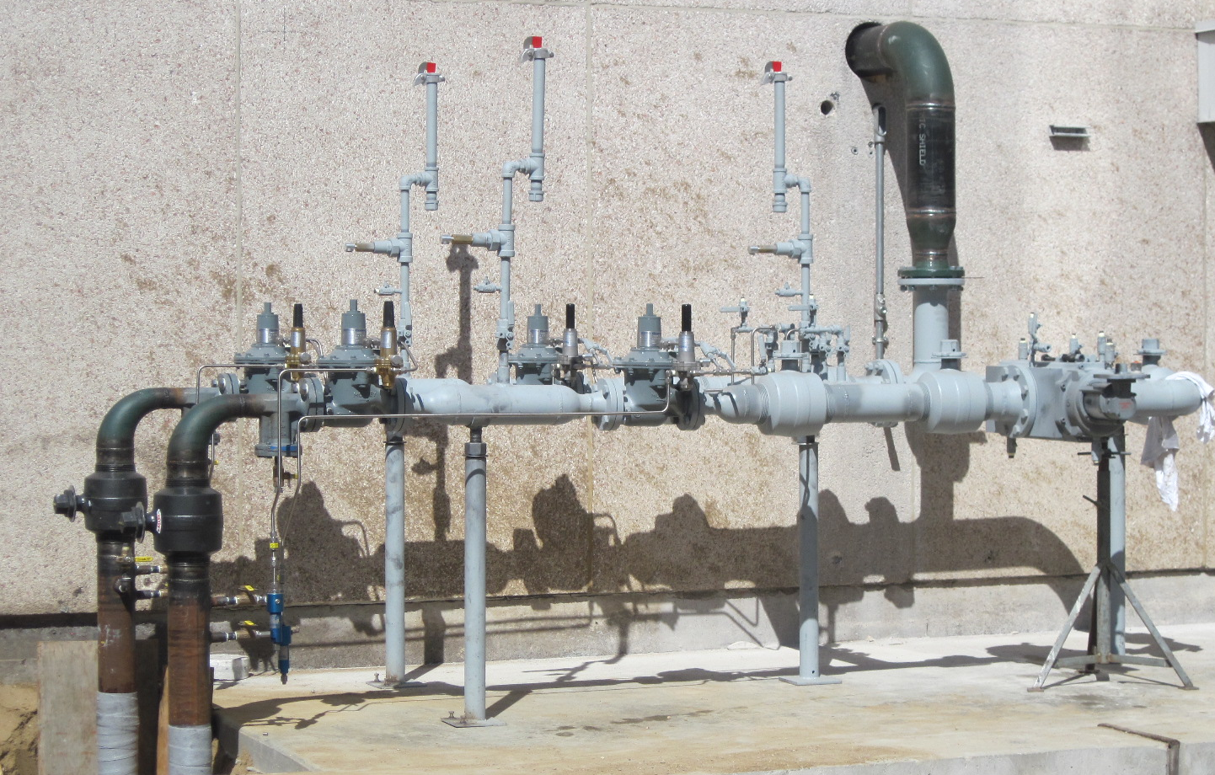
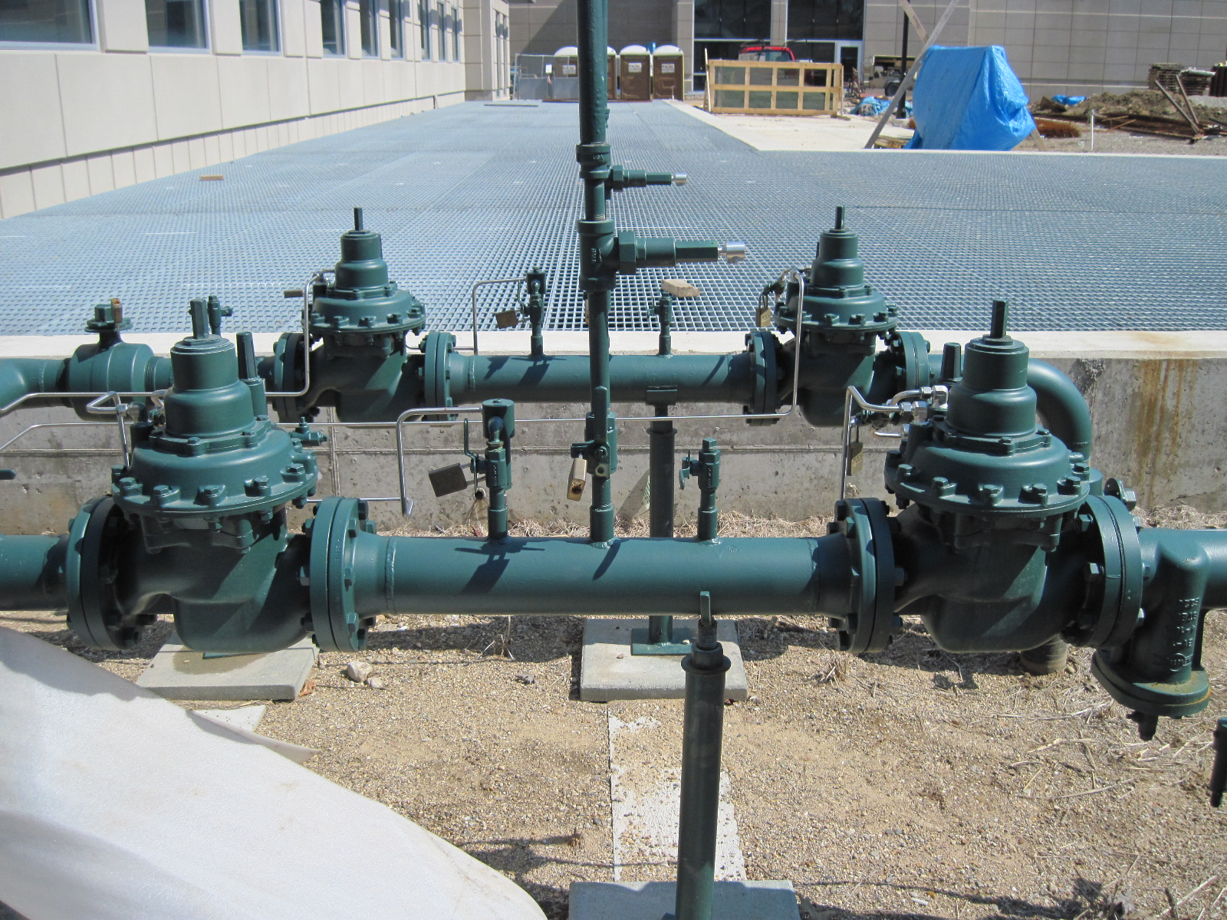
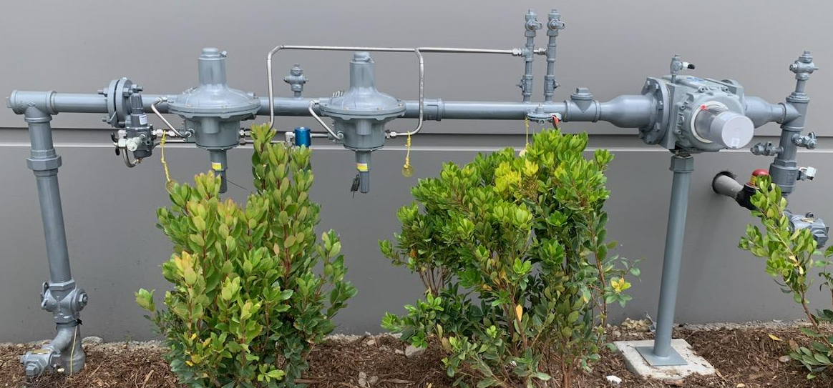
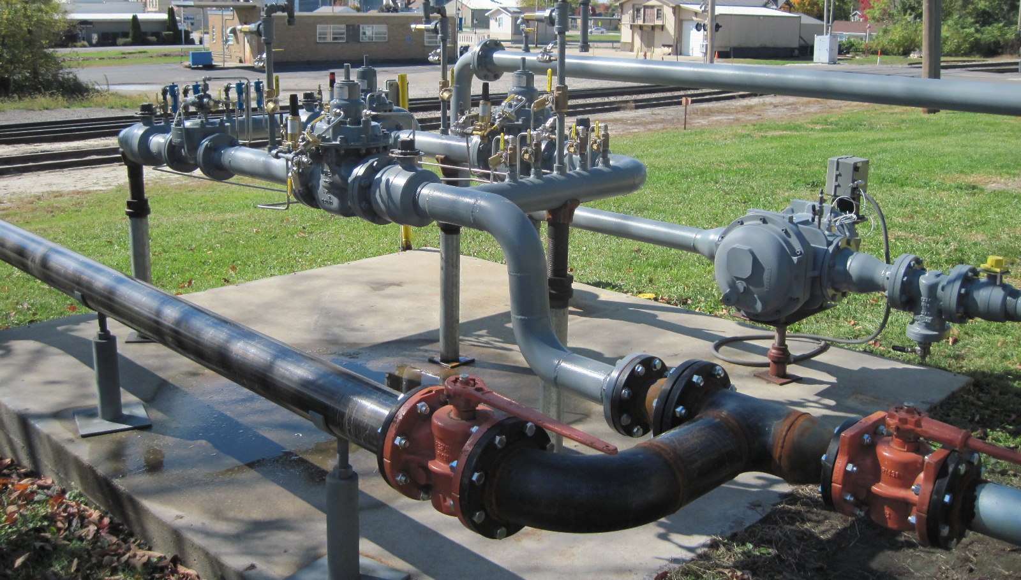
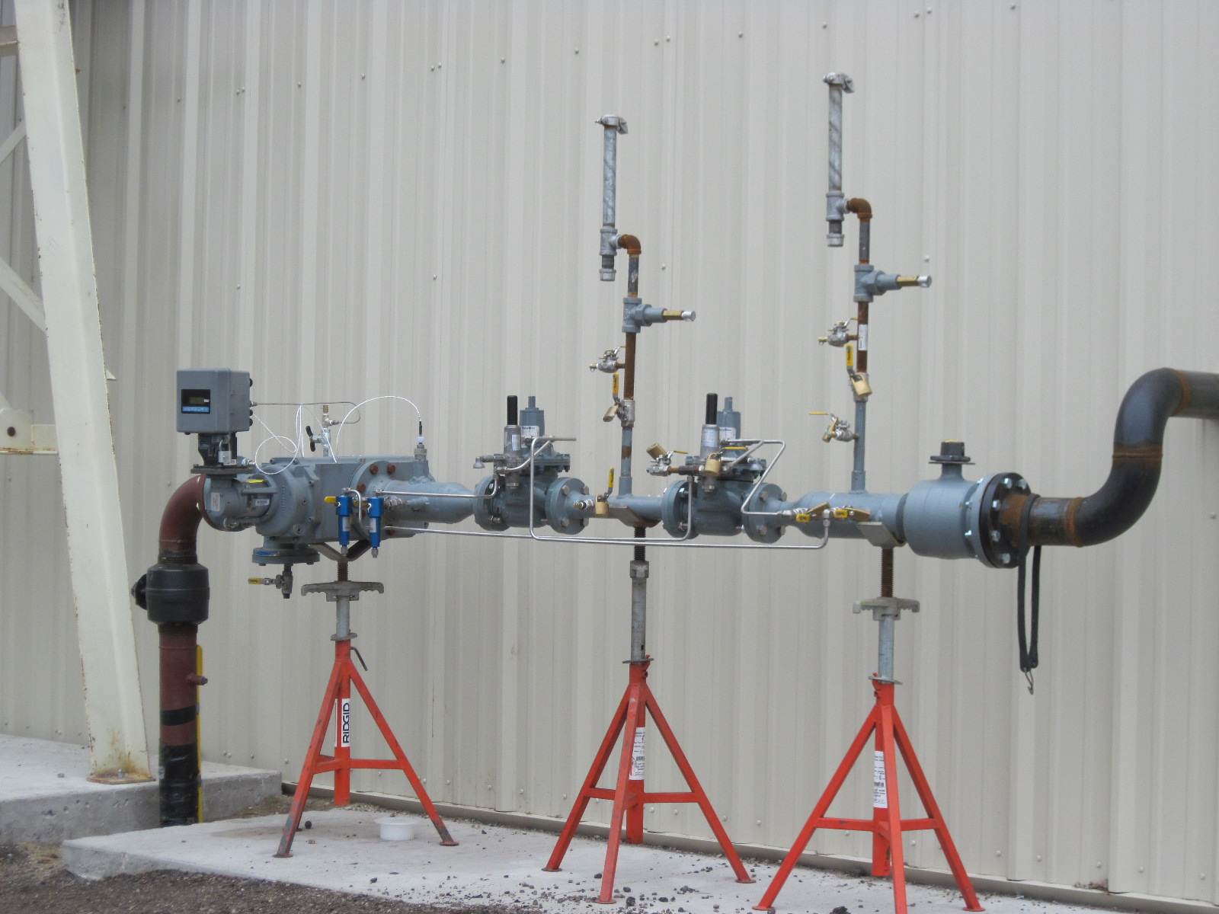
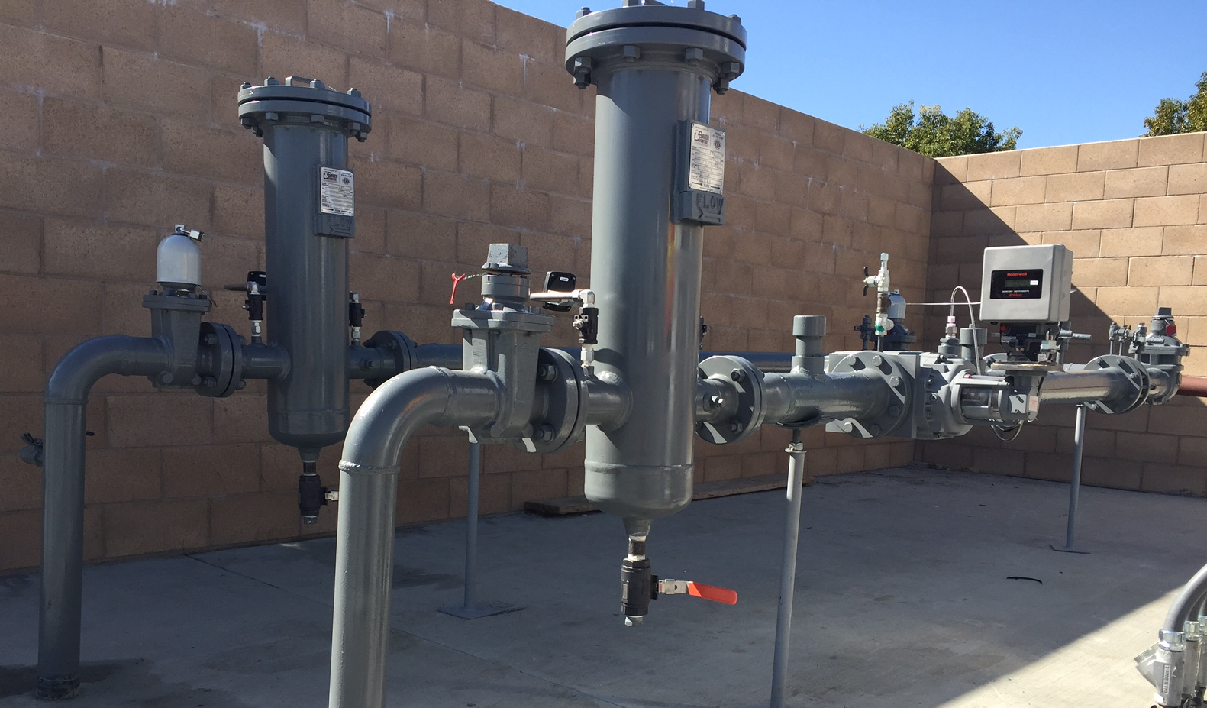
Applications – Pilot Operated Styles
Commercial & Industrial meter sets.
High volume / Low Pressure regulator stations.
Dead-end loads.
Low differential distribution pressure metering designs.
Don’t forget to consider Filters, and full port inlet /outlet isolation valves, as well as, sense line control Valves, ...and location of sense line connections.

Slide 17
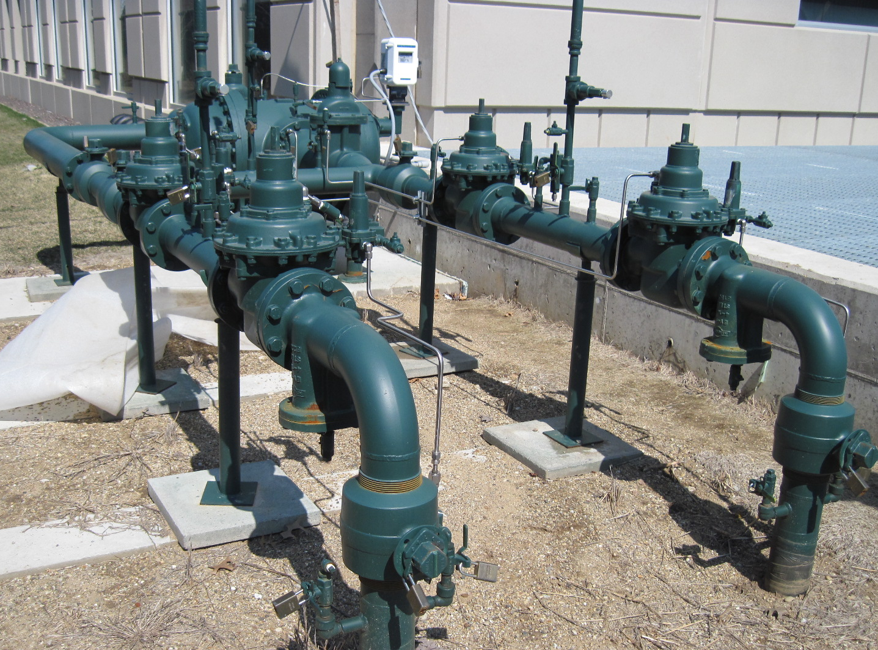
Low flow Applications
Low or swinging inlet pressures, widely varying loads, metering configuration, and regulation method can lead to oversized conditions.
Can be amplified by wide-open monitor or metering configuration.

Slide 18
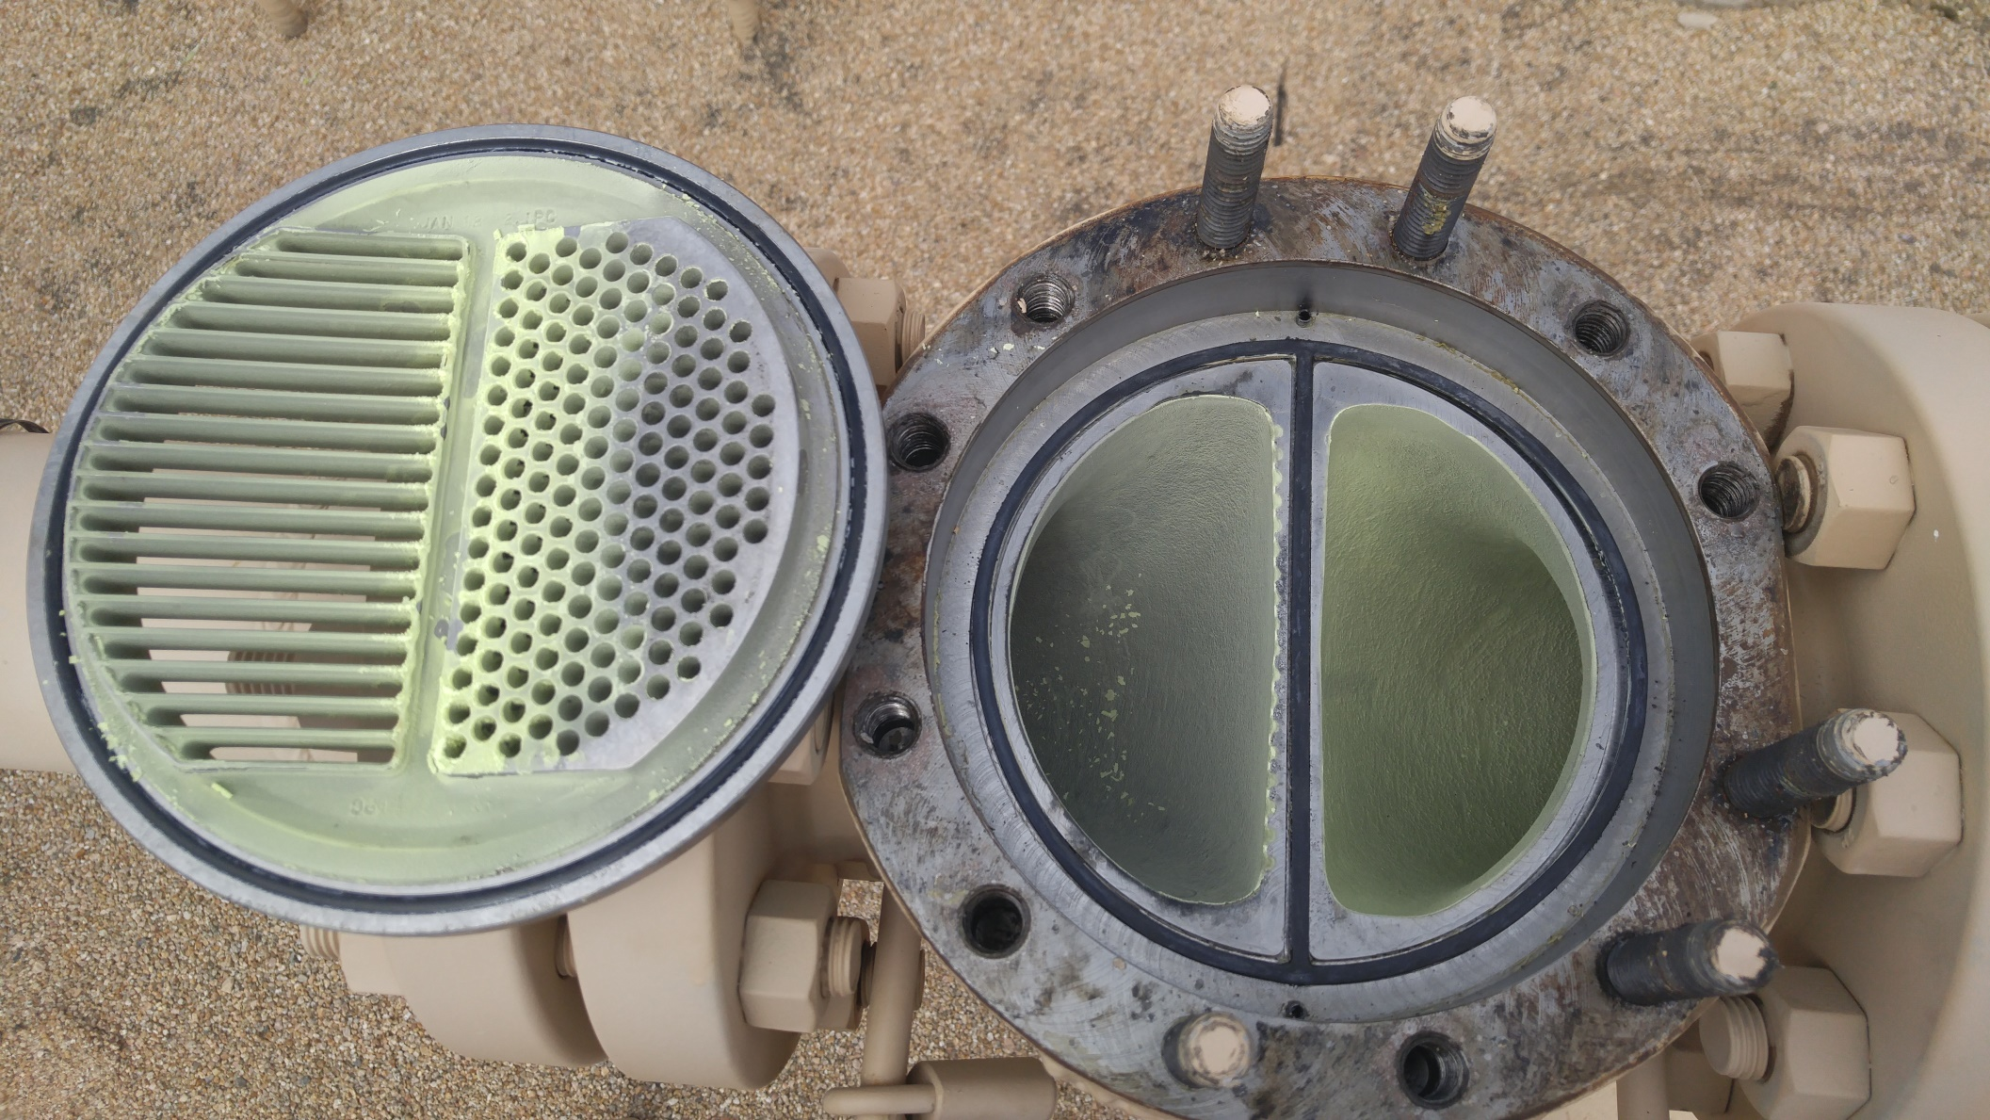
Sulfur – be aware and increase internal inspections for sulfur attaching to reg internals & small orifices in Pilots..

Slide 19
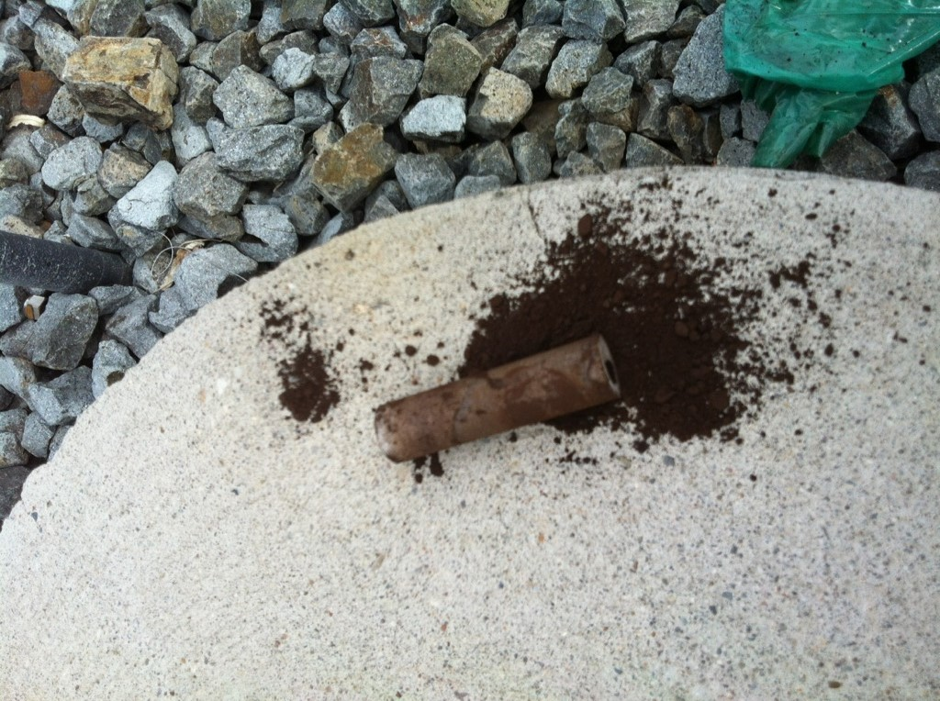
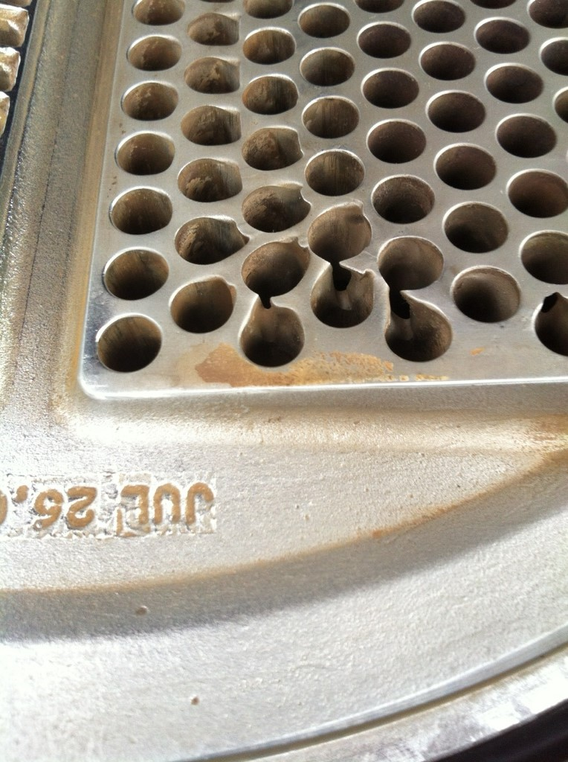
Check for debris, Iron oxide, sand, dirt,weld slag , Sulfur in pipeline which can clog Pilot Filters & wear internal parts, even metal, at higher flow rates.

Slide 20
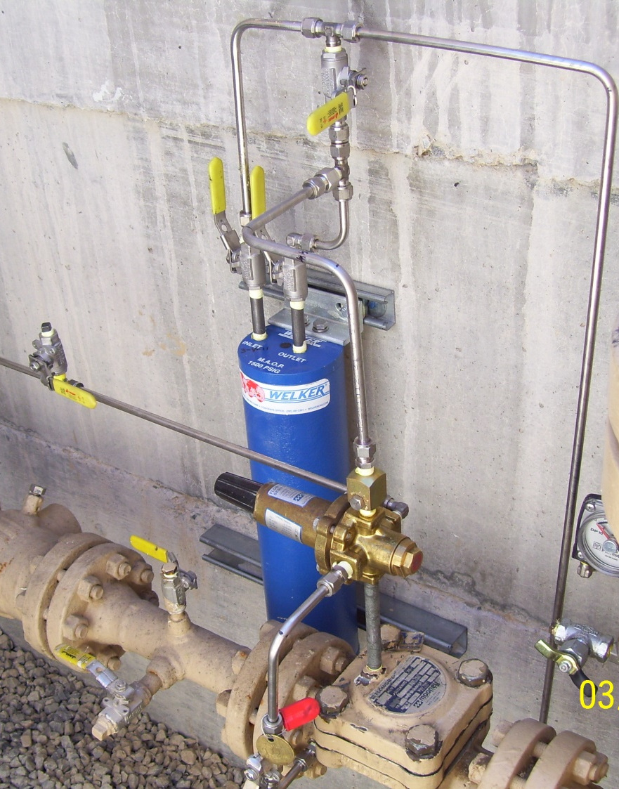
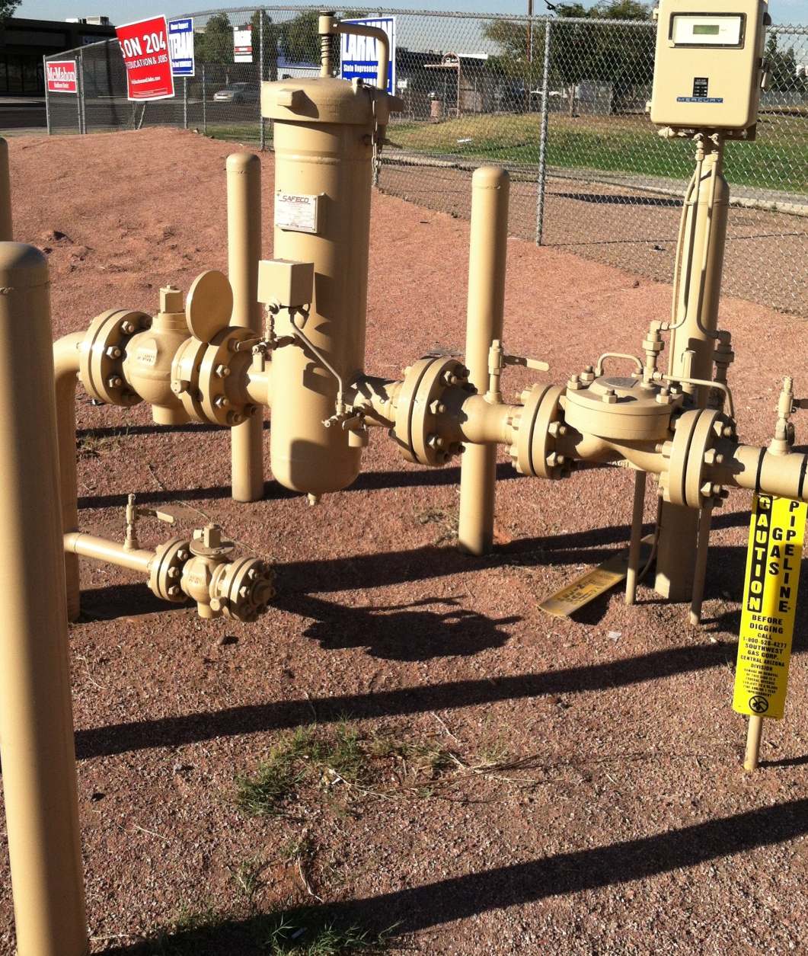
How can you protect the Regulators & equipment, etc. ?
Remove sulfur from Pilot system
Filters for Main Line & Pilot system

Slide 21
Questions?

Slide 22

THANK YOU !
For assistance please contact us at:
Tri-Pacific, Inc
6121 Pacific St, Ste 100
Rocklin, CA 95677
Ph: 916-630-2323
Email: Tripacsup@Tripacific.net
Website: www.Tripacific.net

